Slide 1
University Management System
ICT Education — Role-Based Web Platform for Academic Operations
Final-Year Project Defense | Version v2.4.1
Author: Mahabbat Hossain
FastAPI · React + TypeScript · PostgreSQL · SQLAlchemy · Alembic
ICT Education — University Management System | v2.4.1
1 / 23
Notes:
Good [morning/afternoon]. I'm Mahabbat Hossain, presenting my final-year project: a University Management System for ICT Education, now at version 2.4.1 — a full-stack, role-based platform consolidating attendance, exams, results, fees, and scheduling for Student, Teacher, Parent, and Admin roles. In the next 12 to 15 minutes I'll cover the problem, the architecture, key features per role, and the test evidence, then take questions.

Slide 2
Problem Statement
• Universities manage attendance, results, fees, and scheduling through disconnected tools
• Attendance in spreadsheets, results distributed by email, fees in a separate finance tool
• Consequence 1 — Data duplication: the same fact recorded in multiple places, able to drift out of sync
• Consequence 2 — Weak accountability: no single audit trail for who approved a result or recorded a payment
• Consequence 3 — Inconsistent access control: a shared spreadsheet cannot guarantee a parent only sees their own child's record
• Goal: one authoritative, role-aware system of record, enforced at the server
Before ICT Education UMS
📊
Spreadsheets (Attendance)
📧
Email threads (Results)
💰
Separate finance tool (Fees)
No single source of truth
Notes:
The core problem is fragmentation: attendance in spreadsheets, results by email, fees in a separate finance tool. This causes three recurring problems: data duplication — the same fact recorded in more than one place can drift out of sync; weak accountability — no single audit trail for who approved a result or recorded a payment; and inconsistent access control — a shared spreadsheet can't guarantee a parent only sees their own child's data. The goal was one authoritative system where access control is enforced server-side, not just hidden in the UI.

Slide 3
Objectives
• Replace spreadsheet/email/finance-tool tracking with one authoritative system of record
• Enforce RBAC and per-record ownership at the API layer — never trust the frontend alone
• Provide complete workflow lifecycles: exams (draft → open → published), results (submitted → approved → published)
• Compute derived figures (attendance %, GPA, fee balance) live at query time — never cached or duplicated
• Deliver role-appropriate dashboards for all four roles
• Achieve verifiable correctness through automated testing, not manual inspection alone
• Produce an independently deployable, CI-verified system
7 Objectives
guiding every design decision
Notes:
These seven objectives guided the build. Two I'd highlight: enforcing role-based access and ownership checks at the API layer, so the server rejects unauthorized requests regardless of the UI; and computing derived figures like attendance percentage or GPA live, every time, instead of storing them and risking staleness. All seven objectives were met and are backed by automated tests, which I'll show shortly.

Slide 4
Existing System vs. Proposed System
Existing Approach
✗ Spreadsheets for attendance — manual, error-prone, no audit trail
✗ Results distributed by email — slow, unstructured, easy to lose
✗ Separate, siloed finance software for fees
✗ Scheduling handled ad hoc, often on paper or shared documents
✗ No unified, role-based access control across tools
✗ LMS platforms (e.g. Moodle) cover course content, not fees/scheduling/admin records
✗ ERP platforms (Banner, PeopleSoft) are comprehensive but heavyweight and licensed
Proposed System (This Project)
✓ One decoupled REST API + SPA platform for all five domains
✓ Server-enforced RBAC + ownership checks on every request
✓ Live-computed attendance %, GPA, and fee balances — never stale
✓ Full workflow state machines: exam and result lifecycles, schedule change-requests
✓ Purpose-built for one institution's exact scoped workflow — not a heavyweight multi-tenant ERP
✓ Event-driven notifications reaching students and their linked parents
✓ Continuously verified by a 549-test automated suite via CI
ICT Education — University Management System | v2.4.1
4 / 22
Notes:
On the left is the status quo — fragmented tools, no shared access control, no audit trail. On the right is what I built: a decoupled REST API plus SPA platform where role-based access and ownership are enforced server-side on every request, and every derived number is computed live. This isn't trying to compete with a heavyweight ERP like Banner — it's purpose-built for this institution's five core processes, done properly rather than broadly.

Slide 5
Technology Stack
• Backend: FastAPI (Python 3.12) — async-capable, auto-generated OpenAPI schema
• Database: PostgreSQL, accessed via SQLAlchemy ORM — no raw string-interpolated SQL, ever
• Migrations: Alembic — every schema change is a reviewed, versioned revision (10 migrations, zero drift)
• Frontend: React 18 + TypeScript, styled with TailwindCSS
• Server-state layer: TanStack React Query — no server data duplicated into local/global state
• Auth: JWT (access + refresh tokens), rotated on use
• Documents: ReportLab (PDF) and openpyxl (Excel) for transcripts, invoices, and reports
• Access control: Role-Based Access Control (RBAC) enforced via dependency injection on every route
Technology Stack
Backend
Frontend
FastAPI
React 18
PostgreSQL
TypeScript
SQLAlchemy
TailwindCSS
Alembic
React Query
JWT Auth
Axios
Notes:
On the backend: FastAPI on Python 3.12, PostgreSQL accessed exclusively through the SQLAlchemy ORM — no raw SQL anywhere, which closes off SQL injection by construction. Every schema change goes through Alembic as a versioned migration, ten so far, zero drift. On the frontend: React 18 with TypeScript and TailwindCSS, with all server state living in React Query, never duplicated into component state. Auth is JWT-based with rotated refresh tokens, and RBAC is enforced via dependency injection on every route. Documents use ReportLab and openpyxl — both pure Python.

Slide 6
System Architecture
• Decoupled two-tier architecture: SPA frontend + REST API backend + PostgreSQL
• Backend layered strictly: Router → Service → Repository
• Routers handle request/response shaping only — no business logic, no direct ORM queries
• Services own business rules and workflow state transitions
• Repositories own all SQLAlchemy queries — no business logic
• Frontend: Pages → Feature hooks (React Query) → Components
• Versioned REST API under /api/v1, JSON throughout
• PDF generation and notification dispatch run as background tasks, not inline in the request path
Browser (React SPA)
REST API — FastAPI (/api/v1)
Router → Service → Repository
PostgreSQL
Notes:
This is a decoupled two-tier architecture: an SPA talking to a versioned REST API over HTTPS, backed by PostgreSQL. The backend is strictly layered into three tiers. Routers only handle request/response shaping — no business logic, no direct queries. Services own all business rules and workflow transitions. Repositories own every SQLAlchemy query and contain no business logic. On the frontend, Pages call Feature hooks built on React Query, which render Components — no page calls fetch directly. PDF generation and notification dispatch run as background tasks so they never block the response.

Slide 7
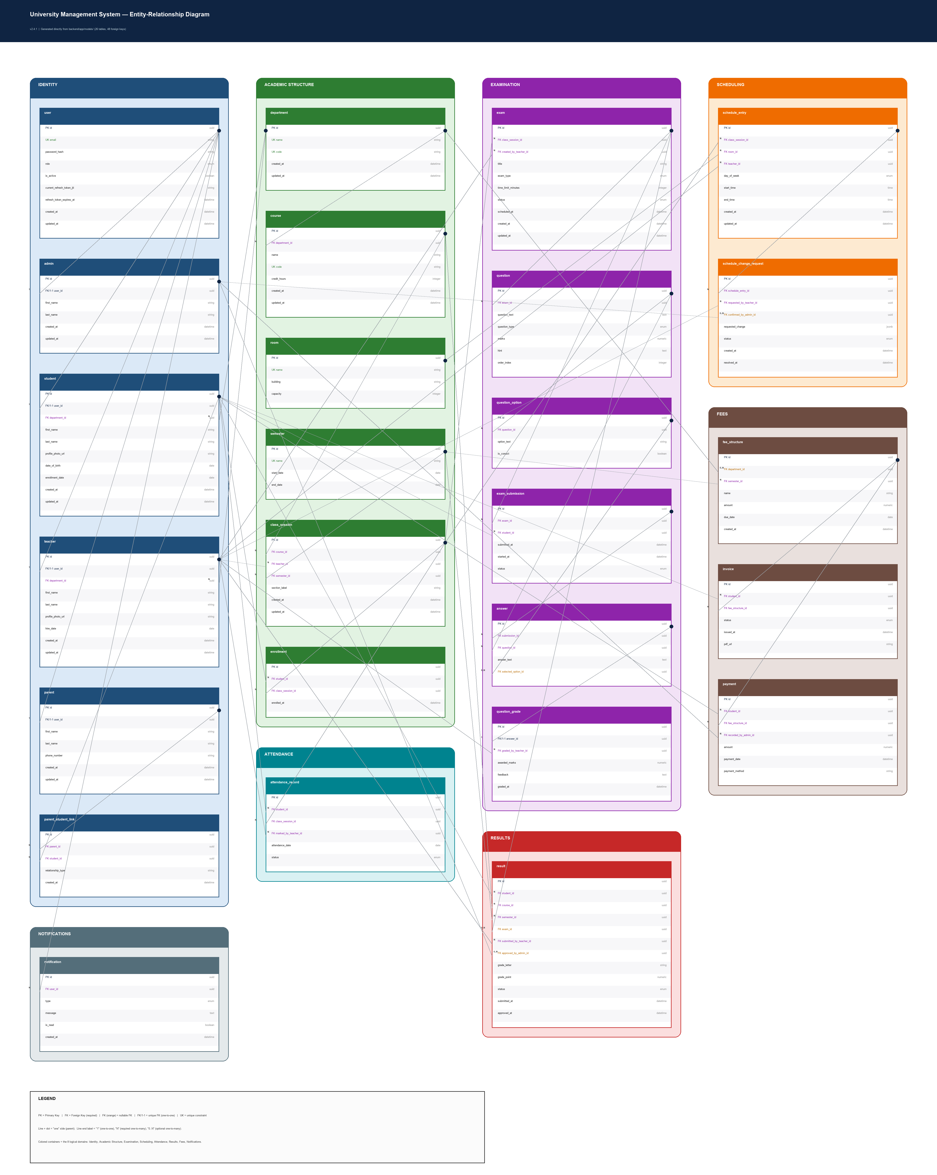
Database Design
• 26 relationally-constrained tables, managed by 10 Alembic migrations, single head, zero drift
• Core entities: user, student, teacher, parent, parent_student_link, department, course, room, semester
• Academic entities: class_session, enrollment, exam, question, exam_submission, question_grade, result
• Operational entities: attendance, fee_structure, invoice, payment, notification, schedule_change_request
• All foreign keys enforced at the database level
• Reference/catalog data: hard-delete with ON DELETE RESTRICT
• Identity records (User/Student/Teacher): deactivation (is_active), never deletion, to preserve history
• Derived figures (attendance %, GPA) are never stored as columns — always computed at query time
Entity-Relationship Diagram
Notes:
The database has 26 tables, fully relationally constrained, managed through ten Alembic migrations with a single head and zero drift, verified automatically in CI. Entities group into three families: core identity/reference data, academic entities like exams and results, and operational entities like attendance and fees. Two decisions worth noting: reference data — departments, courses, rooms — use hard deletes with ON DELETE RESTRICT; but identity records like Users, Students, and Teachers are only ever deactivated, never deleted, to preserve history. And derived figures like attendance percentage or GPA are never stored — always computed live at query time.

Slide 8
Backend Architecture
• FastAPI app organized by domain: auth, users, exams, attendance, results, fees, schedule, notifications, reports
• Each domain mirrored across models/, schemas/, routers/, services/, repositories/
• Every request body validated against a Pydantic schema before reaching business logic
• Every response is a Pydantic schema — ORM models are never returned directly from a router
• Global exception handlers produce one consistent JSON error shape across the whole API
• Structured (JSON) audit logs for result approval, payment recording, account changes, schedule changes
• 82 REST endpoints across 11 domains
• N+1 queries avoided via SQLAlchemy eager-loading (joinedload/selectinload)
📷
API Documentation (Swagger / OpenAPI) Screenshot
screenshot placeholder
GET /docs — grouped endpoint list by domain
Notes:
The backend is organized by domain — auth, users, exams, attendance, results, fees, schedule, notifications, reports — each mirrored across models, schemas, routers, services, and repositories. Every request body is validated against a Pydantic schema before reaching business logic, and every response is also a Pydantic schema — routers never return raw ORM models directly. All errors funnel through global exception handlers into one consistent JSON shape, and structured audit logs cover sensitive operations like result approval and payment recording. In total: 82 REST endpoints across 11 domains, with N+1 queries avoided through SQLAlchemy eager-loading.

Slide 9
Frontend Architecture
• React 18 + TypeScript SPA, feature-sliced structure
• src/pages — one page per screen, matches the requirement doc's screen list 1:1
• src/features — each API domain wrapped in typed React Query hooks (useExams, useAttendance, ...)
• Components call hooks only — never fetch/axios directly
• src/auth — centralized token attachment, silent refresh, and route guarding
• Shared role-based dashboard shell — one Dashboard component, role-specific widgets composed conditionally
• Client-side RBAC hiding is a UX convenience only — never a substitute for server enforcement
• TailwindCSS for styling, lucide-react icons, shared UI primitives (Card, Table, Modal, Toast, Pagination)
📁 frontend/src/
└─ pages/ # one page per screen
└─ features/ # useExams, useAttendance ...
└─ components/ # Card, Table, Modal, Toast
└─ auth/ # token + route guarding
📁 backend/app/
└─ routers/ # request / response only
└─ services/ # business rules
└─ repositories/ # SQLAlchemy queries
└─ models/ schemas/ notifications/ pdf/
Project Folder Structure
Notes:
The frontend follows a feature-sliced structure. Pages correspond one-to-one with the screens in the requirements document. Each API domain is wrapped in a typed React Query hook — components call useExams or useAttendance rather than fetch directly, and React Query handles caching and invalidation. Auth concerns — token attachment, silent refresh, route guarding — are centralized in one module. Rather than four separate app trees, one shared dashboard shell conditionally composes role-specific widgets. Worth stressing: frontend role-based hiding is a UX convenience only — actual enforcement always happens server-side, which I'll cover next.

Slide 10
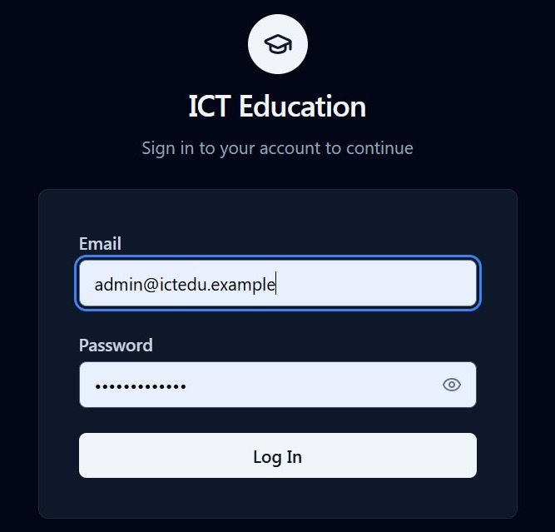
Authentication & RBAC
• JWT-based authentication — short-lived access tokens, refresh tokens rotated on use
• Passwords hashed with a strong adaptive algorithm (bcrypt) — never stored or logged in plaintext
• Four roles: Student, Teacher, Parent, Admin — each with distinct, server-enforced permissions
• Role checks applied via dependency injection on every protected route
• Ownership checks go further than role checks: a Parent must be linked to the specific student requested
• Example: GET /exams?student_id — Parent branch verifies parent_student_link before returning data
• A deactivated user (is_active = false) fails authorization immediately, even with a valid token
• Rate limiting applied to POST /auth/login to mitigate credential-stuffing / brute-force attempts
Login Screen Screenshot
Role-Based Access Control Flow
Login
JWT Issued
Role Check
Ownership Check
200 / 403
Notes:
Authentication uses JWT — a short-lived access token plus a refresh token rotated on every use. Passwords are hashed with bcrypt, never stored or logged in plaintext. There are four roles, and role checks apply via dependency injection on every route. But role alone isn't enough for endpoints scoped to one person's data — for a Parent, the service layer verifies the specific parent-student link actually exists before returning a child's exams, attendance, results, or fees. Change the student ID to someone else's child, and the server rejects it with 403, regardless of the frontend. A deactivated account is rejected immediately, even with a valid token.

Slide 11
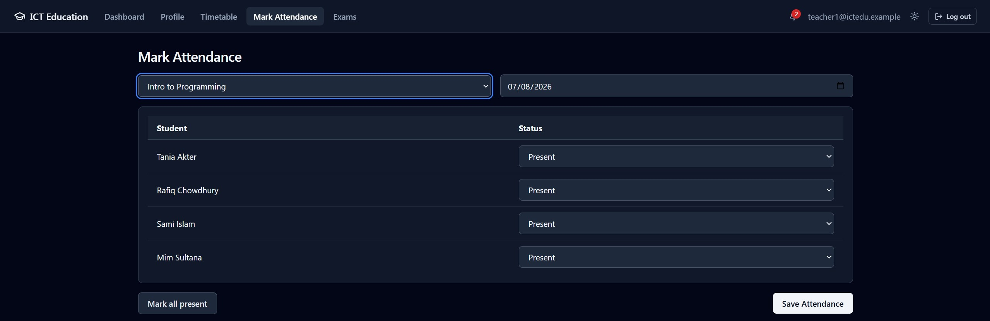
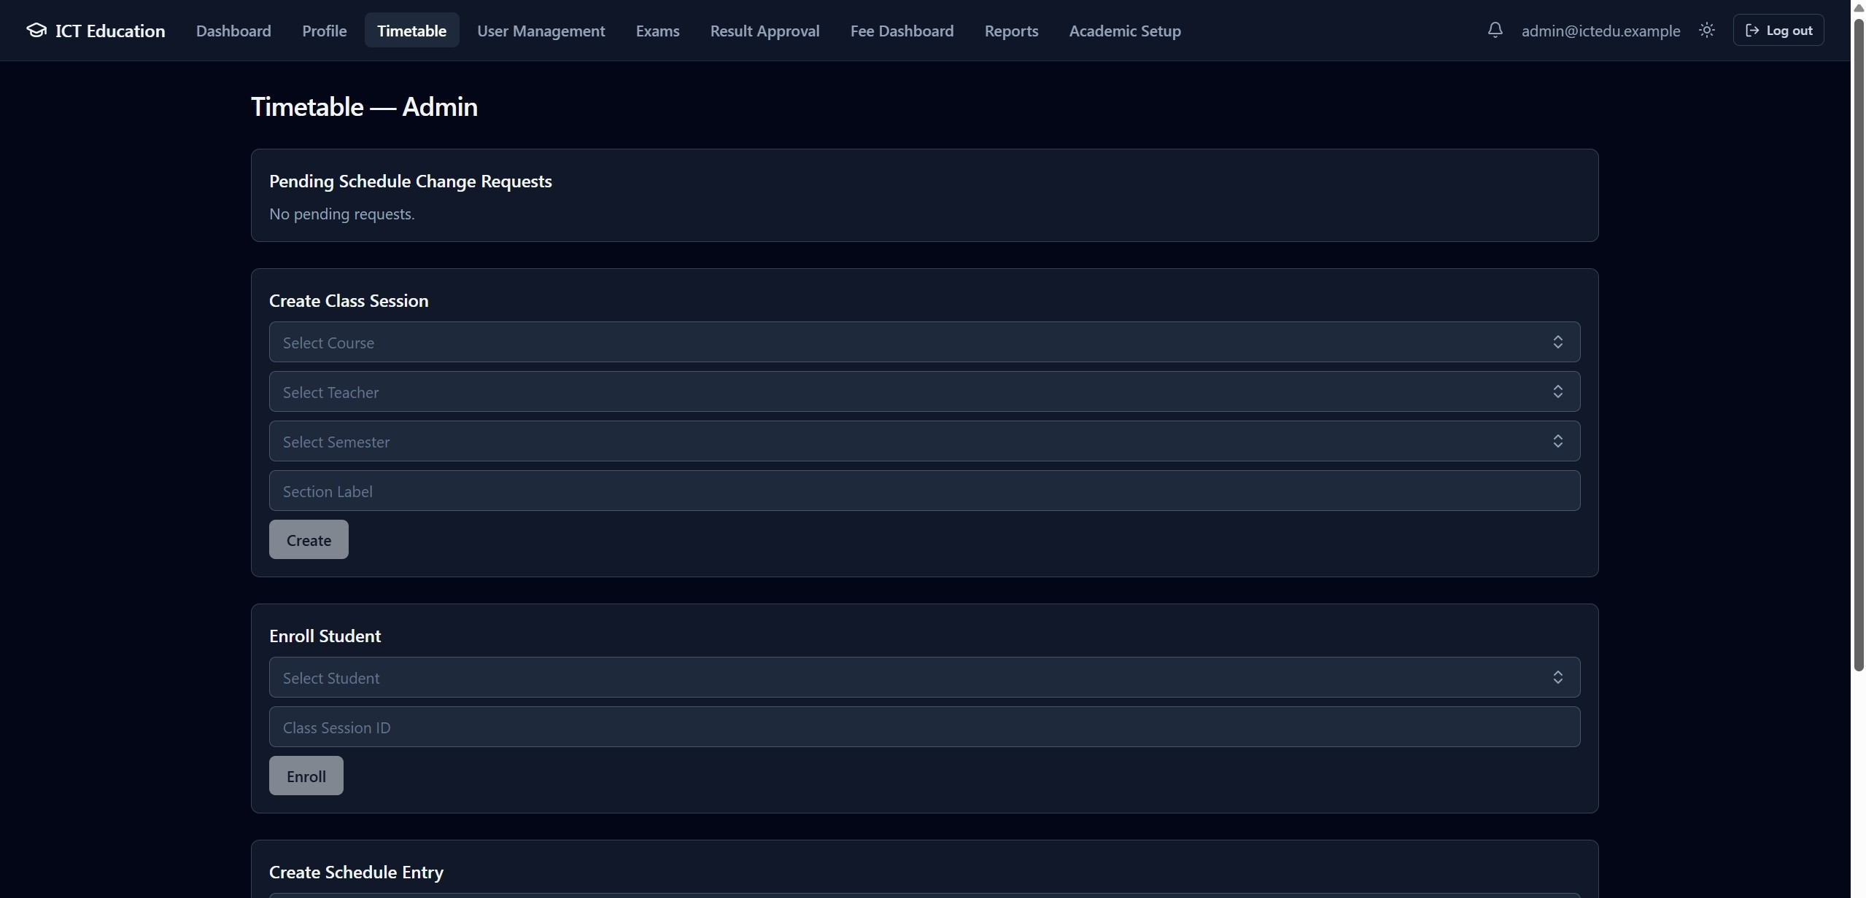

Major Features
• Class scheduling with conflict detection and a Teacher-request / Admin-approval change workflow
• Attendance tracking with live-computed percentages and automatic low-attendance alerts
• Timed exam-taking across four question types (MCQ, short answer, descriptive, coding)
• Per-question grading interface for non-auto-gradable question types
• Result workflow: submitted → approved/rejected → published, with credit-weighted GPA
• PDF transcript generation
• Fee module: auto-generated invoices, payment tracking, PDF invoice/receipt
• Event-driven notifications reaching Students and their linked Parents
• Role-appropriate dashboards for all four roles
Attendance Module Screenshot
Schedule Management Screenshot
Notification Center Screenshot
Notes:
This is the bridge from architecture into the product. Major features fall into five groups: scheduling, with conflict detection and a Teacher-initiated, Admin-approved change-request workflow; attendance, with live percentages and automatic low-attendance alerts; exams, across four question types with a live timer and a dedicated grading interface; results, following a submitted-approved-published workflow with credit-weighted GPA and a PDF transcript; and fees, with auto-generated invoices and a PDF that relabels itself a receipt once paid. All of it is tied together by notifications reaching both the student and their linked parent.

Slide 12
Typical Academic Workflow
One record, one workflow — from semester creation to parent notification
Admin
Creates Semester
Teacher Creates Exam
Student Takes Exam
Teacher Grades
Admin Approves Results
Student Views Results
Parent Receives Notification
Admin
Teacher
Student
Parent
Notes:
This slide ties the previous feature list together into one concrete, end-to-end record: an Admin creates the semester, a Teacher builds and publishes an exam against it, a Student attempts it, the Teacher grades the submission, an Admin approves the result before it publishes, the Student sees it on their dashboard, and their linked Parent is notified — the same ownership and workflow-state rules covered on the Authentication and Major Features slides apply at every arrow in this chain.

Slide 13
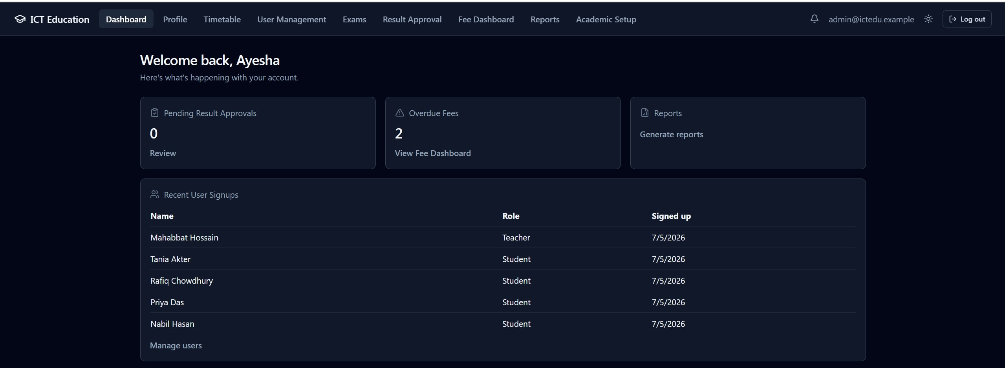
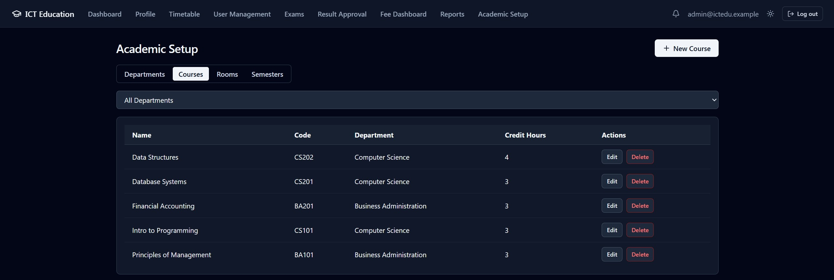
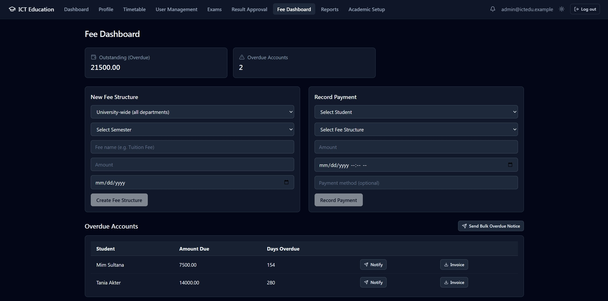
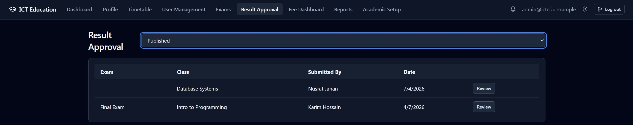
Admin Portal
• Dashboard: system-wide summary — user counts, pending approvals, health status
• User Management: create, edit, deactivate Students/Teachers/Parents/Admins
• Academic Setup: manage Departments, Courses, Rooms, Semesters (reference/catalog data)
• Timetable: create class sessions with conflict detection; approve/reject Teacher change requests
• Result Approval: review and approve/reject submitted results before publication
• Fee Dashboard: define fee structures, record payments, view balances
• Reports: generate attendance, result, and fee reports, filterable by department/semester/student
• Notifications: system-wide audit trail of key events
Admin Dashboard Screenshot
Course Management Screenshot
Result Approval Workflow
Fee Management Screenshot
Notes:
The Admin portal is the operational control center. The dashboard shows a system-wide summary; User Management covers the full account lifecycle for all roles; Academic Setup manages the reference data everything else depends on. The Timetable page creates class sessions with conflict detection, and — critically — reviews and approves or rejects Teacher-submitted change requests, closing a loop that used to be one-sided. Result Approval is the final checkpoint before a result becomes visible to a student or parent, and the Fee Dashboard and Reports page round out the financial side.

Slide 14
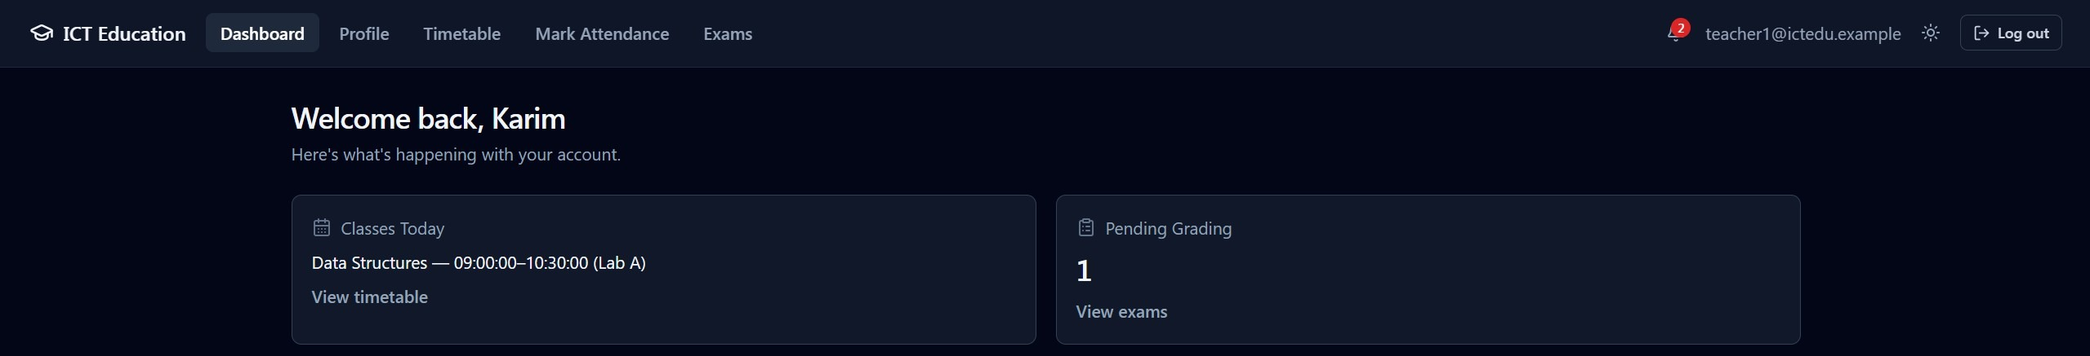
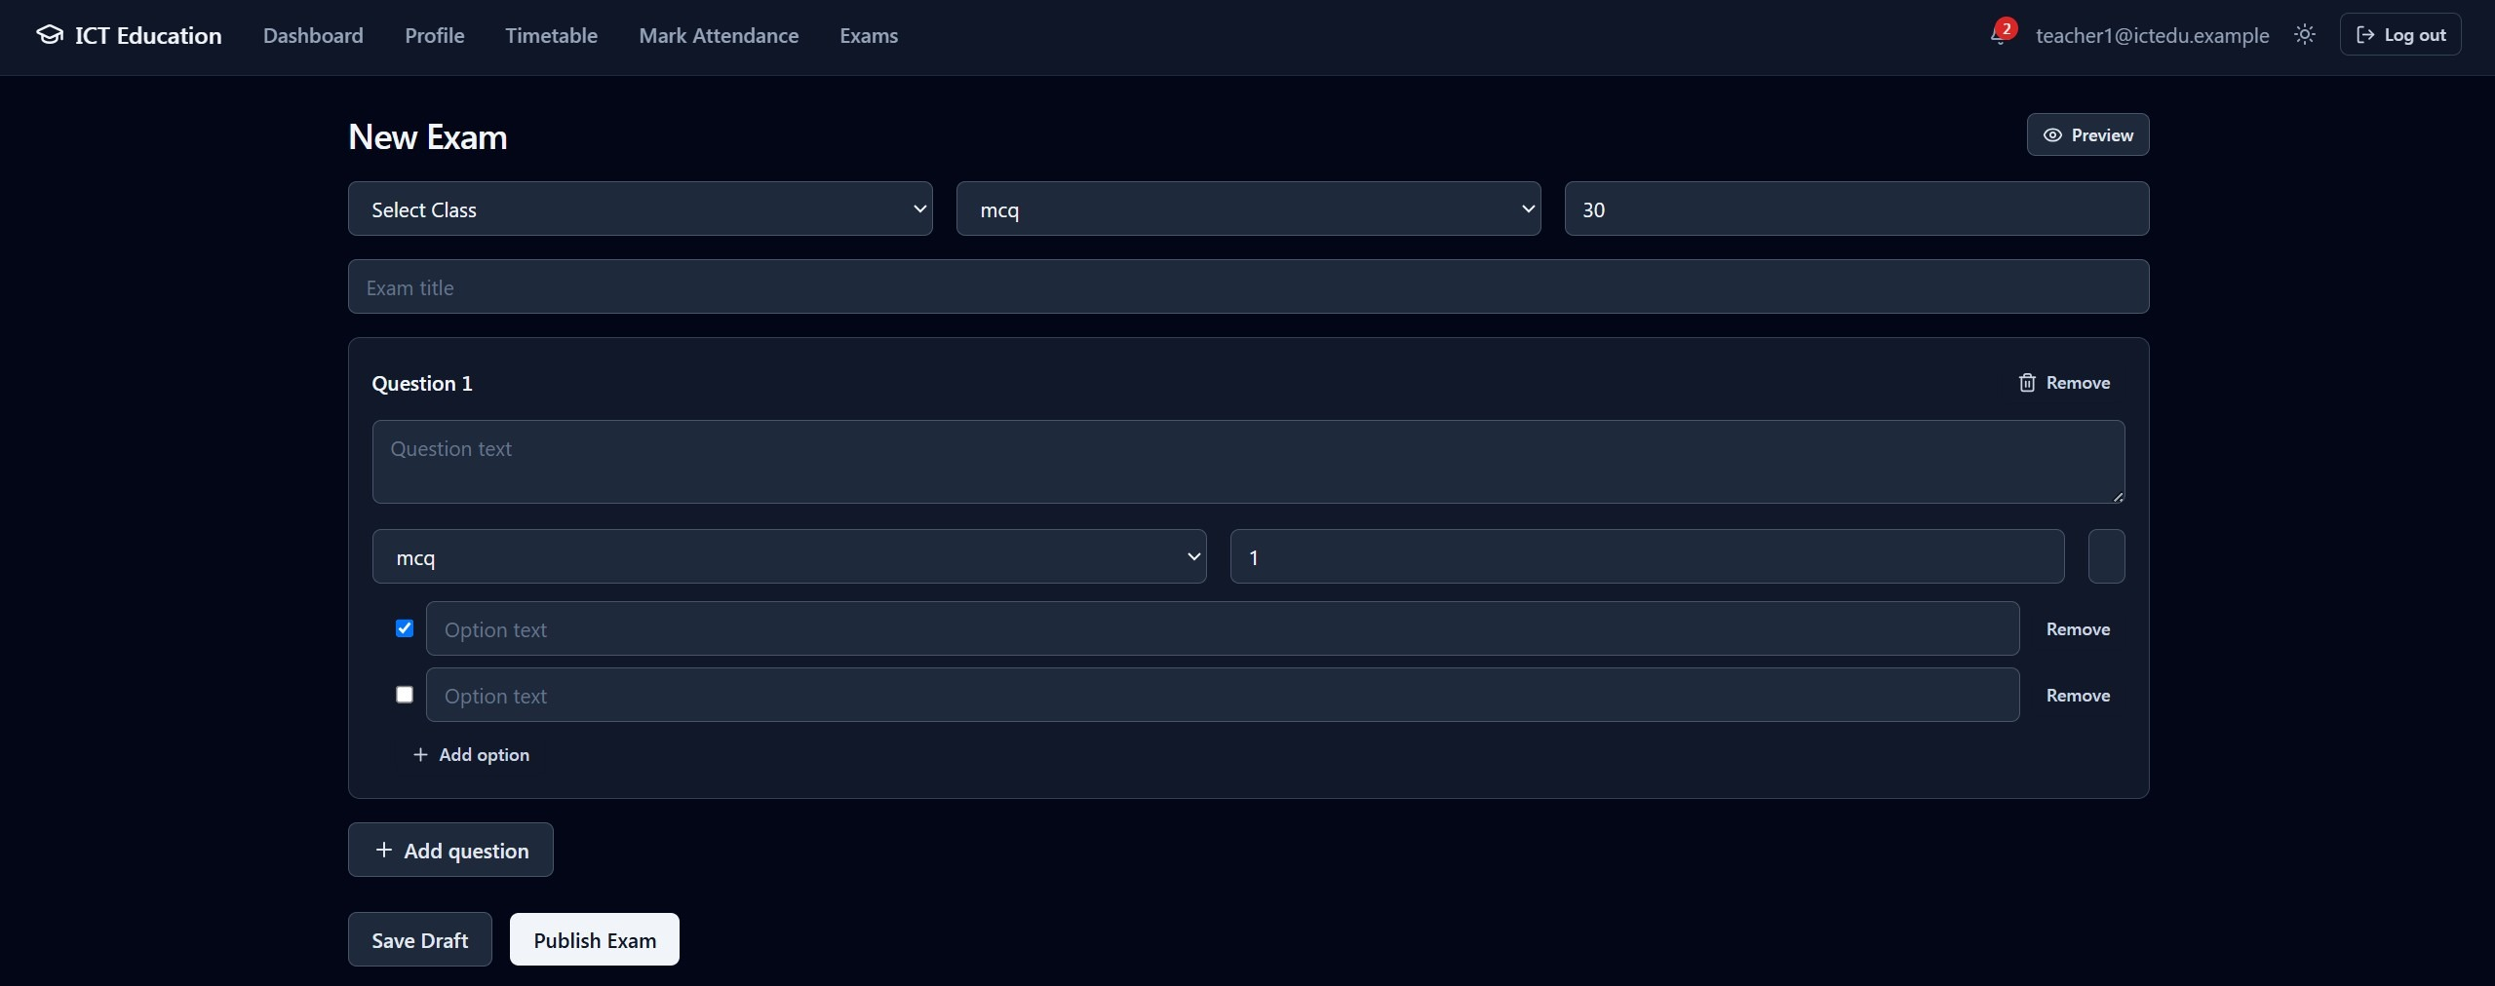
Teacher Portal
• Dashboard: assigned classes and pending-grading summary
• Profile: full Teaching History across all semesters (not just the current one)
• Timetable: own class schedule, with a Request Change action (room/time)
• Attendance Marker: mark present/absent per class session
• Exam Builder: author exams — title, type, time limit, questions across four types
• Exam List: manage exam status lifecycle — draft → scheduled → open → closed → published
• Grading Interface: award marks and feedback per question for submitted answers
• Results: view own course-level results before Admin approval
Teacher Dashboard Screenshot
Exam Builder Screenshot
Notes:
The Teacher portal covers the full academic-delivery workflow. The Profile page now shows a Teacher's complete teaching history across every semester — a UI-labeling fix in this latest version; the backend data was always complete, but the label previously said 'this semester only.' Teachers mark attendance in the Attendance Marker, author exams across four question types in the Exam Builder, and manage each exam through its full status lifecycle. Anything that can't be auto-graded goes through the dedicated Grading Interface for marks and feedback per question.

Slide 15
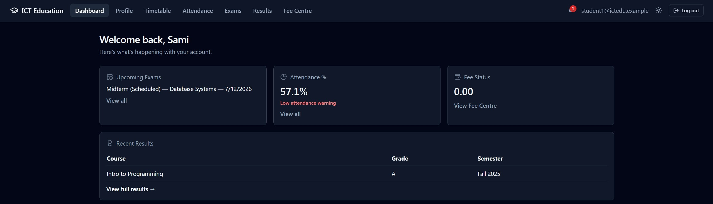
Student Portal
• Dashboard: attendance %, upcoming exams, and recent results at a glance
• Profile: academic history alongside profile data
• Timetable: class schedule, table or calendar view
• Attendance: table and calendar views of own attendance record
• Exams: list of available (non-draft) exams; live timed exam-taking interface
• Results: published results with grade letters and per-semester GPA
• Fee Centre: outstanding balance, invoice history, downloadable invoice/receipt PDF
Student Dashboard Screenshot
📷
Online Examination Screenshot
screenshot placeholder
Live Exam Room — timed attempt in progress
Notes:
The Student portal is the most feature-dense, since students are the primary consumer of nearly every module. The dashboard gives an at-a-glance view — attendance, upcoming exams, recent results. Students view their timetable, their attendance in table or calendar form, and take live timed exams with a real countdown and auto-submission on expiry. Once results are published — not before — they appear with grade letters and per-semester GPA, and the Fee Centre gives direct visibility into balance and downloadable invoices.

Slide 16
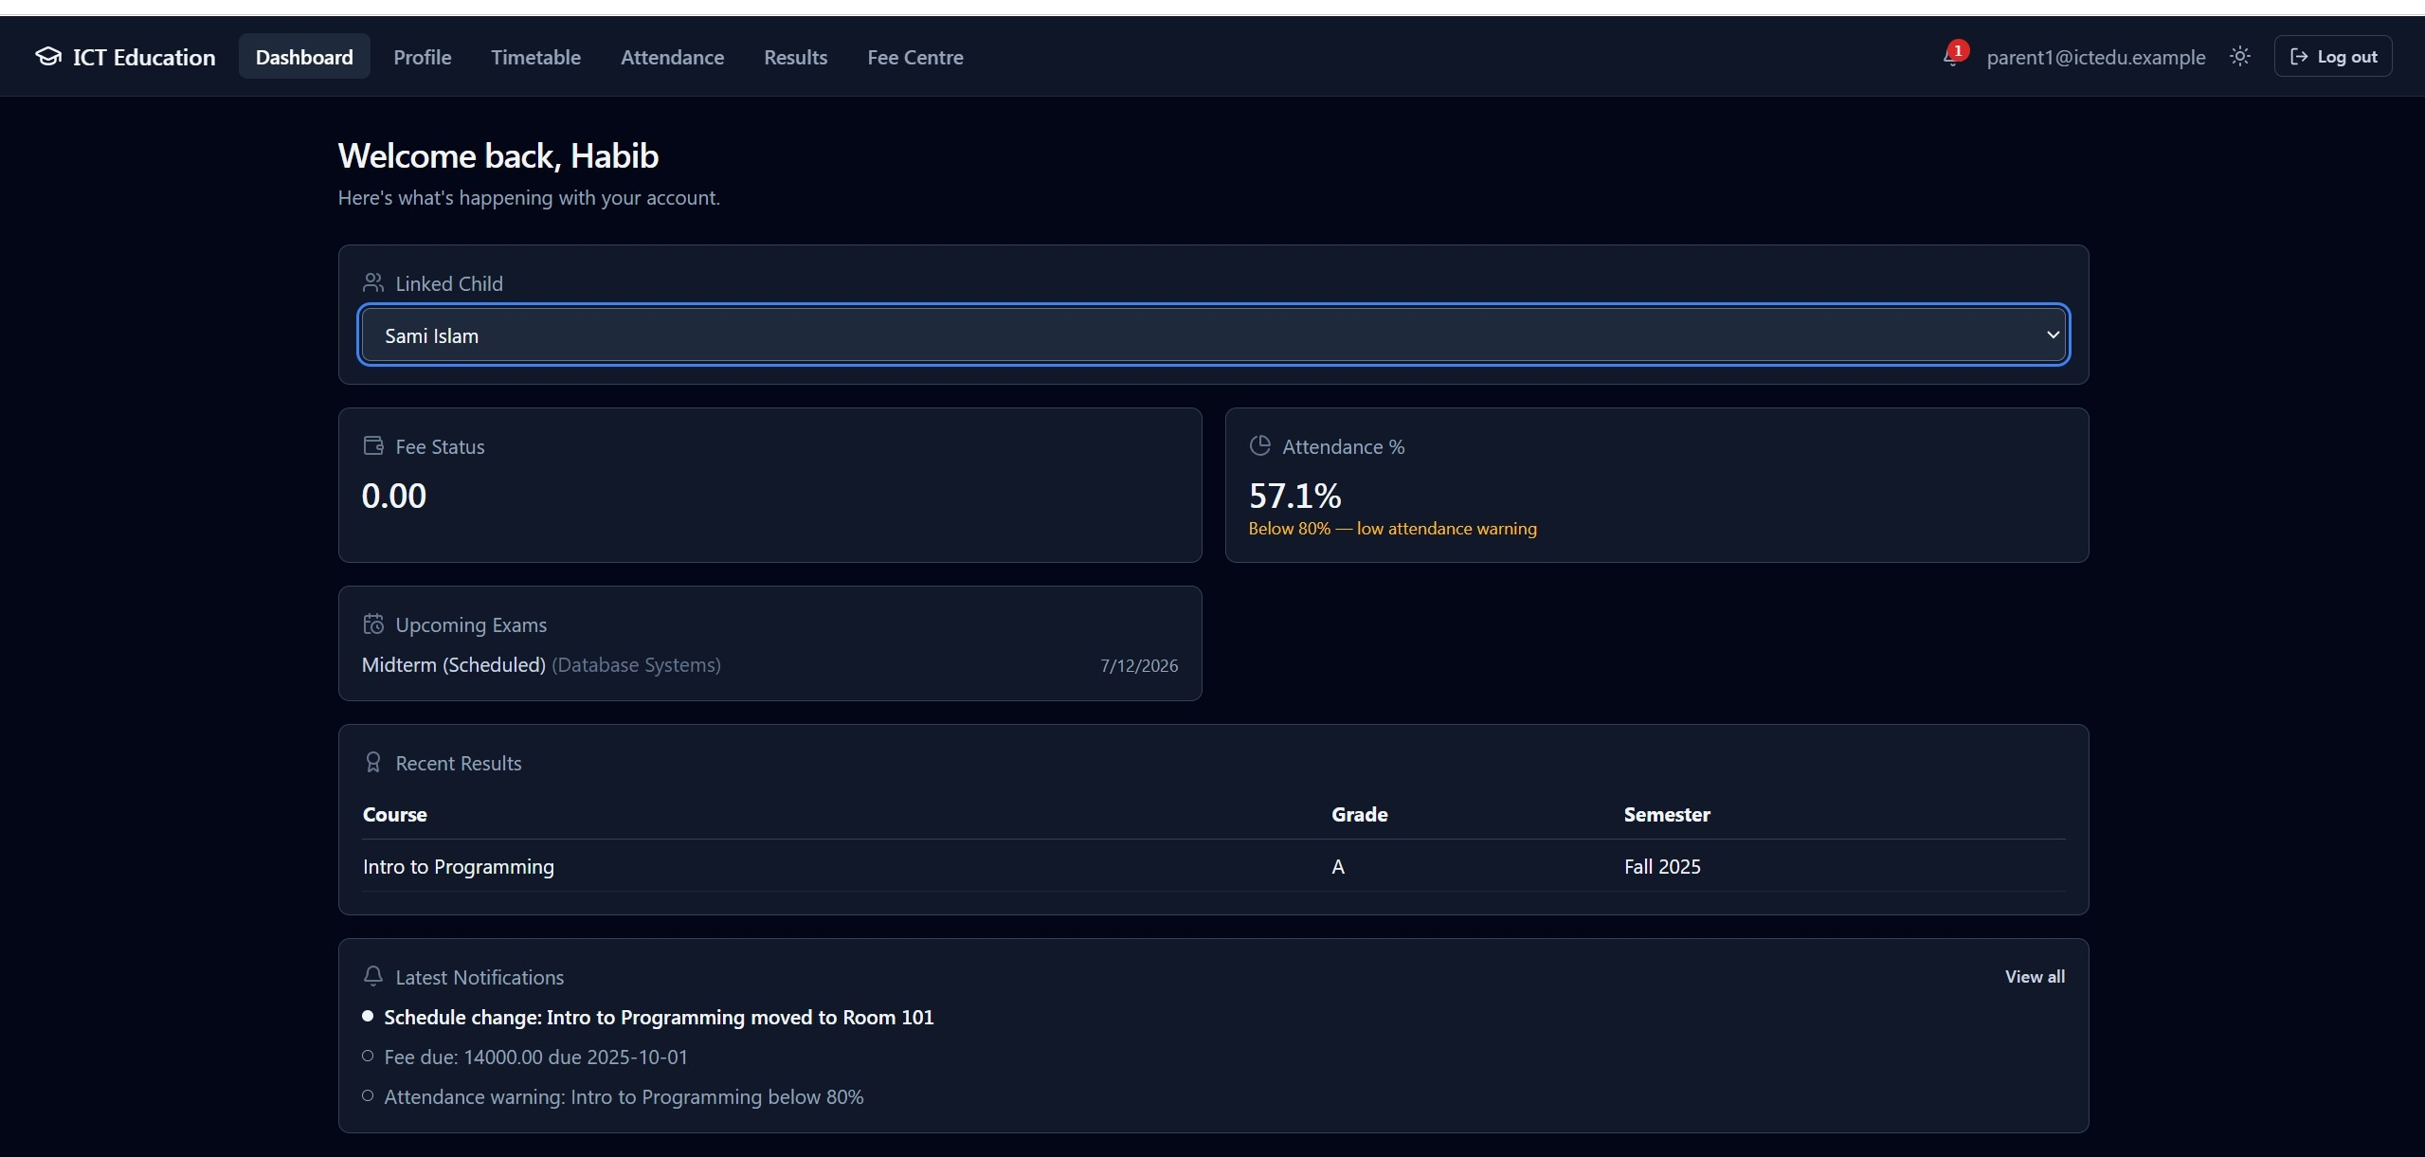
Parent Portal
• Linked-child selector — auto-selected when a Parent has exactly one linked child
• Dashboard: Fee Status, Attendance %, and Upcoming Exams for the selected child
• Attendance: linked child's record with PDF/Excel/CSV export
• Results: linked child's published results
• Fee Centre: linked child's balance and invoice history
• Timetable: linked child's class schedule
• New in v2.4.1 — Upcoming Exams widget: previously showed 'Not available'; now scoped to the linked child
• Every view is ownership-verified server-side against the parent_student_link table
Parent Dashboard Screenshot — Upcoming Exams (v2.4.1)
Notes:
The Parent portal follows a strict never-cross-child-boundaries principle — every view, whether fees, attendance, results, or timetable, is scoped to the linked child and verified server-side, not just filtered on the frontend. I want to highlight the newest addition in v2.4.1: the Upcoming Exams widget. Until this release that space literally said 'Not available' — a closer audit found the underlying endpoint would have returned every exam in the university to a Parent if wired up carelessly. We closed that gap properly: the exam endpoint now has a dedicated Parent branch with the same ownership check used everywhere else.

Slide 17
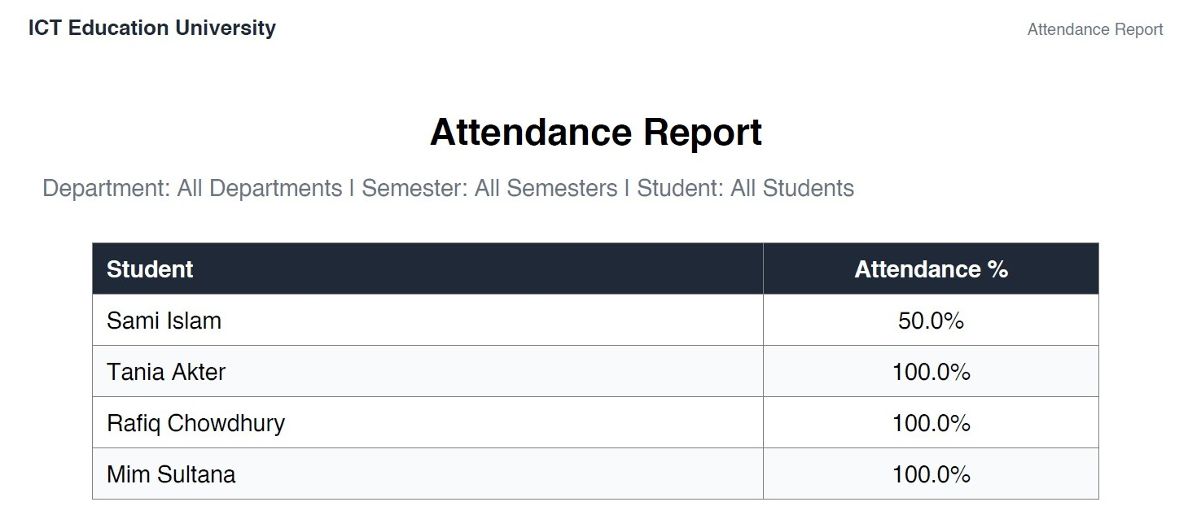
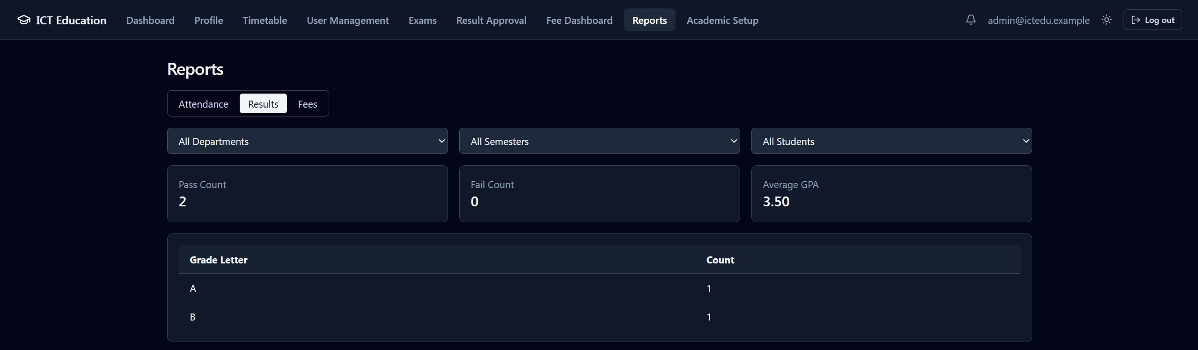

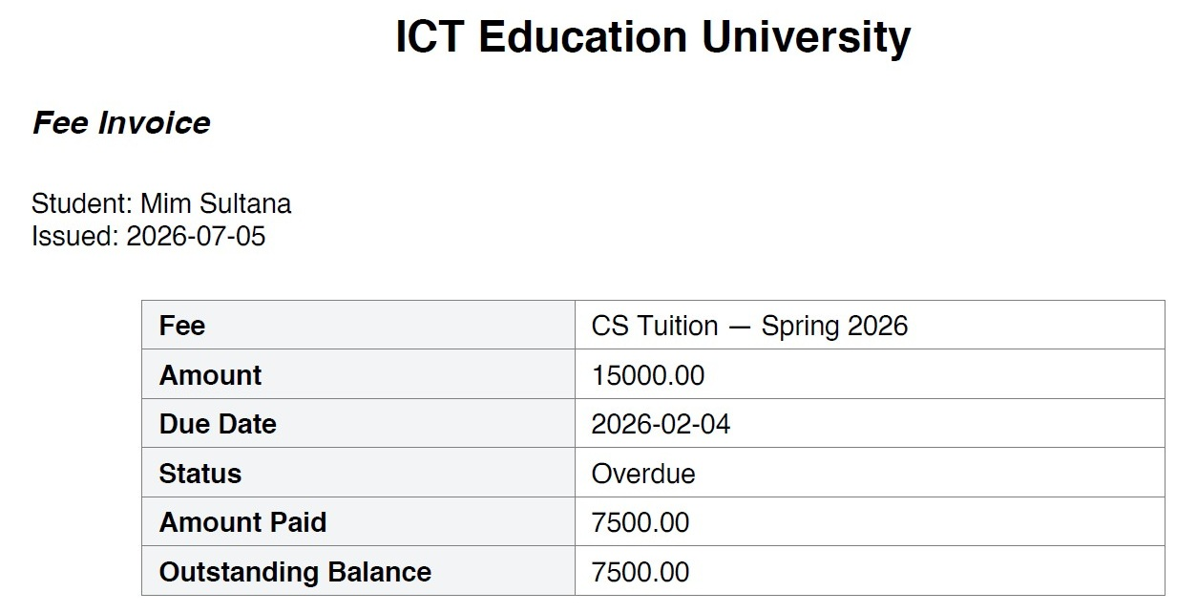
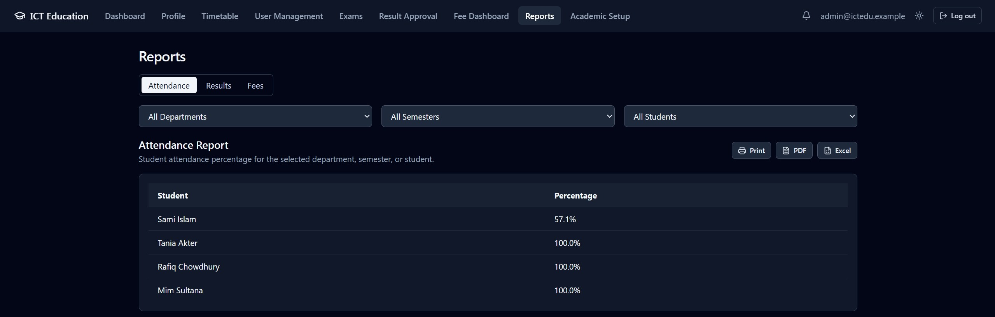
Reports (PDF / Excel / CSV)
• Attendance reports: PDF, Excel, and CSV export, filterable by department/semester/student
• PDF generation via ReportLab — shared layout module reused across transcripts, invoices, reports
• Excel export via openpyxl — pure Python, no external binary dependency
• Transcript PDF: per-semester grades, credit-weighted GPA, custom-drawn institutional seal
• Fee invoice PDF: automatically relabels itself 'Fee Receipt' once the invoice is marked paid
• All generation runs as a background task — never inline in the request path, to keep latency low
• Print-optimized layout (A4, dedicated print stylesheet) available directly in the browser
Attendance Report — PDF Export
Reports Dashboard — Results
Transcript PDF Screenshot
Invoice PDF Screenshot
Notes:
Every document-generation feature — attendance reports, transcripts, fee invoices — shares two things: pure-Python libraries, ReportLab for PDF and openpyxl for Excel, no external binary dependency; and they all run as background tasks, not inline in the request cycle, so generating a large report never slows the response the user is waiting on. A nice detail: the transcript's institutional seal is drawn programmatically since no real logo asset exists, and the fee invoice relabels itself 'Fee Receipt' automatically once paid — no separate generator needed.

Slide 18
Testing Results
• 549 automated tests, all passing — 484 backend (pytest), 65 frontend (Vitest)
• Backend unit tests: service-layer business logic, repositories stubbed, no database required
• Backend integration tests: full request → database → response cycle against a real, disposable PostgreSQL database
• Frontend component tests: exam timer, grading form, approval workflow, Parent-facing views
• Every business rule (BR-xxx) and validation rule (VR-xxx) has a dedicated test
• Every RBAC/ownership boundary has an explicit negative test — wrong-role/wrong-owner requests verified rejected
• Every workflow state machine tested for both valid and invalid transitions
• Continuous Integration (GitHub Actions) runs the full suite plus a schema-drift check on every push
$ pytest
484 passed in 71.4s
$ vitest run
65 passed (16 test files)
549 / 549 tests passing
Test Results Summary (pytest / vitest)
Notes:
Correctness here isn't a claim — it's backed by 549 automated tests, all passing: 484 backend with pytest, 65 frontend with Vitest. Unit tests exercise business logic with repositories stubbed, no database needed; integration tests run the full request-to-database cycle against a real, disposable PostgreSQL instance. Two disciplines I'd call out: every RBAC and ownership boundary has an explicit negative test — proving the wrong-role or wrong-owner request is actually rejected — and every workflow is tested for both valid and rejected invalid transitions. All of this runs in GitHub Actions on every push, including a schema-drift check.

Slide 19
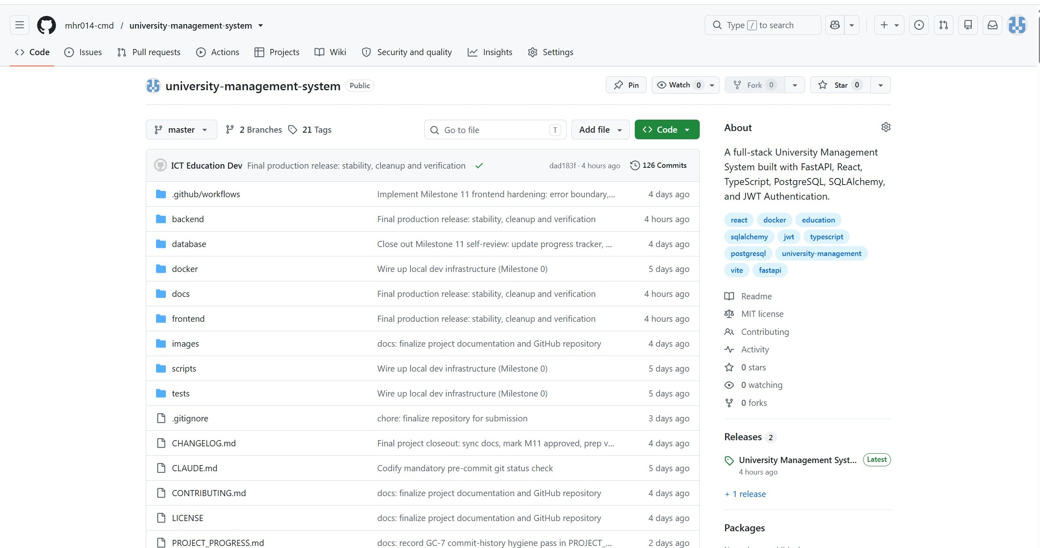
GitHub Version History
• Milestone-based development: 11 milestone tags from v0.1 through v1.1, then v2.0.0
• Post-release hardening tags: v2.1 through v2.4.1 (current)
• Each commit scoped to one logical change, imperative present-tense messages
• docs/Proposal_vs_Engineering_Additions.md — every addition beyond the original proposal is logged and classified
• CI (backend-ci.yml, frontend-ci.yml) runs on every push and pull request
• v2.4.1 — latest release: Parent Upcoming Exams widget + Teacher Teaching History label fix
Milestone → Release Timeline
v0.1
v1.1
v2.0.0
v2.4.1
github.com/mhr014-cmd/university-management-system
Notes:
Development followed a strict milestone-based process — visible directly in the tag history: eleven milestone tags to version 1.1, then a 2.0.0 tag marking the final milestone-program release, followed by four hardening passes — 2.1 through 2.4.1, the current version — closing gaps found in follow-up audits rather than adding unplanned scope. Every commit is scoped to one logical change, and any capability added beyond the original proposal is logged in a dedicated traceability document, classified and justified, so the project's actual scope is always precisely auditable. CI runs the full suite on every push.

Slide 20
Challenges Faced
• Enforcing ownership, not just role, on every Parent-scoped endpoint (attendance, results, fees, exams, schedule)
• Designing workflow state machines (exam, result, schedule-change) that reject invalid transitions cleanly
• Avoiding N+1 query patterns while keeping repositories free of business logic
• Keeping derived figures (attendance %, GPA) always live rather than falling into caching for performance
• Coordinating a strict layered architecture (Router/Service/Repository) across 11 growing domains
• Closing gaps found by later self-audits (e.g. a Parent endpoint with no ownership branch at all) without breaking existing behavior
• Balancing test coverage depth against an incremental, milestone-based delivery schedule
Obstacles Cleared
Ownership vs. Role
State Machines
N+1 Queries
Live Figures
Layered Architecture
Notes:
A few challenges stood out. First, making sure ownership checks — not just role checks — were applied consistently everywhere a Parent could request child data; a later audit found the exam list endpoint had no Parent branch at all and would have silently returned every exam in the university. Closing that safely without breaking the existing Student and Admin paths took care. Second, designing workflow state machines so invalid transitions are rejected cleanly. Third, keeping the layered architecture disciplined as the system grew to eleven domains, resisting shortcuts in routers or repositories. And throughout, tests were written in the same change as the feature, never deferred.

Slide 21
Future Scope
• A shared, Redis-backed rate limiter to support horizontally-scaled deployment
• Email/SMS notification delivery channels, in addition to the existing in-app feed
• A scheduled-task mechanism to support due-date reminders and other time-based triggers
• An overall (cross-semester) CGPA aggregate endpoint
• A Teacher-remarks field on the Result record, for narrative course-level feedback
• A production-oriented Docker Compose profile (reverse proxy/TLS, managed database, multiple replicas)
• An in-app Parent-Teacher Communication/Messaging module, if required by a future scope decision
Roadmap Beyond v2.4.1
v2.4.1 (Today)
Rate Limiter + Redis
Email / SMS Channel
Scheduler + CGPA
Docker Production
Deliberately unbuilt capabilities — documented, not silently omitted
Notes:
None of these were missed by accident — each is a deliberate, documented scope boundary. The most practically important next step is a shared rate limiter, since the current login rate-limiting is in-process memory and wouldn't hold up across horizontally-scaled replicas. Beyond that: email/SMS notification channels, a scheduled-task mechanism for things like fee due-date reminders — the system is purely event-driven today — and a cross-semester CGPA figure. A Parent-Teacher messaging module was explicitly out of scope and would be the largest addition on this list.

Slide 22
Conclusion
• Delivers a complete, verifiably working replacement for fragmented spreadsheet/email/finance-tool tracking
• Every functional requirement from the original proposal was implemented and tested
• Every access-control boundary is enforced server-side and explicitly, negatively tested
• Every derived figure is computed live — never cached or duplicated
• 11 backend domains, 82 endpoints, 26 tables, kept maintainable by a strict layered architecture
• 549 automated tests, run continuously via CI, give confidence beyond manual inspection alone
• Deliberately unbuilt capabilities are documented, not silently omitted
Admin Dashboard
Teacher Dashboard
Student Dashboard
Parent Dashboard
Notes:
To conclude: this project set out to replace the fragmented, spreadsheet-and-email approach to university record-keeping with one authoritative, role-aware system of record, and I believe it does that. Every functional requirement from the original proposal was implemented and is backed by a test. Every access-control boundary — role and ownership both — is enforced on the server and explicitly, negatively tested. Every number a user sees is computed live from source records. The system grew to eleven domains and eighty-two endpoints without becoming unmaintainable, and the 549-test automated suite gives confidence beyond manual testing. Thank you — I'm happy to take questions.

Slide 23
Questions
Thank you for your time.
University Management System (ICT Education) — v2.4.1
ICT Education — University Management System | v2.4.1
23 / 23
Notes:
That brings me to the end of the presentation — thank you for your attention. I'm ready to take any questions. If a question touches on something I've deliberately left out of scope, like the CGPA aggregate or the messaging module, I've documented exactly why on the Future Scope and Limitations slides, so I'm happy to go into more depth on the reasoning behind any of those decisions as well.

