Slide 1

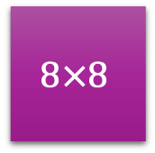

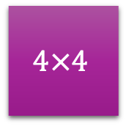

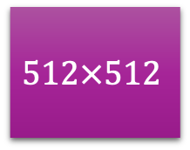
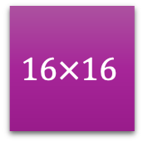

Latent
Space
$$4×4$$
$$8×8$$
$$16×16$$
…
$$512×512$$
…
Add
Add
Add
Add
…
…
$$4×4$$
$$8×8$$
$$256×256$$
$$512×512$$
Upsampling
3-Channel Image

Slide 2
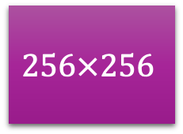
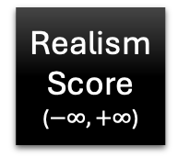
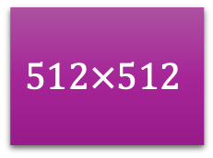
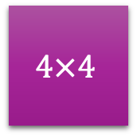
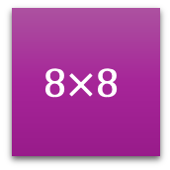
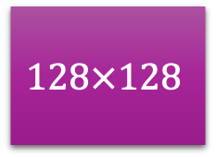
Image
(Fake/Real)
…
$$512×512$$
$$256×256$$
$$128×128$$
…
$$8×8$$
$$4×4$$
Realism
Score
($−∞, +∞$)
…
Residual
Residual
…
Residual

Slide 3
Average
Concatenate
Standard Deviation
Replication of Average

Slide 5
Height
Width
Channels

Slide 6
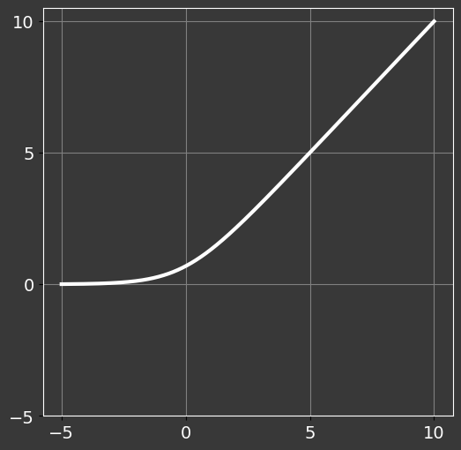


$$f(x)$$
$$x$$

Slide 7



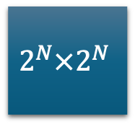

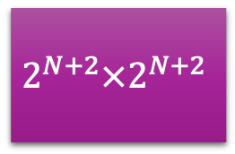
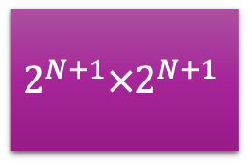
$$2^{N}×2^{N}$$
$$Residual$$
$$Blocks$$
$$2^{N+1}×2^{N+1}$$
$$2^{N+2}×2^{N+2}$$
Add
Add
Add
$$2^{N}×2^{N}$$
$$2^{N+1}×2^{N+1}$$
$$2^{N+2}×2^{N+2}$$
3-Channel Image

Slide 8
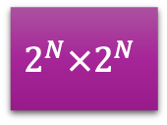
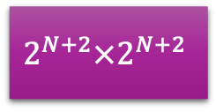
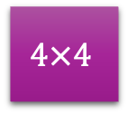

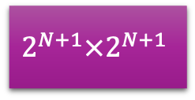

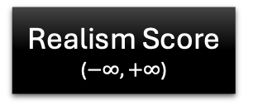
High-Resolution Image
$$2^{N+2}×2^{N+2}$$
$$2^{N+2}×2^{N+2}$$
$$2^{N+1}×2^{N+1}$$
$$2^{N}×2^{N}$$
…
$$4×4$$
Realism Score
($−∞, +∞$)
Low-Resolution Image
$$2^{N}×2^{N}$$
…
…
Residual
Residual
Residual
Residual

Slide 9

$$2^{N}×2^{N}$$
$$Residual$$
$$Blocks$$
$$2^{N}×2^{N}$$

Slide 10
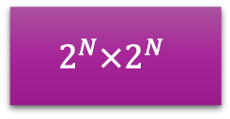

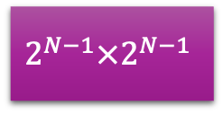

Abnormal Image
$$2^{N}×2^{N}$$
$$2^{N}×2^{N}$$
$$2^{N−1}×2^{N−1}$$
…
$$4×4$$
Realism Score
($−∞, +∞$)
Normal Image
$$2^{N}×2^{N}$$
…
…
Residual
Residual
Residual

Slide 11

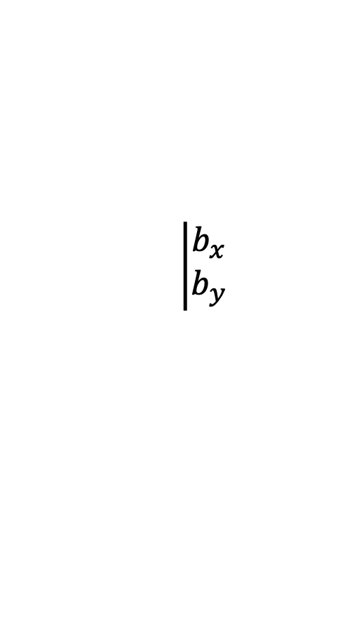


$$\left|\begin{aligned}b_{x} \\ b_{y}\end{aligned}\right.$$
$$b_{h}$$
$$b_{w}$$

Slide 12
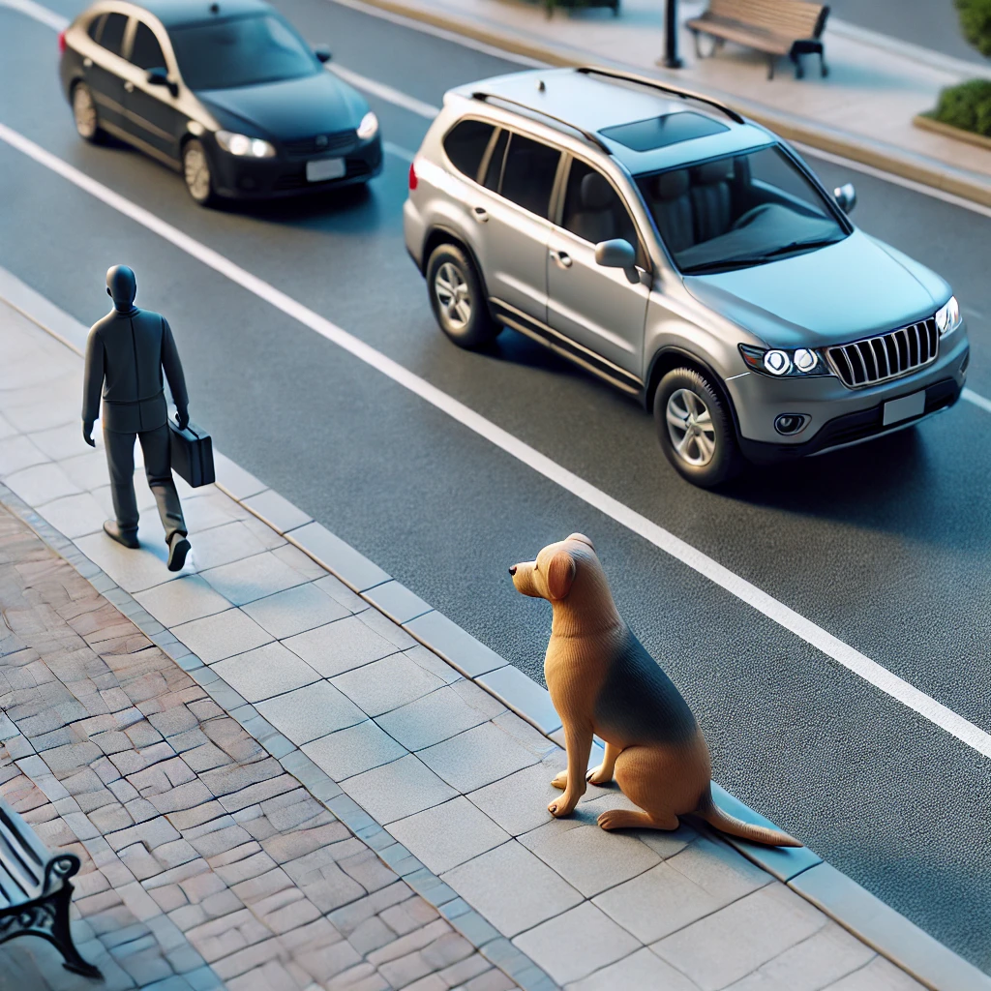

Slide 13
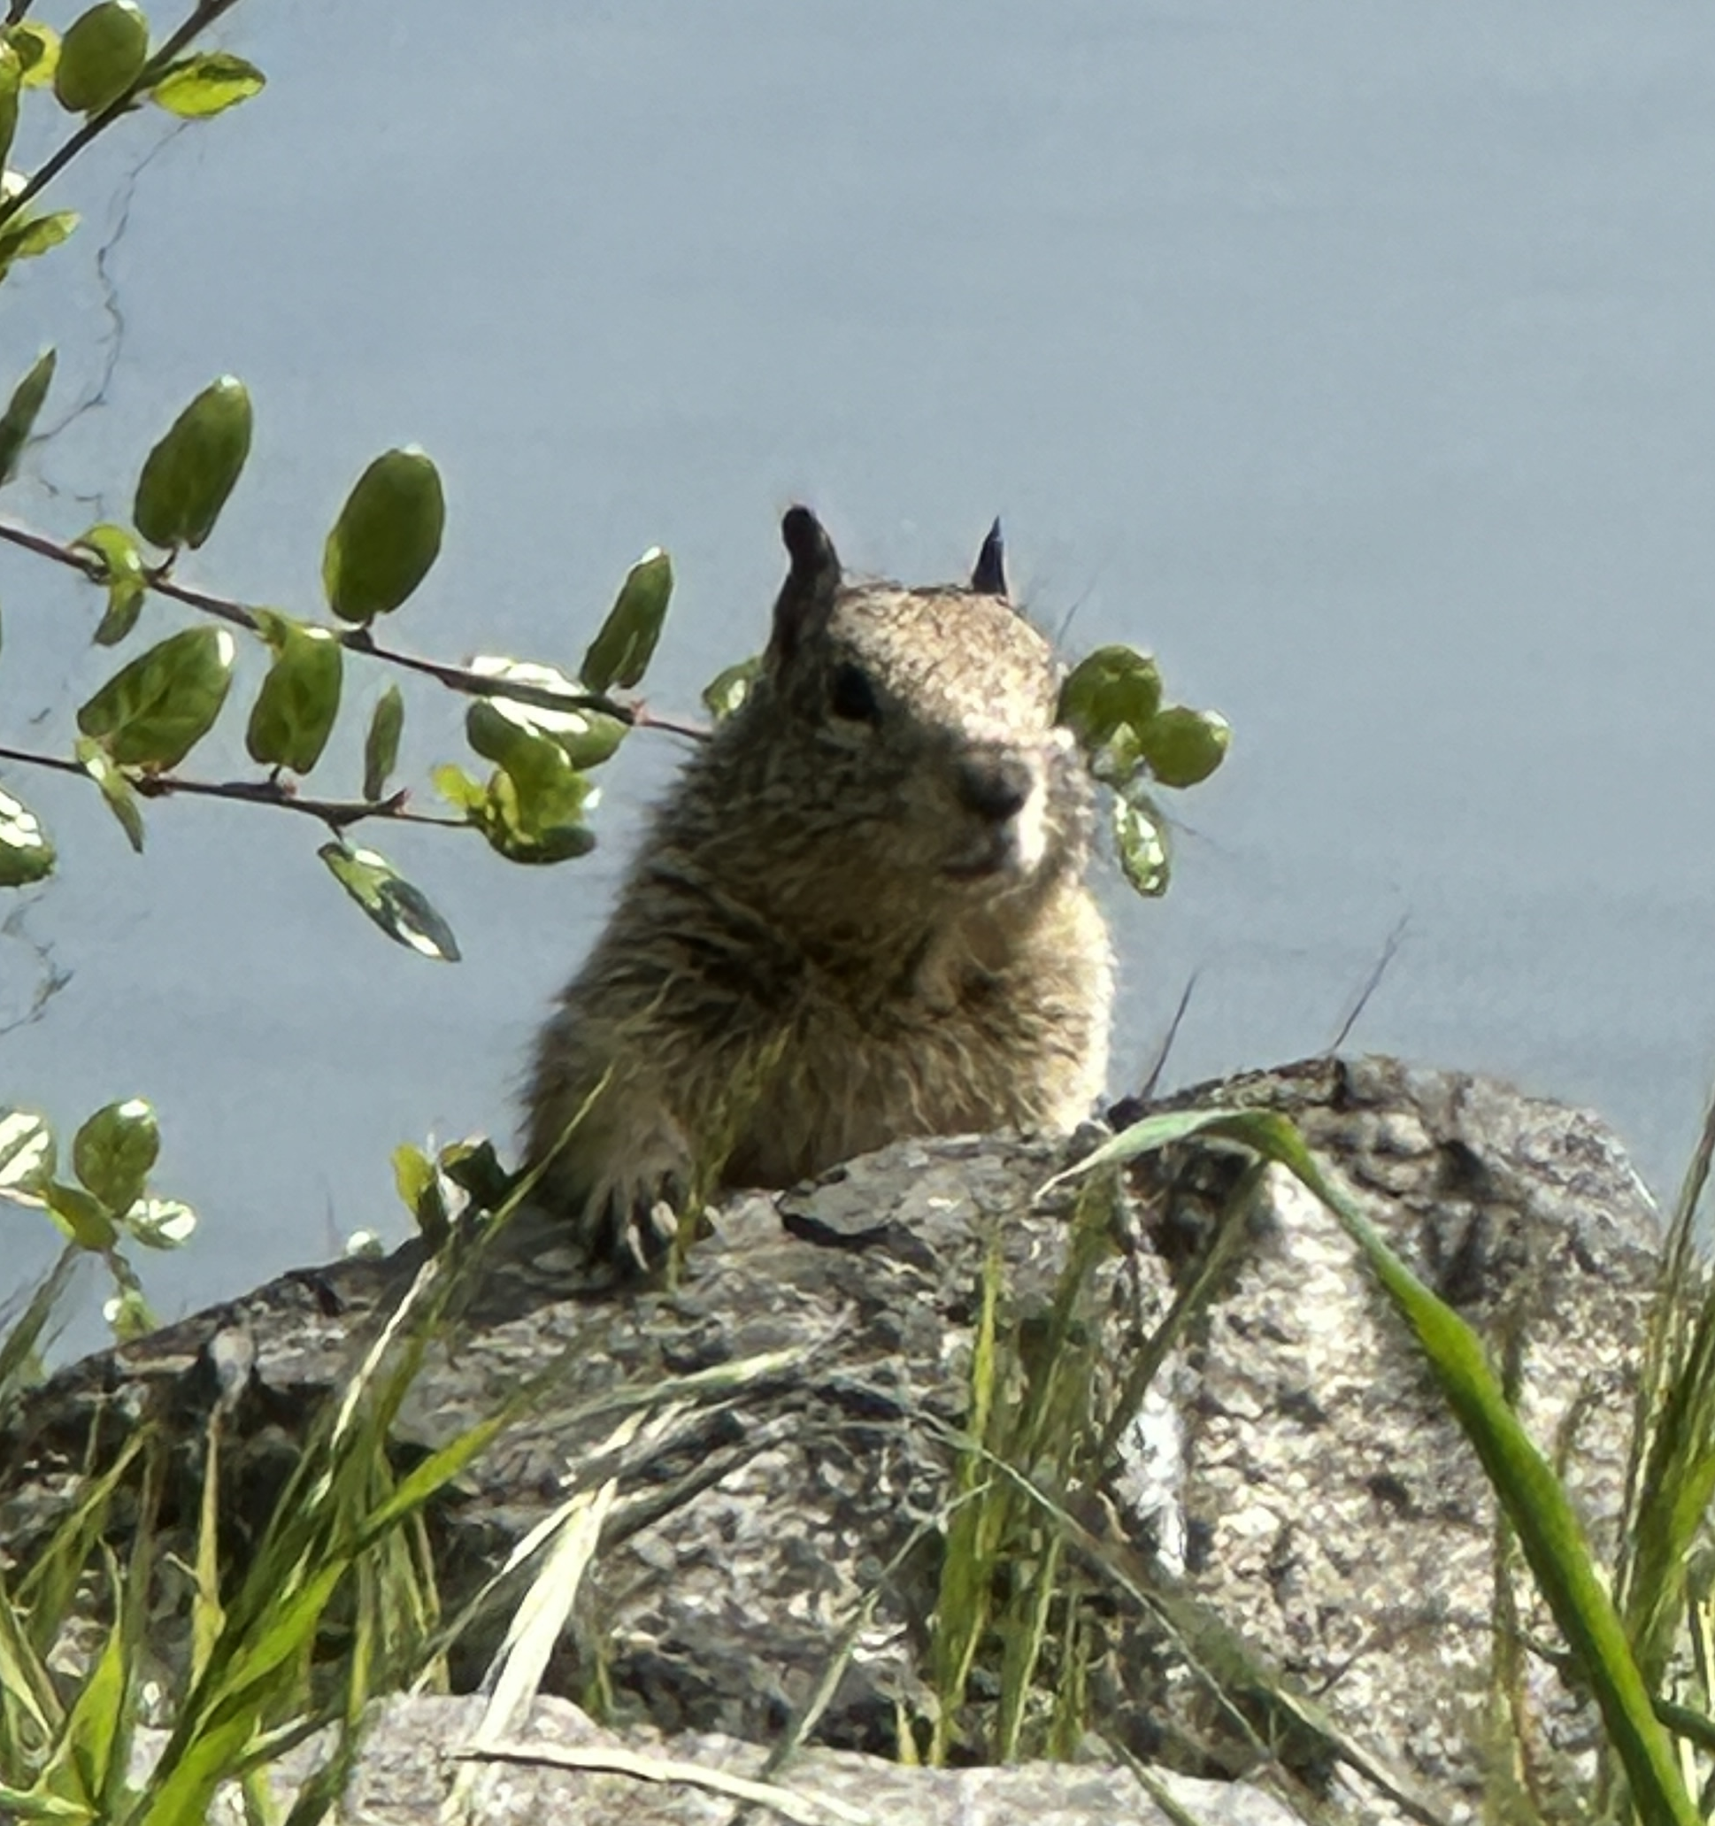
Non-Max Suppression

