Slide 1
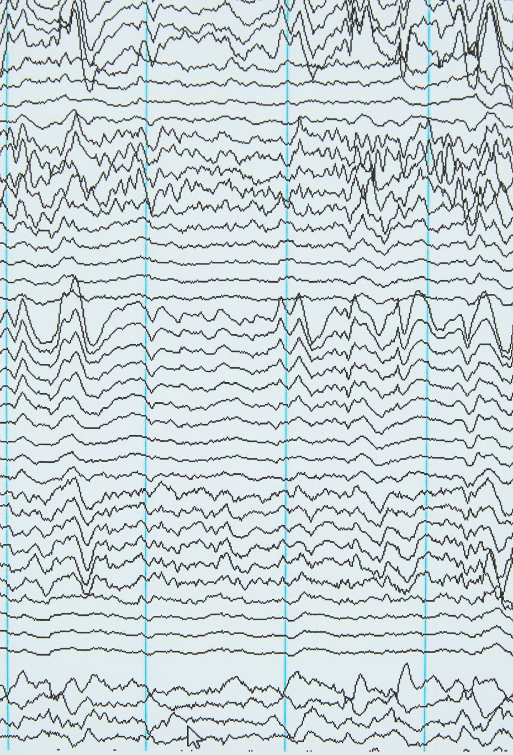
Temporal convolutional networks for musical audio beat tracking – Davies & Bock (2019)
Matthew Rice
220503466

Slide 2
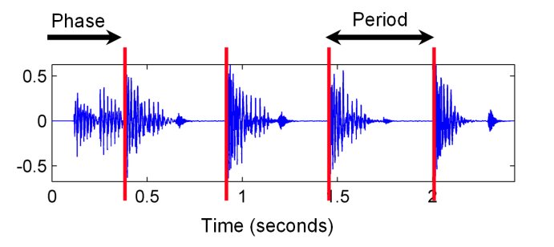
What is Beat Tracking?
From S. Dixon slides on Rhythm and Metre:
Pulse – an equally spaced sequence of perceived accents in time
Primary pulse(beat/tactus) – rate at which one taps along with music
Constant tempo/timing not assumed

Slide 3
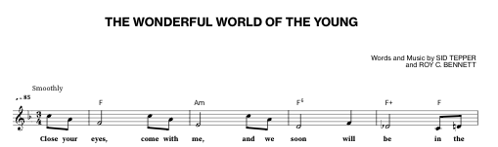
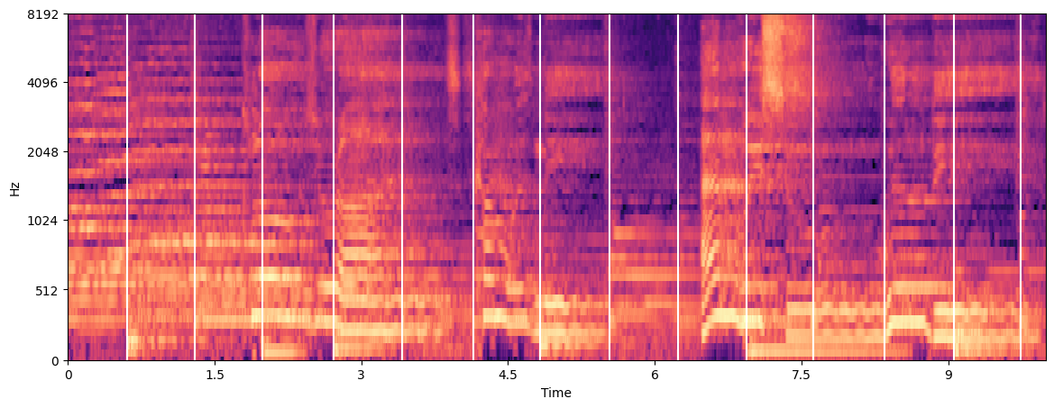

Example

Slide 4

Previous Work
Beat Tracking by Dynamic Programming (Daniel P. W. Ellis 2007)
Match Onset Strength to estimated global tempo
An Efficient State-Space Model for Joint Tempo and Meter Tracking (Krebs et al. 2015)
Efficient implementation of Dynamic Bayesian Network (DBN) for improved accuracy (> 15%)
Joint Beat and Downbeat Tracking with RNNs (Bock et al. 2016)
Use RNN to predict musical onsets combined with DBN to find global best state sequence
Limitations: RNNs hard to train, uninterpretable, and inefficient

Slide 5
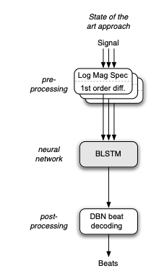
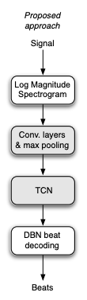
Main Idea: Use TCN instead of RNN
TCN + Conv. Layers
＋ Efficiency
＋ Interpretability
＋ GPU parallelizable
⃝ Similar performance to RNN

Slide 6
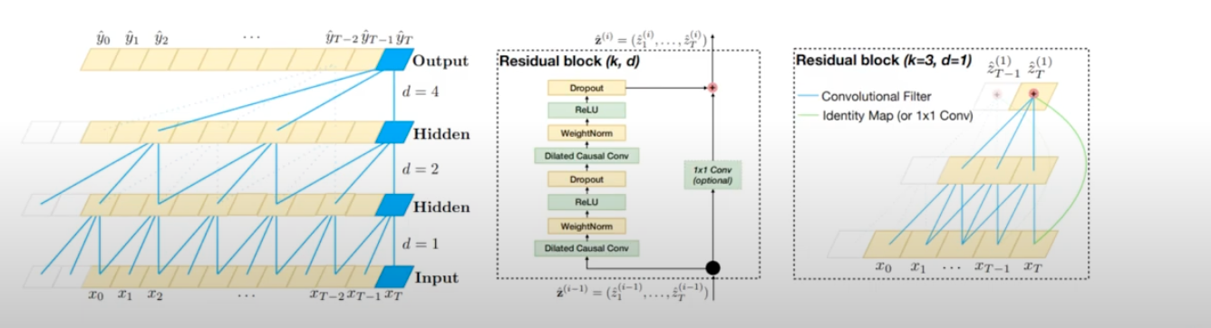
WaveNet (Oord et al. 2016)
Introduction of Temporal Convolutional Network (TCN) – Uses stacked dilated causal convolutions
Image from VU Amsterdam: Lecture 5.4 - CNNs for Sequential Data, (Nov. 04, 2020).

Slide 7
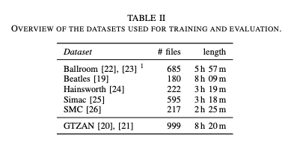
Datasets
8-fold cross validation
Held out test set

Slide 8
Method
Formulation: Treat problem as binary classification task
Input data format
Song:
Spectrogram: (batch, bands, time windows)
Labels
(batch, time windows)
0 → no beat
1 → beat
0.5 → 2 locations adjacent to beat
0 | 0 | 0.5 | 0.5 | 1 | 0.5 | 0.5 | 0 | 0.5 | 0.5 | 1 | 0.5

Slide 9
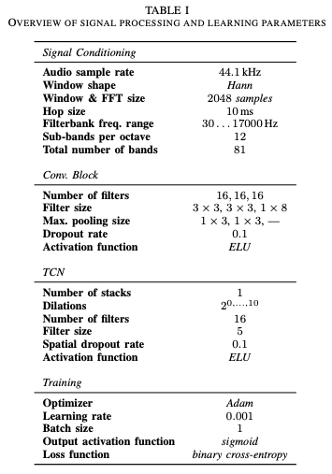
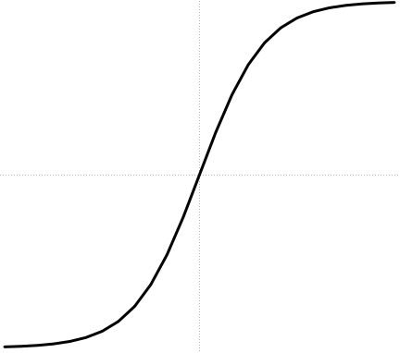
Method
Beat times
Label preprocess
3 Layer CNN to reduce 5 frames
(5x81) to (1x16)
Unlike WaveNet:
Non-causal convolutions
ELU activation
BCE Loss
Same as in RNN paper
Only used during inference
Adam

Slide 10
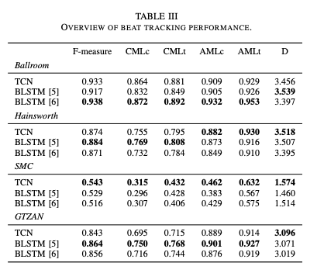
Results

Slide 11
Limitations
No joint beat and downbeat tracking
Large number of parameters not completely tuned
Inference slower than BLSTM (but still faster than real-time)
Non-causal TCN layers inhibit real-time tasks

Slide 12

Implications
TCNs can be adapted from music generation domain to beat tracking (and perhaps other domains!)
TCNs are efficient compared to RNNs while achieving similar performance
35% of weights of RNN approach
60x training speed up on GPU
Reusing post-processing ideas such as DBN are essential to improving accuracy

