Slide 1


Project II - Final Defense
On
Car Rental Portal
Presented By:
Shova Maharjan(6-2-920-14-2019)
October, 2023

Slide 2

Table of contents
Introduction
Problem Statement
Objectives
Methodology
Scheduling
Conclusion
References

Slide 3

Introduction
The car rental portal is an online platform that allows customers to rent vehicles for a specified period.
With the car rental portal, customers can browse through a range of vehicles, select their preferred one, and make a reservation.
Overall, the car rental portal provides a streamlined and efficient process for renting vehicles, saving time and effort for both customers and businesses.

Slide 4
Problem Statement
The current car rental system has an inefficient booking process that leads to long wait times and customer dissatisfaction.
The car rental system has poor maintenance practices, resulting in frequent breakdowns.
Limited private transport options make finding transportation difficult for many individuals.
The current car rental system has poor customer service, resulting in unhappy customers and a negative brand image.

Slide 5
Objective
This system aims to offer a hassle-free way for customers to rent vehicles for a specific period, allowing them to travel comfortably and efficiently without the responsibilities of ownership.
To provide a wide selection of vehicles, ensuring easy booking and return processes, maintaining vehicle safety and cleanliness, and delivering excellent customer service to enhance the overall rental experience.

Slide 6
Methodology
1. REQUIREMENT IDENTIFICATION
Study of existing system :
khojnu.com, sparkcar.org, Self Drive Nepal
Requirement Collection :
Support unique account creation and login system for each individual.
Support users to search for available vehicles.
Support to manage the booking requests, confirm or reject them based on availability.
Support users to provide feedback and rate their rental experience, which can help the portal improve their services.

Slide 7


2. FEASIBILITY STUDY
Technical:
Frontend Tool Used: HTML, CSS, and JS
Backend Tool Used: PHP and MYSQL
Operational:
It is user friendly.
It uses web browser as an interface.
It can be easily used with internet access.
It saves time of the user as well as prevent paperwork.

Slide 8

Economic:
The system does not require extra software and hardware. So there is no recurring cost.
Cost is estimated to be as minimum as possible after analyzing the requirements of the project.
Can do the project without any other additional charges.

Slide 9
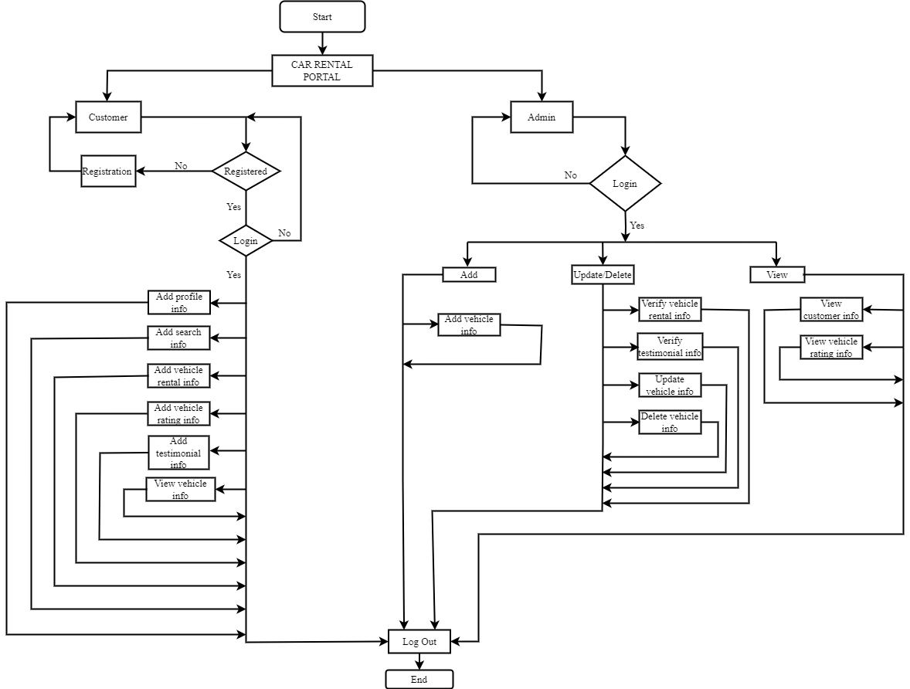
3. HIGH LEVEL DESIGN OF SYSTEM
System Flowchart Chart

Slide 10
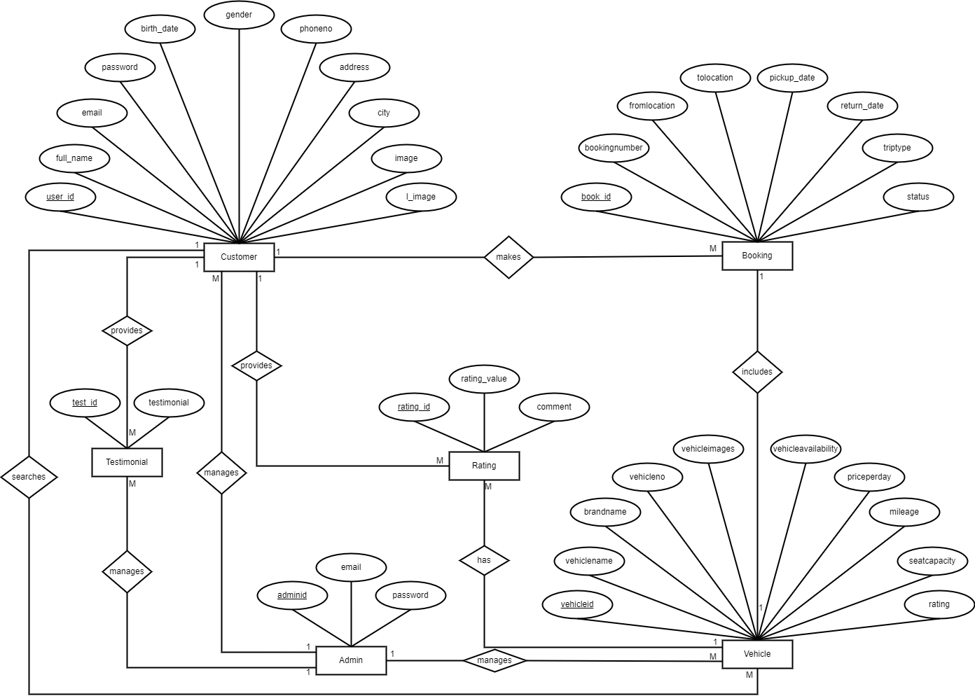
ER Diagram

Slide 11
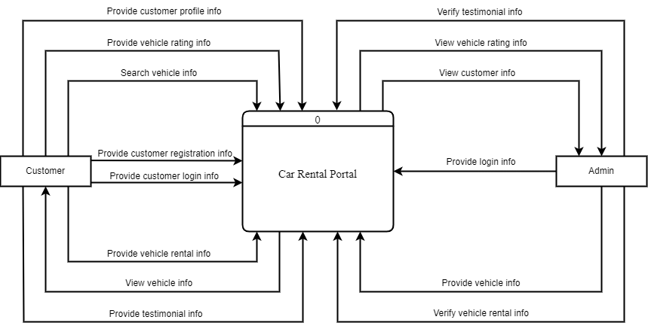
Context Diagram

Slide 12
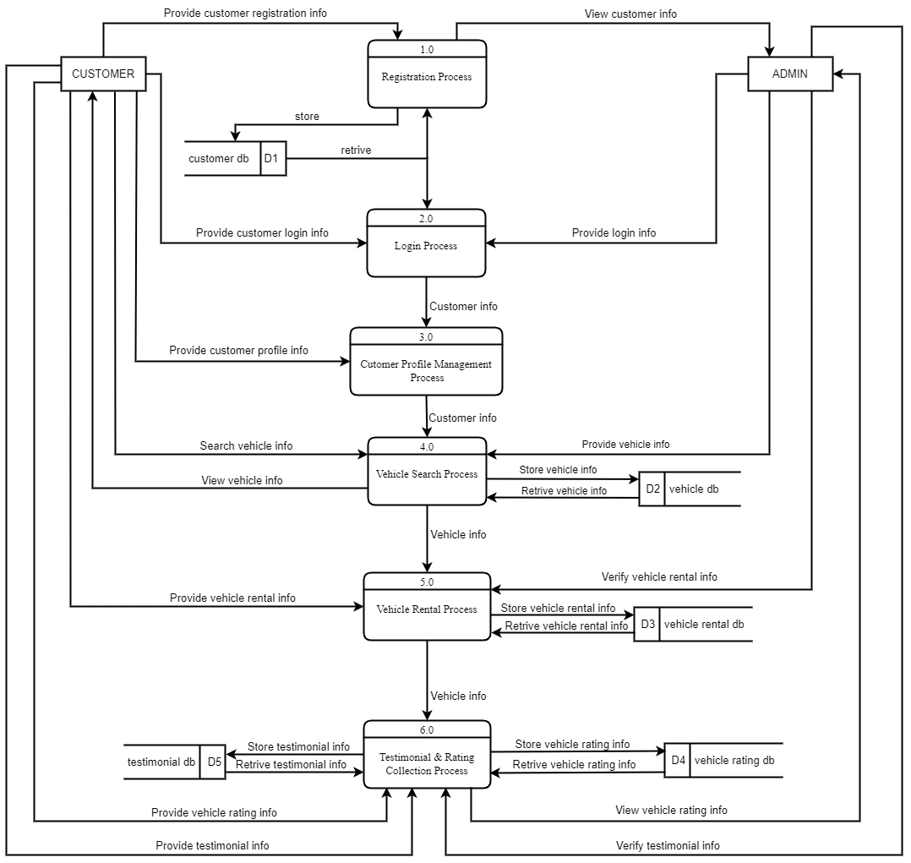
Level 0 DFD

Slide 13
Methodology of System
Waterfall Model
sequential development process that flows like a waterfall through all phases of a project (for example analysis, design, development, and testing), with each phase completely wrapping up before the next phase begins.
Simple and easy to understand and use

Slide 14
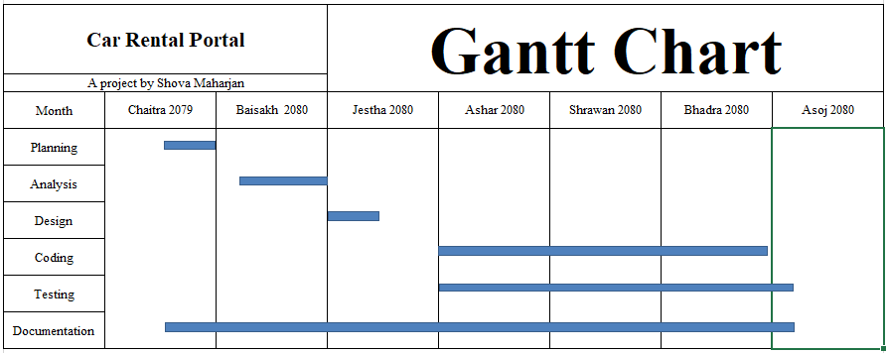
Scheduling

Slide 15
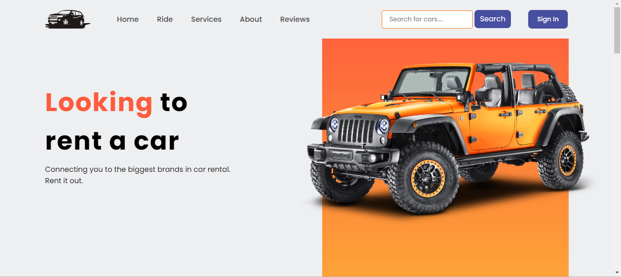
Home page

Slide 16
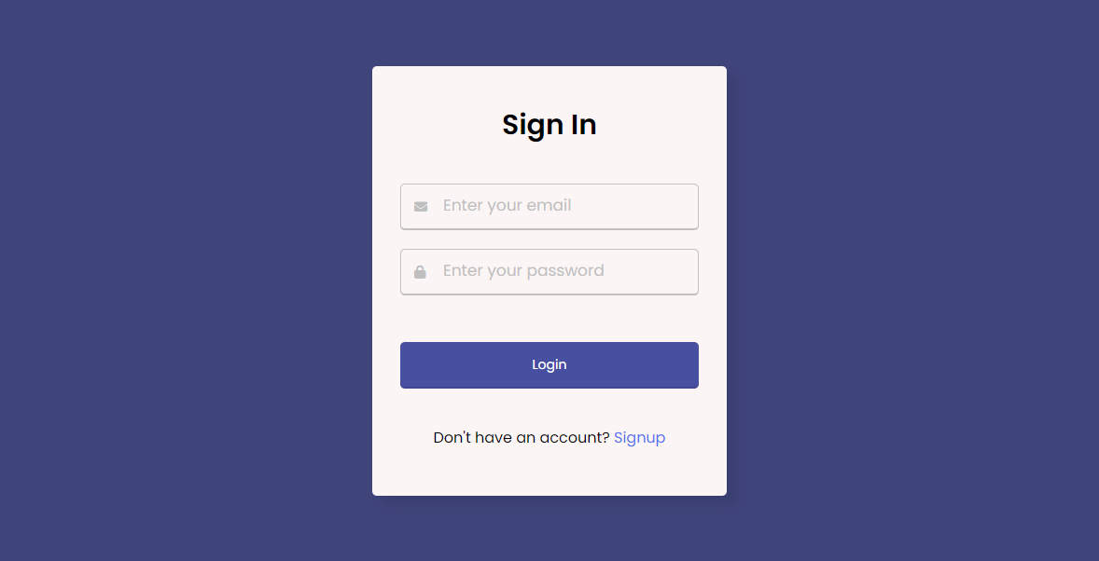
Signin page

Slide 17
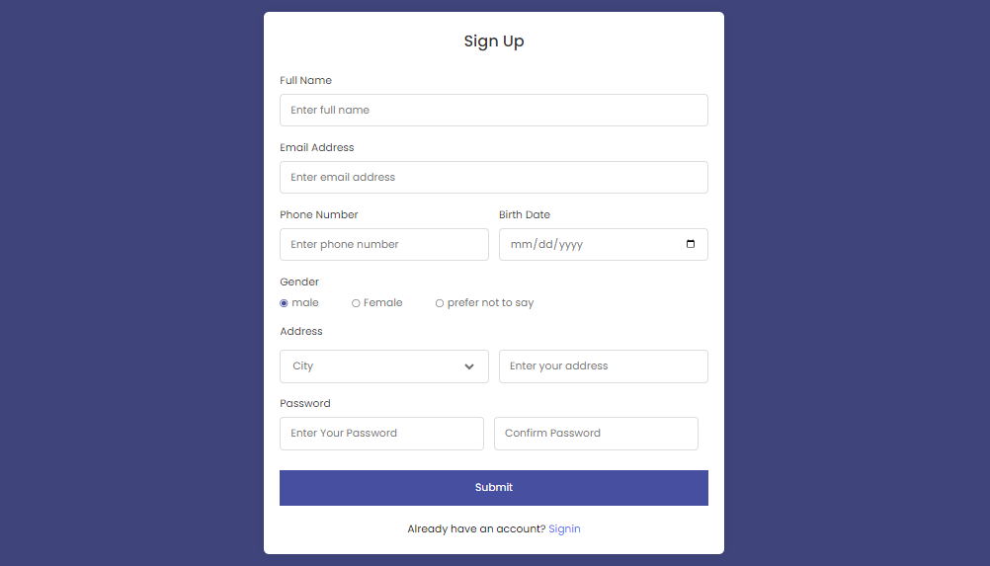
Signup page

Slide 18
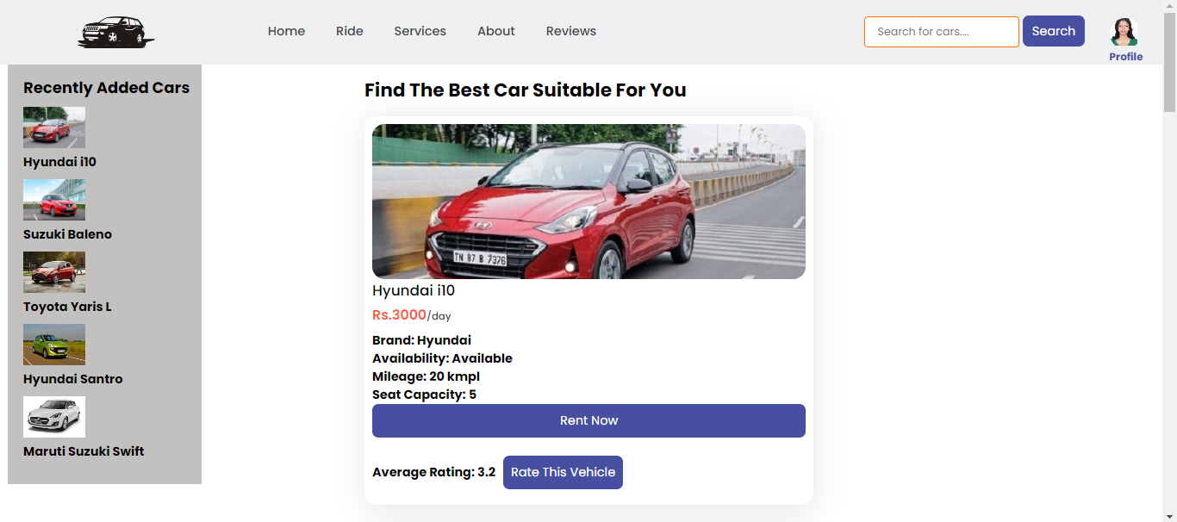
Service page

Slide 19
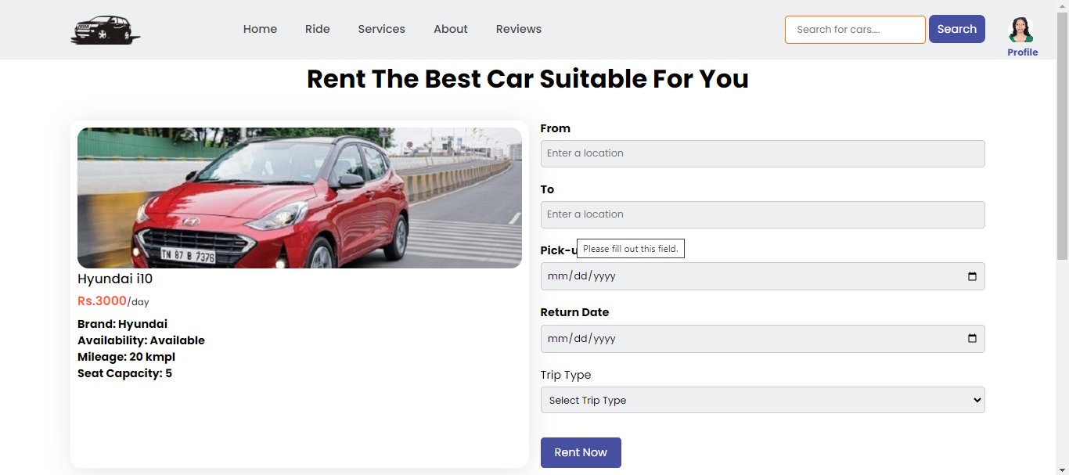
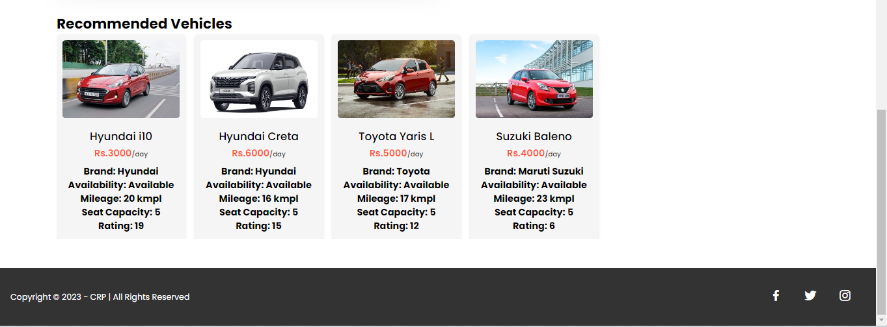
Rent page

Slide 20
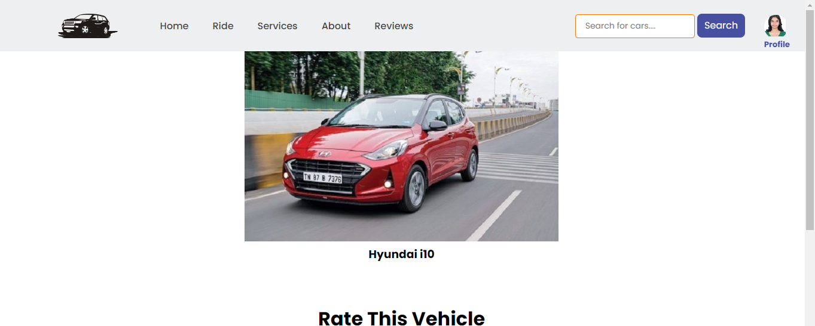

Rate page

Slide 21
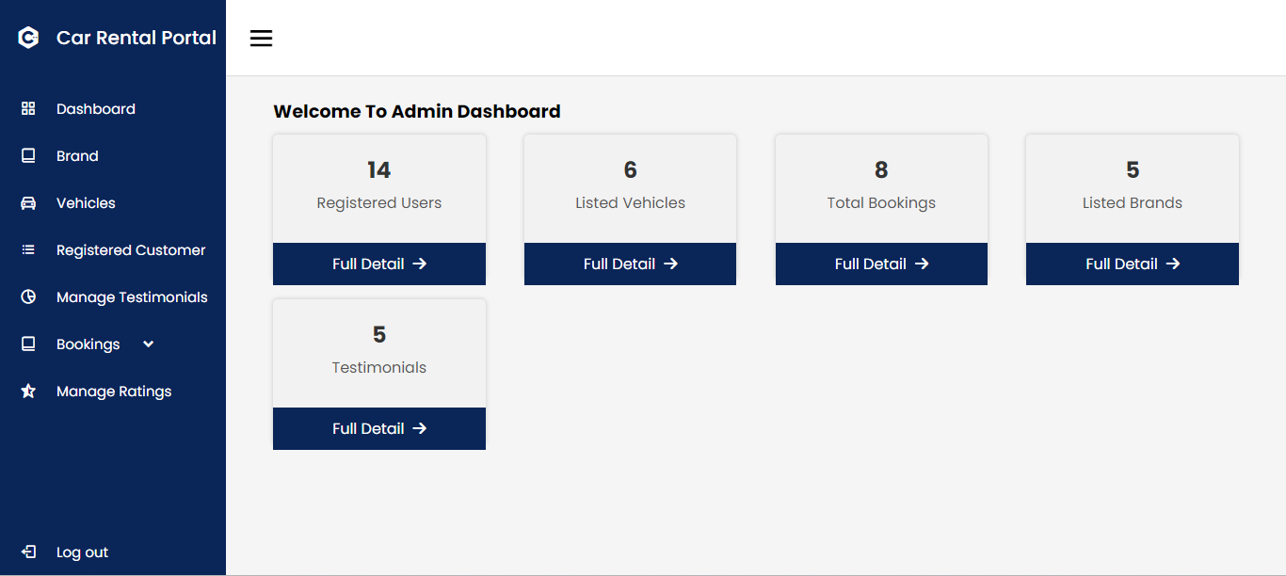
Admin dashboard Page

Slide 22
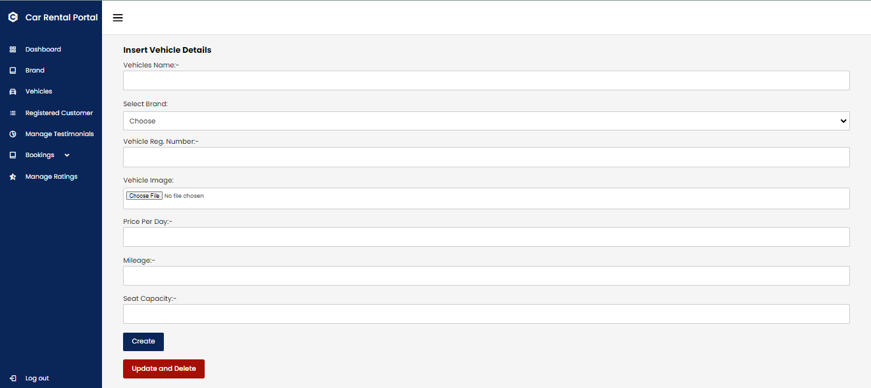
Manage vehicle page

Slide 23
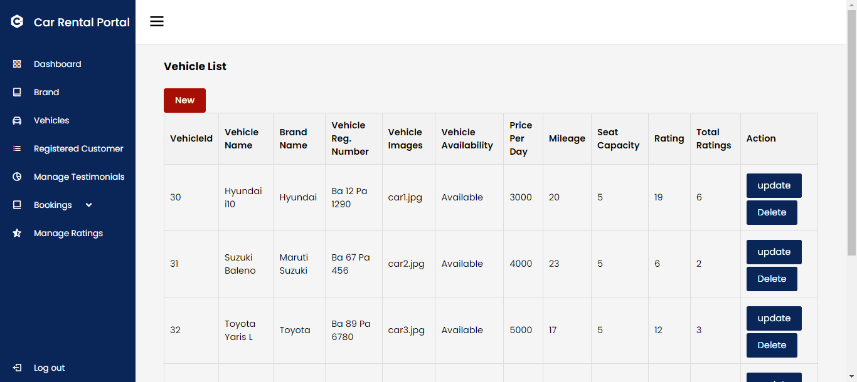

Slide 24
Conclusion
A car rental portal will provide a convenient and efficient way for users to book vehicles for their travel needs.
The portal will be user-friendly that allows users to easily search for available vehicles, make bookings, and share their rental experience.

Slide 25
References
Somerville, Software Engineering, 10th ed. London: Pearson Education Limited, 2016.
Silberschatz, H. Korth and S. Sudarshan, DATABASE SYSTEM CONCEPTS, 6th ed. New York: McGraw-Hill, 2011, pp. 39-55, 259-321.
P. Deitel and H. Deitel, Internet & WorldWideWeb HOW TO PROGRAM, 4th ed. New Jersey: Pearson Education, Inc., 2008.
Draw.io, “Flowchart Maker & Online Diagram Software,” app.diagrams.net, 2023. https://app.diagrams.net/
Khojnu search. Available at: https://www.khojnu.com/
"Project Report on Car Rental System," [Online]. Available: https://www.freeprojectz.com/project-report/1743.
"Car Rental Management System," [Online]. Available: https://www.researchgate.net/publication/353174644_Car_Rental_System

Slide 26
Thank You!
Any Query?

