Slide 1
Information gathering tools
There are no standard rules – but
Information must be acquired accurately, methodically, under the right conditions and with minimum interruption to user personnel.

Slide 2
There are four basic tools for information gathering
Four tools:
1. Review of literature, procedures and forms.
2. On-site observation
3. Interviews
4. Questionnaires

Slide 3
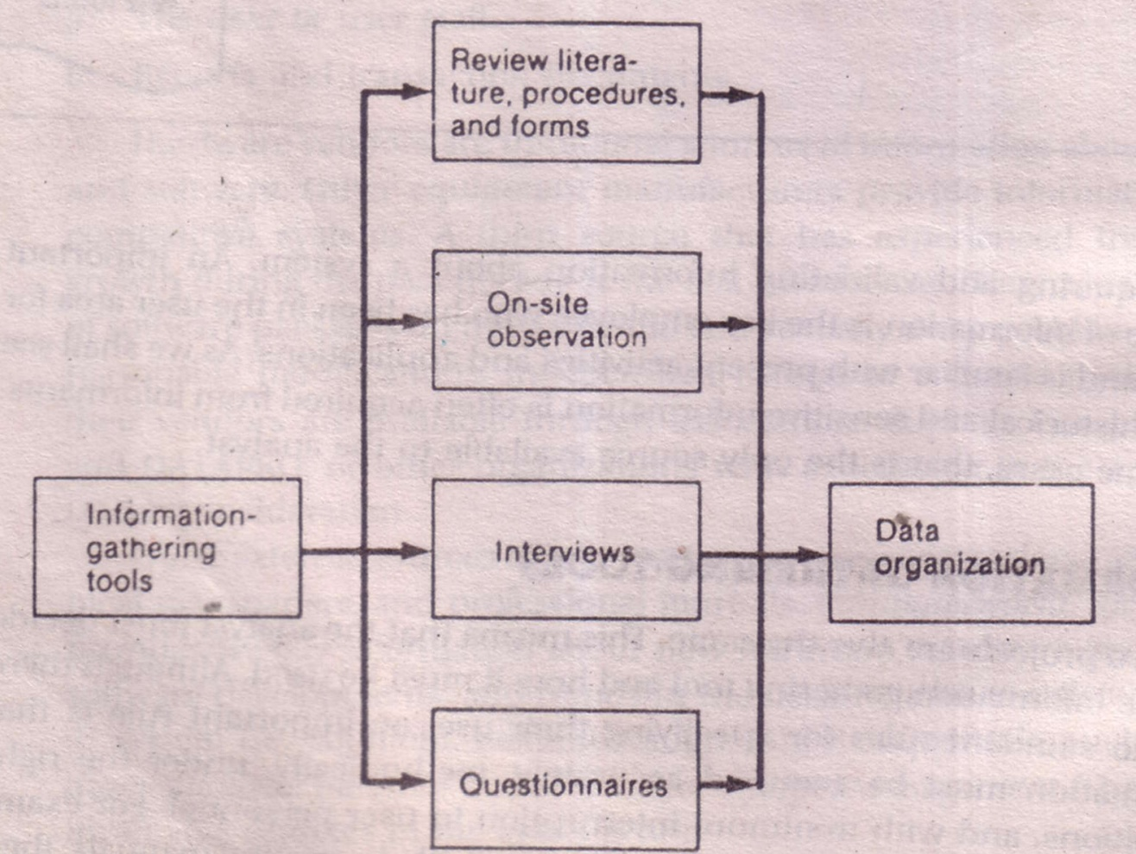
Information gathering methods

Slide 4
Review of literature, procedures and forms
Very few system problems are unique.
A search of the literature through professional references and procedures manuals, textbooks, company studies, government publications or consultant studies may prove invaluable.
Often it is difficult to get certain reports, publications may be expensive and the information may be outdated due to a time lag in publication.

Slide 5
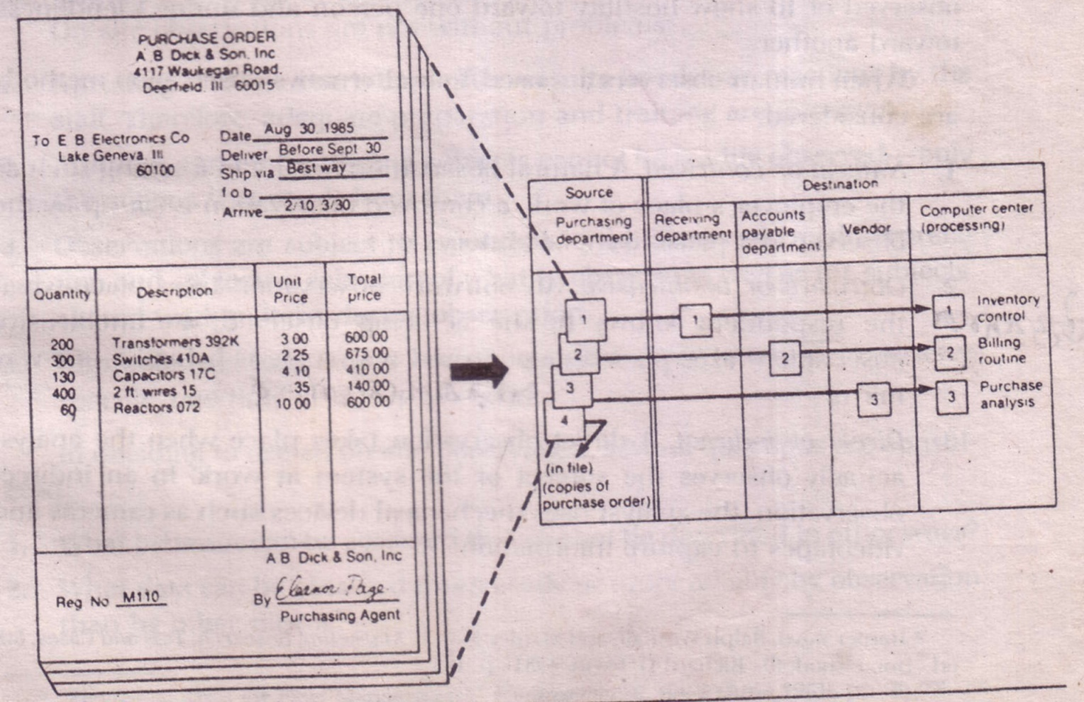
The study of procedures is a close look at existing forms. Printed forms are widely used for capturing and providing information.
Distribution flow of a purchase order in production system

Slide 6
On-site observation
It is a process of recognizing and noting people, objects and occurrences to obtain information.
The major objective of on-site observation is to get close as possible to the real system being studied.
For this reason, it is important that the analyst is knowledgeable about the general makeup and activities of the system.

Slide 7
Interviews
The interview is a face-to-face interpersonal role situation in which a person called the interviewer asks a person being interviewed questions designed to gather information about a problem area.
The interview is the oldest and most often used device for gathering information in systems work.
If the interview is considered a requirement, the interviewer might gain the respondents time and attention, but cannot be certain of the accuracy of the information.

Slide 8
Advantages of interview
There are four primary advantages of the interview:
1. its flexibility explore what question to ask or how to formulate questions
2. evaluate the validity of the information gathered.
3. Effective technique for eliciting information about complex subjects
4. Many people enjoy being interviewed regardless of the subject.

Slide 9
The art of interview
In accordance of experience, interviewing is an art. Most people develop expertise through experience.
It consists of creating a permissive situation in which the answers offered are reliable.
Respondents opinions are offered with no fear of being criticized by others.
Create a friendly atmosphere
Asking questions properly, obtaining reliable responses and recording them accurately and completely.

Slide 10
Guides to a successful interview
Interviewing should be approached as logically as programming.
The following steps should be taken:
1. Set the stage for the interview
2. Establish rapport
3. Phrase questions clearly and concisely
4. Be a good listener; avoid arguments
5. Evaluate the outcome of the interview.

Slide 11
Questionnaires
It is a term used for almost any tool that has questions to which individuals respond.
It is usually associated with self-administered tools with items of the closed or fixed alternative type.

Slide 12
Advantages of questionnaire
It offers the following advantages:
1. it is economical and requires less skill to administer than the interview.
2. it can be administered to large number of individuals simultaneously.
3. it unsure uniformity of the questions.
4. the respondents feel greater confidence in the anonymity of a questionnaire.
5. it places less pressure on subjects for immediate responses.

Slide 13
Types of interviews and Questionnaires
They vary widely in form and structure.
Difference?
Interviews range from the highly unstructured. But
Questionnaires are specified in advance – highly structured.
So they many classified into two categories:
1. The unstructured alternative
2. The structured alternative

Slide 14
The unstructured alternative
It’s a relatively nondirective information gathering technique.
It allows respondents to answer questions freely in their own works.
The responses are spontaneous rather than forced.
Analyst should encourage the respondent to talk freely.

Slide 15
The structured alternative
The questions are presented with exactly the same wording and in the same order to all subjects.
Standardized questions improve the reliability of the responses.
Questions may be either closed or open-ended.

Slide 16
Types of closed questions
Five types:
1. Fill-in-the-blanks: Request specific information.
2. Yes/NO type: Offer two answers.
3. Ranking scales: Ask to rank a list of items in order of importance or preference.
4. Multiple-choice: Offer specific answer choices.
5. Rating scales: Extension of the multiple-choice. Offered a range of responses along a single dimension.

Slide 17
Advantages and limitations of open-ended and closed questions
Types | Advantages | Limitations
Open-ended | Ideal in exploratory situations where new ideas and relationships are sought | Difficulty of interpreting the subjective answers
 |  | Potential analyst bias in interpreting the data
 |  | Time –consuming tabulation
Closed | Quick to analyze | Typically most costly to prepare
 | More appropriate for securing factual information
 | Answers are given in a frame of reference

Slide 18
Advantage and drawbacks of structured and unstructured interview
Types | Advantages | Drawbacks
structured | 1. Easy to administer and evaluate due to standardization | 1. High initial preparation cost
 | 2. Requires limited training | 2. Standardization of questions tends to reduce spontaneity
 | 3. Easy to train new staff | 3. Mechanizes interviewing which makes it impractical for all interview settings
unstructured | 1. Provides for greater creativity and spontaneity in interviewing | 1. More information of questionable use in gathered
 | 2. Facilitates deeper understanding of the feelings and standing of the interviewee | 2. Takes more time to conduct-costly
 | 3. Offers greater flexibility in conducting an overall interview | 3. Requires extensive training and experience for effective results
07/06/2011
Lecture11 MHKABIR

Slide 19
Procedure for questionnaire construction
Six step:
1. Decide what data should be collected
2. Decide what types of questionnaire
3. Outline the topics for the questionnaire
4. Edit the questionnaire for technical defects
5. Pretest the questionnaire
6. Do a final editing

