Slide 1
GAS ALLOCATION & REGIONAL YIELD
Building GARY
A least-cost model of the Eastern Australian gas market — built with an AI coding assistant
Eastern Australian gas market · 2025–2050 · nodal linear program
Presentation · July 2026

Slide 2
THE MODEL
What GARY is
A nodal, least-cost optimisation of the Eastern Australian gas market that decides — for every day of every year to 2050 — where gas is produced, how it flows through the pipeline network, and what it costs at each hub.
14 nodes
365 days × 26 yrs
27 scenarios
Producers, demand hubs, LNG trains and storages from Queensland to Tasmania
Daily resolution, solved year-by-year from 2025 to 2050
AEMO demand future × winter × LNG, pre-solved for instant exploration
It answers questions a spreadsheet can't: if winter demand in the south-east is lower, how much does the winter price spike shrink? If demand runs hot, which pipeline fills the gap — and what new infrastructure must be built?
Python + Pyomo · HiGHS solver · interactive Dash dashboard
2

Slide 3
THE MODEL
How the optimisation works
Minimise total system cost
Decision variables the solver sets
— Production cost
— Pipeline transport cost
— Storage injection / withdrawal
— Network expansion capital
— Penalty on any shortage or curtailment
— Production: at each supply source, each day
— Flow: along every pipeline arc
— Storage: inventory, injection, withdrawal
— Curtailment: gas-power & industrial load shed
— Build: which network expansions to fund
— Prices: recovered as nodal shadow prices (duals)
Subject to physical limits
— Supply & pipeline capacity caps
— Storage continuity day-to-day
— Nodal mass balance — supply in = demand out
— Binary build decisions for expansions
3

Slide 4
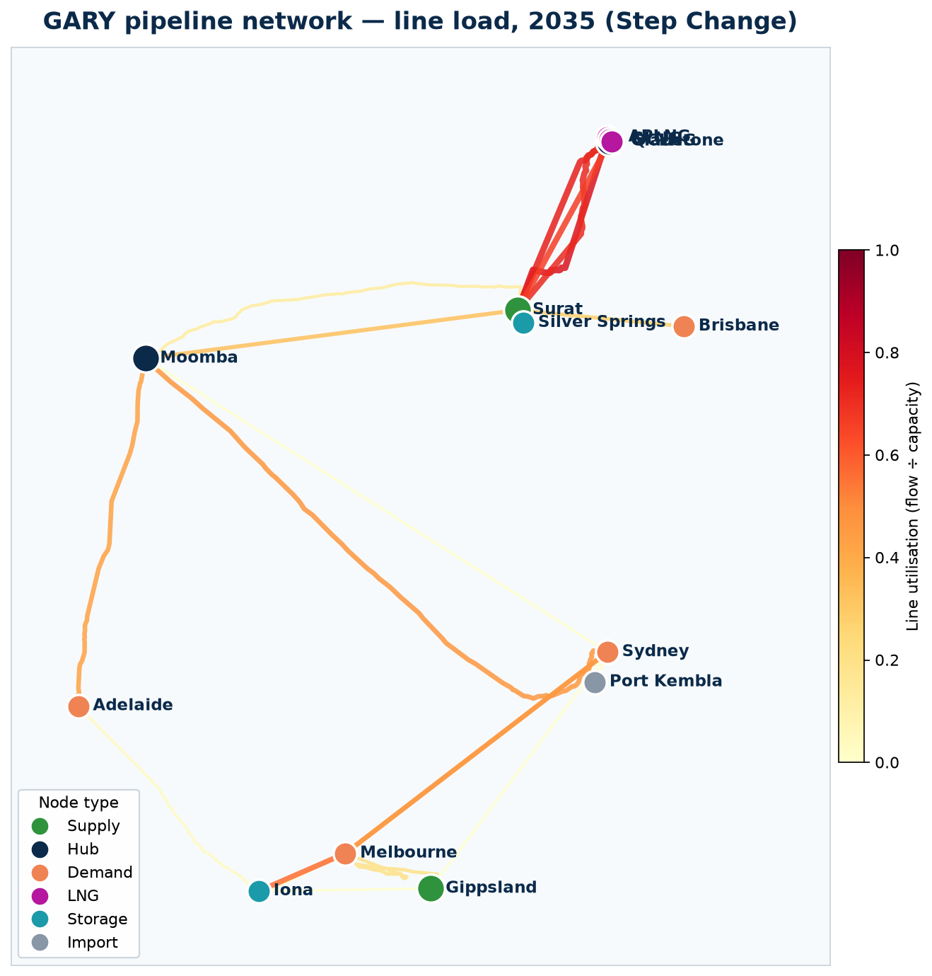
THE MODEL
The network GARY optimises
Reading the map
— Real pipeline routes traced from OpenStreetMap geometry
— Nodes coloured by role — supply, hub, demand, LNG, storage, import
— Line thickness & colour = utilisation (flow ÷ capacity) in 2035
— Queensland supply → LNG export; southern lines carry winter demand
4

Slide 5
THE DATA
Grounded in AEMO's official forecast
— Central case re-based on the AEMO 2026 GSOO: the gas-regionalised forecast the final 2026 ISP defers to for gas demand
— Every demand sector rebuilt: gas-power, industrial, residential/commercial and LNG
— Annual levels anchored to GSOO: while the empirical daily shape — winter peaks, facility detail — is preserved
— Fully deterministic & reproducible: arbitrary growth-rate assumptions removed
One button rebuilds everything
— Extractors read the GSOO workbooks into clean CSVs
— "Regenerate All Data" rebuilds every input from source
— "Run All Scenarios" re-solves all 27 cases
— Clone → click two buttons → full model stands up
Only source inputs are version-controlled; generated data is rebuilt, never committed.
5

Slide 6
SCENARIOS
Three AEMO futures, stress-tested
The central axis is AEMO's three 2026 GSOO demand scenarios; each is then stress-tested across winter and LNG demand.
Step Change
Accelerated
Slower Growth
CENTRAL CASE
FASTEST TRANSITION
LAGGARD CASE
Rapid, coordinated energy transition — the reference future
Strongest electrification & decarbonisation; gas backed out sooner
Weaker growth and a slower transition; gas lingers longer
Stress levers applied to each
— Winter demand — Low / Medium / High: severity of the southern winter peak
— LNG demand — Low / Medium / High: Gladstone export pull
— ADGSM on / off: the domestic gas security (export-trigger) mechanism
6

Slide 7
THE PROCESS
How it was built — with an AI assistant
01
02
03
04
Describe intent
AI drafts & wires
Run · inspect · correct
Automate & document
Plain-English goals — "re-base demand on the GSOO, keep the daily shape" — not line-by-line code
The assistant wrote the extractors, LP model, scenario batch and dashboard, and connected them
Solve, read real outputs together, catch issues (e.g. Yarwun misclassified), refine in the loop
One-button regeneration, HiGHS solver swap, generated data gitignored, docs auto-written
The workflow was conversational and iterative — I stayed the domain expert deciding what was right; the AI did the engineering and kept the whole pipeline reproducible.
7

Slide 8
THE PROCESS
What the AI did vs. what I did
AI assistant
I stayed in control of
— Wrote the Pyomo LP formulation
— Built GSOO extractors & demand builders
— Coded the 27-scenario batch solver
— Built the Dash dashboard & network map
— Swapped CBC → HiGHS for speed
— Set up regeneration & git hygiene
— Wrote the technical documentation
— Which forecast is authoritative (GSOO)
— Market structure & regional definitions
— Sanity-checking every result
— Catching domain errors (Yarwun reclass)
— Scenario design & the questions asked
— What to trust and what to ship
8

Slide 9
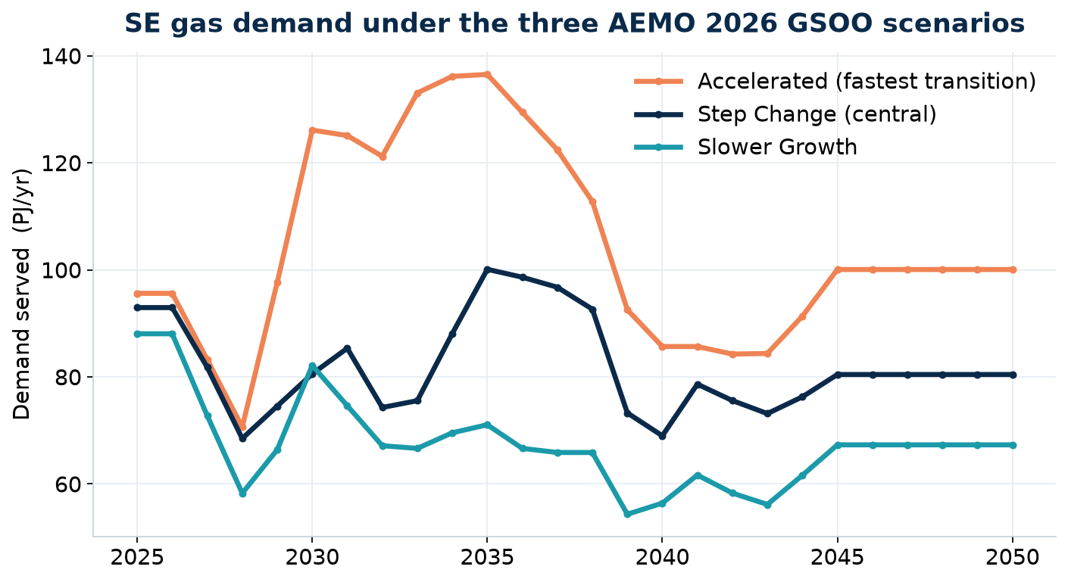
KEY OUTPUT
Demand diverges across the AEMO futures
The finding
— All three futures ease SE gas demand as electrification bites
— Accelerated backs gas out fastest; Slower Growth holds it up longest
— The spread is the planning risk — the same network must serve all three
— Sets the demand backdrop for every price & build result
9

Slide 10
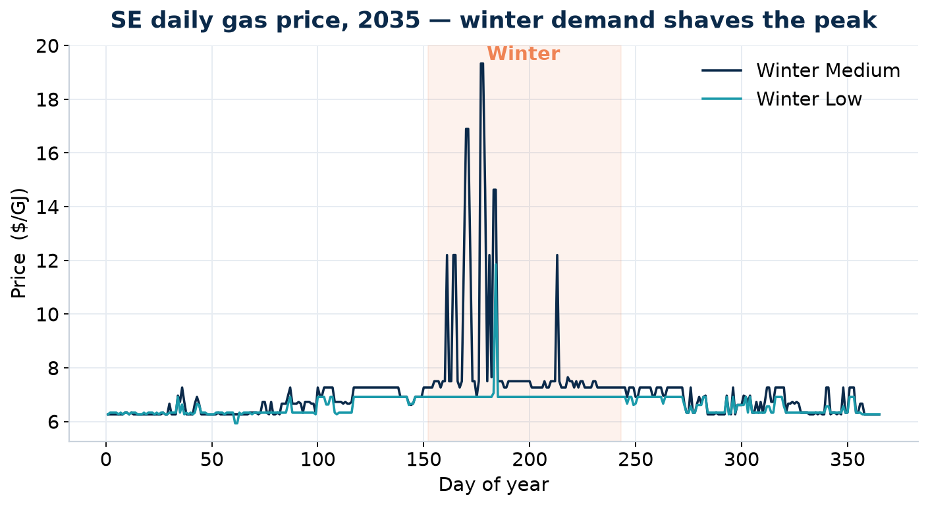
KEY OUTPUT
Lower SE winter demand shaves the price spike
The finding
— Under Step Change, SE winter days spike toward $19/GJ (2035)
— A Low winter-demand outlook flattens those peaks to ~$7/GJ
— Impact concentrates in winter — off-peak days are unchanged
— Winter demand, not annual demand, drives SE price risk
10

Slide 11
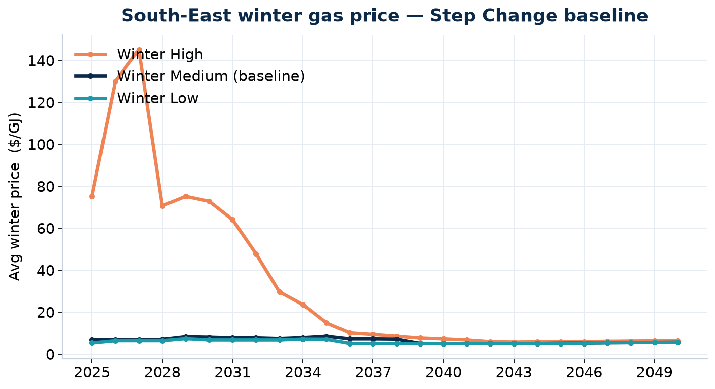
KEY OUTPUT
Winter demand is the dominant early-2030s price driver
Reading it
— A High winter outlook drives extreme SE prices while supply is tight (to ~$145/GJ)
— Prices converge from the late-2030s as new infrastructure arrives
— Low vs Medium track closely — the tail risk sits in the High case
— Shows where scarcity, not cost, sets the price
11

Slide 12
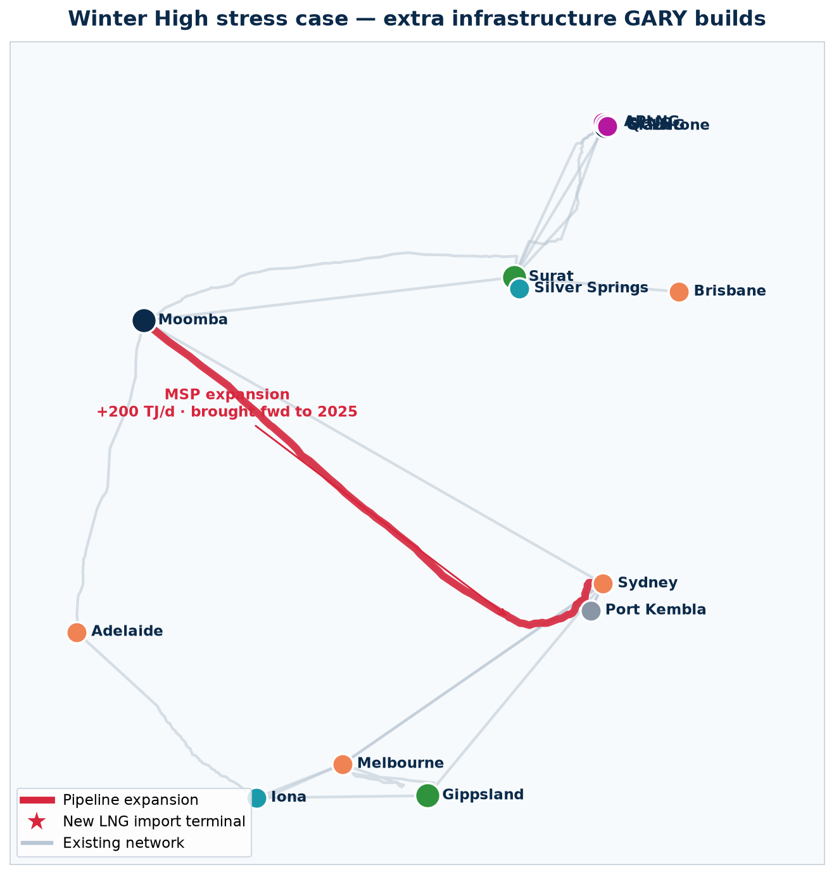
KEY OUTPUT
Winter High forces new infrastructure
The scenario
Winter High — the coldest-winter case: gas-power and heating load in the south-east spike hardest on winter days, on top of the Step Change demand future.
What GARY builds that the Low case never needs
— New Port Kembla LNG import terminal: 500 TJ/d, $250M, online 2028 — imported gas to cover the southern winter peak
— MSP expansion brought forward: +200 TJ/d on Moomba–Sydney, pulled from 2035 to 2025 to move gas south faster
12

Slide 13
Takeaways
A working market model, fast
A full nodal LP of the Eastern gas market — 27 scenarios to 2050 — stood up conversationally.
AI did the engineering, I owned the judgement
Domain expertise steered every decision; the AI wrote and wired the code and kept it reproducible.
Grounded in AEMO's GSOO
Anchored to the official forecast; one button rebuilds every input and re-solves every case.
Decision-useful results
Lower SE winter demand shaves the price spike; a High winter forces a new Port Kembla terminal — findings you can act on.
GARY · Gas Allocation and Regional Yield

