Slide 1


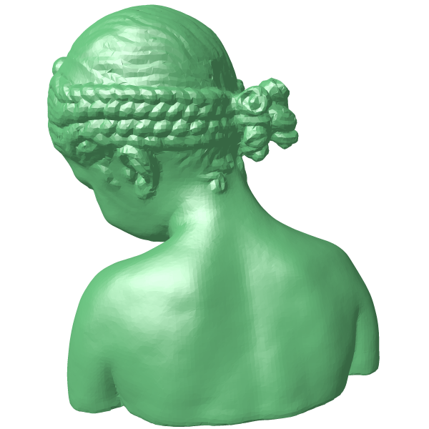
Notes:
https://huggingface.co/blog/gaussian-splatting

