Slide 1
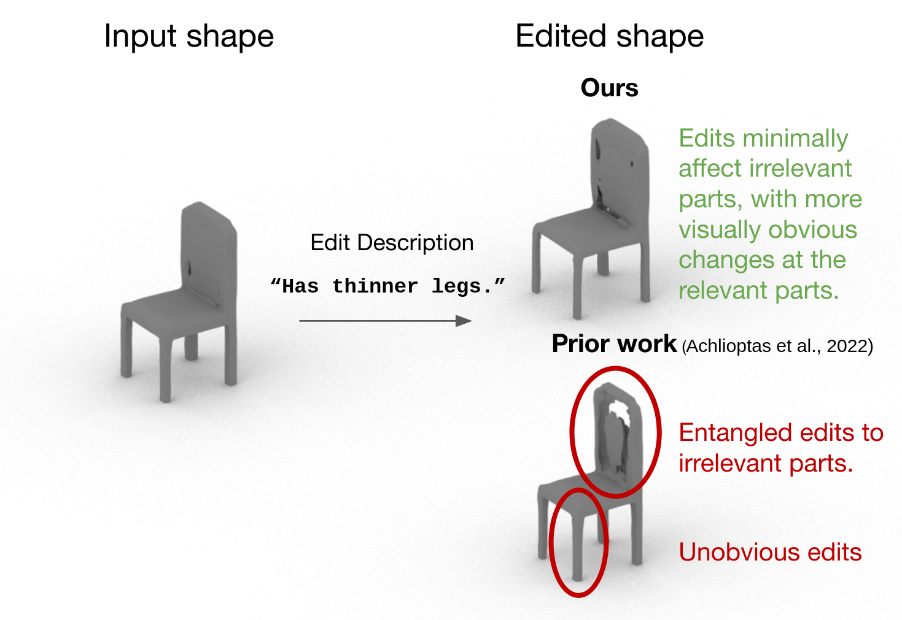
“Has thinner legs.”

