Slide 1
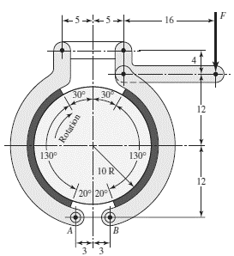
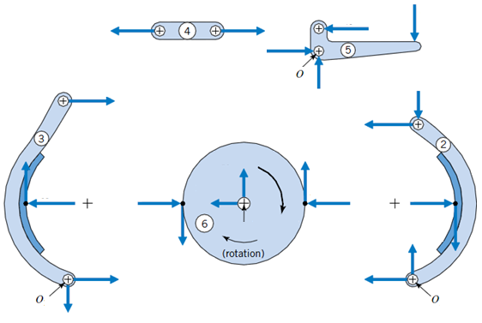
Exercício 13: O freio de sapatas longas apresentado abaixo tem as seguintes caraterísticas: µ=0.3, w=2 cm e pressão máxima de trabalho de 150 KPa. Encontre a força de acionamento F. Todas as unidades apresentadas na Figura estão em cm.
Dados:
• F?
• µ=0.3
• w=2 cm
• pmax=150x10⁶Pa
• Unidades em cm
Unidades em cm
• a=24cm
• by=12cm
• bx=5cm
• c=5cm
• r=10cm

Slide 2
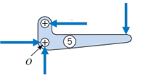



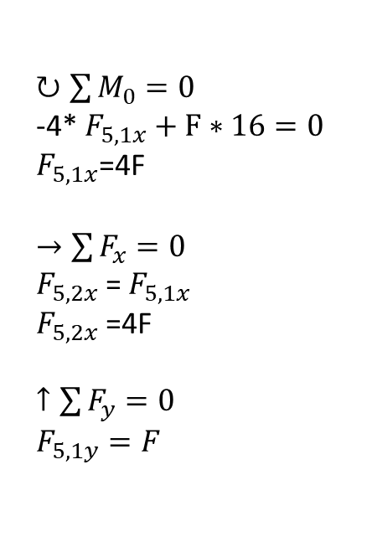

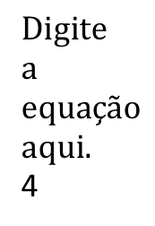
F?
$$F_{5,1x}$$
$$F$$
$$F_{5,1x}$$
$$F_{5,2x}$$
4
$$F_{5,1y}$$
16
$↻\sum{M_{0}}=0$
-4* $F_{5,1x}+F∗16=0$
$F_{5,1x}$=4F
$→\sum{F_{x}}=0$
$F_{5,2x}$= $F_{5,1x}$
$F_{5,2x}$=4F
$↑\sum{F_{y}}=0$
$F_{5,1y}=F$
4

Slide 3


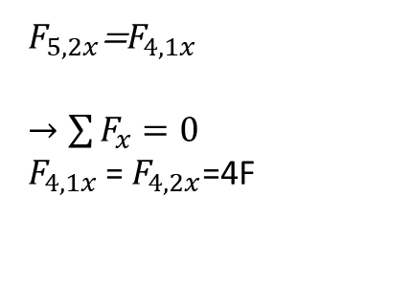

$$F_{4,1x}$$
$$F_{4,2x}$$
$$F_{4,2x}$$
$$F_{5,2x}$$
$$F_{4,1x}$$
$F_{5,2x}$=$F_{4,1x}$
$→\sum{F_{x}}=0$
$F_{4,1x}$= $F_{4,2x}\text{=4}\text{F}$

Slide 4
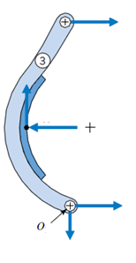

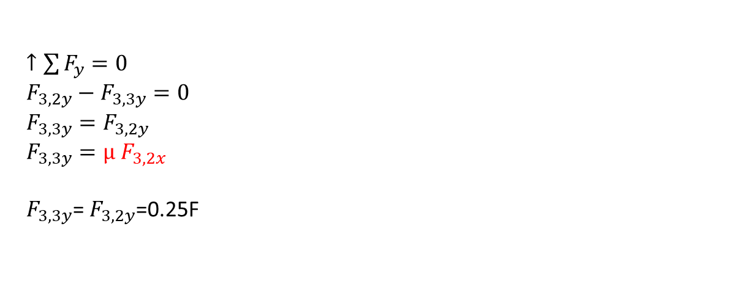
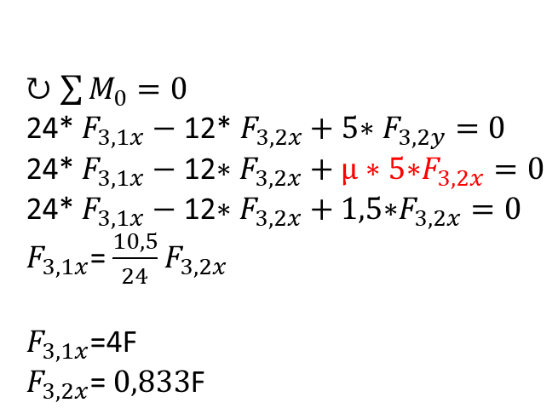
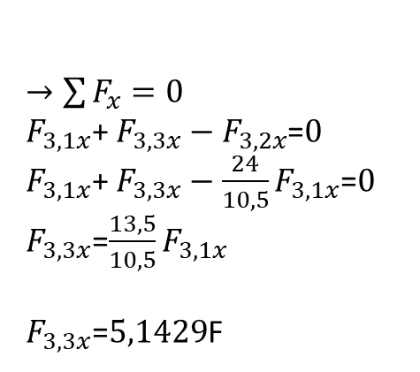
$$F_{3,1x}$$
$$F_{4,2x}$$
$$5$$
$$12$$
$$F_{3,1x}$$
$$F_{3,2y}$$
$$F_{3,2x}$$
$$12$$
$$F_{3,2y}$$
$$F_{3,2x}$$
$$F_{3,3x}$$
$$F_{3,3y}$$
$$F_{3,3x}$$
$$F_{3,3y}$$
$↻\sum{M_{0}}=0$
24* $F_{3,1x}−\text{12}\text{* }F_{3,2x}+5\text{∗ }F_{3,2y}=0$
24* $F_{3,1x}−\text{12}\text{∗ }F_{3,2x}+μ∗5\text{∗}F_{3,2x}=0$
24* $F_{3,1x}−\text{12}\text{∗ }F_{3,2x}+1,5\text{∗}F_{3,2x}=0$
$F_{3,1x}$= $\frac{10,5}{24}F_{3,2x}$
$F_{3,1x}$=4F
$F_{3,2x}$= $0,833$F
$→\sum{F_{x}}=0$
$F_{3,1x}$+ $F_{3,3x}−F_{3,2x}$=$0$
$F_{3,1x}$+ $F_{3,3x}−\frac{24}{10,5}F_{3,1x}$=$0$
$F_{3,3x}$=$\frac{13,5}{10,5}F_{3,1x}$
$F_{3,3x}$=$5,1429$F
$↑\sum{F_{y}}=0$
$F_{3,2y}−F_{3,3y}=0$
$F_{3,3y}=F_{3,2y}$
$F_{3,3y}={μ F}_{3,2x}$
$F_{3,3y}$= $F_{3,2y}$=0.25F

Slide 5
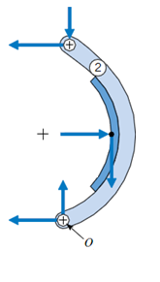
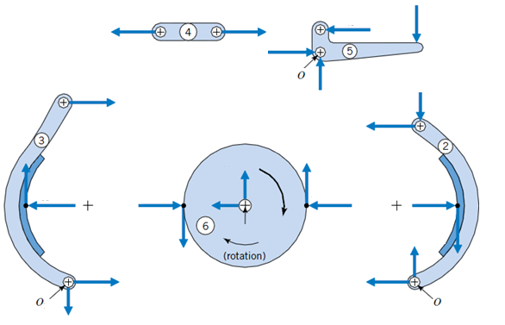












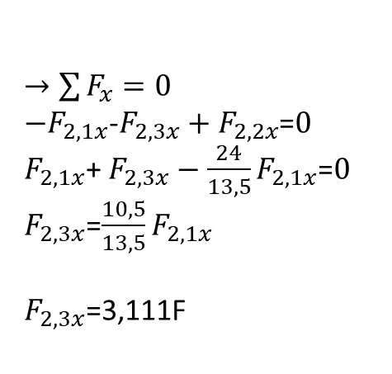



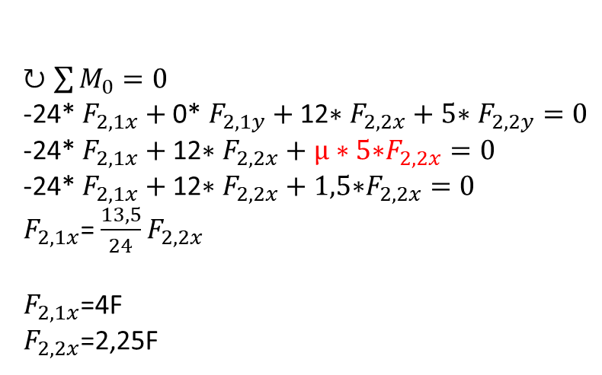



$$F_{2,1y}$$
$$F_{3,2y}$$
$$F_{2,1x}$$
$$5$$
$$F_{5,2x}$$
$$12$$
$$F_{5,1y}$$
$$F_{2,1y}$$
$$F_{2,2x}$$
$$F_{2,1x}$$
$$12$$
$$F_{2,2y}$$
$$F_{2,2x}$$
$$F_{2,3y}$$
$$F_{2,3y}$$
$$F_{2,2y}$$
$$F_{2,3x}$$
$$F_{2,3x}$$
$→\sum{F_{x}}=0$
$−F_{2,1x}$-$F_{2,3x}+F_{2,2x}$=$0$
$F_{2,1x}$+ $F_{2,3x}−\frac{24}{13,5}F_{2,1x}$=$0$
$F_{2,3x}$=$\frac{10,5}{13,5}F_{2,1x}$
$F_{2,3x}$=3,111F
$↑\sum{F_{y}}=0$
$-F_{2,1y}−F_{2,2y}+F_{2,3y}=0$
$F_{2,3y}=F_{2,2y}+F_{2,1y}$
$F_{2,3y}={μ F}_{2,2x}$+ $F_{2,1y}$
$F_{2,1y}$=F
$F_{2,2y}\text{=}\text{0,675}$F
$F_{2,3y}$=0,3*2,25F+F
$F_{2,3y}$=1,675F
$↻\sum{M_{0}}=0$
-24* $F_{2,1x}+\text{0}\text{* }F_{2,1y}+\text{12}\text{∗ }F_{2,2x}+5\text{∗ }F_{2,2y}=0$
-24* $F_{2,1x}+\text{12}\text{∗ }F_{2,2x}+μ∗5\text{∗}F_{2,2x}=0$
-24* $F_{2,1x}+\text{12}\text{∗ }F_{2,2x}+1,5\text{∗}F_{2,2x}=0$
$F_{2,1x}$= $\frac{13,5}{24}F_{2,2x}$
$F_{2,1x}$=4F
$F_{2,2x}$=2,25F

Slide 6
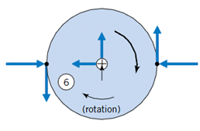




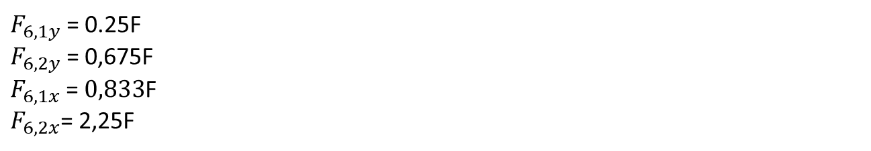

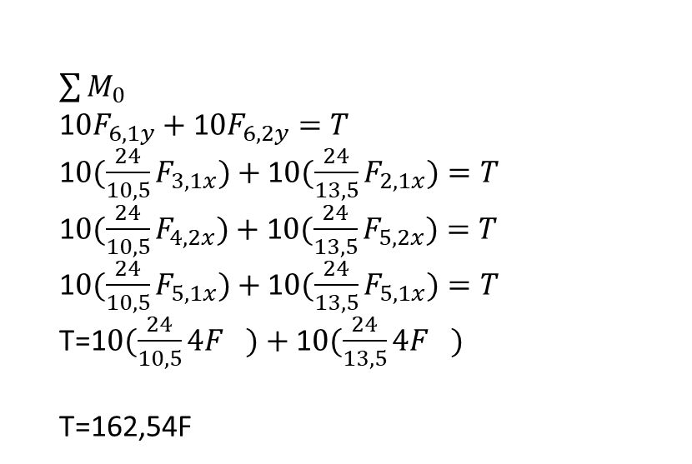


$$F_{3,2y}$$
10
$$F_{6,2y}$$
$$F_{6,1x}$$
$$F_{6,1y}$$
$$F_{6,2x}$$
$$F_{3,2y}$$
$$F_{3,2x}$$
$$F_{2,2x}$$
$$F_{2,2y}$$
$\sum{M_{0}}$
1$0F_{6,1y}+\text{1}0F_{6,2y}=T$
1$0({\frac{24}{10,5}F}_{3,1x})+\text{1}0({\frac{24}{13,5}F}_{2,1x})=T$
1$0({\frac{24}{10,5}F}_{4,2x})+\text{1}0({\frac{24}{13,5}F}_{5,2x})=T$
1$0({\frac{24}{10,5}F}_{5,1x})+\text{1}0({\frac{24}{13,5}F}_{5,1x})=T$
T=1$0({\frac{24}{10,5}4F}_{})+\text{1}0({\frac{24}{13,5}4F}_{})$
T=162,54F
$F_{6,1y}$= 0.25F
$F_{6,2y}$= $\text{0,675}$F
$F_{6,1x}$= $0,833$F
$F_{6,2x}$= 2,25F

