Slide 1
American International University-Bangladesh (AIUB)
Faculty of Engineering (FE) | Department of Electrical and Electronic Engineering (EEE)
Arduino-Based Gas Leakage and Fire Detection System With Prevention and Safety Mechanisms
Course:
Microprocessor and Embedded Systems(COE3104)
Semester:
Spring 2025-2026 | Section: H
Faculty:
DEBRAJ DAS
Group #:
07
Capstone Project Presentation – COE3104 – AIUB

Slide 2
Team Members
01
Md. Murad Hasan
ID: 23-55559-3 | BSc in CSE | AIUB
02
Maruf Ahammed
ID: 23-54391-3 | BSc in CSE | AIUB
03
Abdul Al Bari Kyieash
ID: 23-52851-2 | BSc in CSE | AIUB
04
Md. Mokammel Hossain Remon
ID: 23-54477-3 | BSc in CSE | AIUB
05
Md Hridoy Mia
ID: 23-51001-1| BSc in CSE | AIUB
2

Slide 3
Introduction & Problem Statement
Gas Leakage Risk
77.7%
Gas leaks in homes, restaurants & labs cause explosions, fire, and loss of life.
Concerned about gas
leakage hazards
Delayed Detection
Conventional systems are expensive and often inaccessible to low-income households.
70.4%
Do NOT use any
detection device
Market Gap
70.4% of surveyed households use NO gas or fire detection device at all.
42.6%
Our Solution
Willing to pay
under 1500 BDT
A low-cost, real-time Arduino-based detector with automatic ventilation & shutoff.
3

Slide 4
Motivation & Societal Relevance
Frequent Accidents
Affordability Crisis
Domestic gas incidents are common in urban and semi-urban areas of Bangladesh due to negligence and lack of safety devices.
42.6% of users can only afford devices under 1500 BDT - far below most commercial detectors, creating a design constraint.
Immediate Alert Need
Automation Impact
38.9% of users prioritize a loud buzzer alert over validating our local-first design approach.
Embedded systems with servo-motor gas shutoff and exhaust fan activation can actively prevent hazard escalation without human action.
4

Slide 5
Literature Review
Recent research (2022–2025) on embedded safety systems was reviewed to identify trends and gaps.
Identified Trends
Research Gaps Addressed
✔
Arduino & IoT adoption growing rapidly for gas/flame safety monitoring.
✖
Most systems are expensive and not accessible to common households.
✔
Dual-sensor (gas + flame) architecture improves hazard accuracy.
✖
Many rely on internet connectivity — unreliable in emergencies.
✔
MQ-series sensors validated as effective for combustible gas detection.
✖
Few include automated gas shutoff and ventilation as combined response.
✔
Edge-based processing reduces latency vs cloud-dependent systems.
✖
False alarm rates remain high without proper calibration strategies.
5

Slide 6
Literature Review — Comparative Summary
Citation | Technology Focus | Key Contribution
[1] Mustofa (2025) | NodeMCU, MQ-6, Blynk IoT | IoT system with 9.52% error; 500m smartphone alert range.
[2] Ghasemi et al. (2025) | Dual-Sensor VOC/Pellistor, BLE, LoRa | Reliability testing; dual-sensor strategy for power optimization.
[3] Baballe et al. (2022) | ESP Controller, MQ-5, Email/App | Fast messaging emphasis; mobile notification reliability.
[4] Alao et al. (2024) | ESP32, MQ-2, Flame, Servo Motor | Integrated sensors with servo motor for automatic gas shutoff.
[5] Arfianto et al. (2025) | Arduino Nano 33 BLE, TinyML Edge | Edge processing; reduced latency and power consumption.
Our system addresses gaps: affordable, local-alert-first, with automatic ventilation AND gas shutoff — all in one device.
6

Slide 7
Project Objectives
Main Aim
To design and implement a low-cost, Arduino-based embedded safety system that detects gas leakage and flame hazards in real time, and automatically activates ventilation and gas supply shutoff to prevent accidents.
①
Design a real-time gas & flame detection system using Arduino hardware with MQ-2 and flame sensor.
③
Implement automatic safety mechanisms: exhaust fan activation and servo-motor gas supply shutoff.
②
Generate immediate audio-visual alerts (buzzer, LED) and display system status on a 16×2 LCD.
④
Evaluate the system through experimental testing and validate against numerical simulation results.
7

Slide 8
System Components
Arduino Uno R3
MQ-2 Gas Sensor
Central microcontroller / processing unit
1 pc
Detects combustible gases (butane, LPG, smoke)
1 pc
Flame Sensor Module
Active Buzzer
1 pc
Immediate audio alert on hazard detection
1 pc
Detects infrared radiation from fire sources
Servo Motor
16×2 LCD Display
1 pc
1 pc
Automatically closes gas cylinder valve
Real-time status messages (SAFE / GAS / FLAME)
LED + Resistors
DC Exhaust Fan
Visual flashing alert indicator
3+4 pc
Ventilation activation via MOSFET switching
1 pc
Mosfet
Control Fan Power
1 pc
ESP-01 ESP8266
Send Data Over WiFi
1 pc
8

Slide 9
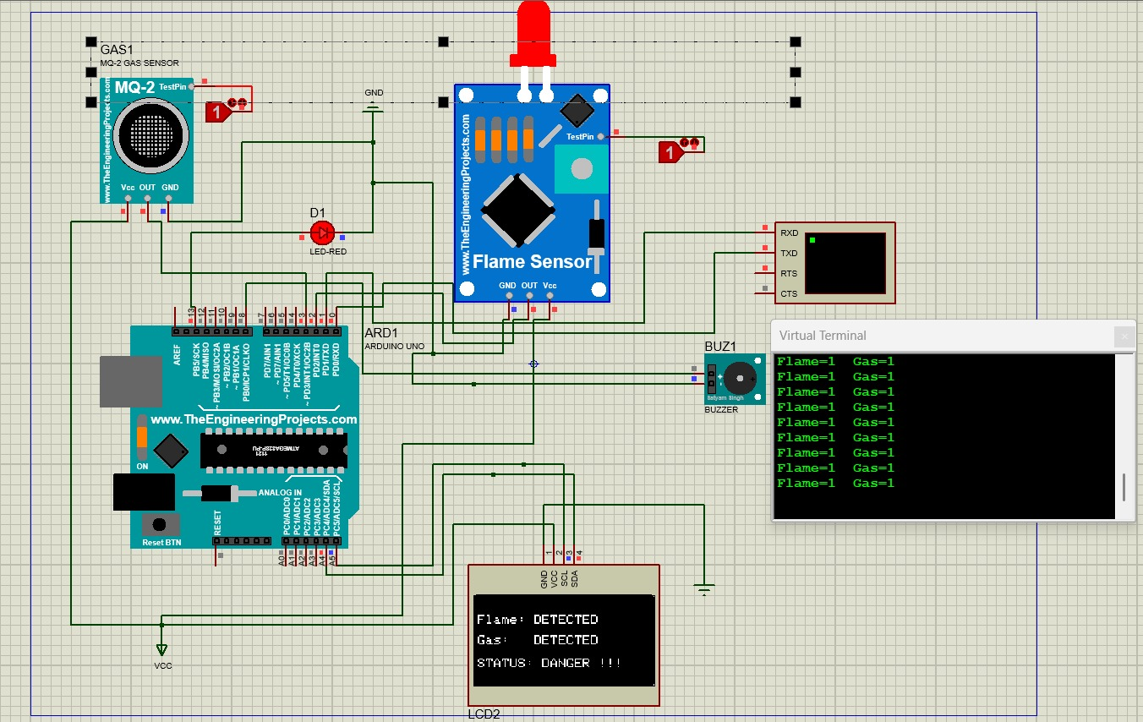
Project Simulation

Slide 10
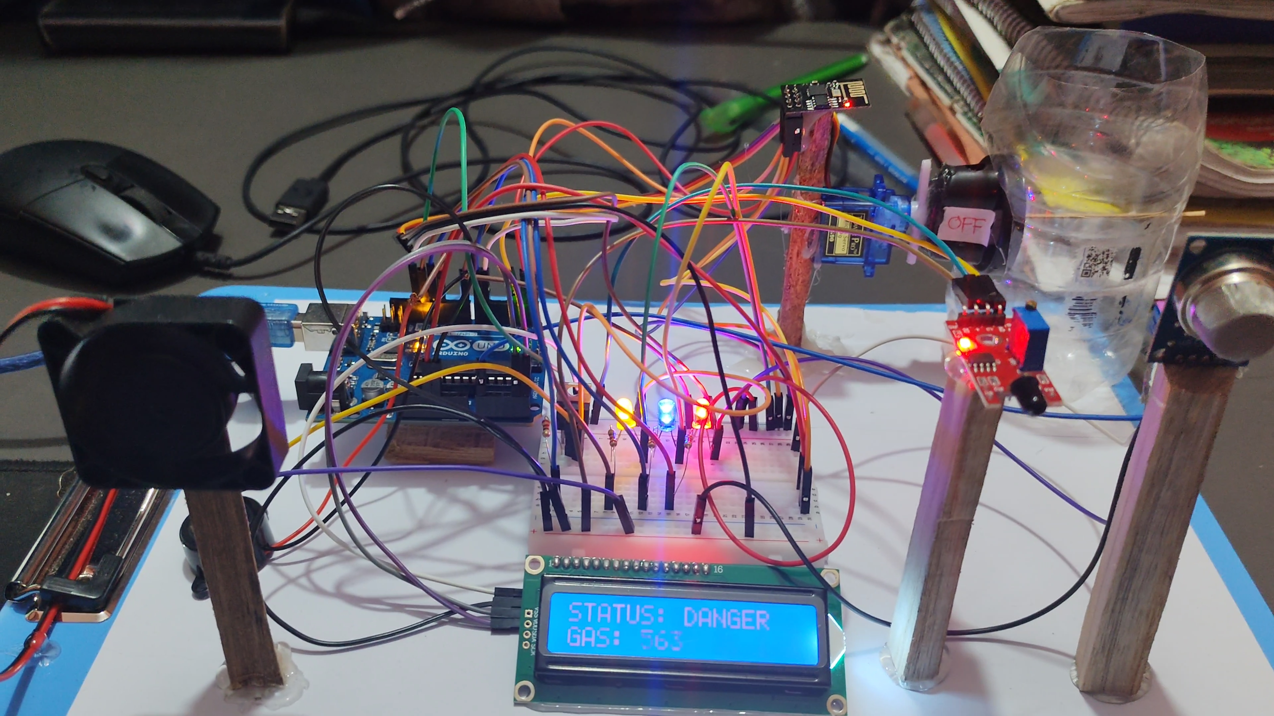
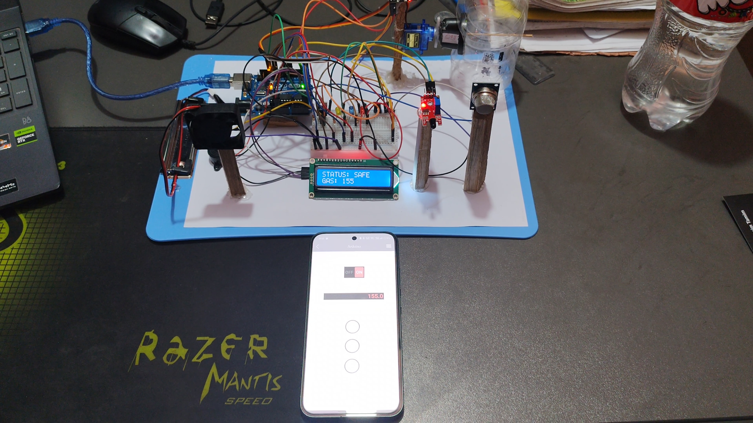
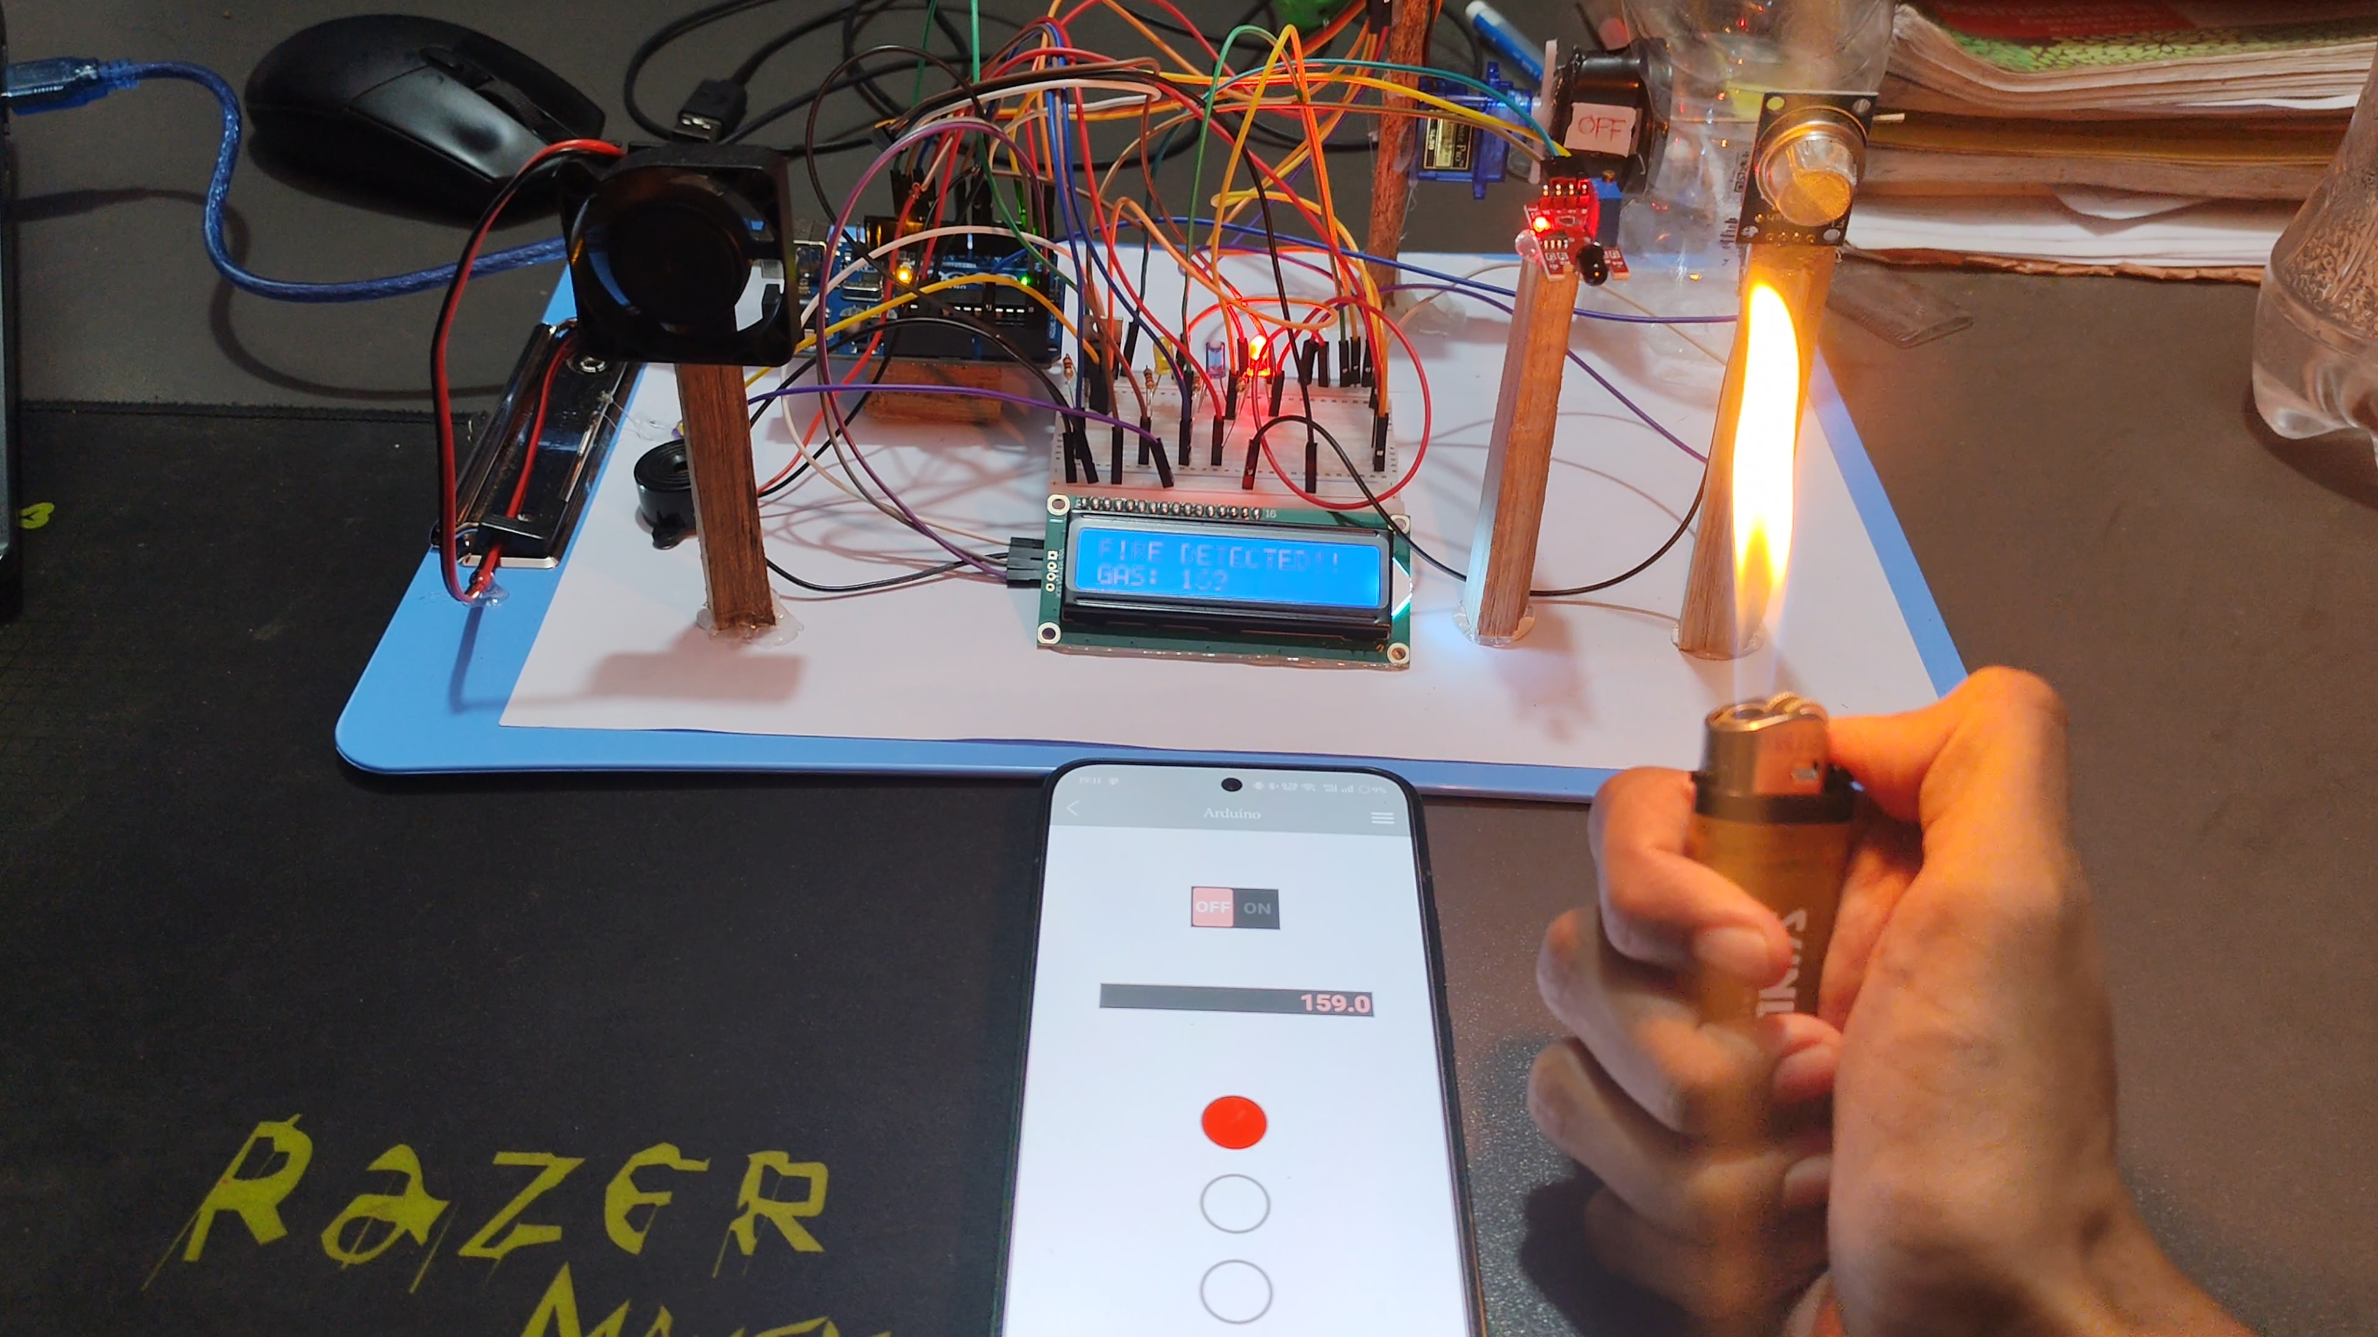
Experimental Results Under Different Conditions
Figure 2: Flame Detection and Alert Activation
Figure 3: Gas Leakage Detection with Fan Activation and Servo Shutoff
Figure 1: System in Normal Condition (Safe State)

Slide 11
Working Principle & System Architecture
The MQ-2 sensor continuously monitors gas concentration; the flame sensor detects infrared radiation. Arduino Uno reads both sensors, compares against thresholds, and triggers: audio-visual alerts, exhaust fan ventilation, and servo motor gas shutoff simultaneously.
Buzzer
+ LED
MQ-2 Gas
Sensor
Arduino
Uno R3
16×2 LCD
Display
Analog/Digital Signals
Control Outputs
Exhaust
Fan
Flame
Sensor
Servo Motor
(Gas Off)
ESP-01 → RemoteXY
Buzzer Alarm
LED Alert
9

Slide 12
Methodology
01
Circuit Design
Designed the schematic linking Arduino Uno, MQ-2, flame sensor, buzzer, LCD, servo motor, MOSFET, and exhaust fan.
02
Sensor Calibration
MQ-2 sensor was tested and calibrated with ADC thresholds. Baseline range (320-360 ADC) and alarm threshold (>450 ADC) determined.
03
Arduino Programming
Threshold-based monitoring logic written in C++. System continuously polls sensors and executes alert & safety routines on threshold breach.
04
Simulation & Validation
System behavior numerically analyzed before physical build. Simulated gas leakage and flame conditions validated all output responses.
05
Hardware Testing
Prototype tested in lab: butane exposure simulated gas leak; lighter flame tested flame detection at multiple distances.
10

Slide 13
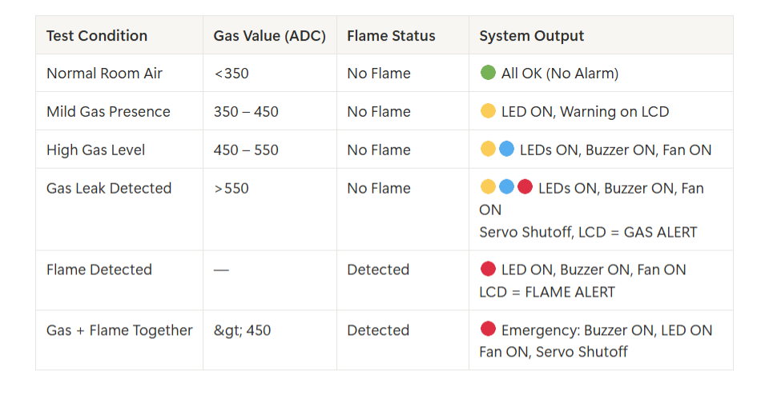
Experimental Test Results
Threshold-based logic confirmed: reliable hazard detection with consistent alert and automated safety response across all test conditions.
11

Slide 14
Performance Analysis & Cost Overview
Real-Time Detection
Cost Analysis
System responds within seconds of gas threshold breach or flame detection — no dependency on internet.
Arduino Uno R3
~450 BDT
Dual Sensor Coverage
MQ-2 Gas Sensor
~120 BDT
MQ-2 gas sensor + flame sensor together minimize false negatives and improve hazard coverage.
Flame Sensor
~80 BDT
Automatic Mitigation
EESP-01
~200 BDT
Exhaust fan + servo-controlled gas shutoff activate simultaneously — no user action required.
Servo Motor
~160 BDT
Stability Confirmed
Exhaust Fan+MOSFET
~130 BDT
Minimal false alarms after calibration; consistent behavior under repeated simulation and lab testing.
Misc (wires, LED, LCD, etc)
~250 BDT
Total Estimate
~1390 BDT
12

Slide 15
Survey Findings & User Research
Platform: Google Forms | Total Respondents: 54 | Focus Areas: Gas safety awareness, device usage, features, pricing
77.7%
70.4%
42.6%
38.9%
Concerned or Very
Concerned about gas hazards
Do NOT use any gas or
fire detection device at home
Would only pay less than
1500 BDT for a safety device
Prioritize LOUD BUZZER
as the #1 safety feature
Survey Metric | Result | Design Implication
Problem Demand | 77.7% concerned | Validates psychological need for the device.
Market Gap | 70.4% no device at home | Confirms massive untapped market opportunity.
Price Constraint | <1500 BDT preferred | Drives strict low-cost component selection.
Feature Priority | Loud buzzer (38.9%) | Justifies audio-visual local alert design.
13

Slide 16
Conclusion
The developed Automatic Gas Leakage and Fire Detection System successfully demonstrates a low-cost, reliable, and real-time safety monitoring solution suitable for households and small commercial environments.
✔
Reliable Hazard Detection
System accurately detects gas leakage (ADC >450) and flame presence in real time with consistent threshold-based response.
✔
Automatic Safety Response
Exhaust fan ventilation and servo-controlled gas shutoff activate immediately — no human intervention required.
✔
Affordable & Accessible
Total cost ~1300 BDT — well within the 1500 BDT price ceiling identified by 42.6% of survey respondents.
✔
Locally Operational
No internet connectivity required; system remains functional during power outages or network disruptions.
14

Slide 17
Future Scope & Enhancements
01 — IoT Remote Alerting
02 — Solenoid Valve Upgrade
Integrate GSM module to send mobile app or SMS alerts when users are away from home.
Replace servo motor with industrial solenoid valve for more powerful and fail-safe gas supply control.
03 — Battery Backup System
04 — Smart Home Integration
Add rechargeable power backup to ensure operation during power outages or emergencies.
Connect with home automation systems to trigger ventilation, appliances, and relay-based safety networks.
05 — Enhanced Sensor Calibration
06 — Cloud Data Logging
Implement filtering algorithms to reduce false alarms under variable humidity, airflow, and temperature.
Log sensor data to a cloud platform for pattern analysis, remote monitoring, and predictive safety alerts.
15

Slide 18
References
[1] S. Kumar and V. Patel, Low-Cost Fire Detection Using Microcontroller and Flame Sensor Network, IEEE Access, vol. 10, pp. 115230-115240, 2022.
[2] M. Uddin, R. Chowdhury, and K. Hossain, Smart Home Safety Monitoring System Using Arduino and IoT, IEEE ICCECE, 2024, pp. 556-561.
[3] H. Tanvir and N. Chowdhury, Embedded LPG and Methane Leakage Alert System for Domestic Applications, IEEE TENSYMP, 2023, pp. 102-107.
[4] R. Singh, M. Das, and P. Roy, Design of a Multi-Sensor Fire and Gas Detection System for Smart Buildings, IEEE IS, 2022, pp. 844-850.
[5] J. Park and J. Lee, Real-Time Fire Detection Using Flame Sensors and Edge Computing, IEEE IoT Journal, vol. 9, no. 12, pp. 9510-9521, 2022.
[6] A. Mustofa, Design an Internet of Things-Based LPG Gas Leak Detection System, 2025.
[7] S. M. Ghasemi et al., Reliability and Performance Evaluation of IoT-Based Gas Leakage Detection Systems, 2025.
[8] M. A. Baballe et al., A Comparative Study on Gas Alarm Detection System, 2022.
[9] P. O. Alao et al., Integrated Gas Leakage Detection and Automatic Shutoff System, 2024.
[10] R. Arfianto et al., Gas Leakage Detection Using Tiny Machine Learning (TinyML), 2025.
16

Slide 19
AIUB | Faculty of Engineering | EEE Department
Microprocessor and Embedded Systems(COE3104)
Thank You
Arduino-Based Gas Leakage and Fire Detection System With Prevention and Safety Mechanisms
Group 07 | Section H | Spring 2025–2026
Questions & Discussions Welcome
Faculty Advisor: Debraj Das
AIUB | EEE3102 Capstone Project | Group 07

