Slide 1
House Prices
Linear Regression

Slide 2
Model to Predict House Prices
This project is concerned with predicting house prices with linear regression:
The independent variables are the features of houses
The dependent variable is the actual price of sold houses
Experiment by training different models with various sets of independent variables and by alternating the dependent variable between real money value and natural logarithm values
The best trained model is tested against unseen data

Slide 3
Data
The training data is 100 rows x 82 columns of house price data, including:
a SalePrice column (the dependent variable)
79 columns of house features (dependent variables)
2 index columns
The test data is a further set of 100 rows x 82 columns of house price data. It is unseen data used to test a trained linear regression model.
The train/test split is 50:50
The data is loaded as .csv files

Slide 4
Code
My code is available at: https://github.com/mhtattersall/LinearRegression
Python
Modules - pandas, numpy, matplotlib, scikit-learn

Slide 5



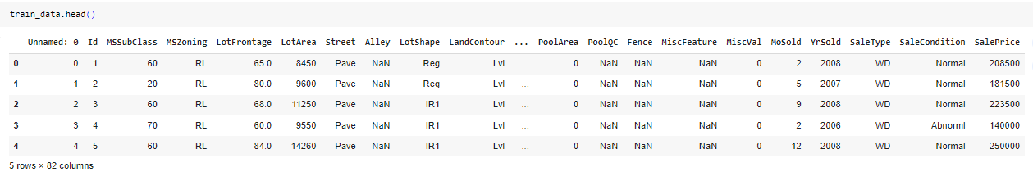
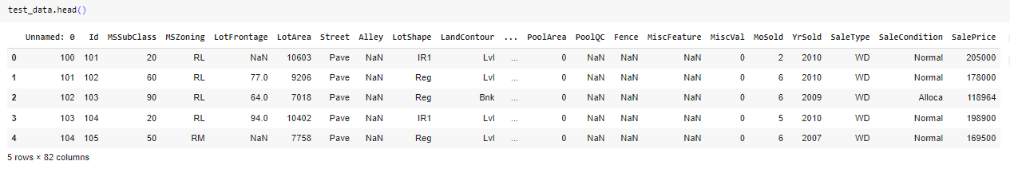
Read data

Slide 6
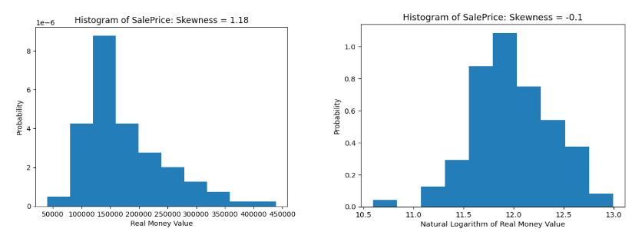
Exploration
The SalePrice target variable has a skewed distribution
The natural logarithm of SalePrice appears to be normally distributed and its skewness is reduced to -0.1

Slide 7
Target variable
We use the numpy log() function to transform the SalePrice column.
This logarithmic transformation may improve the performance of the linear regression.
When logarithmic values are predicted by our trained model they can be transformed into real money values using the numpy exponential function exp().
We experiment with both real money values and the natural logarithm of these values as the target variable.

Slide 8
Data Preparation
Selecting the numeric columns with select_dtypes() method
Checking the columns with null values with the isnull() method
Interpolating to fill missing values with the interpolate() method
Computing the pairwise correlation coefficient between pairs of columns with the corr() method
Checking for missing values with the isnull() method
Dropping columns with missing values with the dropna() method
Selecting data with the iloc[] function
Calculating the mean average of a Series with the mean() function
Fill missing values in a Series with the fillna() method to

Slide 9
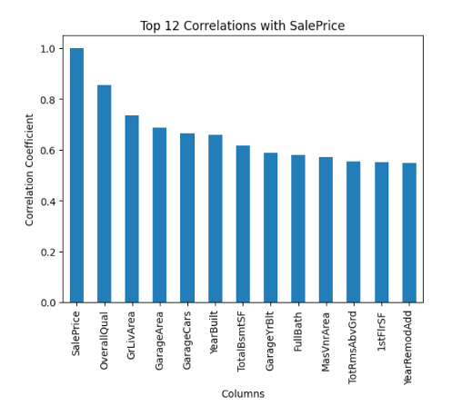
Correlation
We use the pandas corr() function to calculate the correlation coefficient between every pair of columns in the 'interpolated' DataFrame, and examine the top 12 correlation coefficients (not including SalePrice itself)

Slide 10
Experimentation
Train models with sets of 5, 8 and 12 independent variables:
Model 1 is the top 5 columns
Model 2 is the top 8 columns
Model 3 is the top 12 columns
In each case alternate the target variable between real money values and the natural logarithm of these values
Calculate an R-Squared score for each model
Test the most accurate trained model against unseen data

Slide 11
R-squared
The scikit-learn implementation of linear regression uses the method of Ordinary Least Squares to minimize the residual sum of squares between the observed targets in the dataset, and the targets predicted by the linear approximation.
The score() function computes the co-efficent of determination (R-squared) of the model, which indicates the proportion of the variance in the target variable that is explained by the trained linear regression model.
The best possible score is 1.0. A constant model that always predicts the expected value of y, disregarding the input features, would get a score of 0.0.

Slide 12
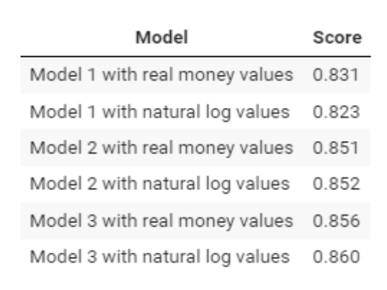
Training
The R-Squared scores of each model are shown below:

Slide 13
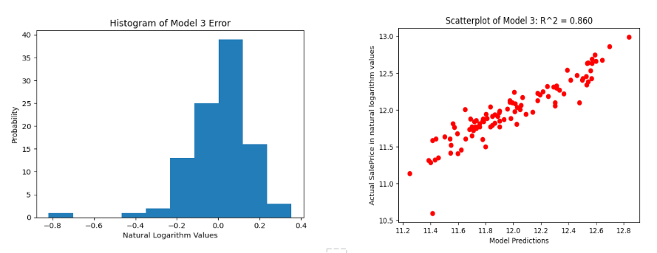
Results
Model 3 with natural logarithm values is the most accurate model in training

Slide 14
Testing & Conclusion
The R-Squared score of the best model against unseen test data is 0.816. This compares to the R-Squared score of 0.860 against training data.
The accuracy of the model has declined from the training phase to the test phase. This may indicate overfitting of the trained model to random fluctuations in the training data.
However, the score of 0.816 indicates a high proportion of the variance in target variable is explained by the trained linear regression model.

