Slide 1

HEADLINER – A language model for scientific title generation.
Jannis Waller, Noah Link, Michael Hüppe

Slide 2

Outline
Motivation & Problem Formulation
Proposed Approach
Dataset Analysis
Model Architecture
Evaluation Metrics
Current Prototype (MVP)
Project Milestones

Slide 3
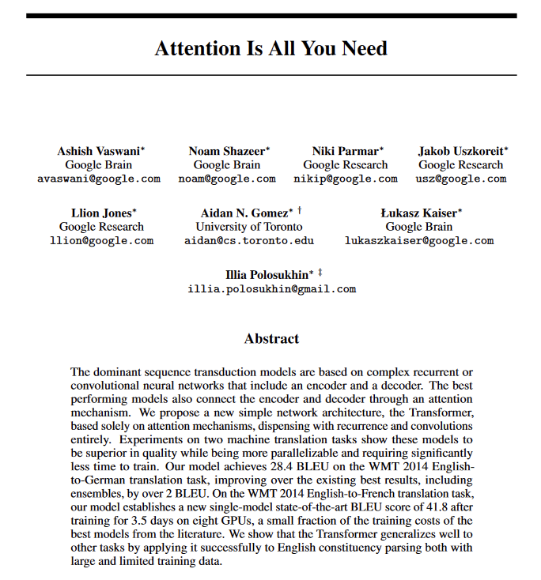
Motivation
Enhances Impact: Engaging titles boost research visibility.
Improves Accessibility: Effective titles stand out in crowded fields.
Data Availability: Abundant data supports effective model training.

Slide 4
Problem Formulation
Sequence-to-Sequence Model
Input: Abstract text (~ 50-180 words).
Output: A concise title (~ 5-15 words).
Domain Focus: Computational Linguistics

Slide 5
Proposed Approach
Capture Abstract-to-Title Mapping in Transformer-Based Model
Employ an encoder-decoder structure:
Encoder processes the abstract
Decoder generates a coherent concise title.
Train the model from scratch on a large, domain-specific dataset of scientific abstracts and titles.

Slide 6
ACL Title and Abstract Dataset
From Association for Computational Linguistics Anthology Network
Restricted domain: Computational Linguistics
10,874 title and abstract pairs
Notes:
Association for Computational Linguistics
https://paperswithcode.com/dataset/acl-title-and-abstract-dataset

Slide 7
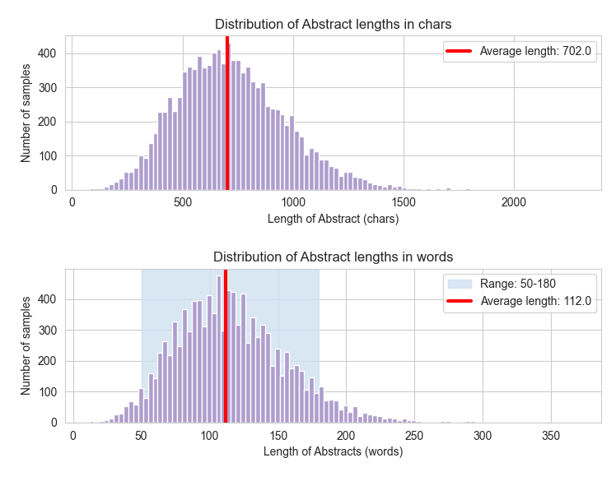
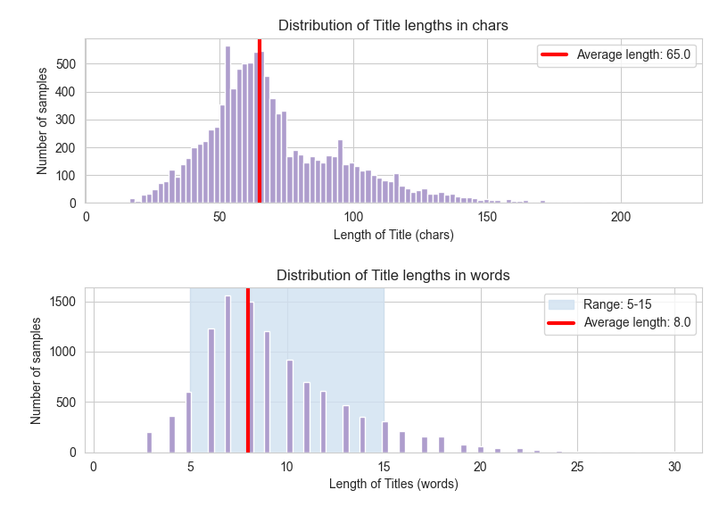
Determining Input and Output shape

Slide 8
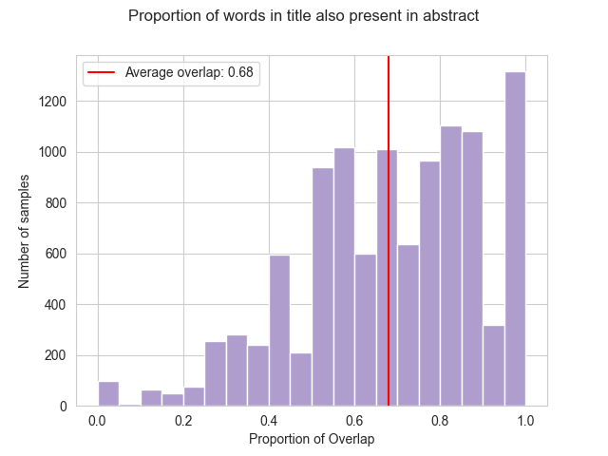
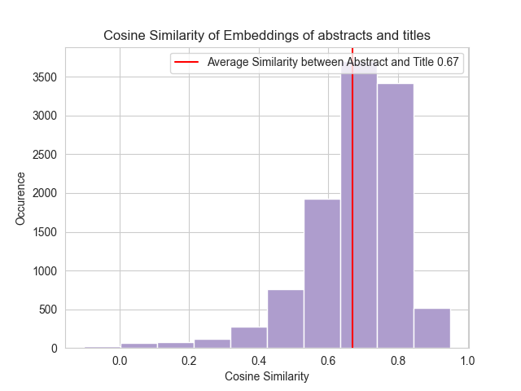
Similarity between Abstract and Title
Notes:
Because of similarity, the model basically just needs to summarize as a lot of the words are already present in the abstract. Not a lot of creativity needed.

Slide 9
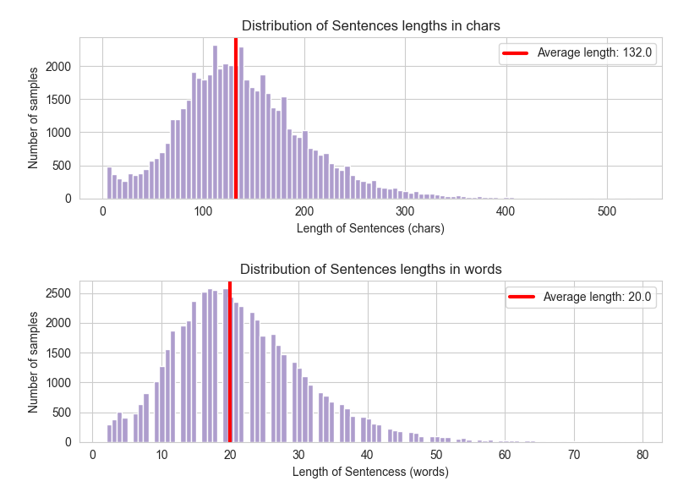
Data Processing
Text Vectorization/Encoding
Filter pairs by title and abstract length
Language Engineering:
Replace all years in the abstract by "years"
Replace all authors in the abstract by "author"
Replace all conference/journal mentions by "publication“
Consider filtering sentence length (see plot)

Slide 10
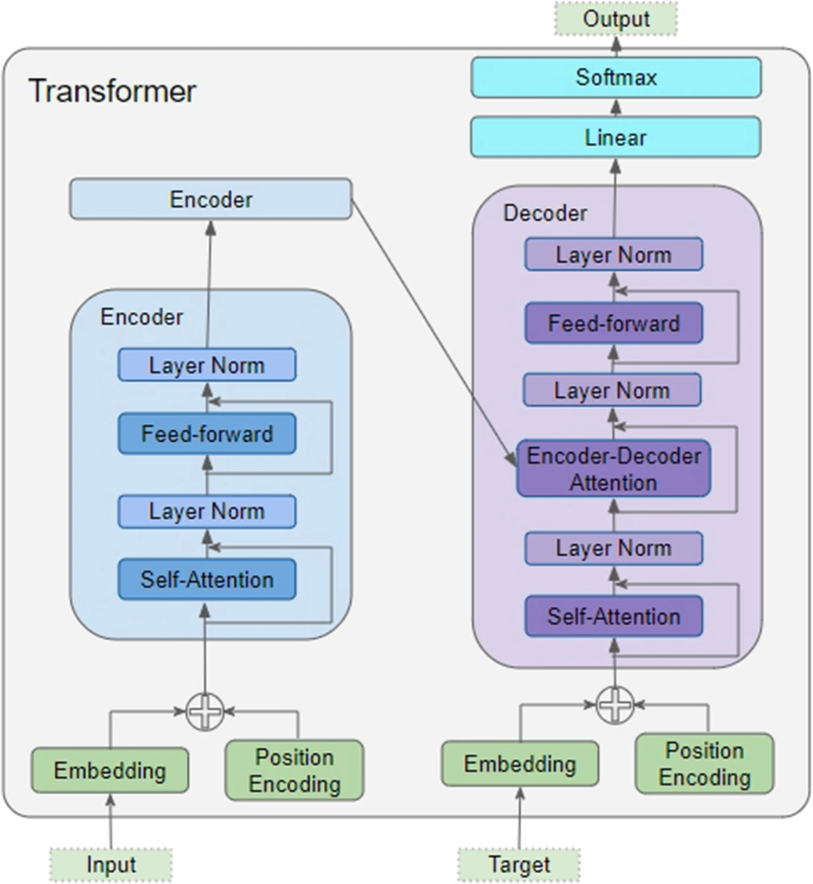
Model Architecture
[Title]
Encoder
Processes embeddings of abstract
Identifies key concepts using self-attention
Decoder
Generates the title by attending to the encoded abstract.
Uses self-attention for title coherence and encoder-decoder attention to focus on essential abstract elements.
[Abstract]
[Title]
Notes:
Identifies key concepts using self-attention

Slide 11
Training Details
Framework
TensorFlow
Data split
80% Training
10% Validation
10% Test

Slide 12
Potential Evaluation Metrics
Grammatical Accuracy Rate
ROUGE Score: Measures recall-oriented aspects, valuable for summarization
BertScore: Semantic similarity between abstracts and titles, using contextual embeddings from BERT
BLEU Score: Measures n-gram overlap between generated and actual tiles
Perplexity: Uncertainty in predicting the next word in a sequence (Confident in predictions)

Slide 13
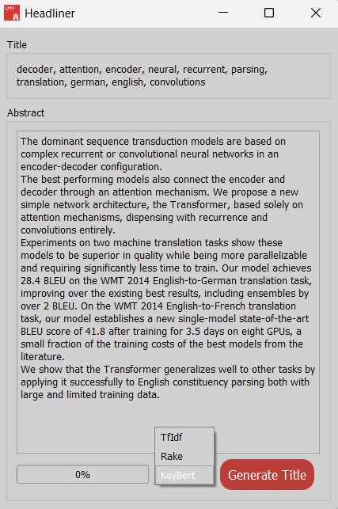

Minimum Viable Product
Input Abstract in Text Field
Press "Generate Title"
Data is preprocessed and put into the model
Model returns creative and fitting title
Current Status: Most Prominent features of the abstract are extracted (TF-IDF, Rake, KeyBert)
Notes:
TF-IDF: rel häufigkeiten von wörtern (term frequency, inverse document frequency)
Rake: rel häufigkeiten von n-grams (aufeinanderfolgende wörter)
KeyBert: (cosine) similarity of embeddings (whole abstract, each unique word)

Slide 14
Milestones
Milestone 1: Data Preprocessing
Milestone 2: Simple Seq2Seq Baseline Model
Milestone 3: Evaluation Metrics & Validation
Milestone 4: Model Optimization & Experimentation
Milestone 5: Compare Model/Data setup
Milestone 6: Final Model Refinement
Milestone 7: Documentation & Final Evaluation

Slide 15
Key tasks for next week
Data Collection & Cleaning
Implement Basic Model Architecture & Pipeline
Implement At Least Two Evaluation Metrics

Slide 16
Questions?

