Slide 1
Euclid VIS + DESI mocks from TNG50
Informal progress report
October 2026

Slide 2
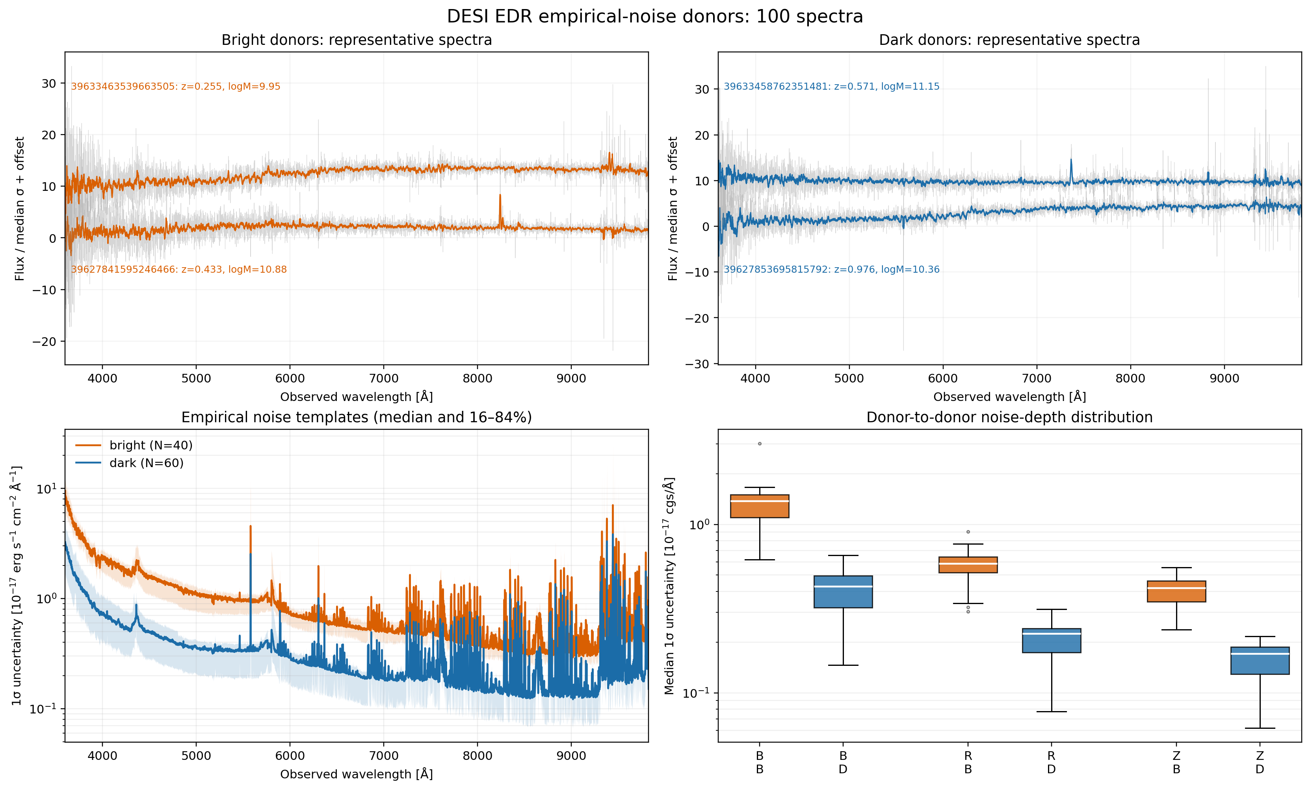
Current end-to-end workflow
Status: complete for a 100-object test sample
Reference sample: Euclid DEEP objects matched to DESI, with z < 1.5 and log M★ > 9.5
TNG50 selection: random redshift and mass, nearest full snapshot, then a resolved subhalo
Synthesis: stellar particles, dust, nebular emission and velocity shifts
Outputs: VIS images and a 1.5 arcsec DESI fiber spectrum
Realism: spatial VIS PSF, tile injection, feasiBGS response and empirical EDR noise

Slide 3
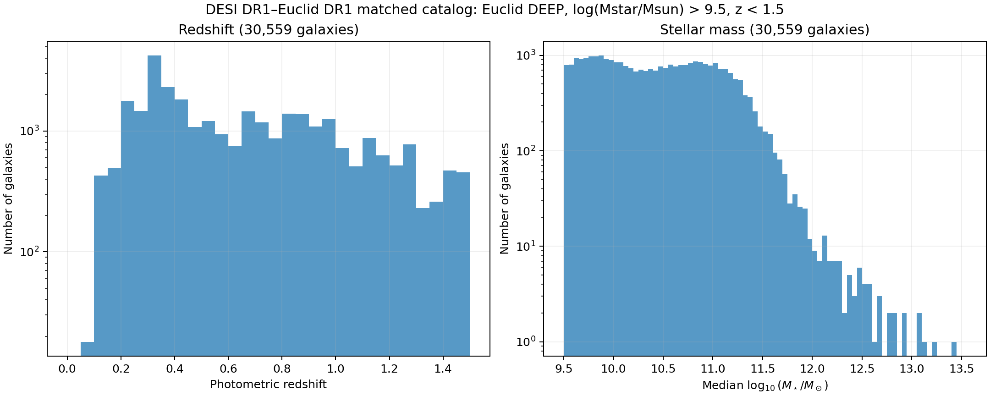
Reference sample and TNG50 selection
Matched to the Euclid DEEP + DESI population
Reference catalog: 30,559 galaxies after z < 1.5 and log M★ > 9.5 cuts
Random draws reproduce the redshift and stellar-mass distributions
Nine full TNG50 snapshots cover the selected redshift interval
Only snapshots with the required particle fields are used
The number of mocks and random seed remain free parameters. Selections are stored in matched_sample.csv

Slide 4
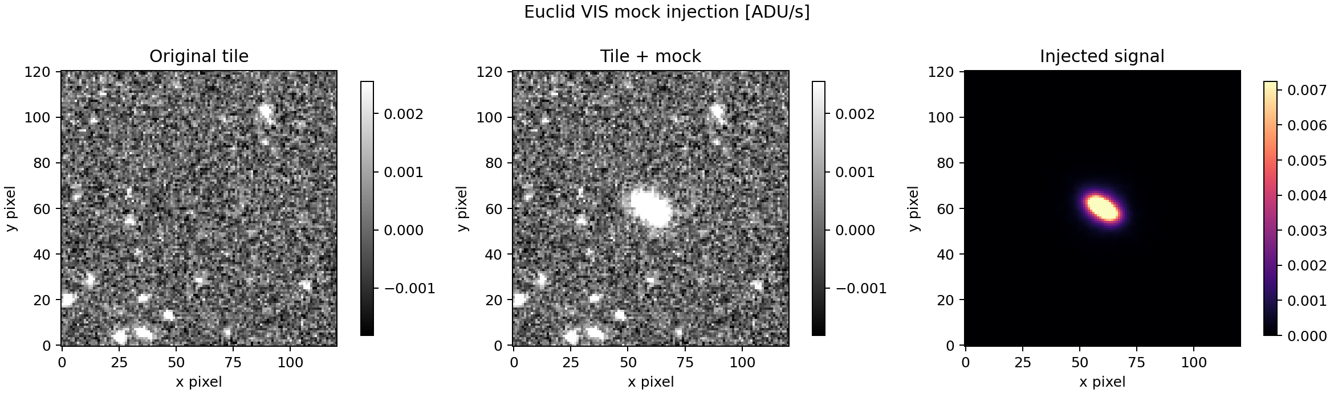
Euclid VIS image generation
Raw images, realistic PSFs and injection into a real tile
Particle spectra are integrated through the Euclid VIS response
Images use a 0.1 arcsec pixel scale and are stored in μJy
Both raw pre-PSF and convolved products are saved
The tile injector selects the nearest position-dependent MER PSF
MAGZERO converts μJy to ADU/s. Occupied tile positions are rejected, and no extra Poisson noise is added to the stacked mosaic

Slide 5
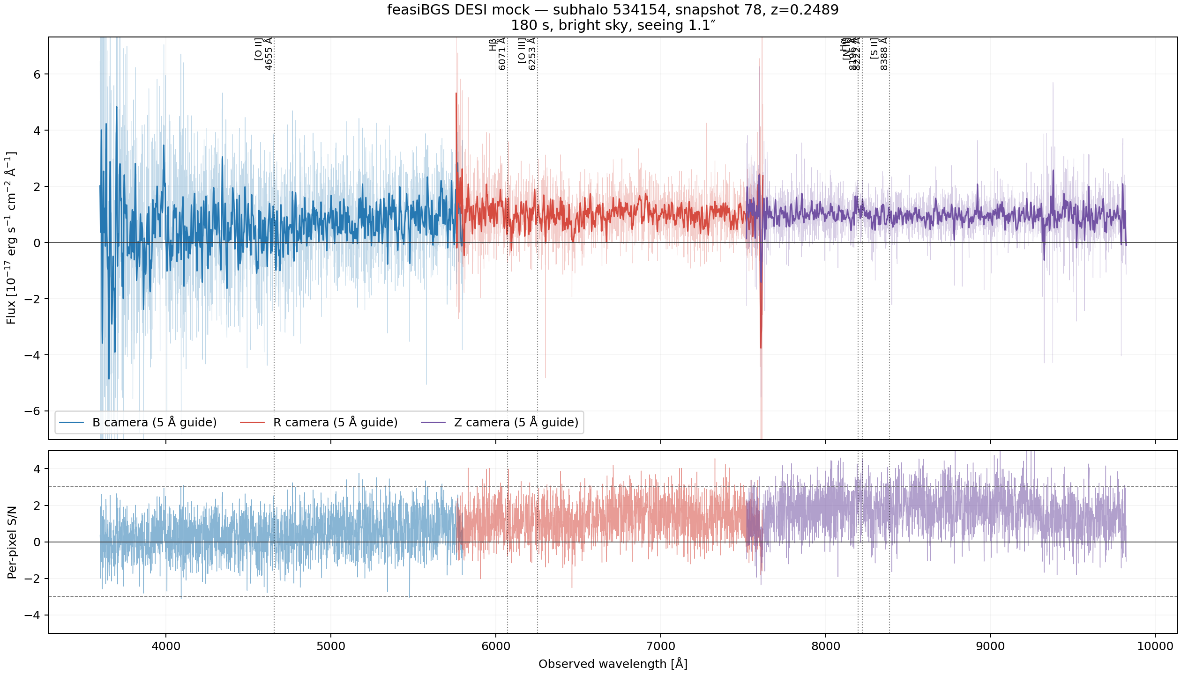
DESI spectrum generation
Fiber aperture, feasiBGS response and EDR noise
Stars inside a 1.5 arcsec aperture provide the observed-frame raw Fν spectrum
Velocity shifts broaden the particle emission naturally
feasiBGS supplies throughput, resolution and the B, R and Z camera grids
Observed EDR donors supply wavelength-dependent IVAR, masks and coadd depth
The raw noiseless spectrum remains unchanged, which lets us test different noise models without regenerating the galaxy

Slide 6
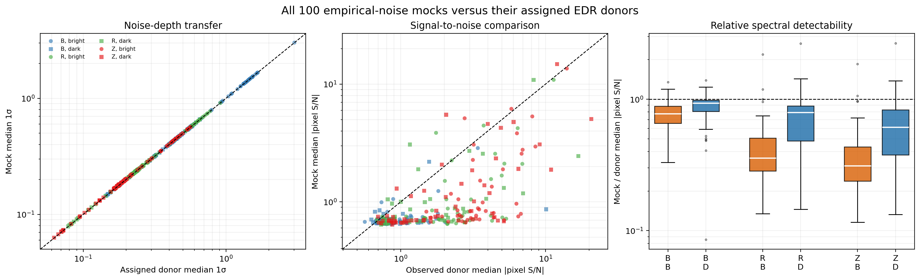
What the DESI comparison shows
The noise model works. The signal still needs attention
The transferred uncertainty follows donor IVAR almost one-for-one in all three arms
Mock median per-pixel signal-to-noise is often lower than in the observed donors
The largest differences appear in the R and Z cameras
Observed emission lines also tend to be stronger than the corresponding mock features
Donor matching now uses redshift, actual TNG mass, clipped specific SFR and an r-band fiber-flux proxy

Slide 7
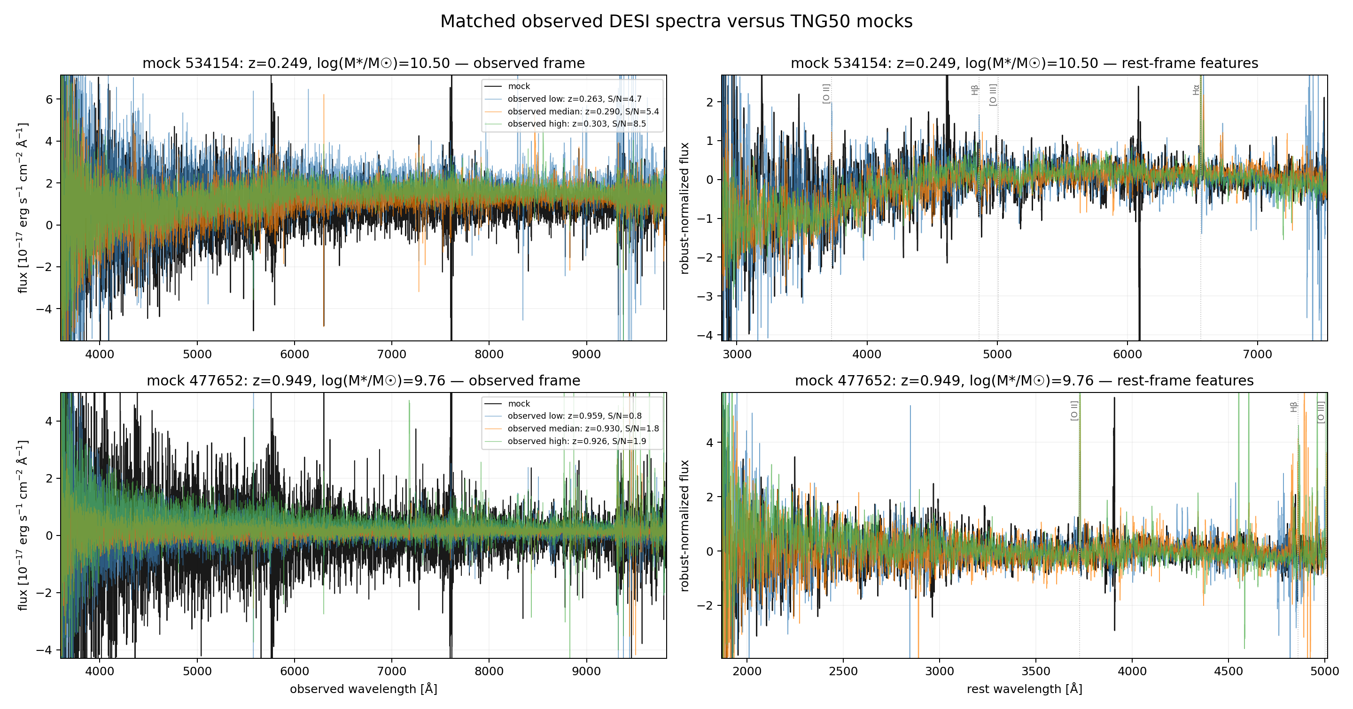
Remaining work before production
The code path is ready. The spectral features need final validation
Rerun EDR donor assignment with specific SFR and apparent r-band flux
Compare emission-line equivalent widths and fiber SFR at fixed mass and redshift
If the lines remain weak, inspect young-star sampling, nebular emission, dust and aperture losses
Run the mocks and held-out observations through the AstroPT DESI encoder
After a final smoke sample, scale n_mocks while preserving manifests and raw products

