Slide 1
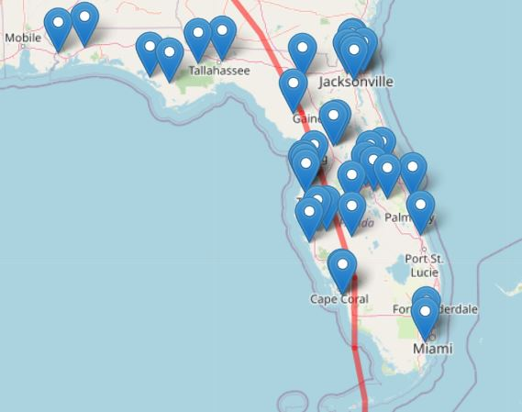
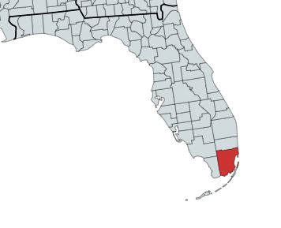
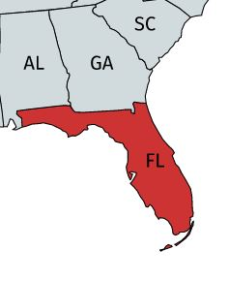
Point Location
Human Impacts Data – Residential Address, Hospital or Business address
Physical Exposure Data – Fixed monitors and sensors, weather stations, stream gauges give point location values of wind speed, precipitation, flooding, temperature, and pressure.
Zip Code/County/Parish
Human Impacts Data – Aggregated information on demographics and population
Physical Exposure Data – Aggregate exposure values (avg wind speed, total precip.) and binary exposure classification (exposed or unexposed)
State/Country
Human Impacts Data – Population totals (number of mortalities, birth defects)
Physical Exposure Data – Aggregated exposure values or estimated values from interpolating and modeling.
Seconds, Minutes, Hours
Human Impacts Data – N/A
Physical Exposures Data – Wind speed & direction, air temperature, air pressure total precipitation, flooding, storm surge
Day
Human Impacts Data – Hospitalizations
Physical Exposures Data – Daily averages for temperature, precipitation, cloud cover, wind speed, etc.
Week
Human Impacts Data – Birth outcomes (pregnancy data usually in weeks)
Physical Exposures Data – Weekly averages for temperature, precipitation, cloud cover, wind speed, etc.
Cumulative Measures of Time
Human Impacts Data – Assessments of mental health, infrastructure damage, economic disruption over a given period of time (such as a hurricane season)
Physical Exposures – Often statistics on the tropical cyclones themselves (number of category 5 hurricanes to make landfall in a year/hurricane season)

Slide 2
Spatial and Temporal Scales
Spatial Scales
Temporal Scales
Point Locations
Zip code/Parish/County
Metropolitan Area
State
Multi-state Region/Country
Seconds/Minutes/Hours
Day
Week
Cumulative Measures of Time

