Slide 1
Playing Atari with Deep Reinforcement Learning
By Hunter Klein

Slide 2
Introduction: Learning More Like a Human Does
Prior to this paper, most successful reinforcement learning methods relied on hand crafted features for each application
Humans can learn many things through visual input alone – Deep Mind proposes the following model to replicate this using a combination of CNNs, experience replay, and Q-learning to play Atari 2600 games.

Slide 3
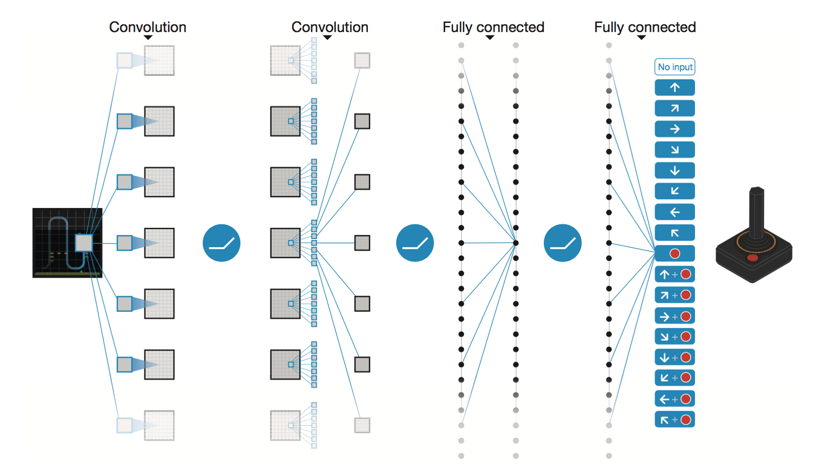

The Model: Q-Value Function as a NN
$$Q(φ,a;θ)$$
Observation
Action
Model Params

Slide 4
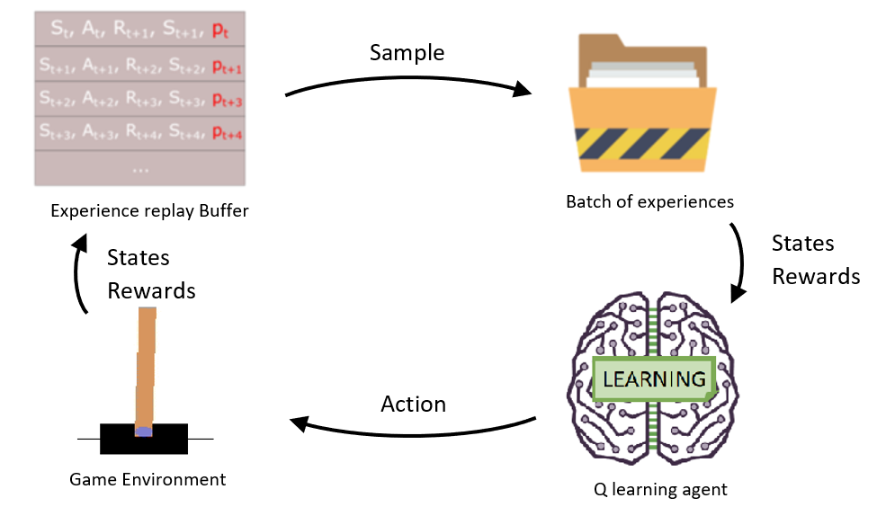
The Model: Experience Replay

Slide 5
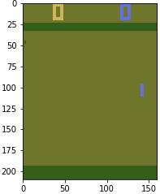
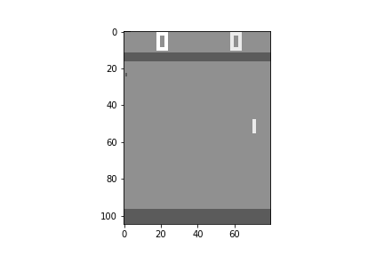
Model Training: The Data
PongDeterministic-v4
Preprocess
(210,160,3) -> (105,80,1)
Repeat Action 4x
(105,80,1) -> (105,80,4)

Slide 6
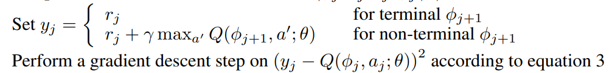
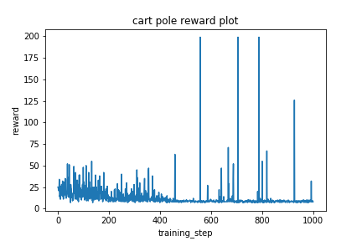
Model Training: Cart-Pole, “the Hello World of RL”

Slide 7
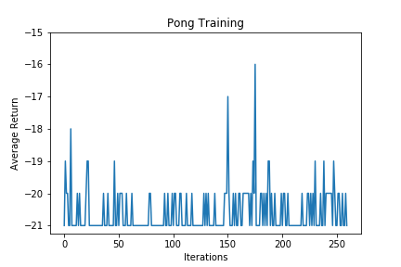
Model Training: Pong (2013 DQN)

Slide 8
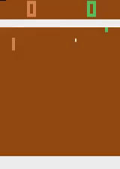
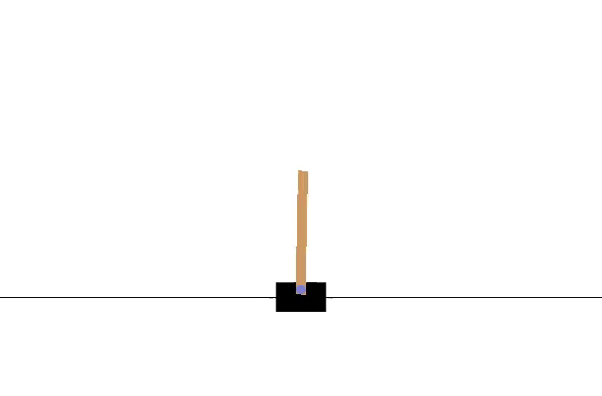
Model Training: Pong – TFAgents DQN (2015)
DQN (2013)
DQN (2013)
Dueling DQN (2015)
Dueling DQN (2015)

