Slide 1
Capstone Presentation- Battle of the Neighborhoods
By Morgan Hurtz

Slide 2
Introduction
The purpose of this project is to help people explore the venues in Scarborough, Toranto. It will allow for educated decisions on choosing the best neighborhoods.
Like all people in a new place, those who have just moved to Scarbourough may have difficulty navigating and exploring, making finding places to connect difficult. This includes shops, restaurants, grocery stores, etc.
Additionally, this project will look at housing prices, providing more information on deciding where to move.

Slide 3
Data
For simplicity's sake, we will use the Toronto Postal Code dataset from the Wikipedia page in week 3. This dataset will be scraped for latitude, longitude, and zip codes. (https://en.wikipedia.org/wiki/List_of_postal_codes_of_Canada:_M).
We will also use Foursquare API, which will provide data on different venues in the area. Foursquare is a location provider with various types of area-specific data, such as neighborhood and venue latitude and longitude.

Slide 4
Methodology
Data scraping and cleaning the Wikipedia page
Clustering: To compare the similarities of two cities, we decided to explore neighborhoods, segment them, and group them into clusters to find similar neighborhoods in other cities. To be able to do that, we need to cluster data using the k-means clustering algorithm.

Slide 5
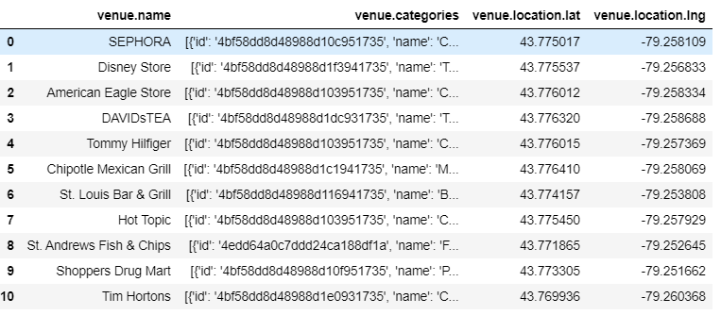
Results: Venue Locations

Slide 6
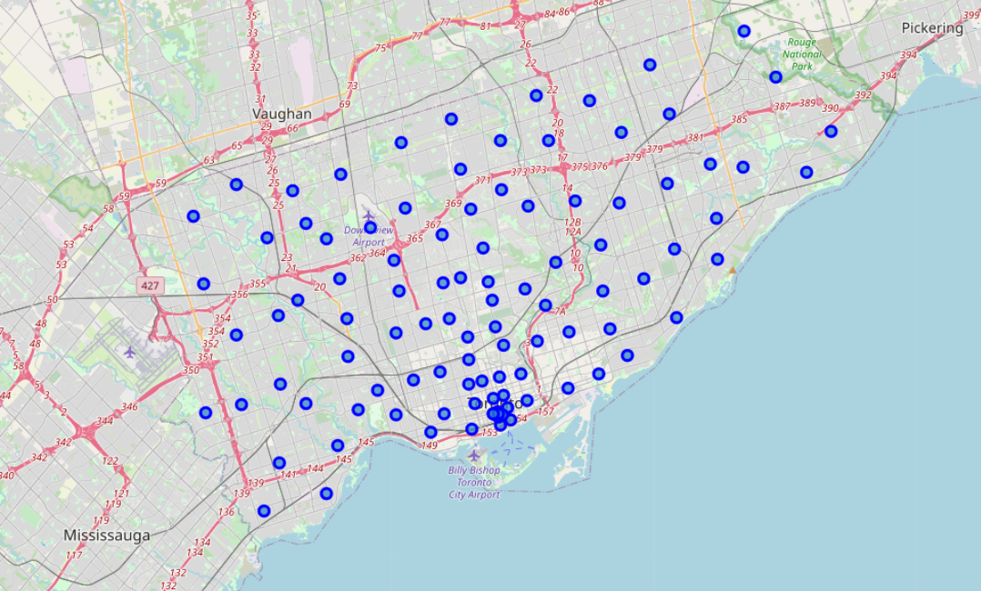
Results: Cluster Map

Slide 7
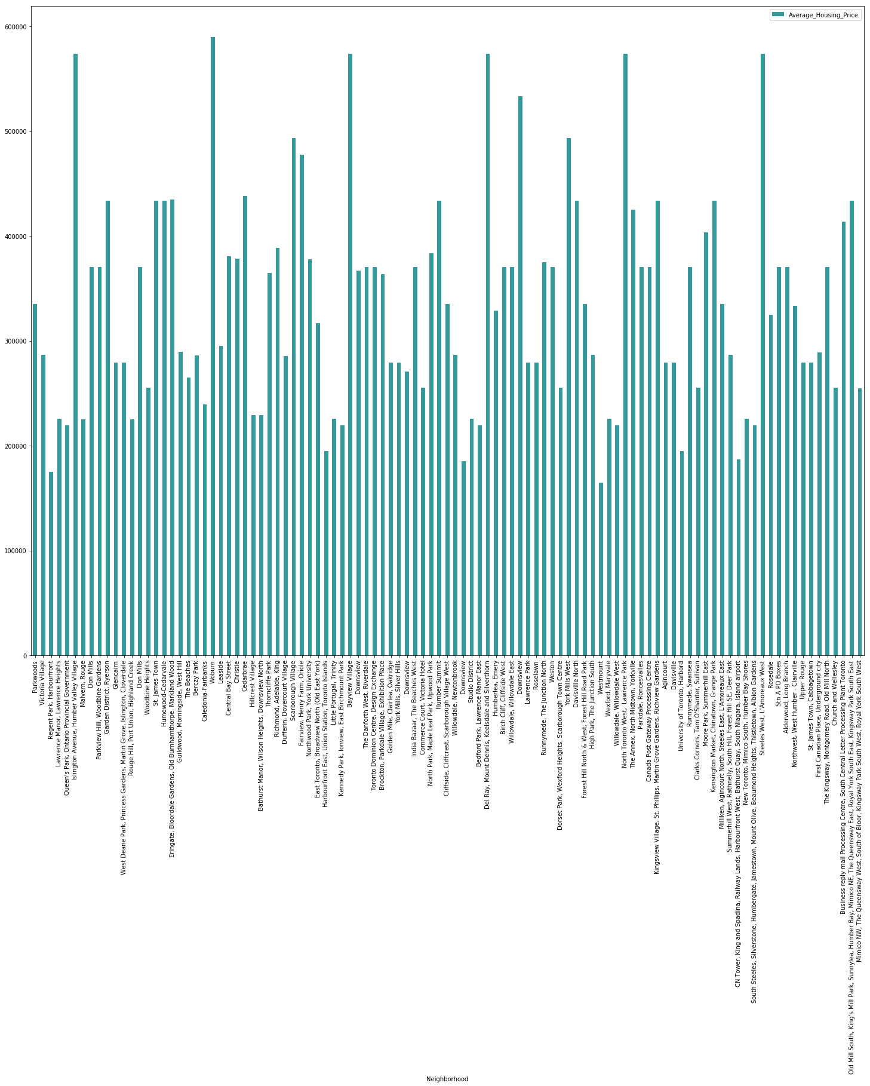
Results: Housing Prices

