Slide 1
XDTools: Testing and Debugging Cross-Device Applications
Master Thesis
Nina Heyder

Slide 2
Content
Motivation Related Work XDTools Sample Applications Evaluation Conclusion Future Work
Motivation
Related Work
XDTools
Sample Applications
Evaluation
Conclusion
Future Work

Slide 3
Motivation
Motivation Related Work XDTools Sample Applications Evaluation Conclusion Future Work
Users typically have access to multiple devices
Studies have shown that users already use multiple devices in parallel, but better functional coordination is needed
Cross-device applications!
Cross-device frameworks provide little support for testing and debugging
Tools for testing traditional and reponsive websites are not well-suited for debugging multiple devices simultaneously
More advanced testing tools for cross-device application could help increase the availabilty of such applications

Slide 4
Related Work
Motivation Related Work XDTools Sample Applications Evaluation Conclusion Future Work
Web application testing and debugging
Browser-integrated debugging tools
Responsive web application testing
Web services
Record and replay
Automated testing tools
Testing with actual devices
Device emulation
Cross-device frameworks
Frameworks with tool support
Web-based frameworks
Example: Chrome DevTools
Example: Timelapse
Example: Selenium
Example: BrowserStack
Example: Ghostlab
Example: Chrome Device Mode
Example: XDSession
Example: XD-MVC
Notes:
- Maybe present one example from each category?

Slide 5
XDTools
Motivation Related Work XDTools Sample Applications Evaluation Conclusion Future Work
EMULATION OF MULTIPLE DEVICES
INTEGRATION OF REAL DEVICES
SWITCHING OF DEVICE CONFIGURATIONS
INTEGRATION WITH DEBUGGING TOOLS
AUTOMATIC CONNECTION MANAGEMENT
RECORD AND REPLAY
Set of tools that facilitate the testing and debugging of cross-device applications

Slide 6
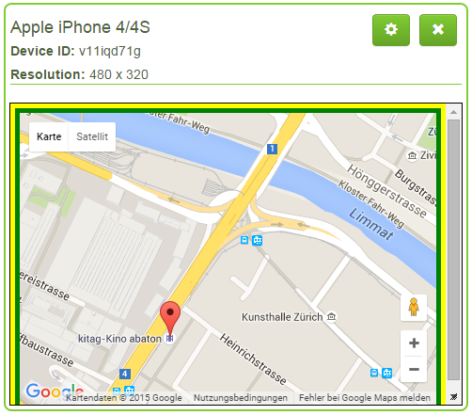
Emulation of Multiple Devices
Motivation Related Work XDTools Sample Applications Evaluation Conclusion Future Work
Devices are emulated using iframes
DNS server that registers one subdomain for each emulated device
Prevents the sharing of local resources
Each device has a unique color for identification
Devices can be moved, scaled, resized and rotated
Emulated device

Slide 7
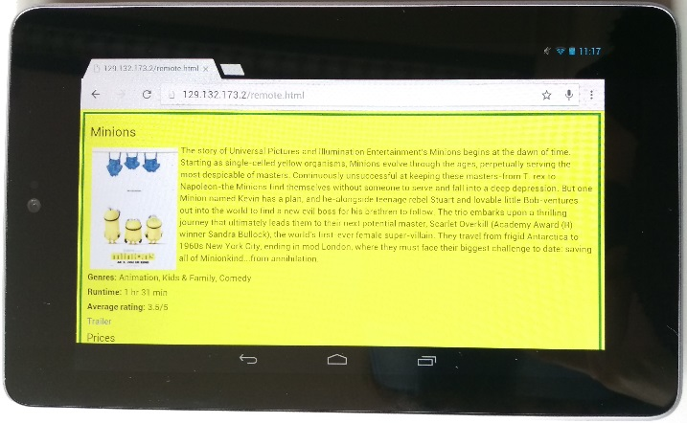
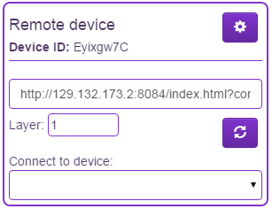
Integration of Real Devices
Motivation Related Work XDTools Sample Applications Evaluation Conclusion Future Work
Scan a QR code to connect a real device
Device is represented by a proxy in XDTools
Can be used alongside emulated devices
Most features of XDTools are also available for real devices
Real devices only show the application under test and no other interface elements
Real device
Proxy of real device

Slide 8

Switching of Device Configurations
Motivation Related Work XDTools Sample Applications Evaluation Conclusion Future Work
Device configurations can be stored
Only emulated devices are stored
For each device, the following information is stored:
Name
Resolution
Position
Scaling
Layer
Developer can quickly switch between configurations

Slide 9
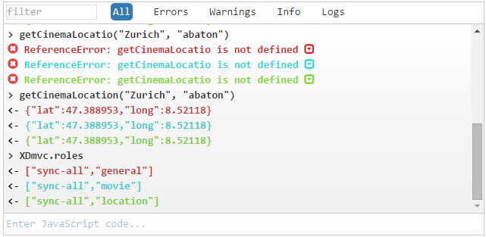
Integration with Debugging Tools
Motivation Related Work XDTools Sample Applications Evaluation Conclusion Future Work
Shared JavaScript console
Console outputs are aggregated from all devices
Commands can be sent to multiple devices
Shared CSS editor
CSS rules can be applied to all devices simultaneously
HTML Inspection
Directly jump to the body element of an emulated device in the Chrome DevTools
Function debugging
Set a breakpoint at the beginning of a function on multiple devices
Function debugging and HTML inspection only work for emulated devices
Shared JavaScript console

Slide 10
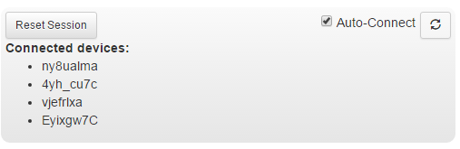
Automatic Connection Management
Motivation Related Work XDTools Sample Applications Evaluation Conclusion Future Work
Devices can be connected automatically or manually
A set of connected devices = a session
Auto-connect can be enabled for one session
All newly created/connected devices are automatically connected to that session
Drop-down menu to manually connect devices
A session

Slide 11
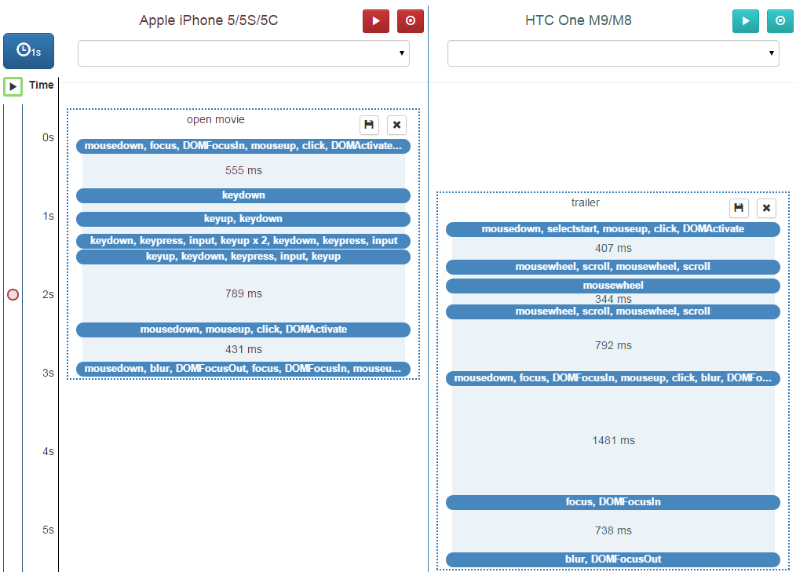
Record and Replay
Motivation Related Work XDTools Sample Applications Evaluation Conclusion Future Work
Record and replay interactions
Recorded event sequences are visualized
Move event sequences to different devices
Split event sequences into multiple parts
Configure the timing of the replays using drag and drop
Replay on all devices simultaneously
Set breakpoints
Visualized event sequences

Slide 12
Sample Applications
Motivation Related Work XDTools Sample Applications Evaluation Conclusion Future Work
XDYouTube
XDCinema
Insights

Slide 13
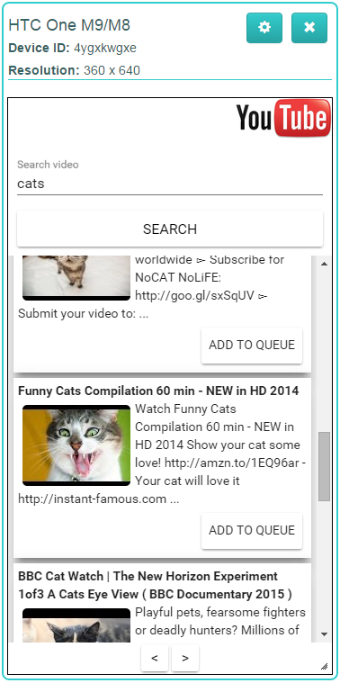
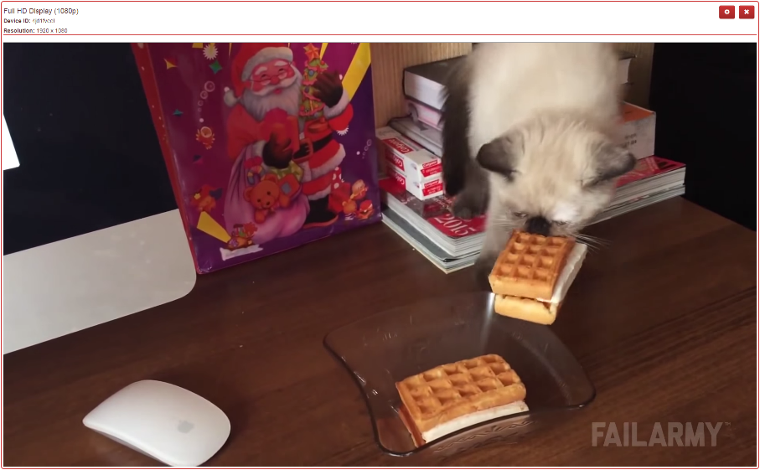
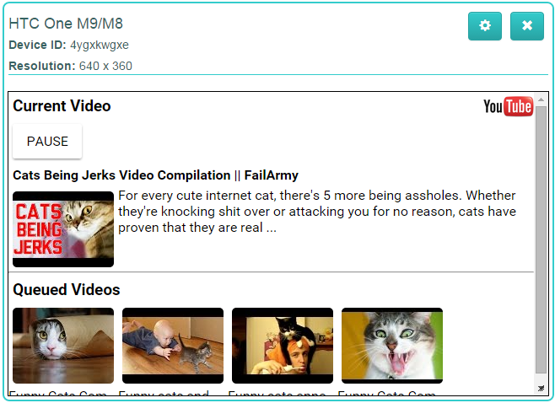
XDYouTube
Player view
Controller view
Plays the current video
Largest device
Search and queue videos
Play/pause videos
See current video + queue

Slide 14
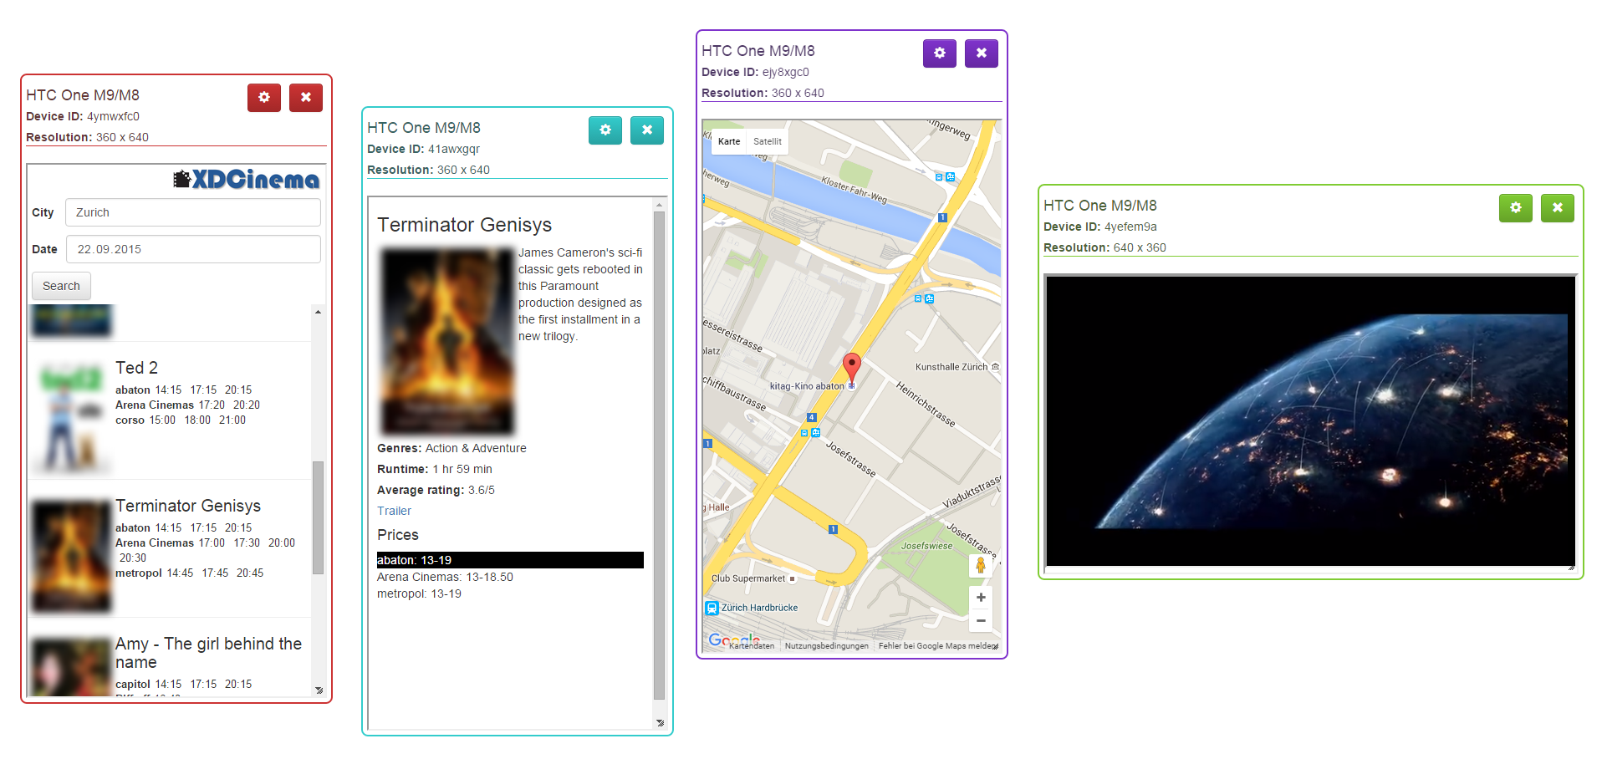
XDCinema
Motivation Related Work XDTools Sample Applications Evaluation Conclusion Future Work
Check the cinema program
Four views:
Search view: Search for movies in the cinema
Movie view: Movie description, ratings, ...
Location view: Location of a cinema
Trailer view: Plays the trailer of a movie
Trailer view
Location view
Search view
Movie view

Slide 15
Insights
Motivation Related Work XDTools Sample Applications Evaluation Conclusion Future Work
Some way of debugging the JavaScript of devices is required
Function debugging
Manually connecting devices is tedious
Connection management
Automatically find a free space for new devices
Maybe in the future?
XDTools was helpful while developing the applications
Especially emulation of multiple devices

Slide 16
Evaluation
Motivation Related Work XDTools Sample Applications Evaluation Conclusion Future Work
Setup
Participants
Tasks
XDYouTube implementation task
REsults

Slide 17
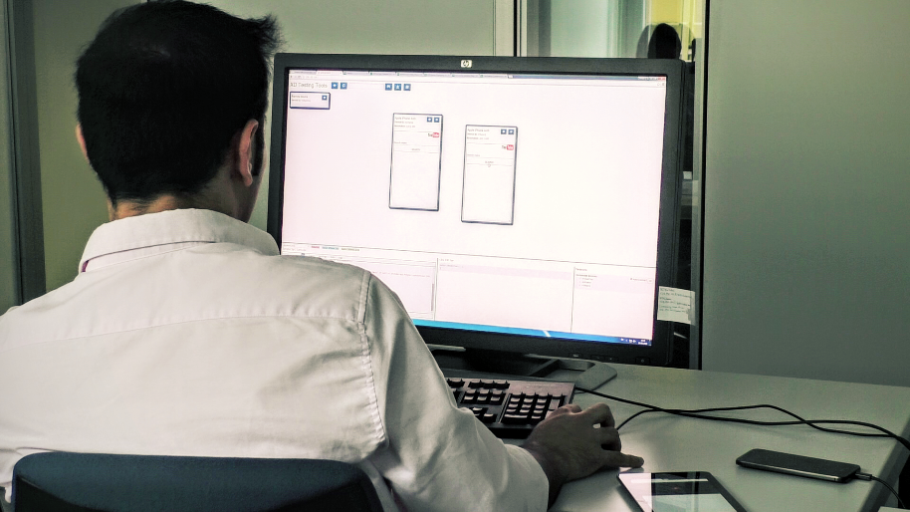
Setup
Motivation Related Work XDTools Sample Applications Evaluation Conclusion Future Work
Browser debugging tools as a baseline for comparison
30-inch screen and 2 additional devices
Asus Nexus 7 (2012 version)
HTC One M9
Some features were disabled, e.g. record and replay
Remote debugging was already set up
5 Chrome profiles were already created
Study setup

Slide 18
Participants
12 participants (2 female), median age 26
All members of the computer science department of ETH
Basic knowledge in client-side web technologies required
8 out of 12 participants had some cross-device development experience
Most of them used both real devices and emulation tools for testing
Most participants already had experience with Chrome DevTools
Experience from basic to proficient
Experience with Chrome DevTools

Slide 19
Tasks
Motivation Related Work XDTools Sample Applications Evaluation Conclusion Future Work
Sample applications used for the tasks
One debugging and one implementation task per application
One app with XDTools, the other without
Order of the applications is counter-balanced
→ 4 different conditions
Questionnaire after each task and after completion all tasks
XDYouTube
Debugging task: Fix a bug related to the video queue
XDCinema
Debugging task: Wrong location was returned because of a switched variable
Implementation task: Implement a remote control for the video
Implementation task: Display and highlight prices of cinemas that show a movie

Slide 20
XDYouTube implementation task
Overall, participants benefited the most from XDTools in this task
Device emulation, connection features and console most popular for this task
Features were generally rated as very useful
Feature ratings similar in other tasks
Feature ratings
Comparison XDTools – Browser tools

Slide 21
Results (1)
Motivation Related Work XDTools Sample Applications Evaluation Conclusion Future Work
Participants generally preferred implementing and debugging with XDTools
Features were rated as useful in all tasks
Participants would use XDTools while implementing cross-device applications
Preference for implementing
Preference for debugging
Usefulness of XDTools

Slide 22
Results (2)
Motivation Related Work XDTools Sample Applications Evaluation Conclusion Future Work
No difference in task completion strategies with and without XDTools
Very similar task completion times
5 tasks aborted (for 3 different participants)
Slightly higher number of emulated devices used with XDTools
Real devices were rarely used
Average task completion times
Average number of emulated devices

Slide 23
Conclusion
Motivation Related Work XDTools Sample Applications Evaluation Conclusion Future Work
Although there are many cross-device frameworks, support for testing and debugging is limited
Tools for testing traditional/responsive web applcations are only partially useful
User study showed promising results
XDTools improves the testing and debugging process of cross-device applications
Serves as a basis for future research

Slide 24
Future Work
Motivation Related Work XDTools Sample Applications Evaluation Conclusion Future Work
Tighter integration with browser
Integrate XDTools directly into browser debugging tools
More advanced access to features
Long-Term Study
Let developers use XDTools while developing an entire application
Analyse usage
Extended record and replay
Apart from recording interactions, also record other non-deterministic data
Periodic feedback
Workarounds like the DNS server can be skipped
Dates, random numbers, server responses, interrupts, ...
First step: Github

Slide 25
Questions?
Thank you for your attention!

