Slide 1
XDTools: Testing and Debugging Cross-Device Applications
Master Thesis
Nina Heyder

Slide 2
Content
Motivation Related Work XDTools Sample Applications Evaluation Conclusion Future Work
Motivation
Related Work
XDTools
Sample Applications
Evaluation
Conclusion
Future Work

Slide 3
Motivation
Motivation Related Work XDTools Sample Applications Evaluation Conclusion Future Work
Users typically have access to multiple devices
Studies have shown that users already use multiple devices in parallel, but better functional coordination is needed
Cross-device applications!
Cross-device frameworks provide little support for testing and debugging
Tools for testing traditional and reponsive websites are not well-suited for debugging multiple devices simultaneously
More advanced testing tools for cross-device applications could help increase the proliferation of such applications

Slide 4
Related Work
Motivation Related Work XDTools Sample Applications Evaluation Conclusion Future Work
Web application testing and debugging
Browser-integrated debugging tools
Responsive web application testing
Web services
Record and replay
Automated testing tools
Testing with actual devices
Device emulation
Cross-device frameworks
Frameworks with tool support
Web-based frameworks
Example: Chrome DevTools
Example: Timelapse
Example: Selenium
Example: BrowserSync
Example: Ghostlab
Example: Chrome Device Mode
Example: XDStudio
Example: XD-MVC
Notes:
- Maybe present one example from each category?

Slide 5
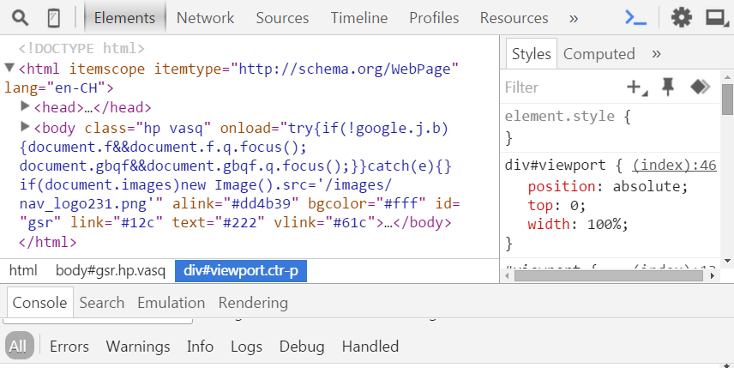
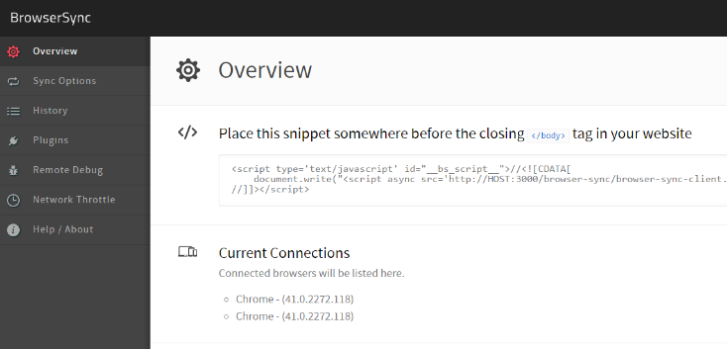
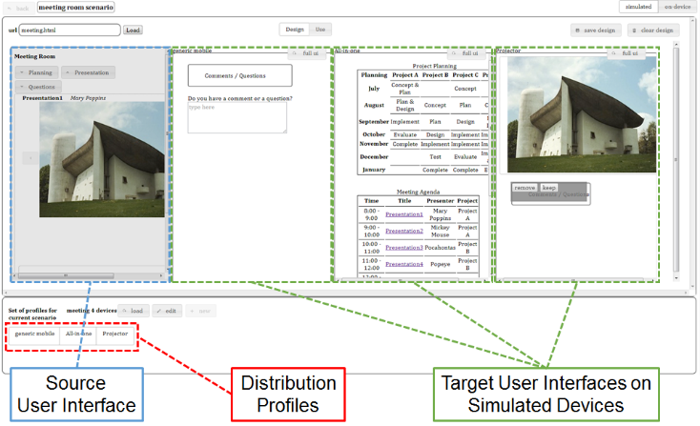
Examples
Motivation Related Work XDTools Sample Applications Evaluation Conclusion Future Work
Chrome DevTools
BrowserSync
XDStudio
DOM tree + CSS inspection and modification
JavaScript debugging
Console
Synchronize interactions
Remote debugging
Automatic refresh when files are changed
Simulated and on-device authoring
Use mode and design mode
Distribution profiles

Slide 6
XDTools
Motivation Related Work XDTools Sample Applications Evaluation Conclusion Future Work
EMULATION OF MULTIPLE DEVICES
INTEGRATION OF REAL DEVICES
SWITCHING OF DEVICE CONFIGURATIONS
INTEGRATION WITH DEBUGGING TOOLS
AUTOMATIC CONNECTION MANAGEMENT
RECORD AND REPLAY
Set of tools that facilitate the testing and debugging of cross-device applications

Slide 7
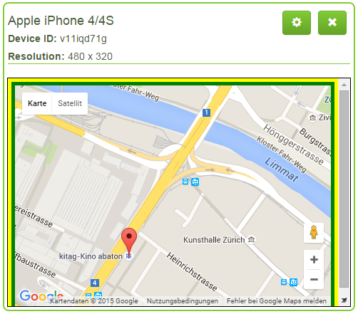
Emulation of Multiple Devices
Motivation Related Work XDTools Sample Applications Evaluation Conclusion Future Work
Goal: Emulate multiple devices in one browser window and prevent the sharing of local resources
Predefined and custom devices
Devices are emulated using iframes
Local DNS server registers one subdomain for each emulated device
Prevents the sharing of local resources
Each device has a unique color for identification
Devices can be moved, scaled, resized and rotated
Emulated device

Slide 8
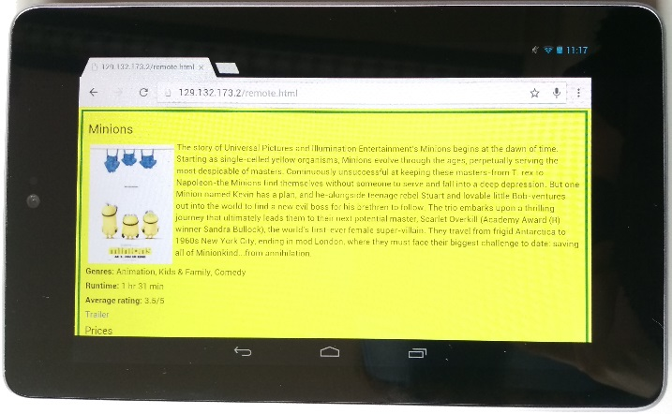
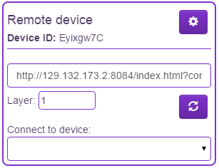
Integration of Real Devices
Motivation Related Work XDTools Sample Applications Evaluation Conclusion Future Work
Goal: It should be easy to connect real devices to XDTools.
Scan a QR code to connect a real device
Device is represented by a proxy in XDTools
Can be used alongside emulated devices
Most features of XDTools are also available for real devices
Real device
Proxy of real device

Slide 9

Switching of Device Configurations
Motivation Related Work XDTools Sample Applications Evaluation Conclusion Future Work
Goal: Quickly create new device configurations and switch between them
Device configurations are stored in Local Storage
Only emulated devices are stored
Real devices might not be available
For each device, the following information is stored:
Name
Resolution
Position
Scaling
Layer

Slide 10
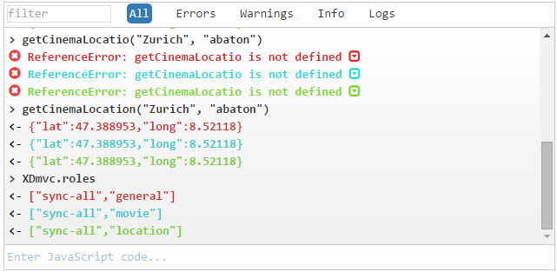
Integration with Debugging Tools
Motivation Related Work XDTools Sample Applications Evaluation Conclusion Future Work
Goal: Include popular features of browser debugging tools in XDTools
Shared JavaScript console
Console outputs from all devices are aggregated
Commands can be sent to multiple devices
Shared CSS editor: CSS rules can be applied to all devices simultaneously
HTML Inspection: Directly jump to the body element of an emulated device in the Chrome DevTools
Function debugging: Set a breakpoint at the beginning of a function on multiple devices
Function debugging and HTML inspection only work for emulated devices
Shared JavaScript console

Slide 11
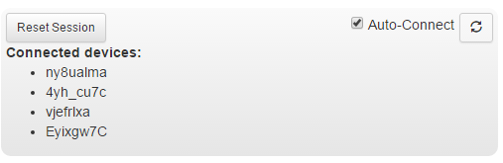
Automatic Connection Management
Motivation Related Work XDTools Sample Applications Evaluation Conclusion Future Work
Goal: It should be possible to automatically and manually connect devices
Set of connected devices = a session
Auto-connect can be enabled for one session
All newly created/connected devices are automatically connected to that session
Drop-down menu to manually connect devices
A session

Slide 12
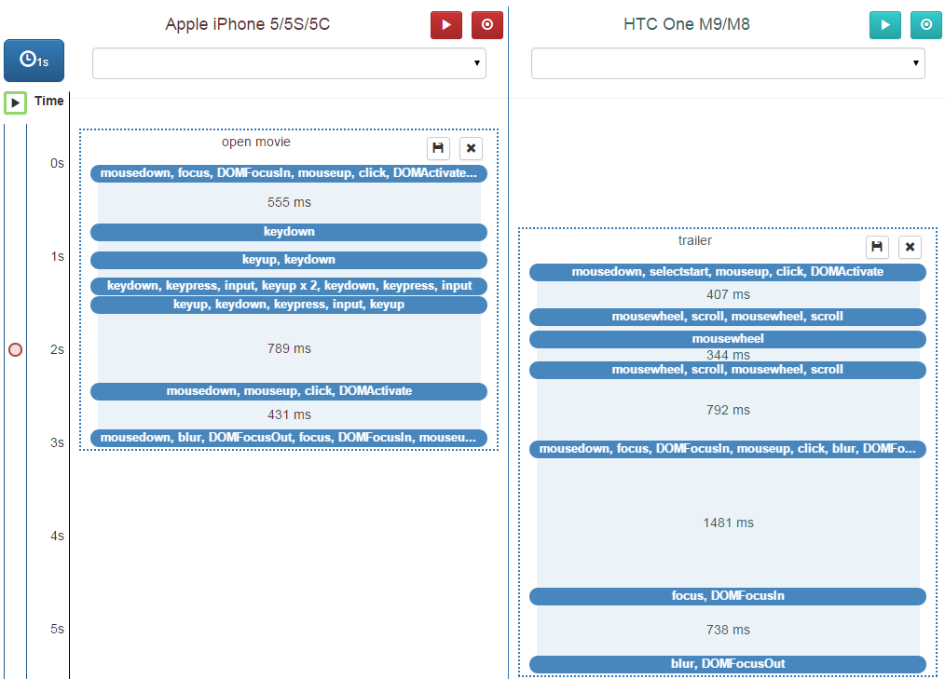
Record and Replay
Motivation Related Work XDTools Sample Applications Evaluation Conclusion Future Work
Goal: Provide a record and replay mechanism that allows accurate timing and replaying on multiple devices simultaneously
Recorded event sequences are visualized
Move event sequences to different devices
Split event sequences into multiple parts
Configure the timing of the replays using drag and drop
Replay on all devices or on one device
Set breakpoints
Visualized event sequences

Slide 13
Sample Applications
Motivation Related Work XDTools Sample Applications Evaluation Conclusion Future Work
XDYouTube
XDCinema
Insights

Slide 14
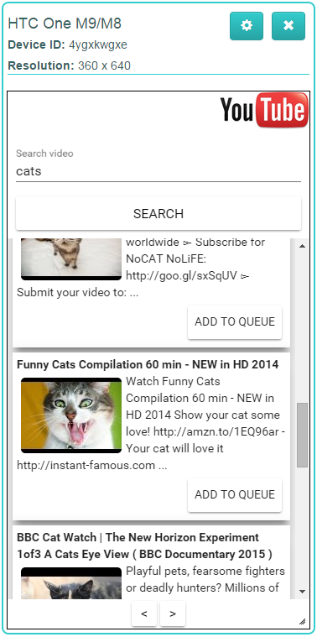
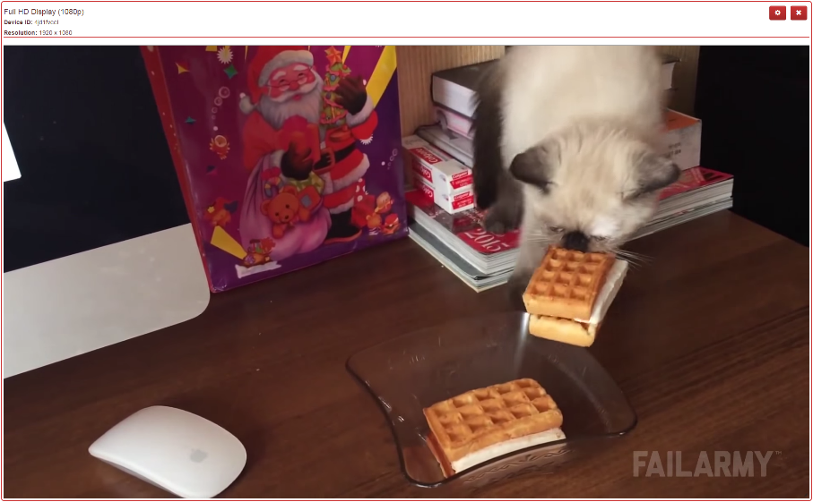
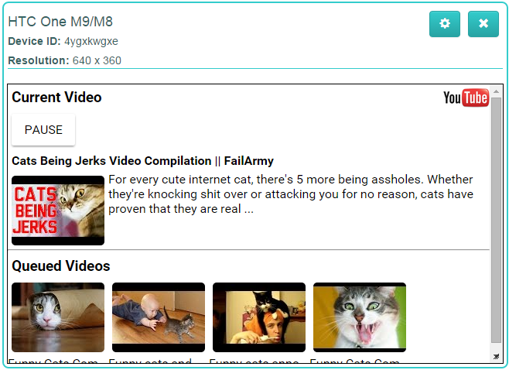
XDYouTube
Player view
Controller view
Plays the current video
Largest device
Search and queue videos
Play/pause videos
See current video + queue

Slide 15
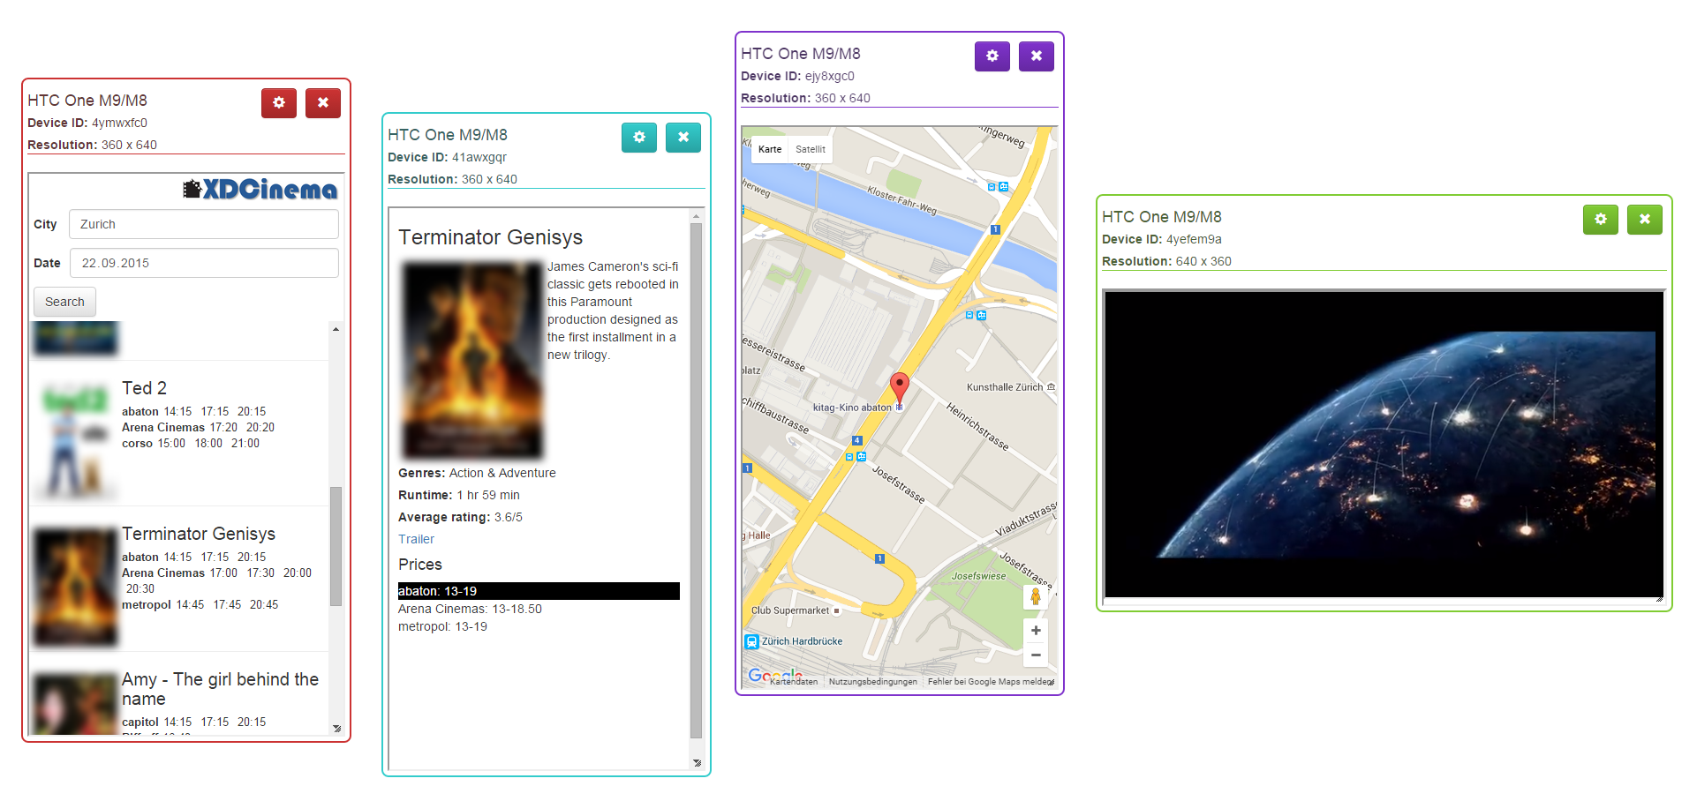
XDCinema
Motivation Related Work XDTools Sample Applications Evaluation Conclusion Future Work
Check the cinema program
Four views:
Search view: Search for movies in the cinema
Movie view: Movie description, ratings, ...
Location view: Location of a cinema
Trailer view: Plays the trailer of a movie
Trailer view
Location view
Search view
Movie view

Slide 16
Insights
Motivation Related Work XDTools Sample Applications Evaluation Conclusion Future Work
Some easy way of debugging the JavaScript of devices is required
Function debugging
Manually connecting devices is tedious
Automatic connection management
Automatically find a free space for new devices
Maybe in the future?
XDTools was helpful while developing the applications
Especially emulation of multiple devices

Slide 17
Evaluation
Motivation Related Work XDTools Sample Applications Evaluation Conclusion Future Work
Setup
Participants
Tasks
XDYouTube implementation task
REsults

Slide 18
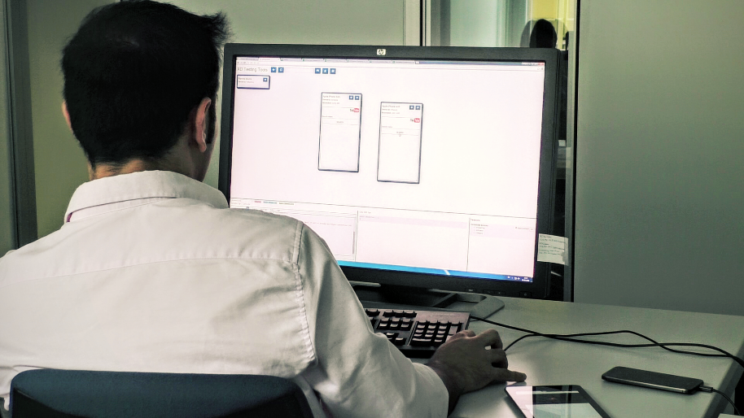
Setup
Motivation Related Work XDTools Sample Applications Evaluation Conclusion Future Work
Browser debugging tools as a baseline for comparison
30-inch screen and 2 additional devices
Asus Nexus 7 (2012 version)
HTC One M9
Some features were disabled, e.g. record and replay
Remote debugging was already set up
5 Chrome profiles were already created
Study setup

Slide 19
Participants
Motivation Related Work XDTools Sample Applications Evaluation Conclusion Future Work
12 participants (2 female), median age 26
All members of the computer science department of ETH
Basic knowledge in client-side web technologies required
8 out of 12 participants had some cross-device development experience
Most of them used both real devices and emulation tools for testing
Most participants already had experience with Chrome DevTools
Experience from basic to proficient
Experience with Chrome DevTools

Slide 20
Tasks
Motivation Related Work XDTools Sample Applications Evaluation Conclusion Future Work
Sample applications used for the tasks
One debugging and one implementation task per application
Time limit 15 and 30 minutes
One app with XDTools, the other without
Order of the applications is counter-balanced
→ 4 different conditions
Questionnaire after each task and after completion all tasks
XDYouTube
Debugging task: Fix a bug related to the video queue
XDCinema
Debugging task: Wrong location was returned because of a switched variable
Implementation task: Implement a remote control for the video
Implementation task: Display and highlight prices of cinemas that show a movie

Slide 21
XDYouTube Implementation Task
Motivation Related Work XDTools Sample Applications Evaluation Conclusion Future Work
Overall, it seems that participants benefited the most from XDTools in this task
Participants found that the task was easier and more efficient to complete with XDTools
Device emulation, connection features and JavaScript console most popular for this task
Only one participant used a real device
Features were generally rated as very useful
Feature ratings similar in other tasks
Comparison XDTools – Browser tools
Feature ratings

Slide 22
XDYouTube Implementation Task
Motivation Related Work XDTools Sample Applications Evaluation Conclusion Future Work
Overall, it seems that participants benefited the most from XDTools in this task
Participants found that the task was easier and more efficient to complete with XDTools
Device emulation, connection features and JavaScript console most popular for this task
Features were generally rated as very useful
Feature ratings similar in other tasks
Comparison XDTools – browser tools
Feature ratings
Notes:
Alternative version of previous slide

Slide 23
Results (1)
Motivation Related Work XDTools Sample Applications Evaluation Conclusion Future Work
Participants generally preferred implementing and debugging with XDTools
Participants would use XDTools while implementing and debugging cross-device applications
Preference for implementing
Preference for debugging
Usefulness of XDTools

Slide 24
Results (2)
Motivation Related Work XDTools Sample Applications Evaluation Conclusion Future Work
5 tasks aborted (for 3 different participants)
Very similar task completion times
What if participants had more time to get used to XDTools?
Slightly higher number of emulated devices used with XDTools
Real devices were rarely used
No difference in task completion strategies with and without XDTools
Average task completion times
Average number of emulated devices

Slide 25
Conclusion
Motivation Related Work XDTools Sample Applications Evaluation Conclusion Future Work
No tools available that allow exhaustive testing of cross-device applications
Potential reason for the low availability of such applications
XDTools improves the testing and debugging process of cross-device applications
User study showed promising results and participants provided some enthusiastic feedback
«I wish I had access to the tool when I was working on a cross-device application last year.»
XDTools serves as a basis for future research in cross-device testing

Slide 26
Future Work
Motivation Related Work XDTools Sample Applications Evaluation Conclusion Future Work
Tighter integration with browser
Integrate XDTools directly into browser debugging tools
More advanced access to features
Long-Term Study
Let developers use XDTools while developing an entire application
Analyse usage
Extended record and replay
Apart from recording interactions, also record other non-deterministic data
Periodic feedback
Workarounds like the DNS server can be avoided
Dates, random numbers, server responses, interrupts, ...
First step: Github

Slide 27
Questions?
Thank you for your attention!

