Slide 1
Cross-Device Application Testing
Master Thesis, Nina Heyder
Mid Term Presentation
Notes:
Screen 1

Slide 2
Content
Motivation Goals Features Challenges Architecture Next Steps Conclusion
Motivation
Goals
Features
Challenges
Architecture
Next Steps
Conclusion
Notes:
Screen 2, with title slide, not incremental

Slide 3
Motivation
Motivation Goals Features Challenges Architecture Next Steps Conclusion
Current tools for testing cross-device applications:
Notes:
Screen 1, incremental

Slide 4
Motivation
Motivation Goals Features Challenges Architecture Next Steps Conclusion
Current tools for testing cross-device applications:
…. → None!
Notes:
Screen 1, incremental

Slide 5
Motivation
Motivation Goals Features Challenges Architecture Next Steps Conclusion
Current tools for testing cross-device applications:
…. → None!
There are many frameworks for developing cross-device applications, but none of them focus on testing
Notes:
Screen 1, incremental

Slide 6
Motivation
Motivation Goals Features Challenges Architecture Next Steps Conclusion
Current tools for testing cross-device applications:
…. → None!
There are many frameworks for developing cross-device applications, but none of them focus on testing
Many tools for testing web applications in general
E.g. Chrome Developer Tools
Notes:
Screen 1, incremental

Slide 7
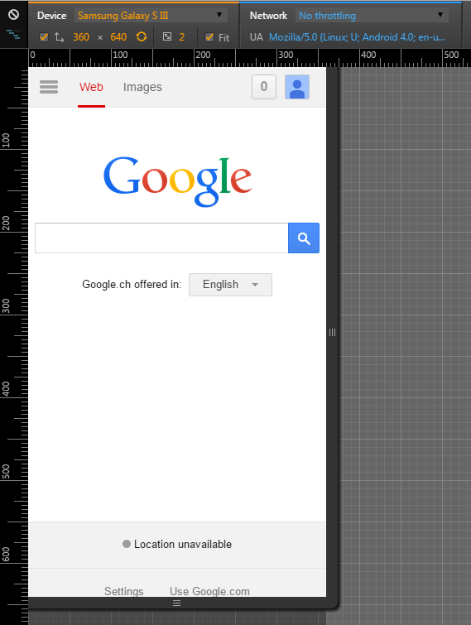
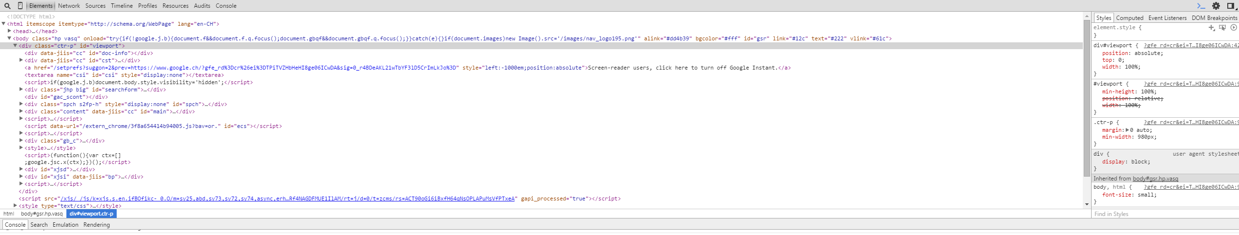
Chrome Developer Tools
HTML+ CSS inspection and modification
JavaScript console
Debugging Java Script
Device mode
Limitations
Everything is only applied to one device
Only one device can be emulated at a time
Notes:
Screen 2, when Chrome Dev Tools are mentioned

Slide 8
Motivation
Motivation Goals Features Challenges Architecture Next Steps Conclusion
Current tools for testing cross-device applications:
…. → None!
There are many frameworks for developing cross-device applications, but none of them focus on testing
Many tools for testing web applications in general
E.g. Chrome Developer Tools
In particular for responsive design: BrowserStack, CrossBrowserTesting, Ghostlab, Chrome Device Mode, …
Notes:
Screen 1, incremental

Slide 9
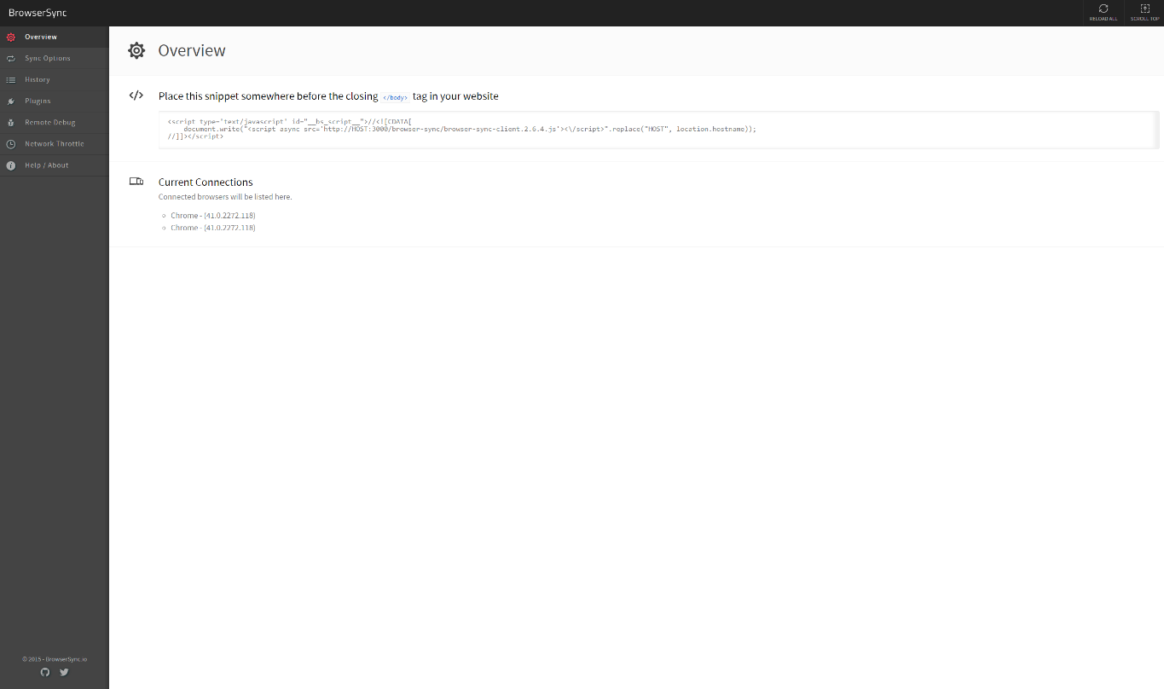
BrowserSync
Synchronize clicks, scrolls, form submits, …
Reload all browsers
Remote debugging of HTML and CSS
Automatically reload when files are changed
Limitations
Real devices required
Synchronizing all devices not useful for cross-device apps
Notes:
Screen 2, when responsive testing tools are mentioned

Slide 10
Goals
Motivation Goals Features Challenges Architecture Next Steps Conclusion
Analyze
Gather requirements for improvements
Find limitations
General web testing tools
Testing tools for responsive design
Notes:
Screen 1, incremental

Slide 11
Goals
Motivation Goals Features Challenges Architecture Next Steps Conclusion
Analyze
Testing tools for responsive design
Design and Implement
Set of tools for simplifying cross-device application testing
General web testing tools
Based on requirements gathered during analysis
Find limitations
Gather requirements for improvements
Notes:
Screen 1, incremental

Slide 12
Goals
Motivation Goals Features Challenges Architecture Next Steps Conclusion
Analyze
Testing tools for responsive design
Design and Implement
Set of tools for simplifying cross-device application testing
User Study
Test the suitability and quality of the tools
General web testing tools
Based on requirements gathered during analysis
Find limitations
Gather requirements for improvements
Notes:
Screen 1, incremental

Slide 13
Features
Motivation Goals Features Challenges Architecture Next Steps Conclusion
General Features
Emulating Devices
Connecting Actual Devices
Record/Replay
Shared JavaScript Console
Shared CSS Editor
Notes:
Screen 1, not incremental

Slide 14
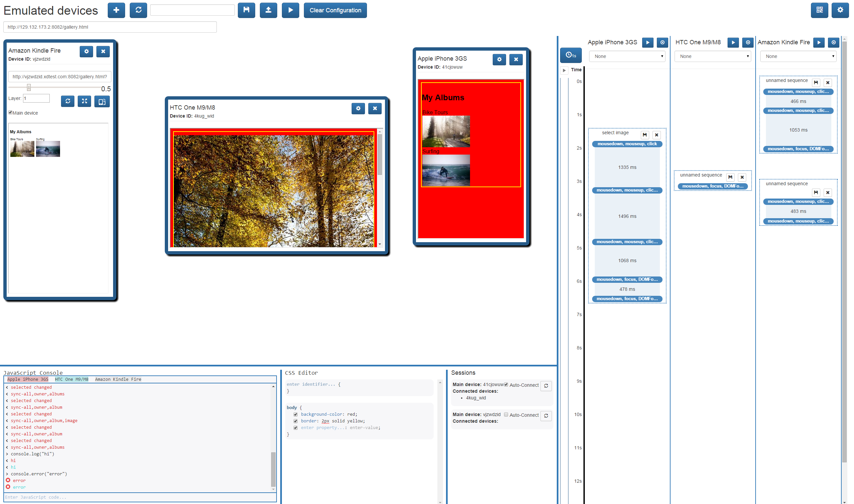
Notes:
Screen 2, not incremental

Slide 15
General Features
Motivation Goals Features Challenges Architecture Next Steps Conclusion
Refresh all devices
Notes:
Screen 1, incremental

Slide 16
Notes:
Screen 2, highlights incremental

Slide 17
General Features
Motivation Goals Features Challenges Architecture Next Steps Conclusion
Refresh all devices
Load URL on all devices
Notes:
Screen 1, incremental

Slide 18
Notes:
Screen 2, highlights incremental

Slide 19
General Features
Motivation Goals Features Challenges Architecture Next Steps Conclusion
Refresh all devices
Load URL on all devices
Save and load device configurations
Notes:
Screen 1, incremental

Slide 20
Notes:
Screen 2, highlights incremental

Slide 21
General Features
Motivation Goals Features Challenges Architecture Next Steps Conclusion
Refresh all devices
Load URL on all devices
Save and load device configurations
Connect a device to another device by selecting the device in a drop-down menu
Notes:
Screen 1, incremental

Slide 22
General Features
Motivation Goals Features Challenges Architecture Next Steps Conclusion
Refresh all devices
Load URL on all devices
Save and load device configurations
Connect a device to another device by selecting the device in a drop-down menu
Auto-connect all newly created devices to a specific device
Notes:
Screen 1, incremental

Slide 23
Notes:
Screen 2, slide 22 + 23

Slide 24
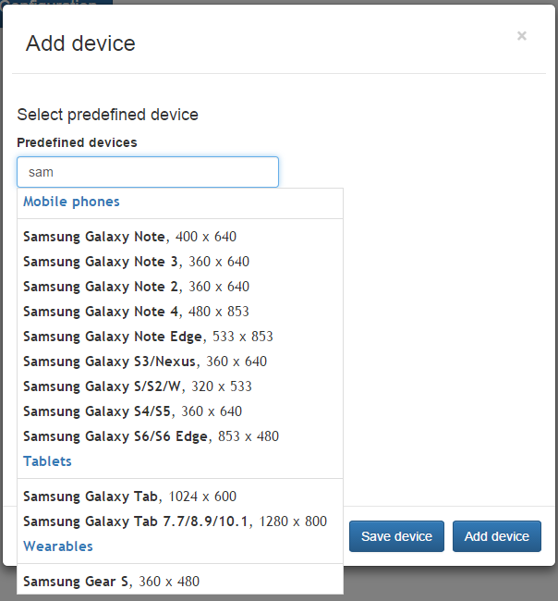
Emulating Devices
Motivation Goals Features Challenges Architecture Next Steps Conclusion
A set of predefined devices is available for emulating
Notes:
Screen 1, incremental

Slide 25
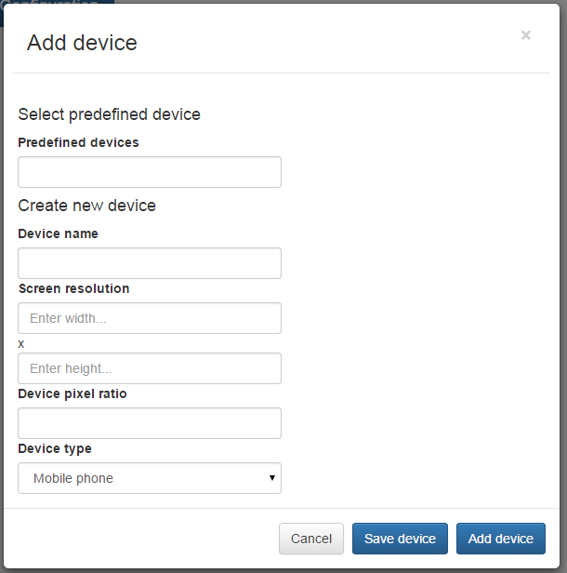
Emulating Devices
Motivation Goals Features Challenges Architecture Next Steps Conclusion
A set of predefined devices is available for emulating
Custom devices can be added and saved
Notes:
Screen 1, incremental

Slide 26
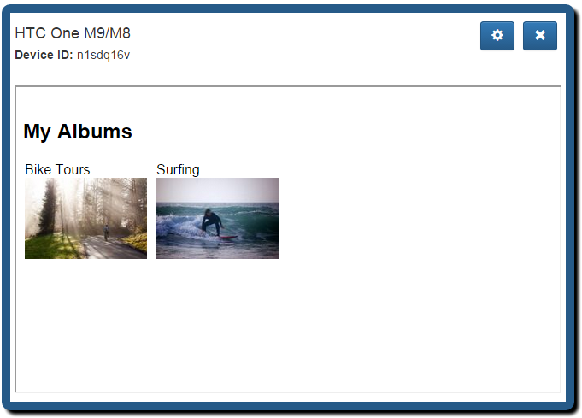
Emulating Devices
Motivation Goals Features Challenges Architecture Next Steps Conclusion
Devices can be arranged arbitrarily on the screen
Devices can be scaled up and down
Notes:
Screen 1, show devices incremental

Slide 27
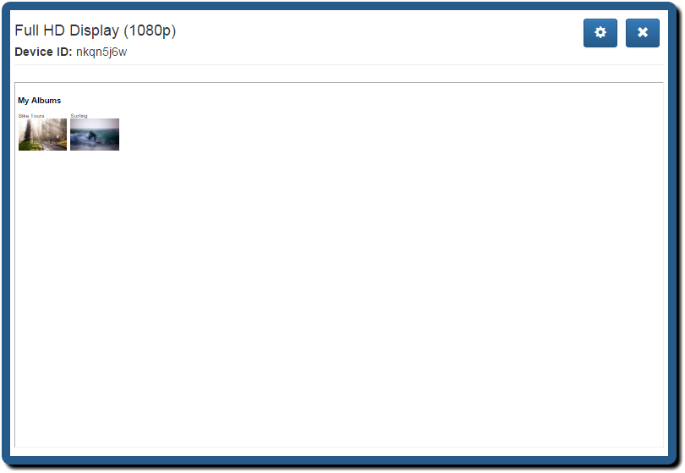
Emulating Devices
Motivation Goals Features Challenges Architecture Next Steps Conclusion
Devices can be arranged arbitrarily on the screen
Devices can be scaled up and down
Notes:
Screen 1, show devices incremental

Slide 28
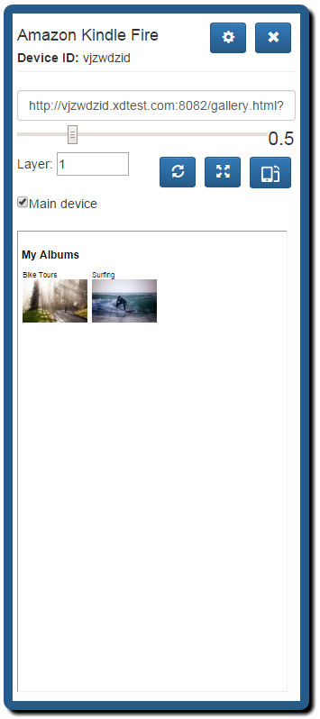
Emulating Devices
Motivation Goals Features Challenges Architecture Next Steps Conclusion
Devices can be arranged arbitrarily on the screen
Devices can be scaled up and down
Notes:
Screen 1, show devices incremental

Slide 29
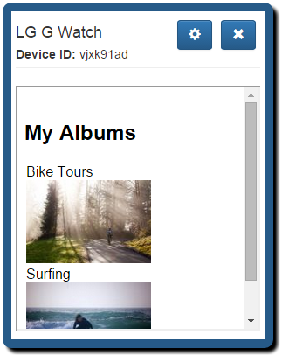
Emulating Devices
Motivation Goals Features Challenges Architecture Next Steps Conclusion
Devices can be arranged arbitrarily on the screen
Devices can be scaled up and down
Notes:
Screen 1, show devices incremental

Slide 30
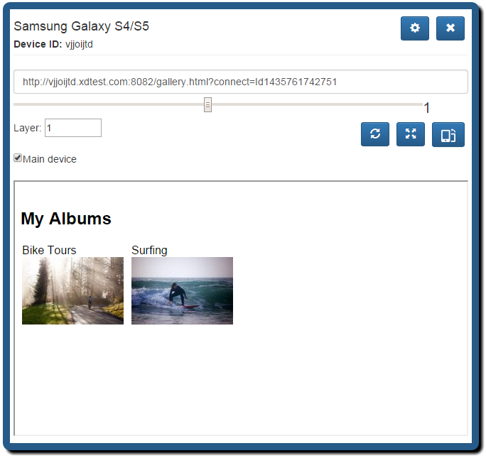
Emulating Devices
Motivation Goals Features Challenges Architecture Next Steps Conclusion
Orientation can be switched
Notes:
Screen 1, incremental

Slide 31
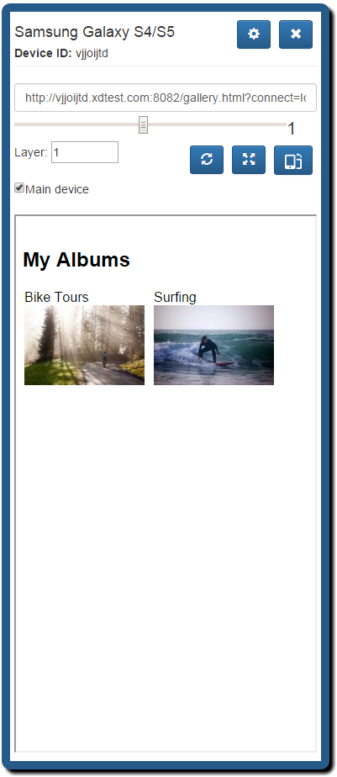
Emulating Devices
Motivation Goals Features Challenges Architecture Next Steps Conclusion
Orientation can be switched
Notes:
Screen 1, incremental

Slide 32
Notes:
Screen 2 for slide 11-13

Slide 33

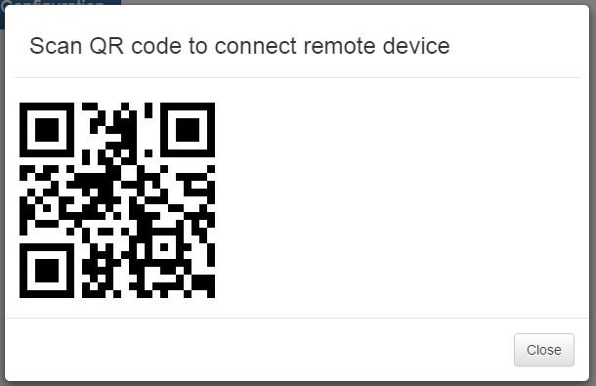
Connecting Actual Devices
Motivation Goals Features Challenges Architecture Next Steps Conclusion
Actual devices can be connected in two ways:
Scanning a QR code
Typing a URL into the browser
Screenshot of an actual device
Notes:
Screen 1

Slide 34
Notes:
Screen 2

Slide 35
Record/Replay
Motivation Goals Features Challenges Architecture Next Steps Conclusion
Record sequence
On emulated device
Notes:
Screen 1, incremental

Slide 36
Record/Replay
Motivation Goals Features Challenges Architecture Next Steps Conclusion
Record sequence
On emulated device
Visualize sequence
Display events in a timeline
Adjust timing
Drag and drop sequence
Replay sequence
Set breakpoints
Move sequence to other device
On any device
Add breaks of one second
Save sequence
Notes:
Screen 1, incremental

Slide 37
Notes:
Screen 2, maybe highlight individual steps

Slide 38
Shared JavaScript Console
Motivation Goals Features Challenges Architecture Next Steps Conclusion
Send JavaScript commands to all devices
Or a selected set of devices
Notes:
Screen 1, incremental (main points)

Slide 39
Shared JavaScript Console
Motivation Goals Features Challenges Architecture Next Steps Conclusion
Send JavaScript commands to all devices
Or a selected set of devices
Aggregates console outputs of all devices in one place
console.log/console.info/console.warn/console.error
Variables
Return values of functions
JavaScript errors
Notes:
Screen 1, incremental (main points)

Slide 40
Notes:
Screen 2

Slide 41
Shared CSS Editor
Motivation Goals Features Challenges Architecture Next Steps Conclusion
Add CSS rules to all devices
Or to a selected set of devices
Notes:
Screen 1, incremental

Slide 42
Shared CSS Editor
Motivation Goals Features Challenges Architecture Next Steps Conclusion
Add CSS rules to all devices
Or to a selected set of devices
Enable/disable rules
Notes:
Screen 1, incremental

Slide 43
Shared CSS Editor
Motivation Goals Features Challenges Architecture Next Steps Conclusion
Add CSS rules to all devices
Or to a selected set of devices
Enable/disable rules
Stylesheet is created at the beginning of testing
Notes:
Screen 1, incremental

Slide 44
Shared CSS Editor
Motivation Goals Features Challenges Architecture Next Steps Conclusion
Add CSS rules to all devices
Or to a selected set of devices
Enable/disable rules
Stylesheet is created at the beginning of testing
Rules are added/removed from this stylesheet
Notes:
Screen 1, incremental

Slide 45
Notes:
Screen 2

Slide 46
Challenges
Motivation Goals Features Challenges Architecture Next Steps Conclusion
Browser State
Event Capturing
Accurate Event Visualization
Scaling Devices
Notes:
Screen 1

Slide 47
Browser State
Motivation Goals Features Challenges Architecture Next Steps Conclusion
Problem
Solution
Emulated devices must not share browser data
Actual devices don’t share browser data → Emulated devices should also not share browser data
Local DNS server (rainbow-dns)
Each emulated device gets its own subdomain based on its ID
Unknown domains are forwarded to the usual DNS server
Notes:
Screen 1

Slide 48
Event Capturing
Motivation Goals Features Challenges Architecture Next Steps Conclusion
Problem
Solution
We must receive all events before anyone else receives them and modifies the page or prevents the event from propagating further
Include a script at the top of the page that is tested
Script adds event handlers before any other event handlers can be added
Add event handlers on the document itself with event capturing
Notes:
Screen 1

Slide 49
Accurate Event Visualization
Motivation Goals Features Challenges Architecture Next Steps Conclusion
Problem
Solution
Event visualization must represent the true timing of events if timing is to be configured using drag and drop
Each element that represents an event requires some space
Events are grouped based on their timing
Take the first event that needs to be visualized, then take all events that occur within x milliseconds of the first event
Notes:
Screen 1

Slide 50
Scaling Devices
Motivation Goals Features Challenges Architecture Next Steps Conclusion
Problem
Solution
Devices need to be scaled down because space on the screen is limited, but scaling devices changes the resolution and thus the layout of the page that is tested
Use CSS property “transform” to set the scaling of the device
E.g. “transform: scale(0.5)”
Use negative margins so the device does not take up more space than it should
Notes:
Screen 1

Slide 51
Architecture
Motivation Goals Features Challenges Architecture Next Steps Conclusion
Server
Notes:
Screen 1, incremental

Slide 52
Main Device
Where all the functionality is available
JavaScript
jQuery, jQuery UI
Bootstrap
HTML5/CSS3
Socket.io
Notes:
Screen 2

Slide 53
Architecture
Motivation Goals Features Challenges Architecture Next Steps Conclusion
Main device
Desktop
Server
Application, commands, …
Notes:
Screen 1, incremental

Slide 54
Our Server
Runs our application
Node.js with Express
Socket.io
Provides script for the testing application
Pure JavaScript
Commands are sent/received using HTML5 postMessage functionality
Notes:
Screen 2, for each component

Slide 55
Architecture
Motivation Goals Features Challenges Architecture Next Steps Conclusion
Main device
Desktop
Actual devices
Server
Application, commands, …
Sends commands
Notes:
Screen 1, incremental

Slide 56
Actual Devices
Only responsible for receiving and executing commands
JavaScript
jQuery, jQuery UI
Bootstrap
HTML5/CSS3
Socket.io
Notes:
Screen 2

Slide 57
Architecture
Motivation Goals Features Challenges Architecture Next Steps Conclusion
DNS Server
Main device
Desktop
Requests subdomain
Actual devices
Server
Application, commands, …
Sends commands
Notes:
Screen 1, incremental

Slide 58
DNS Server
rainbow-dns
Node.js based DNS server
Registers subdomains for emulated devices
Notes:
Screen 2

Slide 59
Architecture
Motivation Goals Features Challenges Architecture Next Steps Conclusion
DNS Server
Main device
Desktop
Requests subdomain
Application Server
Provides application that is being tested
Sends script
Actual devices
Server
Application, commands, …
Sends commands
Notes:
Screen 1, incremental

Slide 60
Architecture
Motivation Goals Features Challenges Architecture Next Steps Conclusion
DNS Server
Main device
Desktop
Requests subdomain
Application Server
Provides application that is being tested
Sends script
Actual devices
Server
Application, commands, …
Sends commands
Notes:
Screen 1, incremental

Slide 61
Architecture
Motivation Goals Features Challenges Architecture Next Steps Conclusion
DNS Server
Main device
Desktop
Requests subdomain
Application Server
Provides application that is being tested
Sends script
Actual devices
Server
Application, commands, …
Sends commands
Notes:
Screen 1, incremental

Slide 62
Architecture
Motivation Goals Features Challenges Architecture Next Steps Conclusion
DNS Server
Main device
Desktop
Requests subdomain
Application Server
Provides application that is being tested
Sends script
Actual devices
Server
Application, commands, …
Sends commands
Notes:
Screen 1, incremental

Slide 63
Architecture
Motivation Goals Features Challenges Architecture Next Steps Conclusion
DNS Server
Main device
Desktop
Requests subdomain
Application Server
Provides application that is being tested
Sends script
Actual devices
Server
Application, commands, …
Sends commands
Notes:
Screen 1, incremental

Slide 64
Architecture
Motivation Goals Features Challenges Architecture Next Steps Conclusion
DNS Server
Main device
Desktop
Requests subdomain
Application Server
Provides application that is being tested
Sends script
Actual devices
Server
Application, commands, …
Sends commands
Notes:
Screen 1, incremental

Slide 65
Application Server
Runs the application that is being tested
Can use any technologies
Not dependent on XDMVC framework
Only restriction:
Must be a web application
Notes:
Screen 2

Slide 66
Next Steps
Motivation Goals Features Challenges Architecture Next Steps Conclusion
Sample applications
Cross-Device YouTube application
Anyone can queue videos
Videos are played on the “main” device
News application? Amazon application? Some other application?
Notes:
Screen 1

Slide 67
Next Steps
Motivation Goals Features Challenges Architecture Next Steps Conclusion
Sample applications
Cross-Device YouTube application
Anyone can queue videos
Videos are played on the “main” device
News application? Amazon application? Some other application?
Possibly more features
Easy inspection of HTML/JS files associated with emulated devices?
Improvements based on observations during sample application development
Script for connecting
Notes:
Screen 1

Slide 68
Next Steps
Motivation Goals Features Challenges Architecture Next Steps Conclusion
Sample applications
Cross-Device YouTube application
Anyone can queue videos
Videos are played on the “main” device
News application? Amazon application? Some other application?
Possibly more features
Easy inspection of HTML/JS files associated with emulated devices?
Improvements based on observations during sample application development
User study
Test the suitability and quality of the tools
Notes:
Screen 1

Slide 69
Conclusion
Motivation Goals Features Challenges Architecture Next Steps Conclusion
Notes:
Screen 1

Slide 70
Questions?
Thank you for your attention!
Notes:
Screen 2, when conclusion is over

Slide 71
DNS Server
Main device
Desktop
Requests subdomain
Application Server
Chrome extension
Provides application that is being tested
Sends script
Actual devices
Server
Application, commands, …
Sends commands

