Slide 1
Deep learning final project
Arlette Michelle Perez Espinoza
Miray Yüce
Mostafa Hussein

Slide 2
Task 1: Prediction of the final error using MLP
Two hidden layers with 64 units each, and ReLU activation functions
Parameter | Min Value | Max Value | Log
Batch size | 32 | 512 | No
Learning rate | 10⁻⁶ | 10⁰ | Yes
# units in layer 1 | 16 | 1024 | Yes
# units in layer 2 | 16 | 1024 | Yes
# units in layer 3 | 16 | 1024 | Yes

Slide 3
MLP and Random Forest results for raw data
 | Network |  |  |  |  | Baseline
Experiment | LR | Alpha | Batch size | Noise | Mean MSE of 3 splits | Max depth | # Estimators | Min leaf | Mean MSE of 3 splits
w/out reg. | 0.001 | 0 | 265 | 0 | 0.0067 | 32 | 32 | 2 | 0.0109
L1 | 1e-5 | 0.0001 | 64 | 0 | 0.007 | 32 | 16 | 4 | 0.0101
L2 | 1e-5 | 0.0001 | 64 | 0 | 0.009 | 32 | 16 | 4 | 0.0101
Noise | 1e-4 | 1e-5 | 8 | 0.02 | 0.012 | 16 | 32 | 4 | 0.0099
Decay | 1e-4 – 1e-6 | 0 | 128 | 0 | 0.0083 | 16 | 8 | 4 | 0.0101
L1-Noise | 1e-4 | 0.001 | 128 | 0.02 | 0.0076 | 8 | 16 | 4 | 0.0101
L2-Noise | 1e-5 | 1e-5 | 128 | 0.02 | 0.0084 | 8 | 16 | 4 | 0.0101
L1-Decay | 0.01 – 1e-6 | 1e-4 | 265 | 0 | 0.0087 | 8 | 16 | 4 | 0.0101
L2-Decay | 0.001 – 1e-6 | 1e-5 | 265 | 0 | 0.0090 | 8 | 16 | 4 | 0.0101
Noise-Decay | 0.001 – 1e-6 | 0 | 128 | 0.02 | 0.0082 | 16 | 8 | 4 | 0.0101
L1-Noise-Decay | 0.001 – 1e-6 | 1e-5 | 265 | 0.02 | 0.0071 | 8 | 16 | 4 | 0.0101
L2-Noise-Decay | 0.01 – 1e-6 | 1e-4 | 265 | 0.02 | 0.0079 | 8 | 16 | 4 | 0.0101

Slide 4
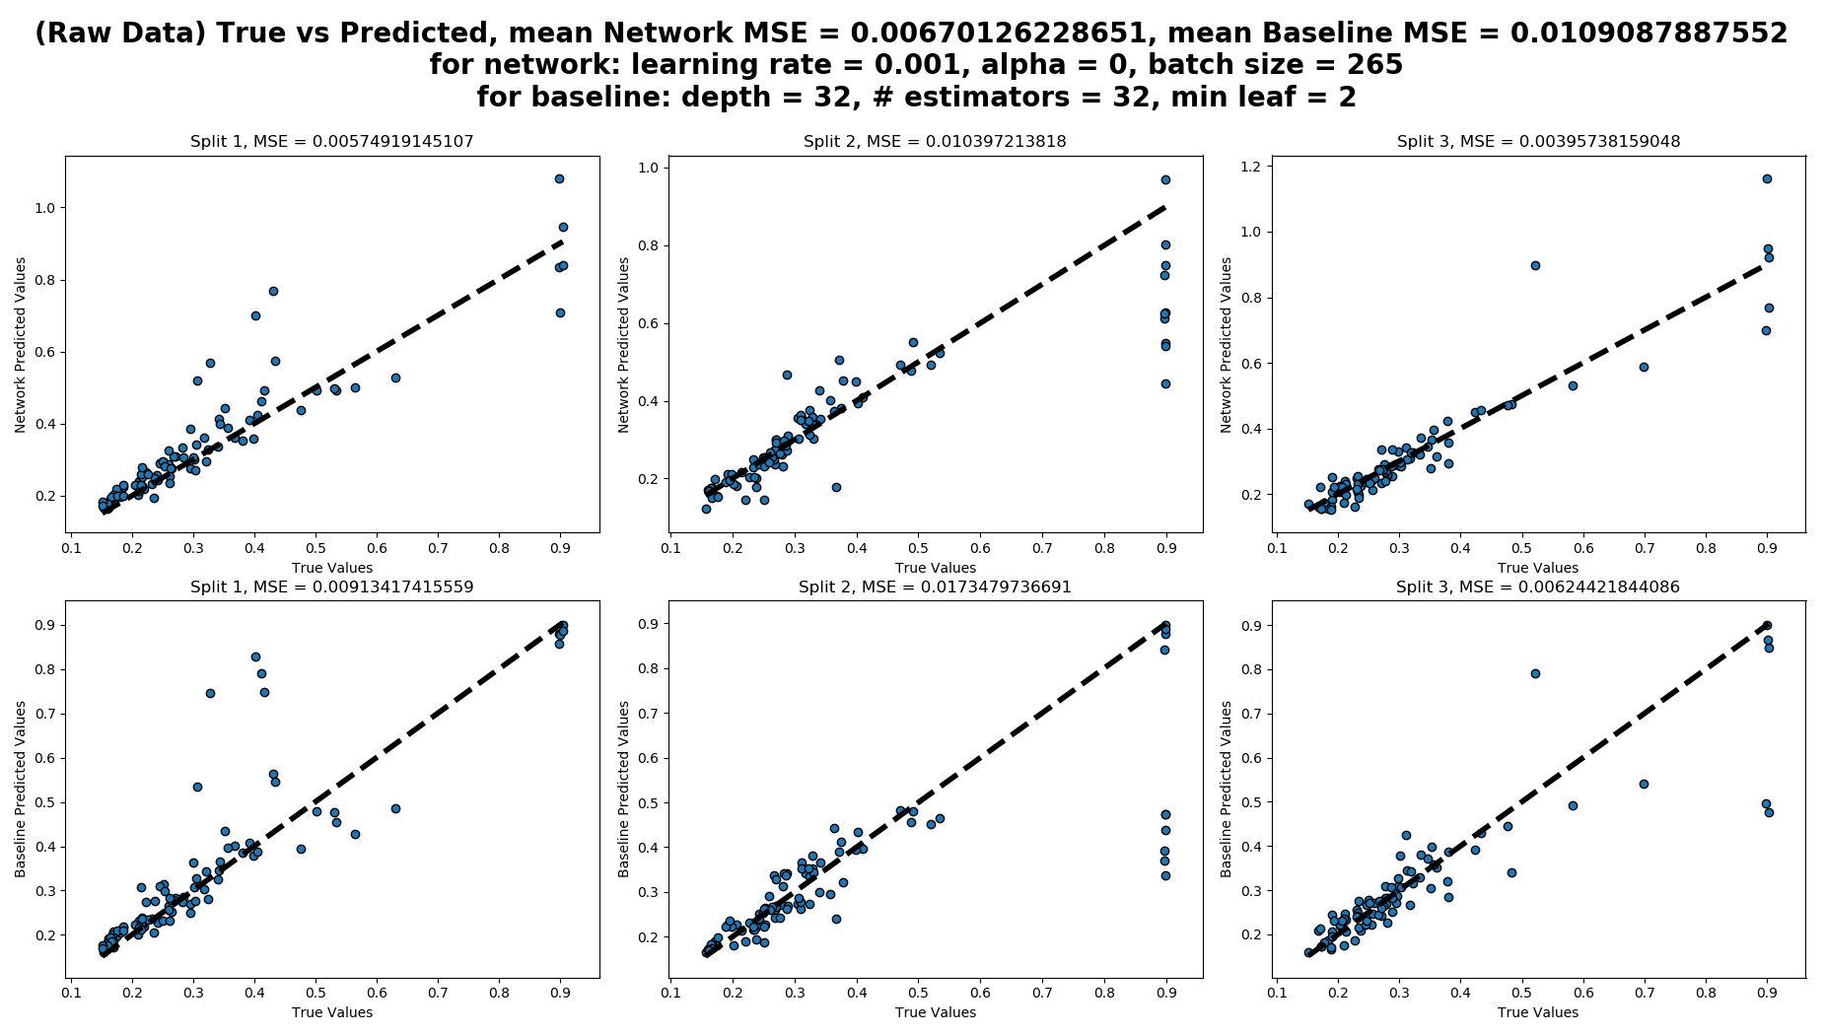

Slide 5
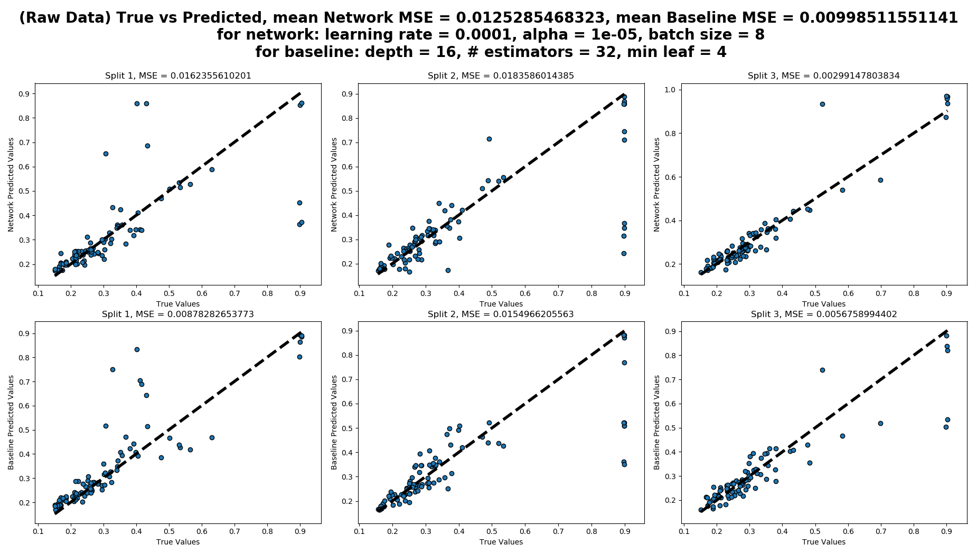

Slide 6
MLP and Random Forest results for scaled data
 | Network |  |  |  |  | Baseline
 | LR | Alpha | Batch size | Noise | Mean MSE of 3 splits | Max depth | # Estimators | Min leaf | Mean MSE of 3 splits
w/out reg. | 1e-5 | 0 | 64 | 0 | 0.0040 | 8 | 4 | 4 | 0.0119
L1 | 1e-5 | 0.0001 | 64 | 0 | 0.0109 | 16 | 32 | 4 | 0.0106
L2 | 1e-5 | 0.0001 | 0.0080 | 0 | 0.009 | 16 | 32 | 4 | 0.0106
Noise | 1e-4 | 1e-5 | 8 | 0.02 | 0.0084 | 16 | 32 | 4 | 0.0099
Decay | 1e-4 – 1e-6 | 0 | 128 | 0 | 0.0051 | 16 | 4 | 4 | 0.0123
L1-Noise | 1e-5 | 1e-5 | 32 | 0.02 | 0.0080 | 32 | 32 | 4 | 0.0106
L2-Noise | 1e-6 | 1e-4 | 64 | 0.02 | 0.0078 | 32 | 32 | 4 | 0.0106
L1-Decay | 0.01 – 1e-6 | 1e-5 | 8 | 0 | 0.0102 | 8 | 16 | 4 | 0.0105
L2-Decay | 0.001 – 1e-6 | 1e-5 | 265 | 0 | 0.0087 | 8 | 16 | 4 | 0.0105
Noise-Decay | 1e-4 – 1e-6 | 0 | 128 | 0.02 | 0.0072 | 16 | 4 | 4 | 0.0123
L1-Noise-Decay | 0.001 – 1e-6 | 1e-5 | 265 | 0.02 | 0.0059 | 8 | 16 | 4 | 0.0105
L2-Noise-Decay | 0.001 – 1e-6 | 1e-5 | 265 | 0.02 | 0.0055 | 8 | 16 | 4 | 0.0105

Slide 7
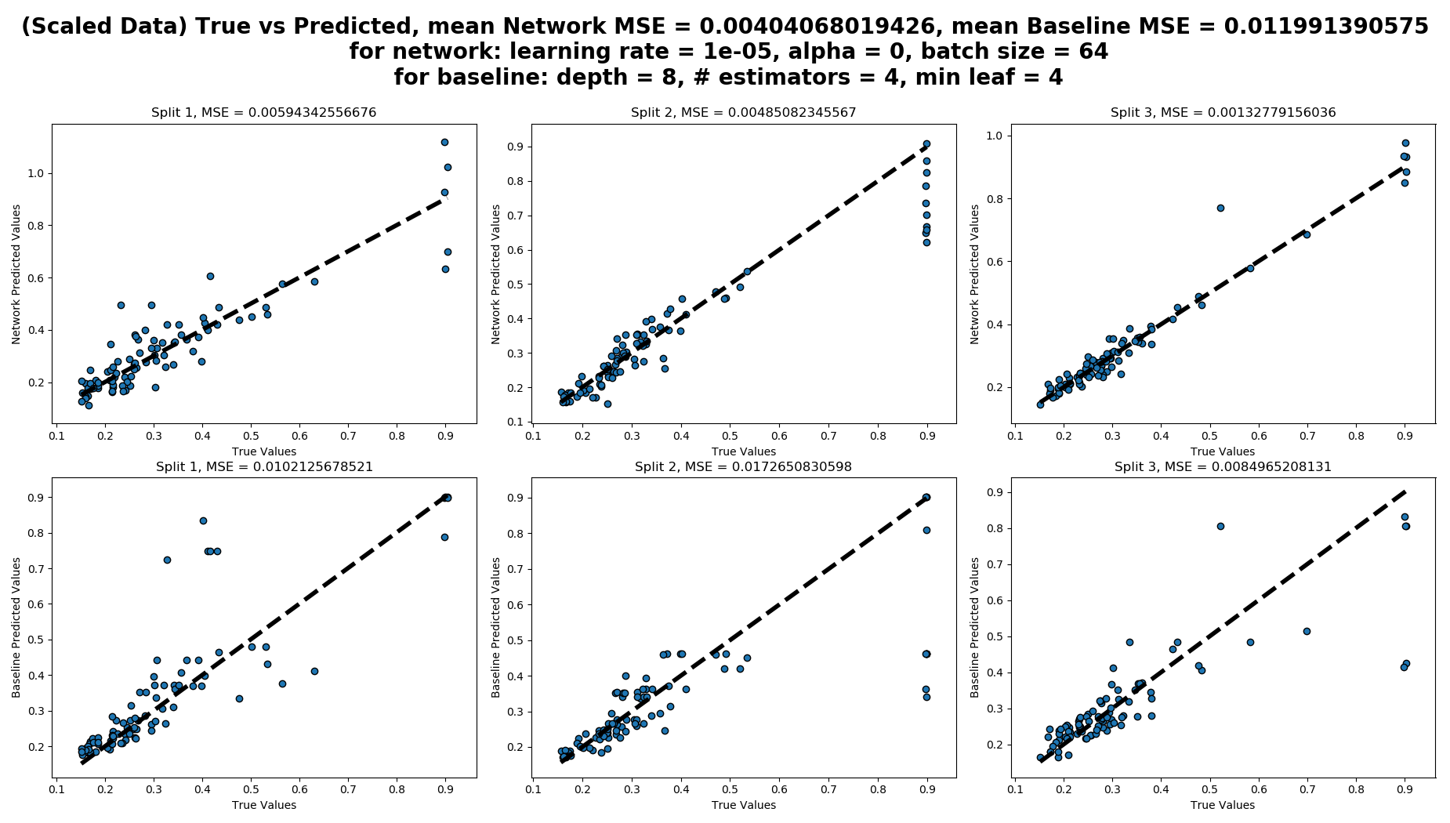

Slide 8
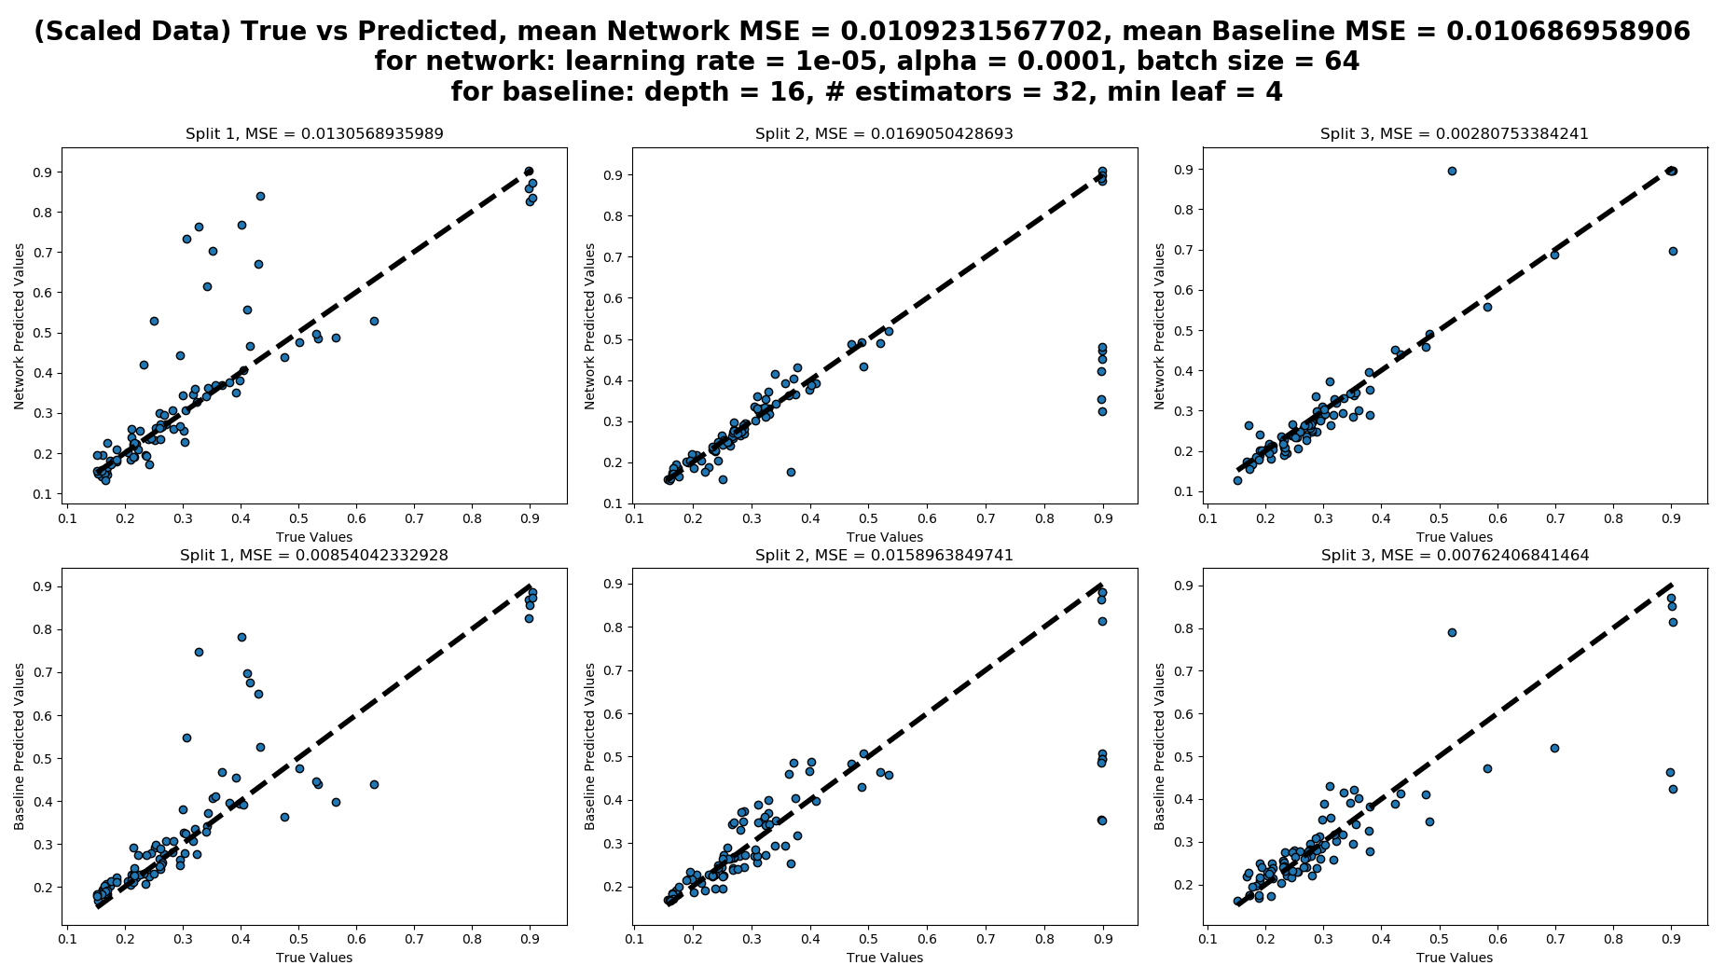

Slide 9
Task 2: Extrapolation of learning curves
Architecture
2 LSTM layers, 64 units each
2 Dense layers, 64 units each, ReLu activation
Regularizations:
Gaussian Noise of 0.02 between layers, except before the output layer
L2 regularization of kernels
Optimizations:
Adam
Kernel initialization: random uniform [0.01, 0.05]
Bias initialization: constant 0.1

Slide 10
Results of task 2: RNN’s and baselines
 | LR | Alpha | Pred 5 MSE | Pred 10 MSE | Pred 20 MSE | Pred 30 MSE
Train 5 | 0.001 – 1e-6 | 1e-7 | 0.0282 | 0.0267 | 0.0257 | 0.0272
Train 10 | 1e-4 – 1e-6 | 1e-5 | 0.0228 | 0.01011 | 0.0272 | 0.0264
Train 20 | 0.001 – 1e-6 | 1e-6 | 0.0279 | 0.0260 | 0.0068 | 0.0283
Random | 1e-4 – 1e-7 | 1e-5 | 0.0089 | 0.0066 | 0.0056 | 0.0046
 | Max depth | # Estimators | Min leaf | MSE
Train 5 | 32 | 16 | 1 | 0.0015
Train 10 | 32 | 32 | 4 | 0.0010
Train 20 | 32 | 16 | 1 | 0.0004
Last 4 point prediction | 32 | 16 | 8 | 0.0003

Slide 11
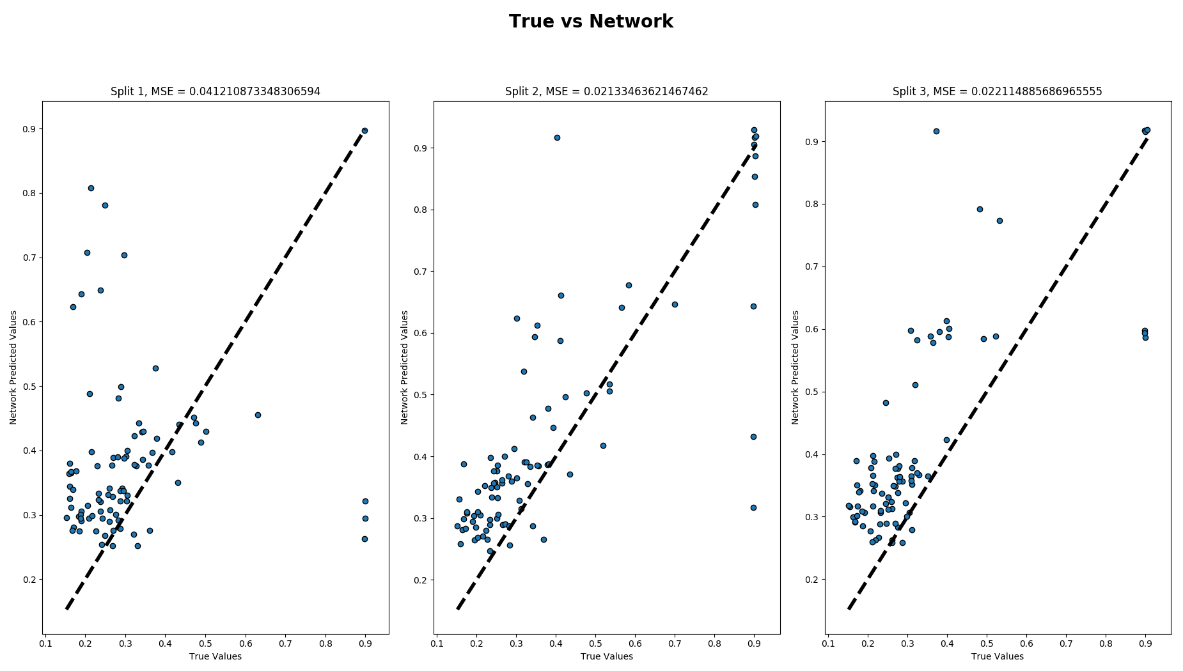
RNN trained with fixed input length: 5

Slide 12
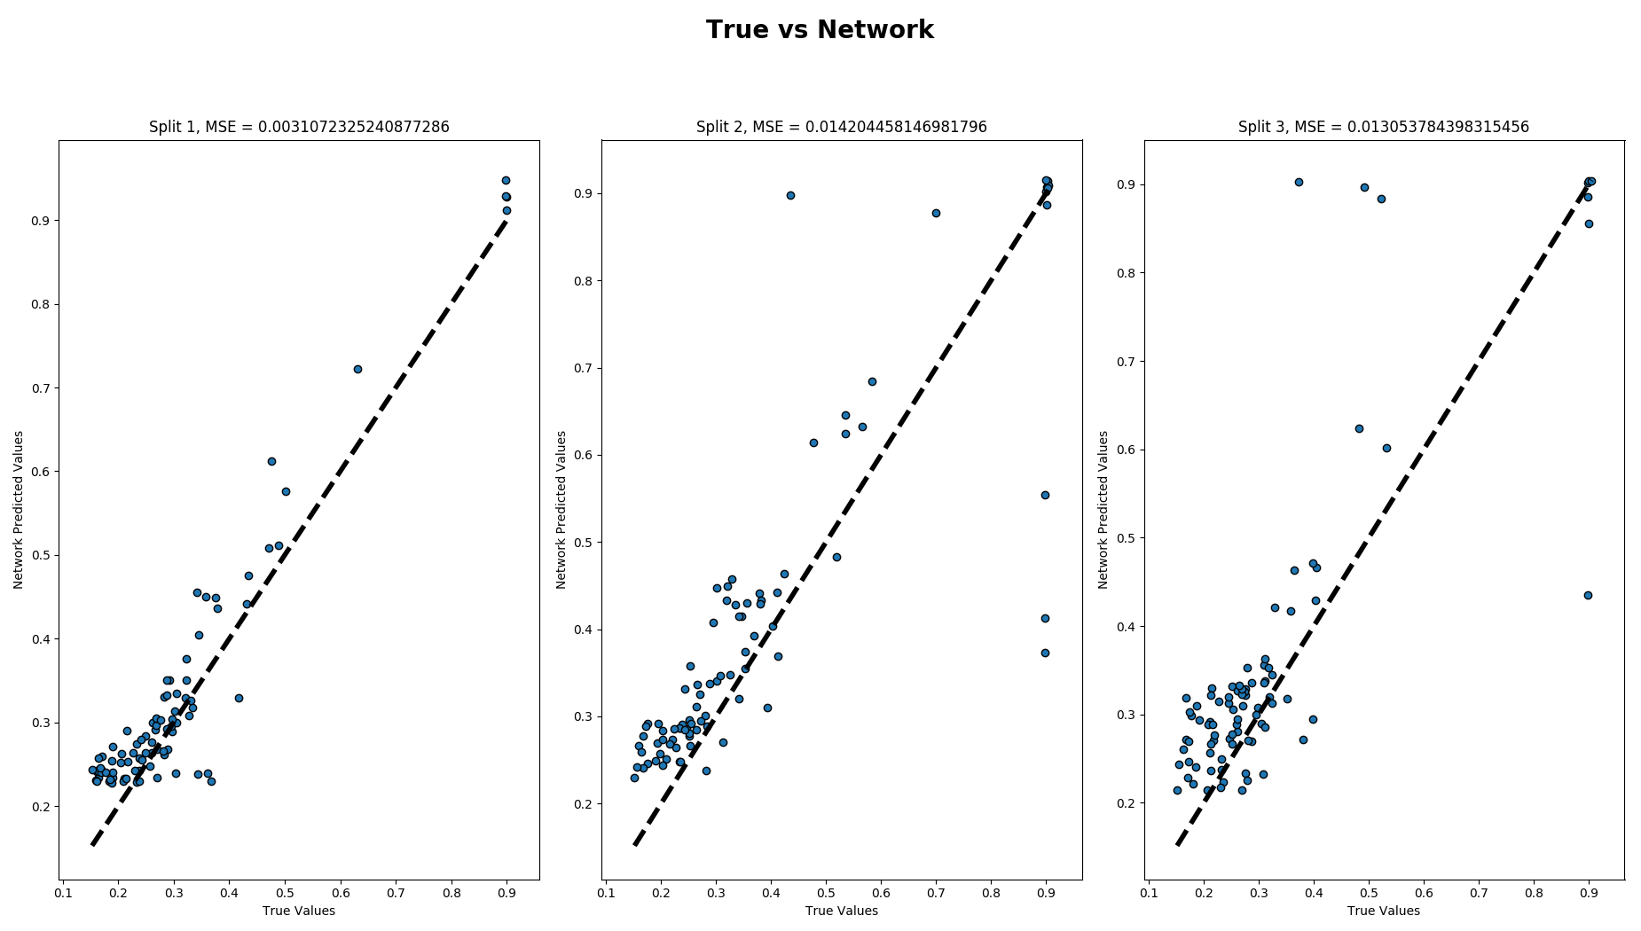
RNN trained with fixed input length: 10

Slide 13
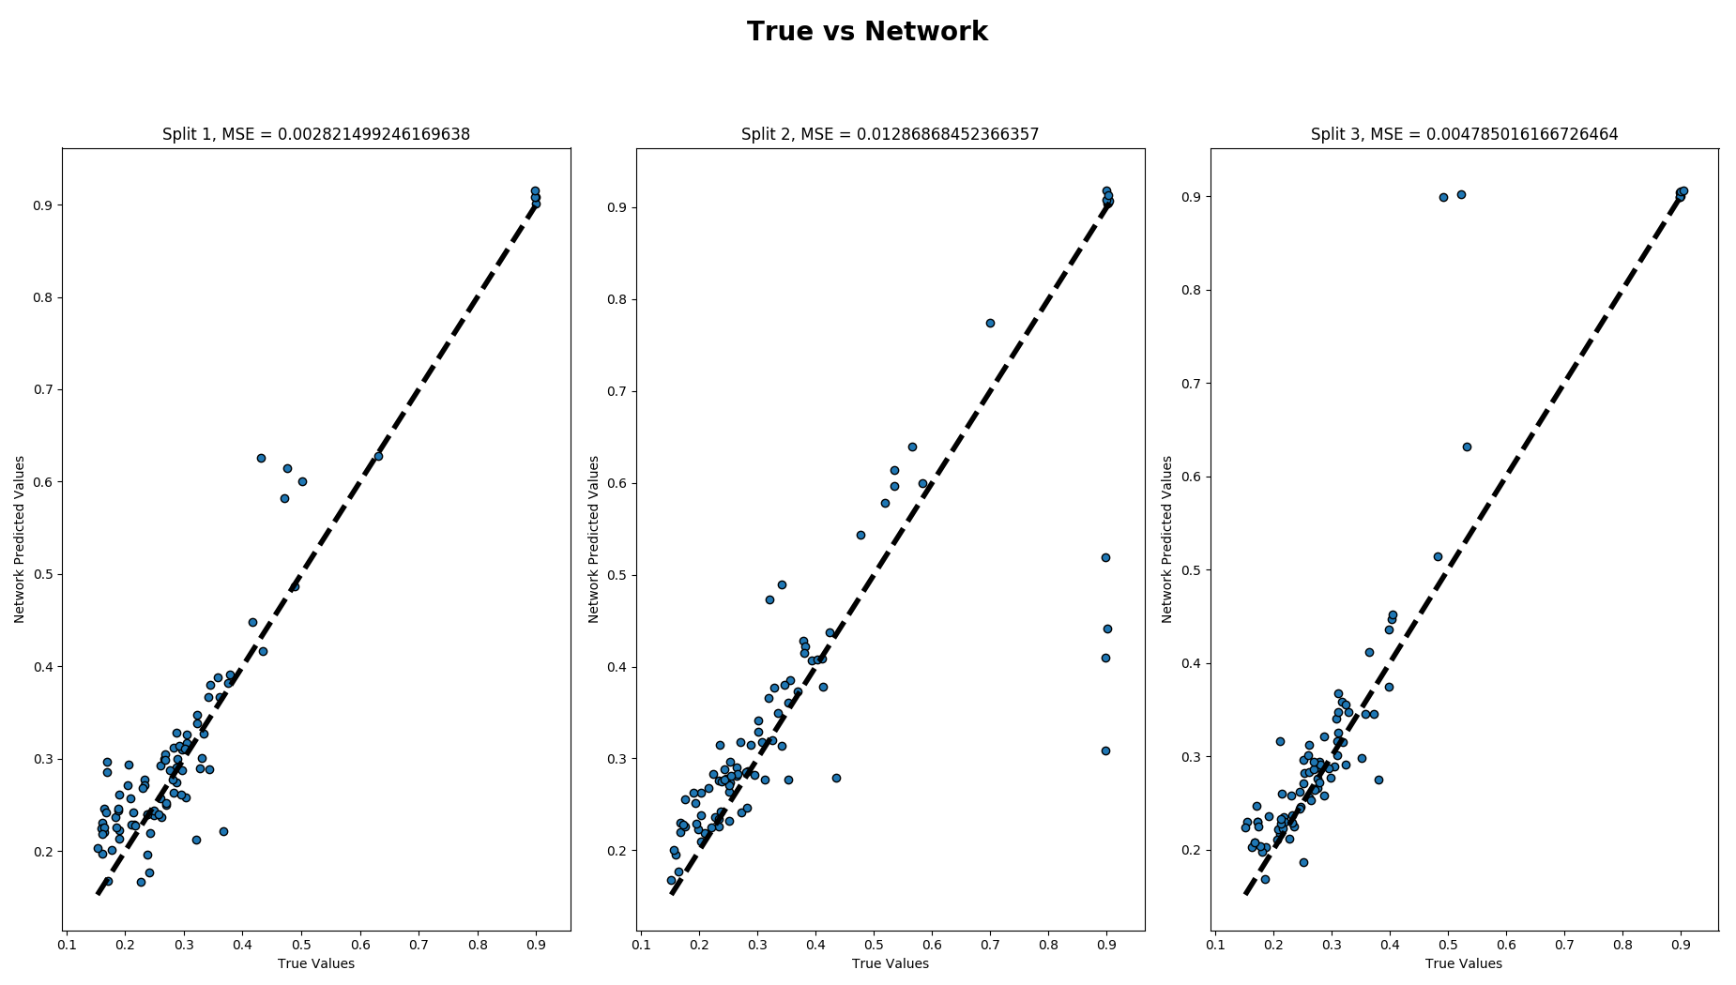
RNN trained with fixed input length: 20

Slide 14
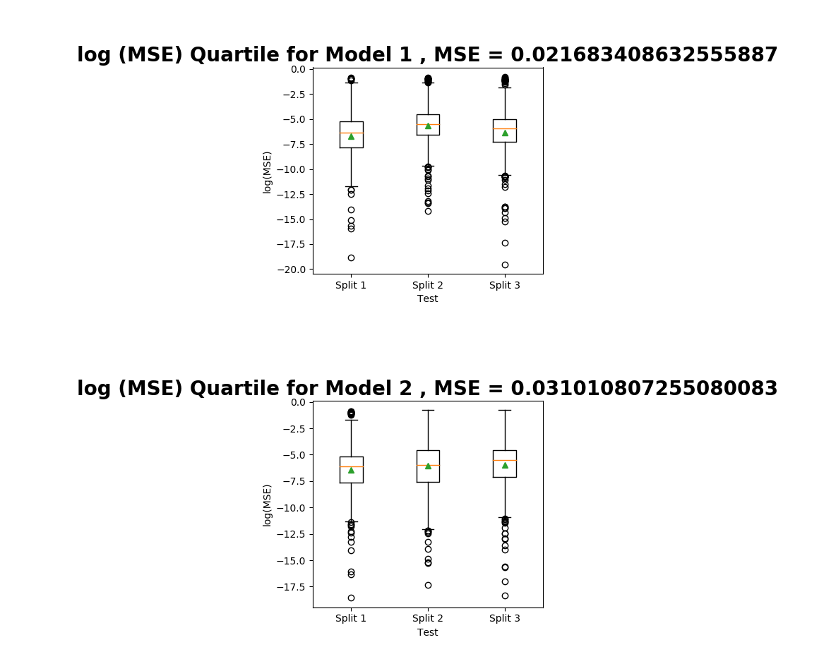
Boxplot for Train on 10 with two models

Slide 15
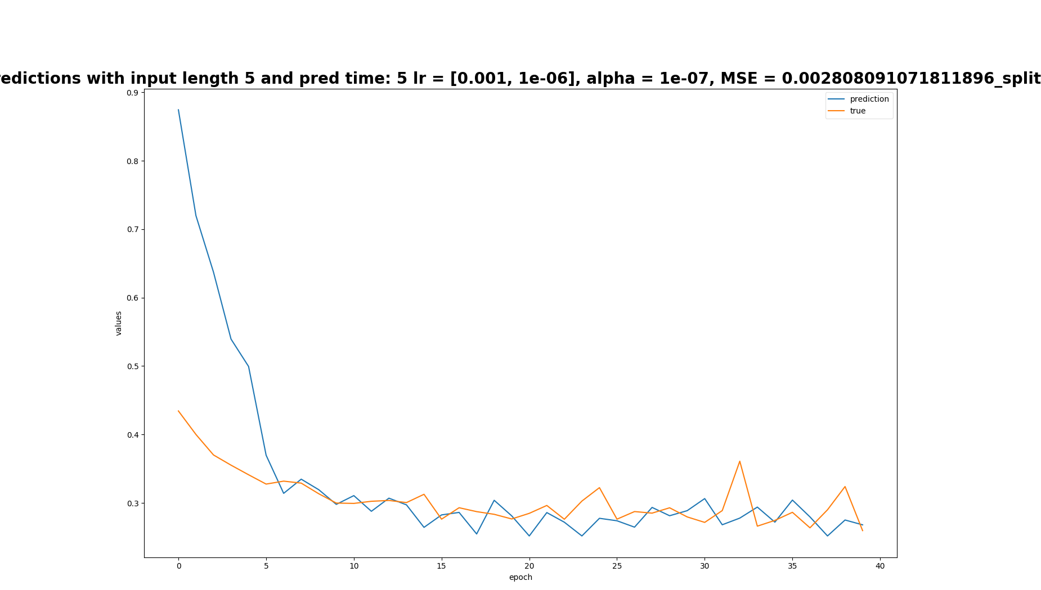
Train on 5, predictions of split 1

Slide 16
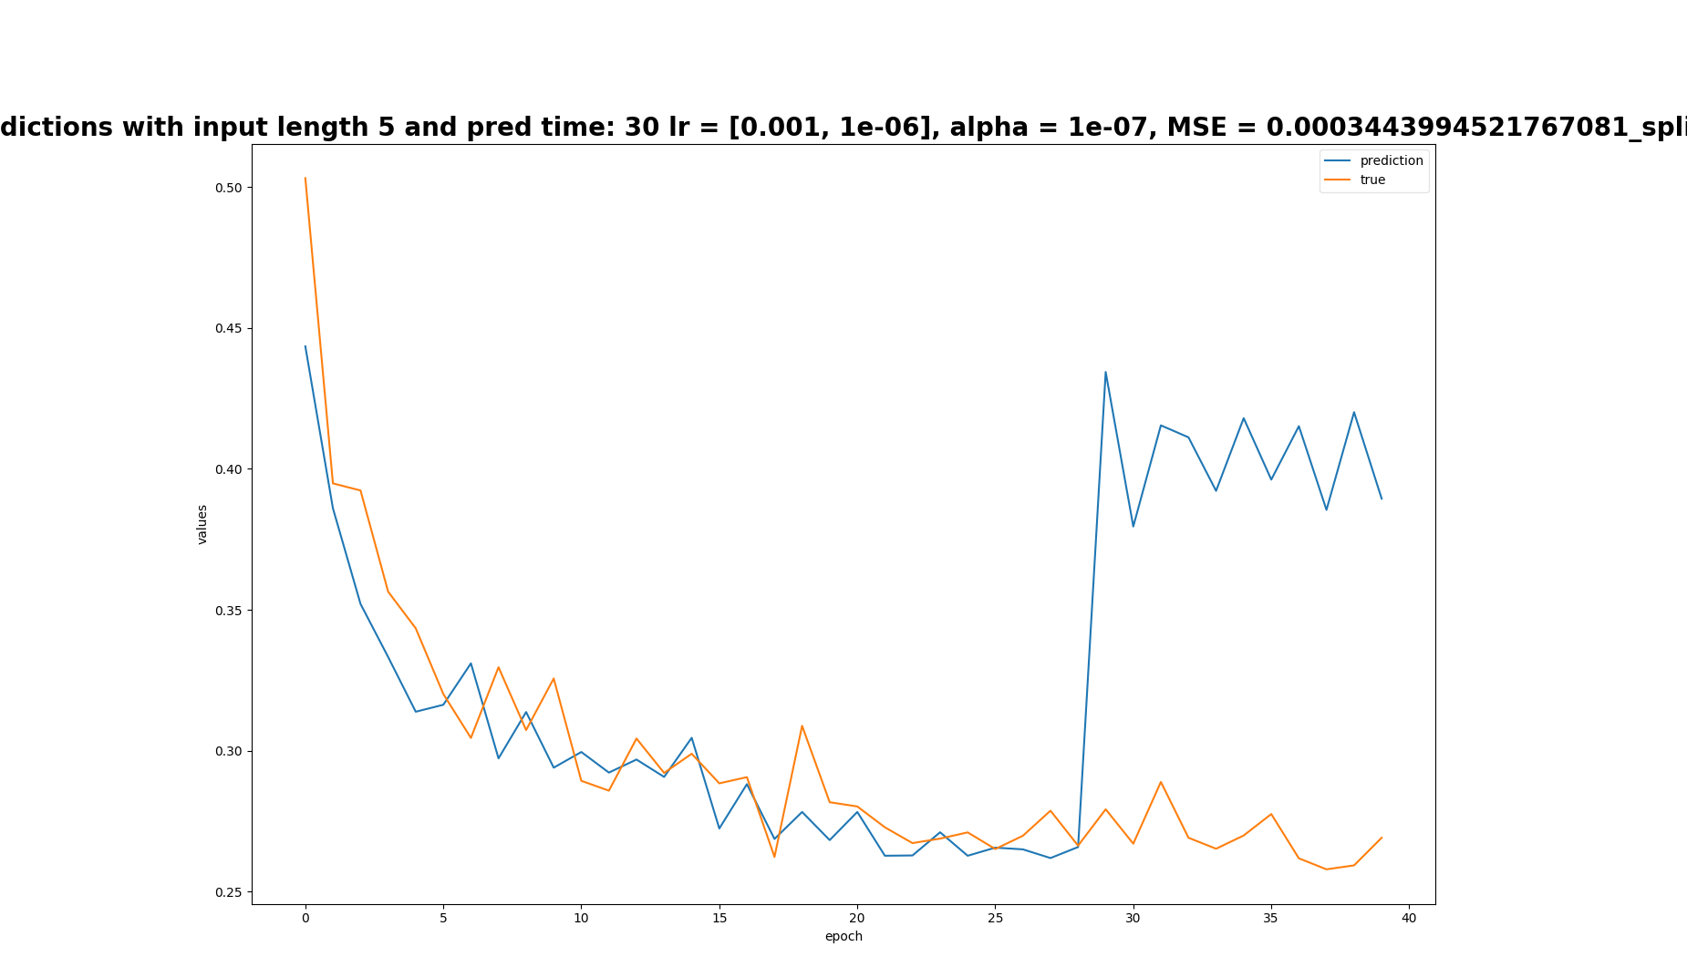
Train on 5, predictions of split 3

Slide 17
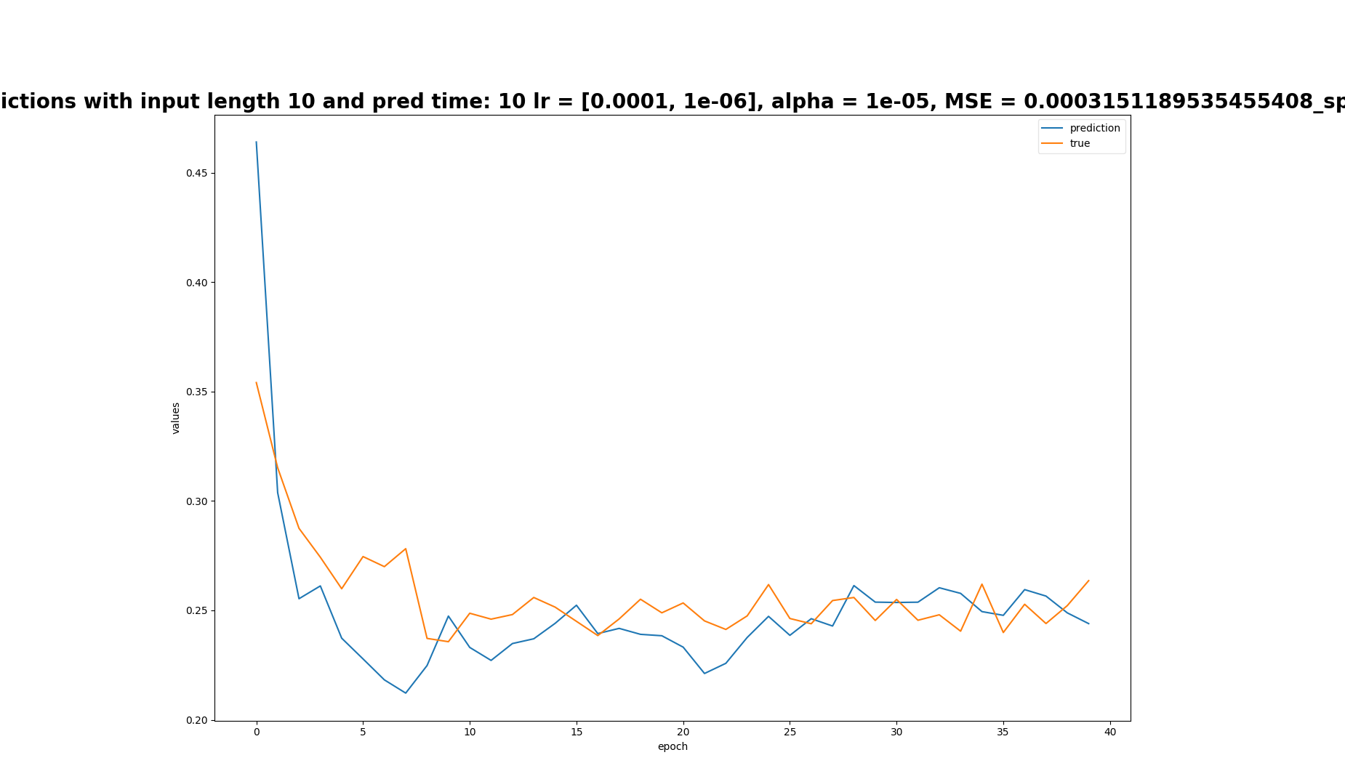
Train on 10, predictions of split 2

Slide 18
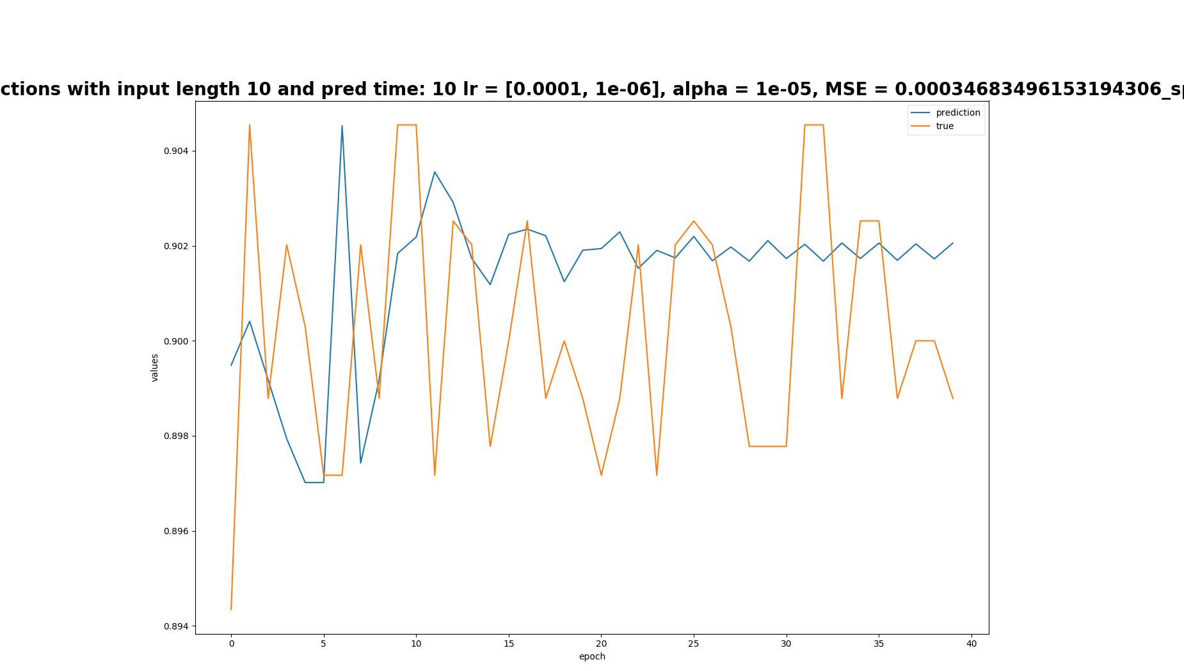
Train on 10, predictions of split 3

Slide 19
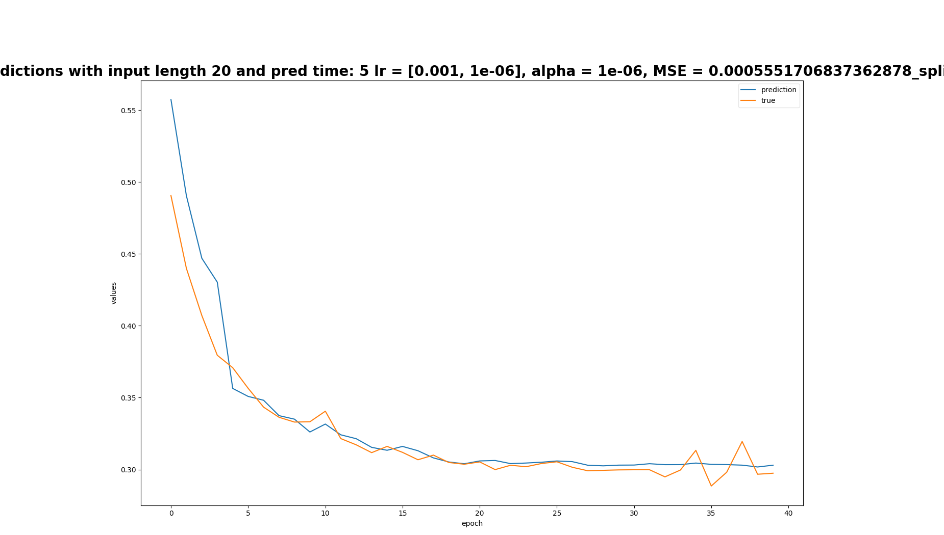
Train on 20, predictions of split 1

Slide 20
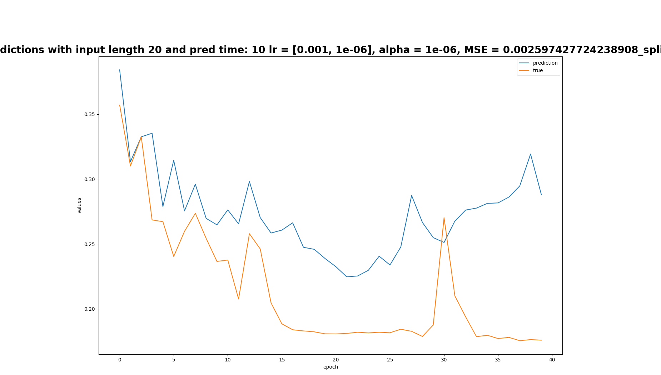
Train on 20, predictions of split 2

Slide 21
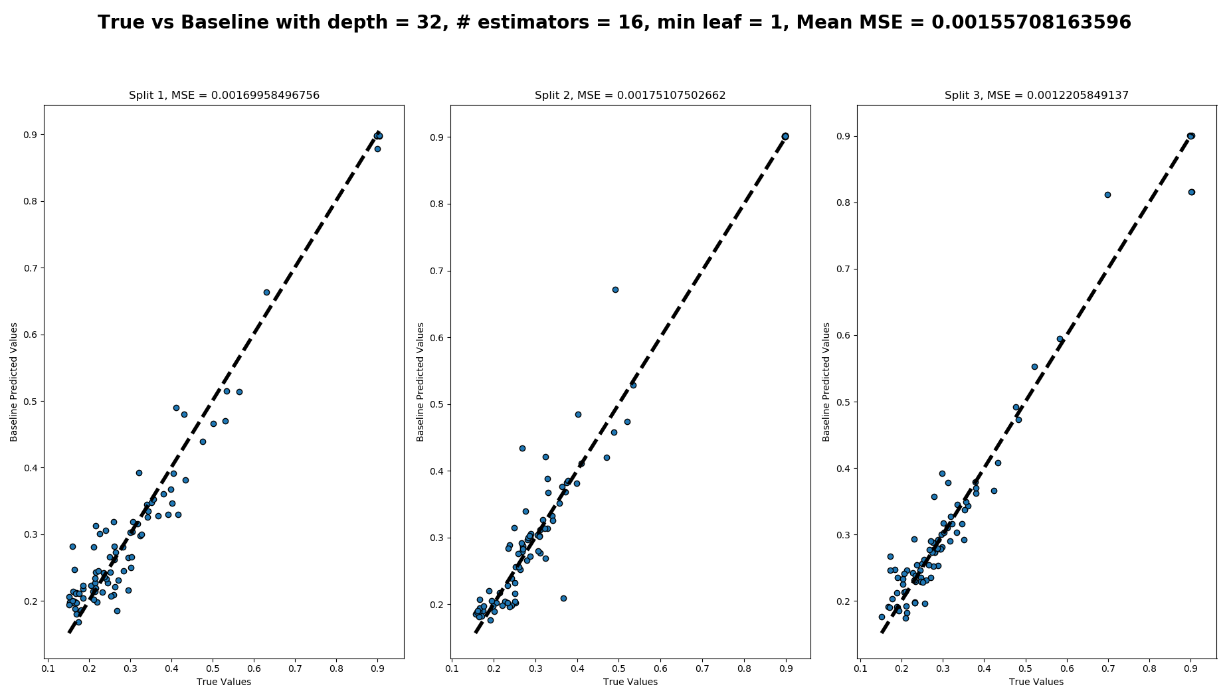
Baseline with fixed number of observations: 5

Slide 22
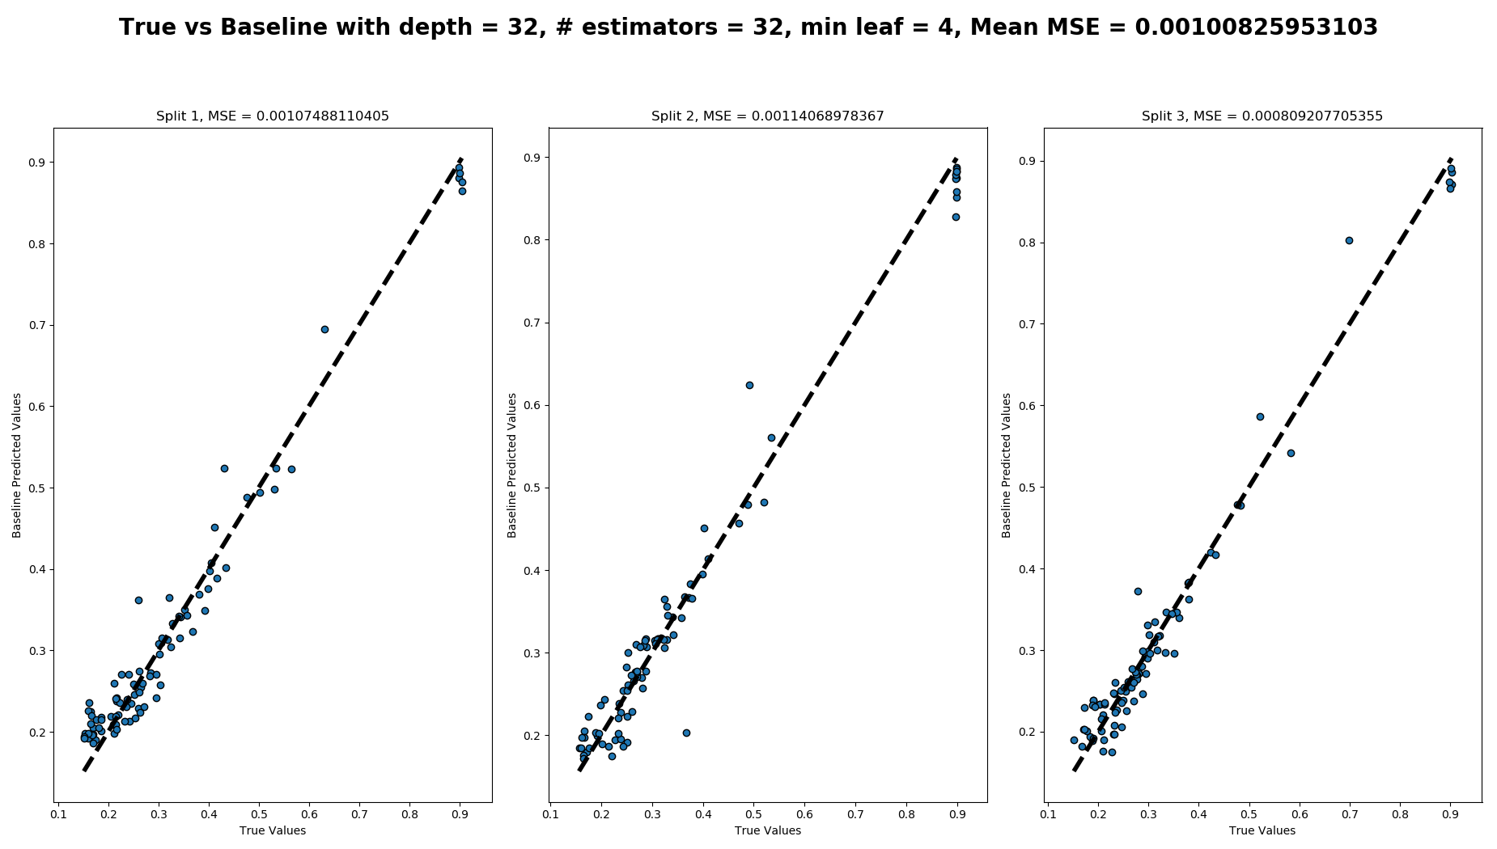
Baseline with fixed number of observations: 10

Slide 23
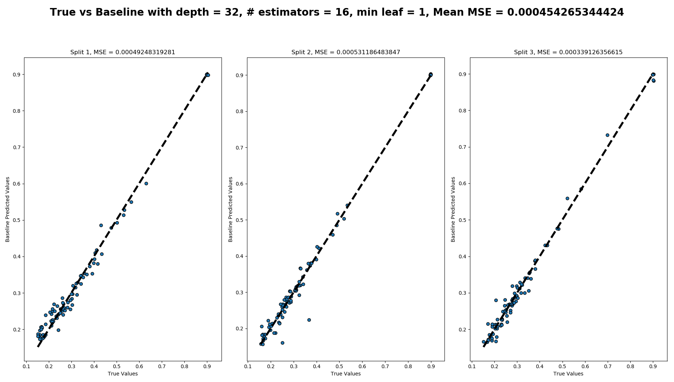
Baseline with fixed number of observations: 20

Slide 24
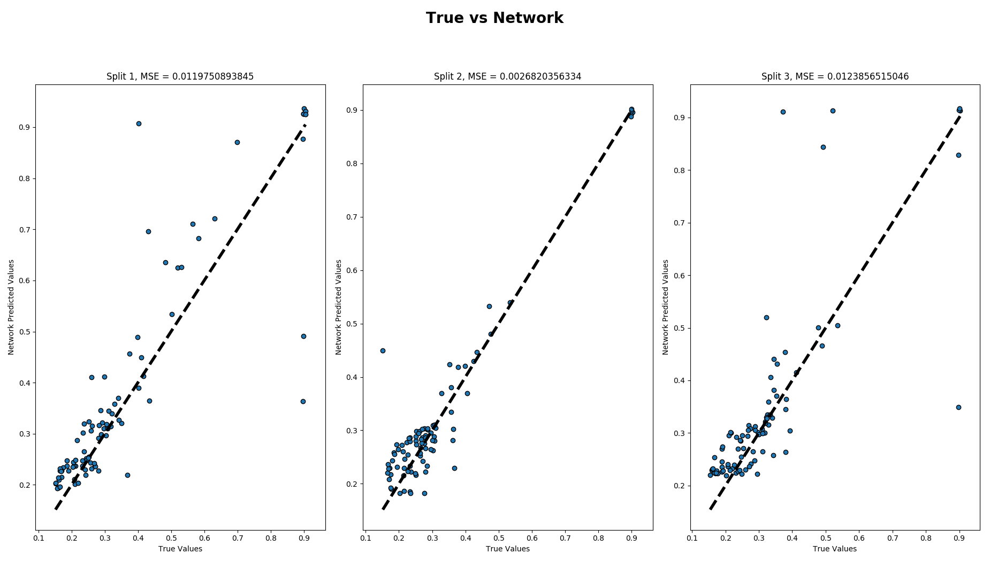
RNN trained with random input length, predictions after 5th epoch

Slide 25
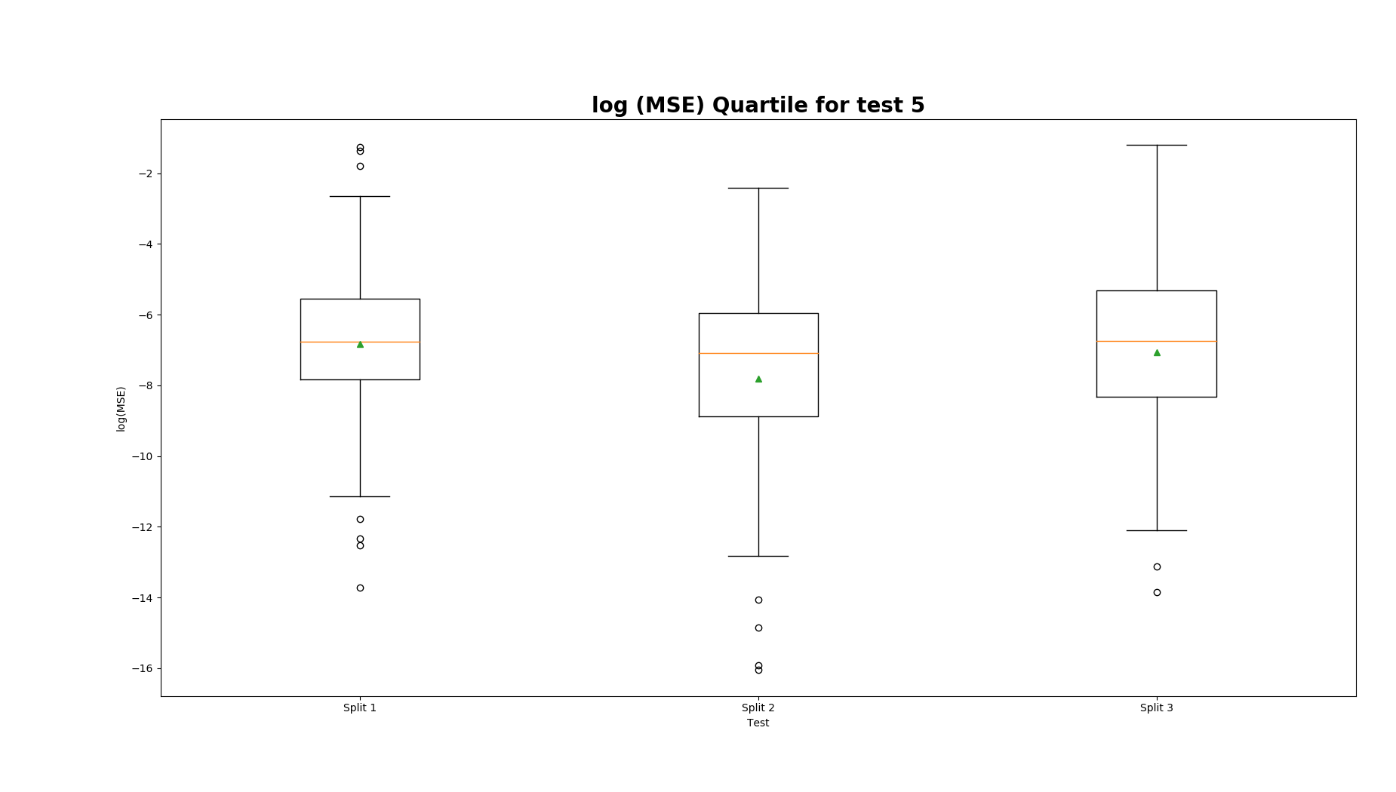
RNN trained with random input length, predictions after 5th epoch

Slide 26
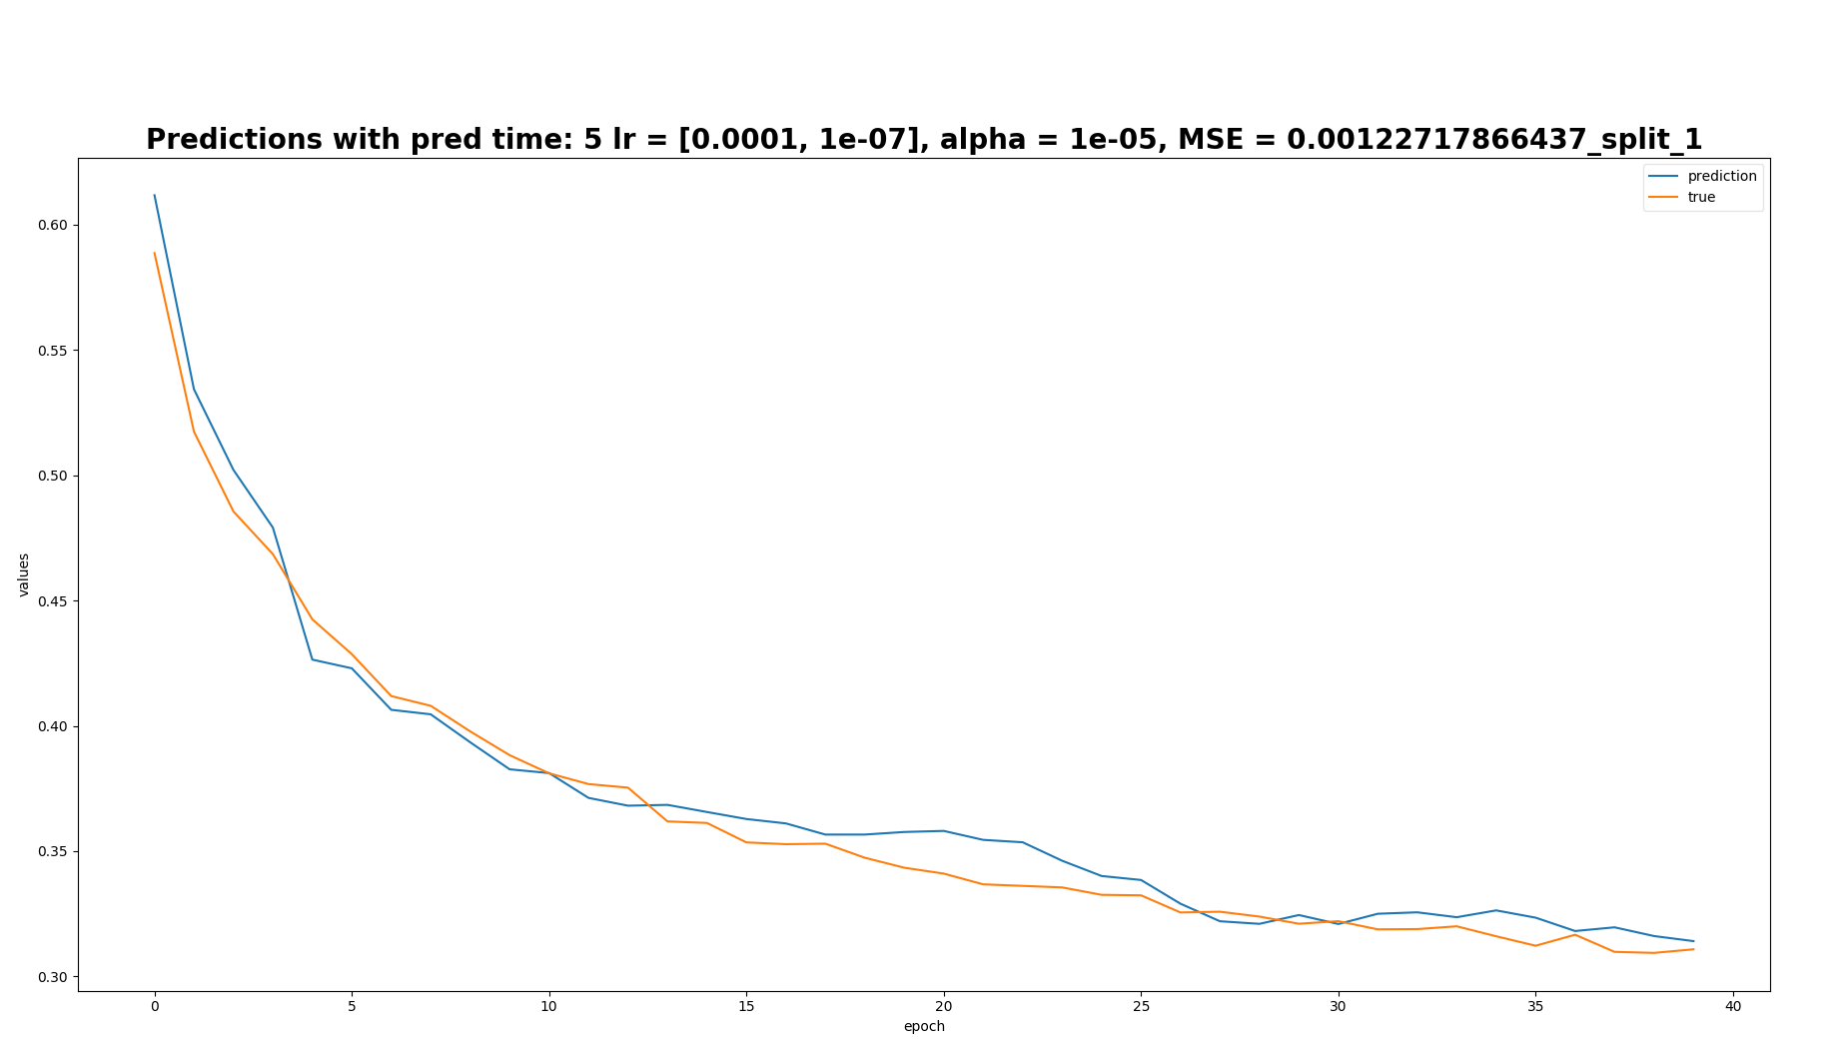

Slide 27
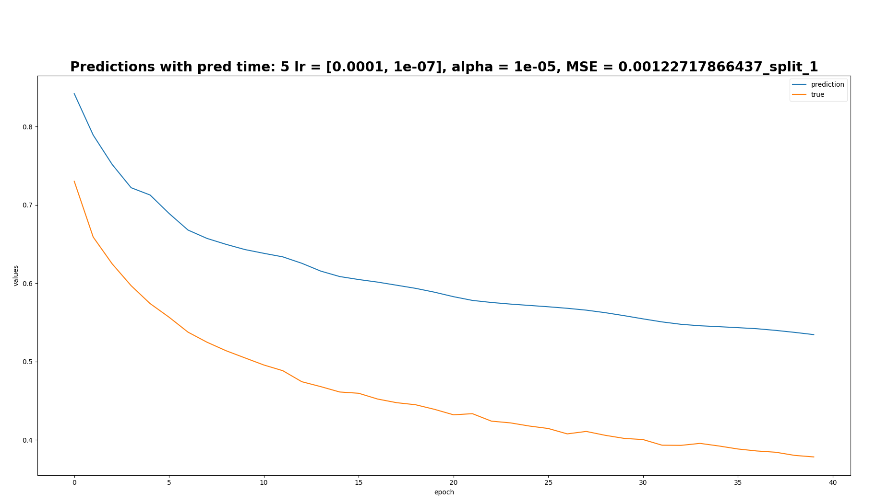

Slide 28
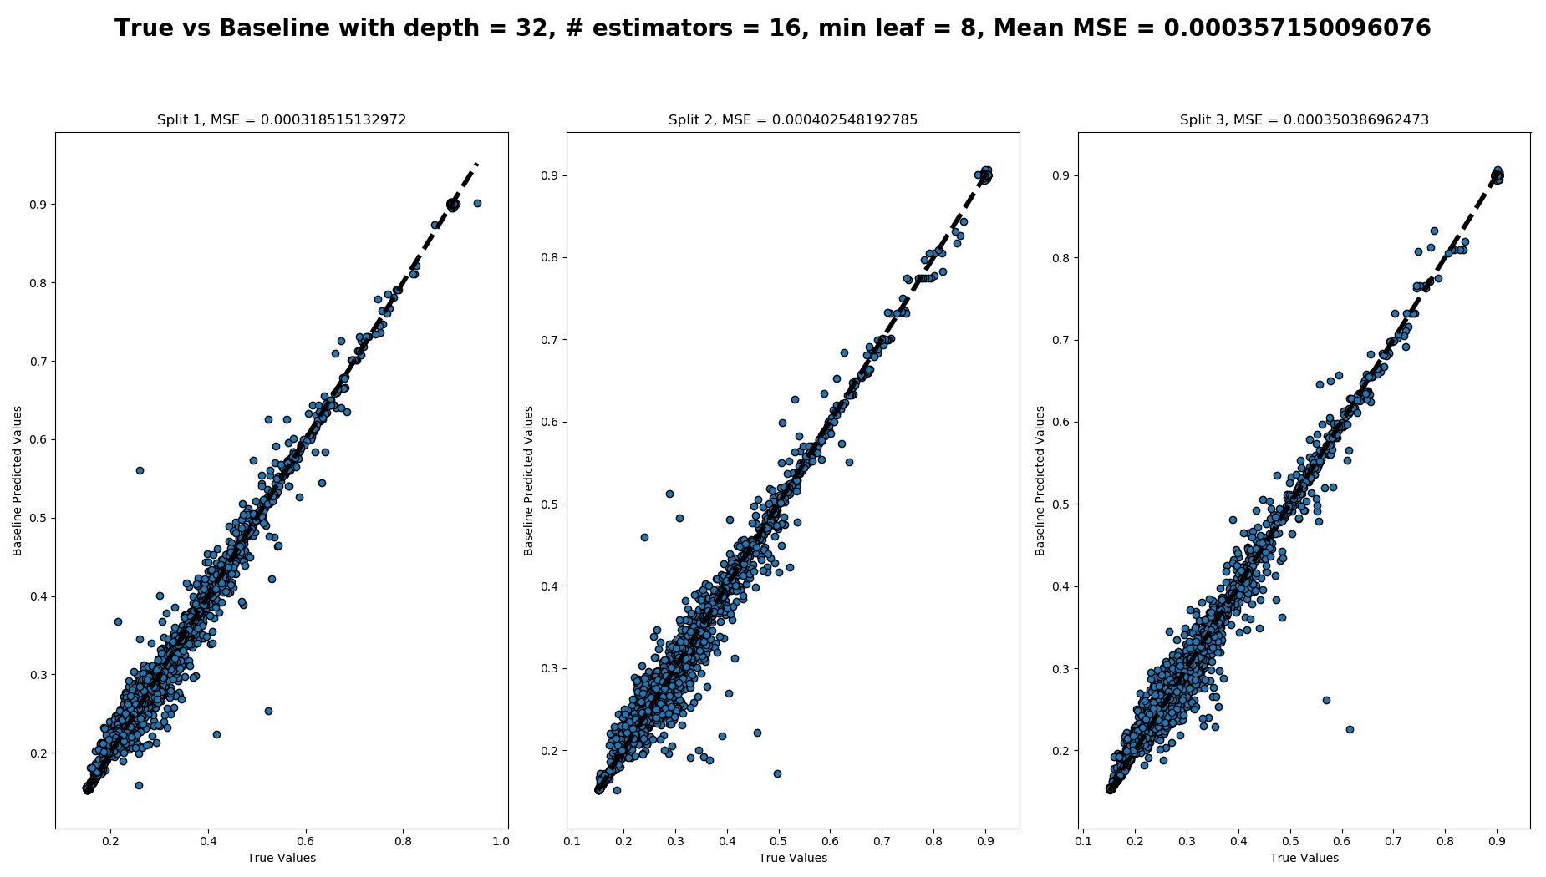
Baseline to predict next point given previous four

Slide 29
Comparison between RNN’s and last baseline
 | LR | Alpha | Pred 5 MSE | Pred 10 MSE | Pred 20 MSE | Pred 30 MSE
Train 5 | 0.001 – 1e-6 | 1e-7 | 0.0282 | 0.0267 | 0.0257 | 0.0272
Train 10 | 1e-4 – 1e-6 | 1e-5 | 0.0228 | 0.01011 | 0.0272 | 0.0264
Train 20 | 0.001 – 1e-6 | 1e-6 | 0.0279 | 0.0260 | 0.0068 | 0.0283
Random | 1e-4 – 1e-7 | 1e-5 | 0.0089 | 0.0066 | 0.0056 | 0.0046
 | Max depth | # Estimators | Min leaf | MSE
Last 4 point prediction | 32 | 16 | 8 | 0.0003

