Slide 1
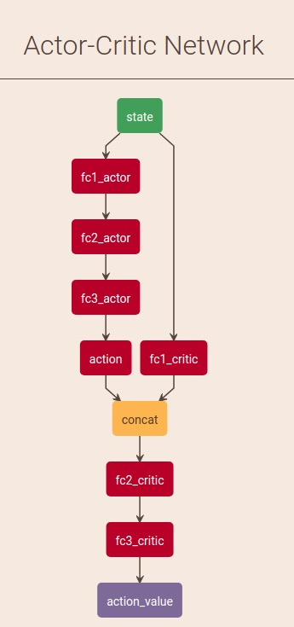
Motivation
DQN with experience replay
REINFORCE
Actor-critic without / with experience replay
Deep Deterministic Policy Gradient
Continuos action space
Experience replay
Action noise
Gradient based method
Notes:
DQN with experience replay
Solves problems with high-dimensional observation spaces, it can only handle discrete and low-dimensional action space.
REINFORCE
Actor-critic without / with experience replay
These networks compute action predictions for the current state and generate a temporal-difference (TD) error signal each time step.
Deep Deterministic Policy Gradient
Continuos action space
Gradient based method
Action noise

Slide 2
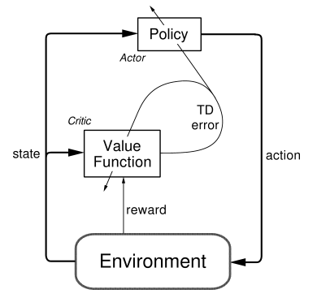

Slide 3
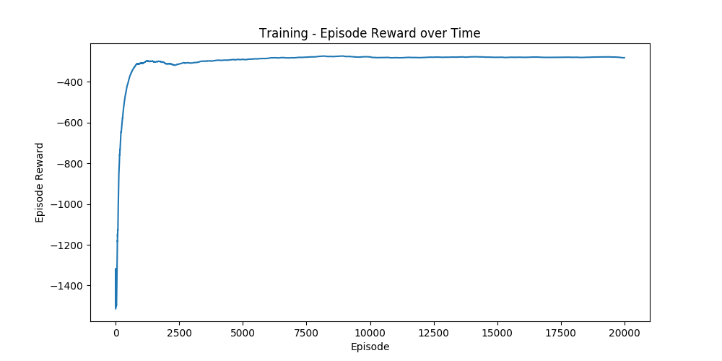
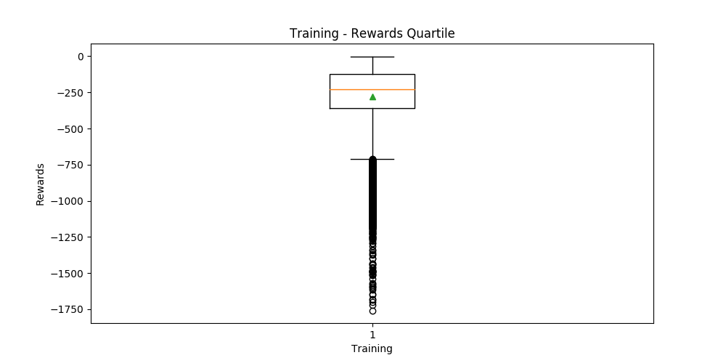
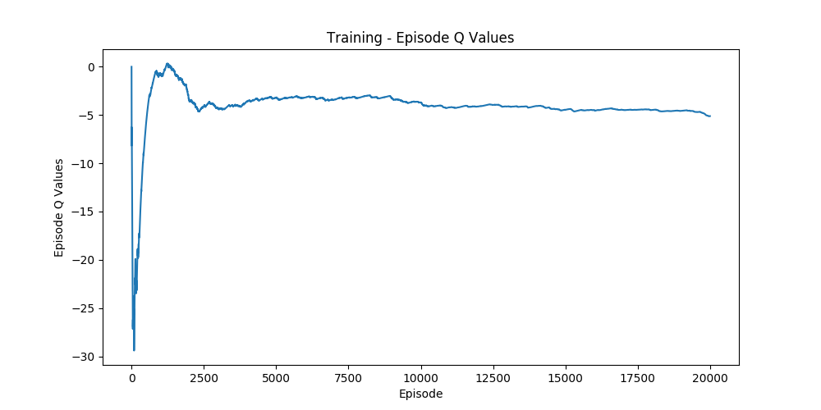
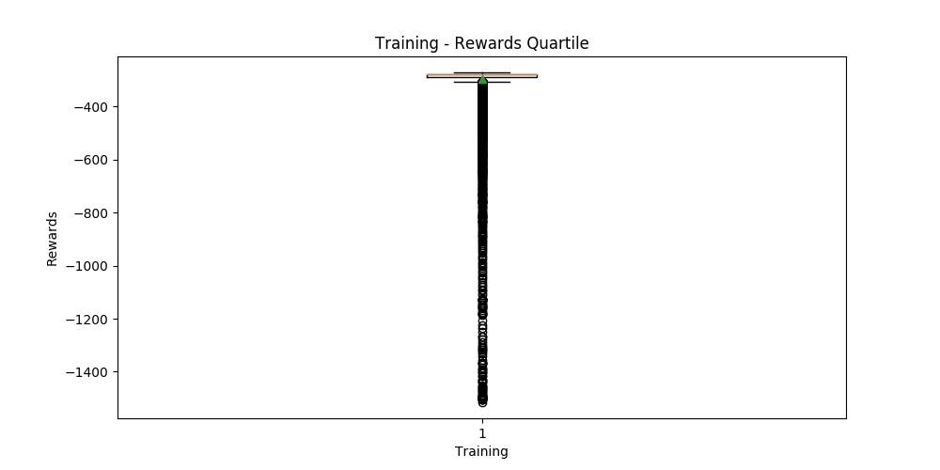
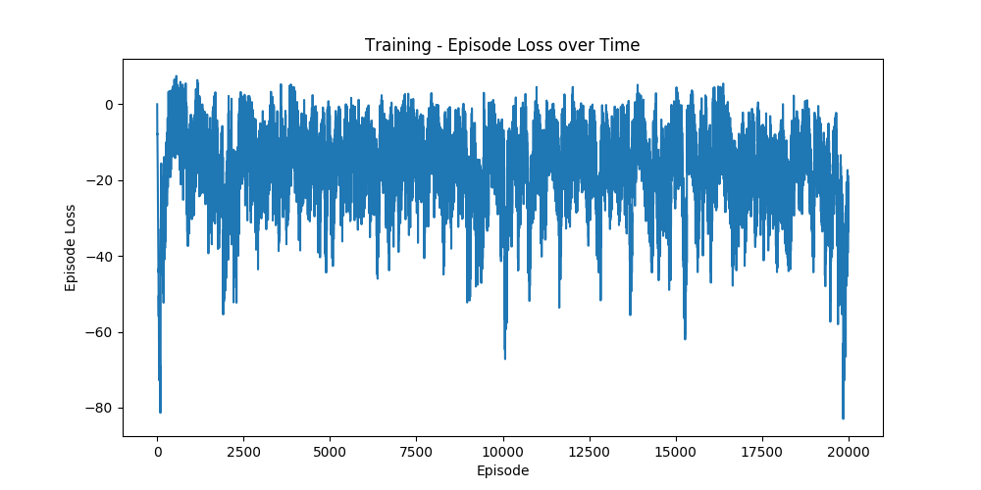
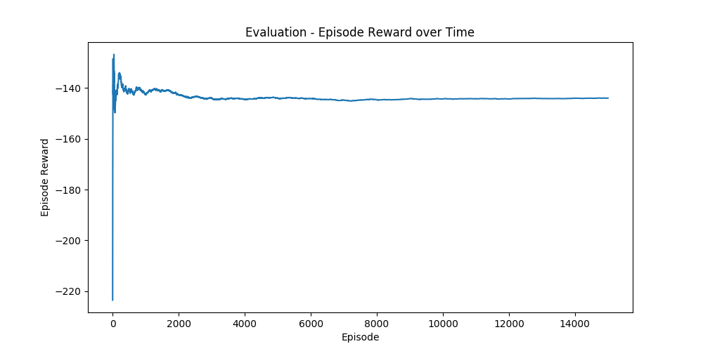

Slide 4
