Slide 1
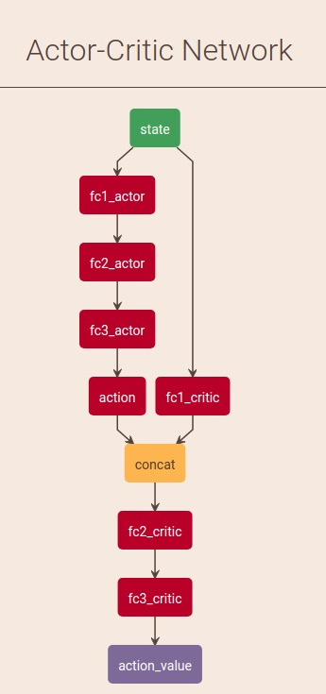
Motivation
DQN with experience replay
REINFORCE
Actor-critic with/without experience replay
Deep Deterministic Policy Gradient
Continuous action space
Experience replay
Action noise
Gradient based method
Notes:
DQN with experience replay
Solves problems with high-dimensional observation spaces, it can only handle discrete and low-dimensional action space.
REINFORCE
Actor-critic without / with experience replay
These networks compute action predictions for the current state and generate a temporal-difference (TD) error signal each time step.
Deep Deterministic Policy Gradient
Continuos action space
Gradient based method
Action noise

Slide 2
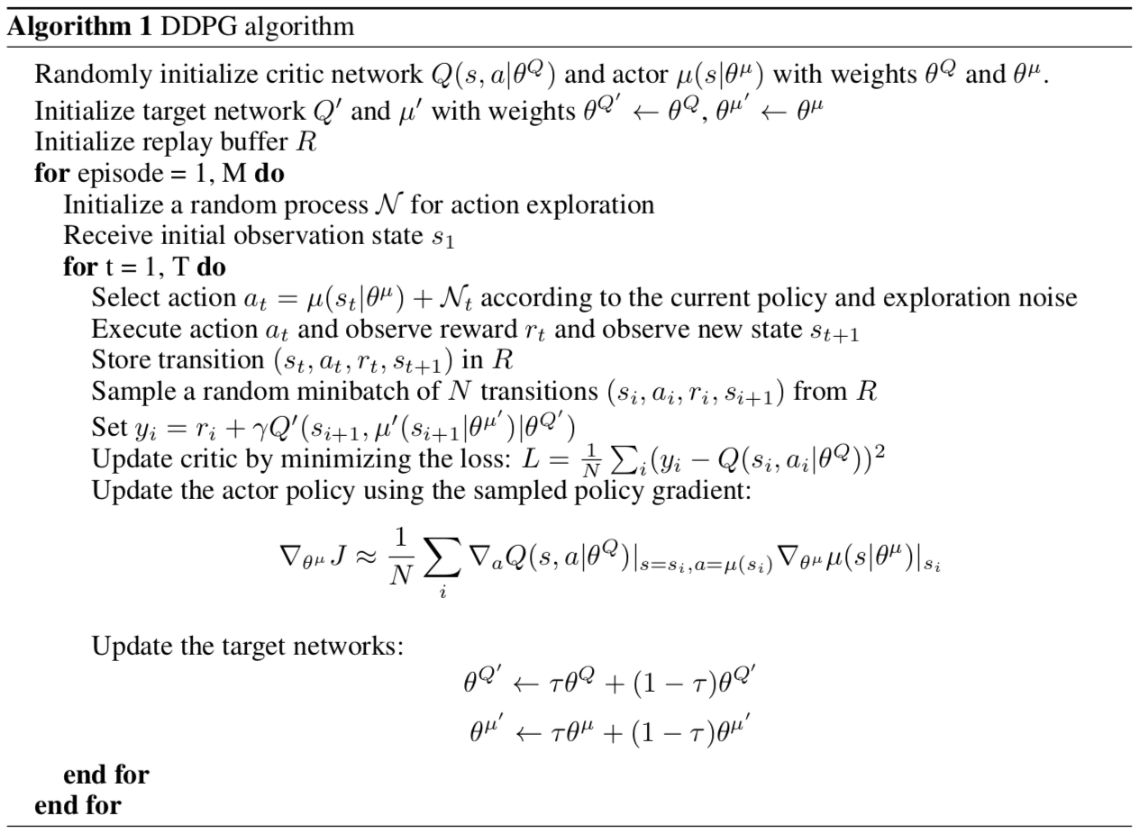

Slide 3
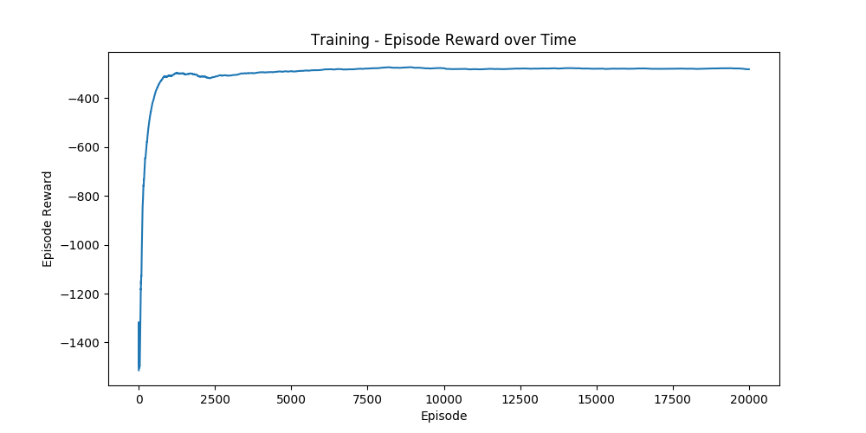
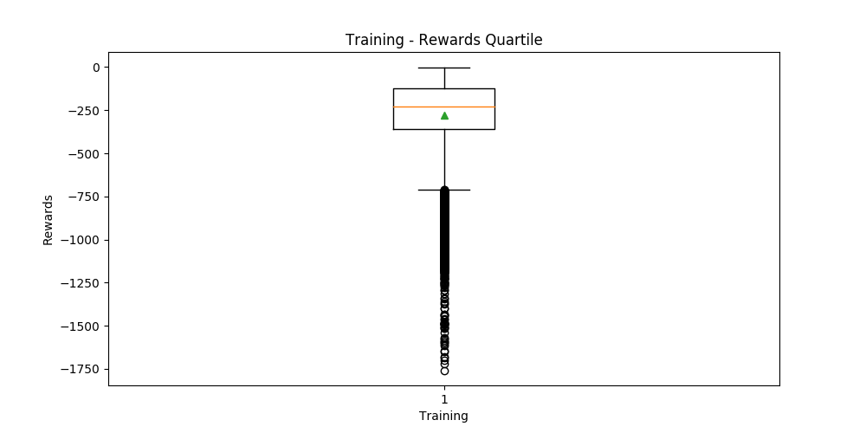

Slide 4
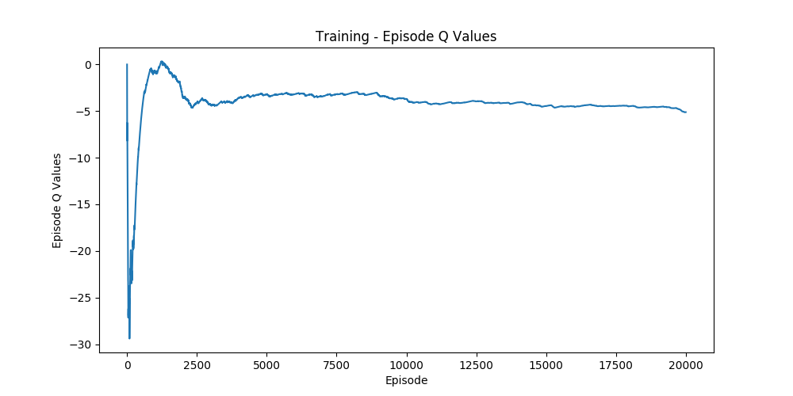
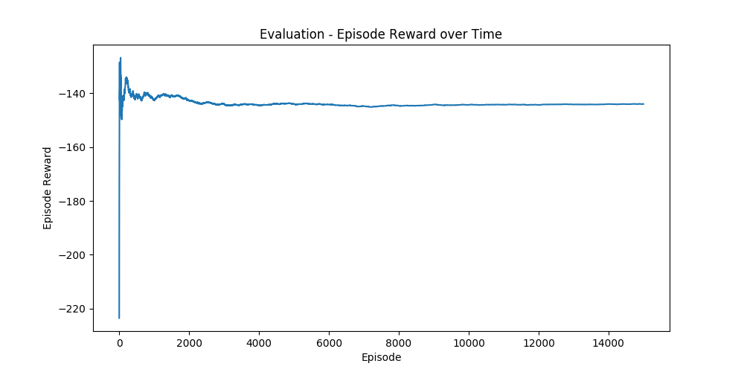

Slide 5
Discussion
Improvements
Convergence is happening after around 1000 episodes
DDPG is implemented which is very useful for continuous action space problems
Using parameter space noise, which can lead to more consistent exploration and a richer set of behaviors – Results from [1] show that RL with parameter noise learns more efficiently than traditional RL with action space noise
Use a priority algorithm for sampling from the replay buffer instead of uniformly sampling
Different hyperparameters settings
[1] PARAMETER SPACE NOISE FOR EXPLORATION - https://arxiv.org/pdf/1706.01905.pdf

