Slide 1

Bapatla Engineering College: Bapatla – 522102
(Autonomous)
Department of Computer Science and Engineering
Automated Resume Screening using AI-Powered Parsing and Job suggestion using K-NN with Cosine Similarity
Presented by
M.Priyanaka[Y21ACS508]
K.Amrutha[Y21ACS483] M.Harshavardhan[Y21ACS514]
M.RahulRayudu[Y21ACS513]
Batch No – B11
Under the Guidance of
P.Nanda Kishore, _{M.Tech.}
_{Assitant Professor}

Slide 2
Agenda
2
Abstract
Existing system
Proposed system
Design Methodology
Implementation
Conclusion
Future Scope

Slide 3
Abstract
3
Resume screening is the process of assessing job seekers' resumes based on specific criteria.
It helps determine a candidate’s suitability for a job by comparing their qualifications, skills, and technical expertise with the role’s requirements.
In screening process, we will extract skill-set and suggest the job according to their skills. It will also help in recommending latest courses.
This system will help the job seekers in choosing better career path.

Slide 4
Existing System
Manual Screening: Time-consuming, inefficient ,leads to lot of errors because of human interventions and prone to bias.
AI-Based Screening: Bias in Training Data, Over-Reliance on Keywords, Lack of Human Judgment and False Positives & Negatives.
Deep Learning Approaches: Lack of Explainability, making bulk processing slow, Requires Large Training Data, High Computational Cost

Slide 5
Proposed System
The feature we are trying to implement is suggesting courses according to candidate’s inefficiency.
If candidate is efficient the system will suggest you the jobs based on the skill set
For extracting skill set and other properties of job seeker we are using NLTK library(AI-Powered Parsing).
For job suggestions and course suggestions we will use the machine learning algorithm(K-NN with Cosine Similarity).
Benefits:-
Fair & Unbiased Screening
Scalability & Versatility
Skill Gap Analysis & Career Guidance
Current Trend View

Slide 6
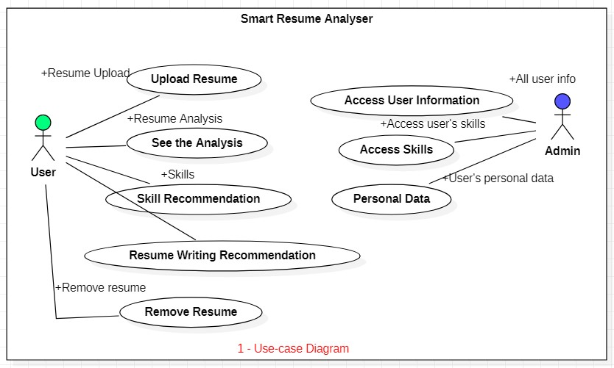
Design Methodology
Use case Diagram

Slide 7
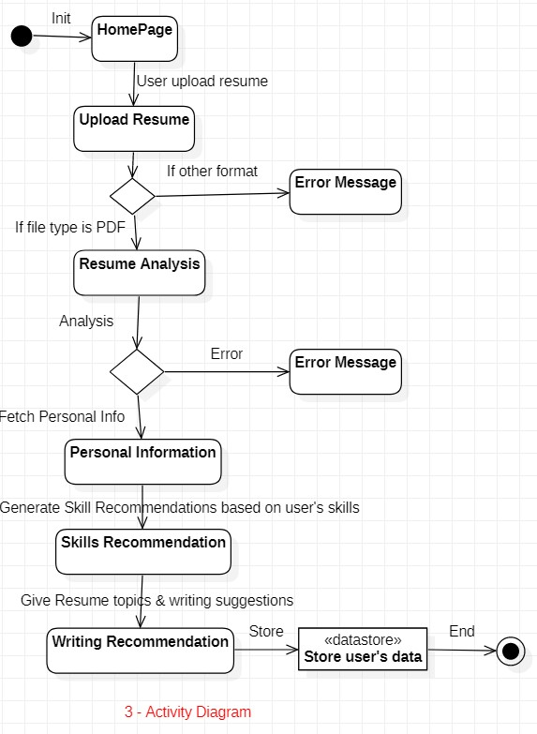
Activity Diagram

Slide 8
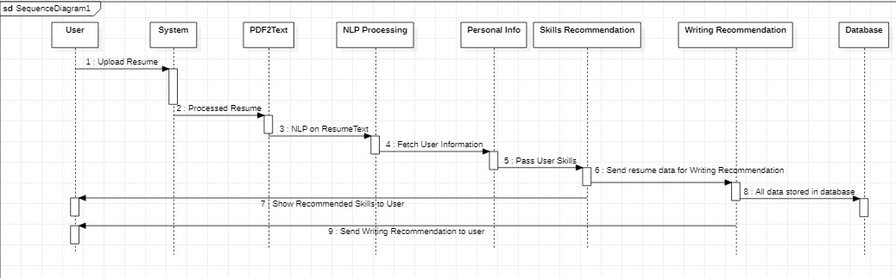
Sequence Diagram

Slide 9
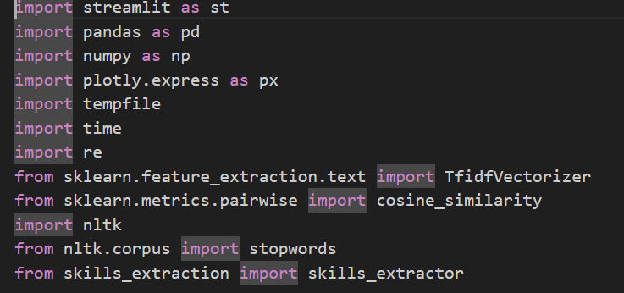
Implementation
Importing Libraries:
The first step in the implementation involves importing essential Python libraries required for text extraction and suggesting jobs and analyzing code.
PDF Extracting:
PDF Extracting is a module that automatically retrieves the user’s resume, provided that the resume is in PDF format. This module extracts the user’s data from the resume.

Slide 10
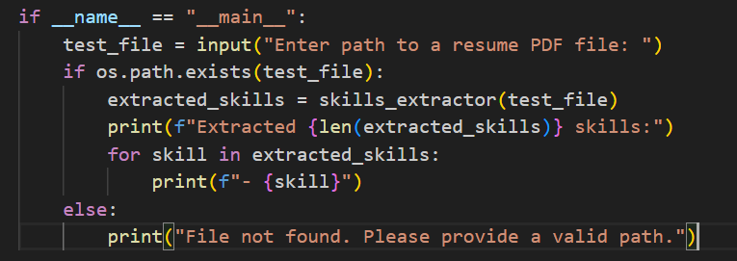
Text Extracting:
Text Extracting is a module that fetches the text information from the resume. This text data is used for language processing in further tasks, such as recommendations and fetching the user’s personal information.
Career/Skills Recommendation:
Based on the user’s current skills, this module provides career path and skills recommendations. For example, if the user has skills in Machine Learning, it will offer career, tools, and technology recommendations in that field.

Slide 11
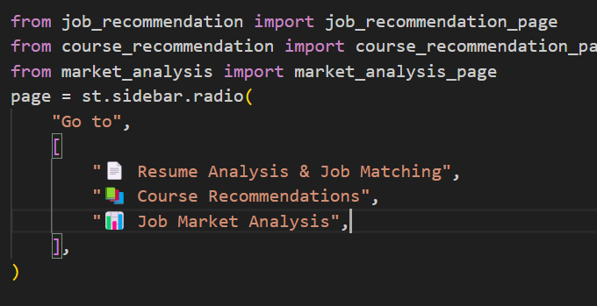
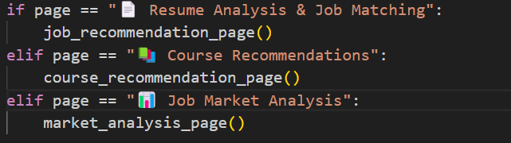
Job Recommendation , Course Recommendation and Job Market Analysis code outline:

Slide 12
Conclusion
12
Automated Resume Screening using AI-Powered Parsing and Job suggestion using K-NN with Cosine Similarity" project represents a significant advancement in applying artificial intelligence to the recruitment sector.
By integrating resume analysis, job matching with K-NN and cosine similarity, personalized course recommendations, and market insights into a unified platform, we have created a comprehensive tool that addresses multiple facets of the job search process.
The system successfully extracts skills from resumes using NLP techniques, matches candidates with suitable positions through vectorization and K-NN algorithms, identifies skill gaps and recommends targeted courses for professional development, and provides data-driven market insights to inform career decisions.
Testing demonstrates that our approach achieves high accuracy in skills extraction and job matching while delivering an intuitive user experience through the Streamlit interface.

Slide 13
Future Scope
Currently web applications are deployed locally, our future aim is to deploy them on the internet (AWS ,Heroku, etc).
In the future, we will add more formats of resumes. Currently, the system only supports PDF format for uploading resumes.
This system currently works with a limited set of fields and recommendations, specifically designed for IT professionals. We plan to add more fields and data in the future to provide recommendations for all types of resumes.
Future enhancements could include integration with job application platforms, more sophisticated learning path recommendations, and expanded market analysis capabilities.

Slide 14
Thank You

