Slide 1
Geometric Networks
M hamza wahla
Course of Geo-database
DEPARTMENT OF GEO-INFORMATICS

Slide 2
A network may be
an arrangement of intersecting horizontal and vertical lines
a group or system of interconnected people or things.

Slide 3
Types of Networks
Dentritic networks
Loop networks

Slide 4
Geometric Networks
A geometric network is a set of connected edges and junctions, along with connectivity rules.
E.g., A water network consisting of water mains, valves, pump stations etc.
Arc-Catalog or Arc-Tool Box can be used to build geometric networks.

Slide 5
Edges and Junctions
A geometric network consists of edge network features and junction network features.
Edges are network features similar to simple line features. E.g., water mains.
Junctions are network features similar to simple point features. E.g., valves.
Edge – Edge connectivity is built through junctions.
Junction
Edge

Slide 6
While creating a geometric network in your arc-catalog you will encounter following terminologies

Slide 7
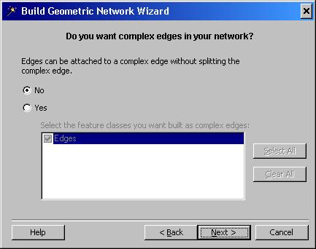
Simple and Complex features
Simple Edges are always connected to exactly two junctions, one at each end.
Complex Edges are always connected to
at least two junctions at their endpoints but can be connected to additional junctions along their length.

Slide 8
snapping
Snapping is a process moving features. For example making line ends and junctions coincide.
Snap tolerance defines the maximum distance a network feature could be moved.

Slide 9
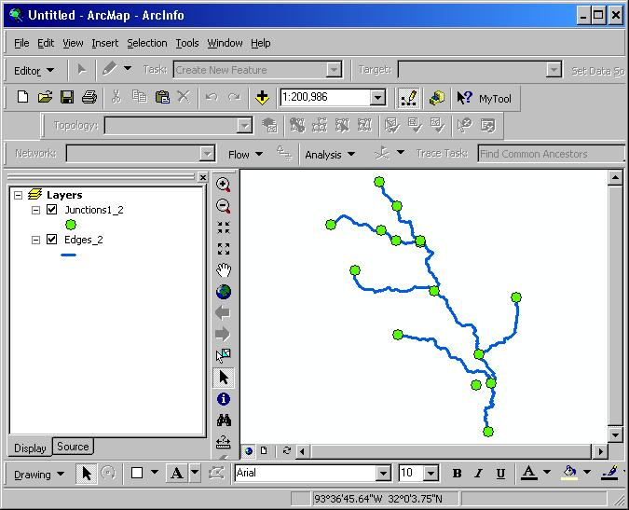
Snapping

Slide 10
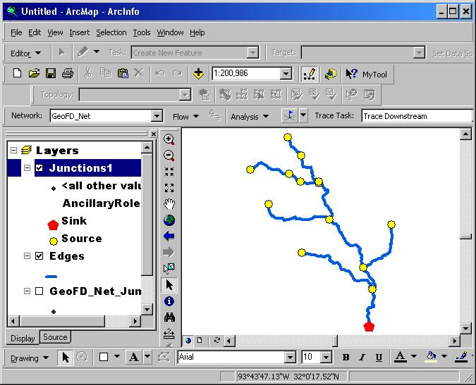
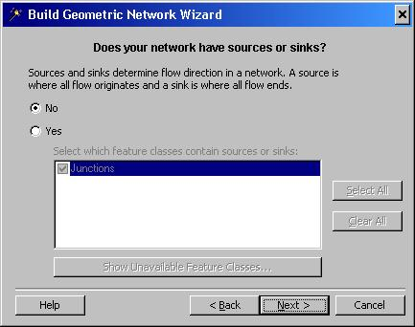
Sources and Sinks
Sources and Sinks are used to define the flow direction in the network.
Sources are junctions that push the flow away from themselves.
Sinks are junctions that pull flow towards themselves.
An attribute called ‘Ancillary Role’ defines whether a junction is source or sink.

Slide 11
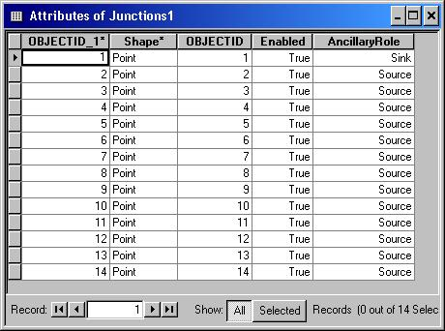
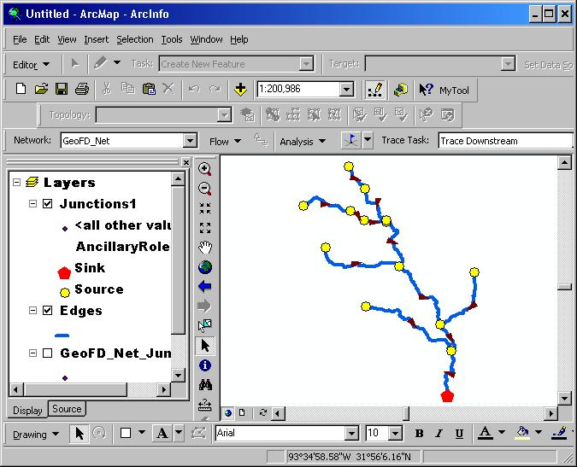
Flow Direction
The flow direction is based on the source and sink

Slide 12
Flow types
Determinate flow occurs in as edge if a unique flow direction can be assigned.
E.g. A dendritic stream network.
Indeterminate flow direction occurs in an edge if the flow direction is not unique.
E.g. A transportation network.
Uninitialized flow direction occurs when the flow in a edge is not influenced by sources and sinks.
E.g. A stream network with sources and sinks not defined

Slide 13
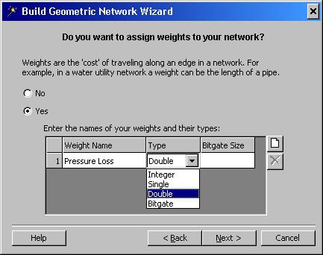
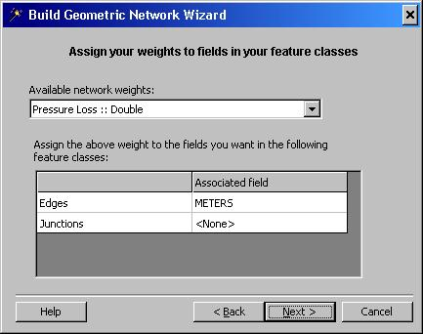
Network weights
A weight can be defined as the cost for traversing an element in the network.
E.g., pressure loss (per unit length) due to friction in the pipe.
Many to zero or many to one relationships exist between attributes and network weights.

Slide 14
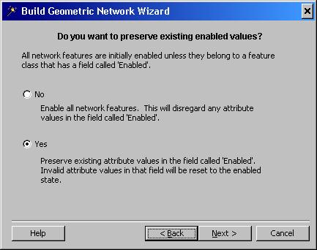
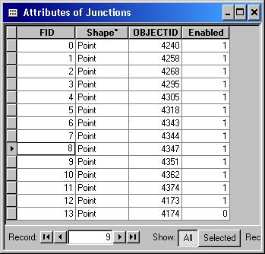
Enabled and Disabled features
Features in a network can be enabled or disabled.
Disabled features act as barriers to flow, whereas enabled features allow the flow to path through.
E.g., due to maintenance of a pipe in the network, it may be disabled temporarily.

Slide 15
Now the demo

