Slide 1
Making 3D point cloud using web ODM API
Open Drone Mapping
Notes:
Vagrant Box:
https://bitbucket.org/inftec/vagrant-playground/branch/docker-demo
VM: \\192.168.0.200\Public\2014-12-18 Workshop Docker
DEPRECATED:
Preparation:
Windows: Install boot2docker: https://github.com/boot2docker/boot2docker
Optional: Clean images and containers from installation
Pull required Images
docker pull ubuntu
docker pull training/webapp

Slide 2
Agenda
What is Docker?
Docker vs. Virtual Machine
History, Status, Run Platforms
Hello World
Images and Containers
Volume Mounting, Port Publishing, Linking
Around Docker, Docker Use Cases
Hands-On implementations Drone images to 3D surface and DEM

Slide 3
What is Docker?
Docker is an open-source project that automates the deployment of applications inside software containers, by providing an additional layer of abstraction and automation of operating system–level virtualization on Linux.
[Source: en.wikipedia.org]

Slide 4
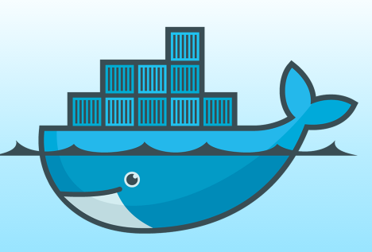
Docker: Name
[www.docker.com]
docker [naut.]: der Dockarbeiter, der Hafenarbeiter
Source: leo.org
Provide a uniformed wrapper around a software package: «Build, Ship and Run Any App, Anywhere» [www.docker.com]
Similar to shipping containers: The container is always the same, regardless of the contents and thus fits on all trucks, cranes, ships, ...

Slide 5
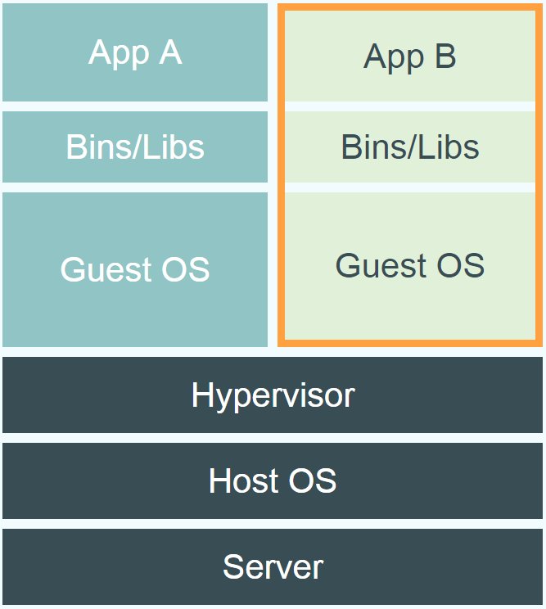
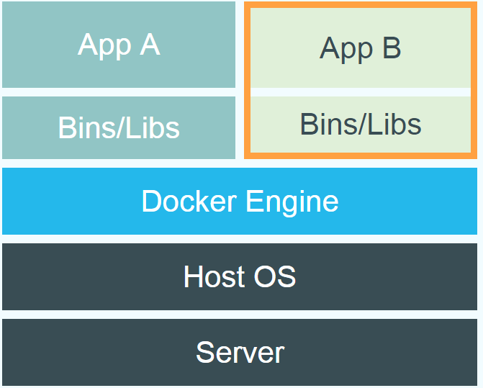
Docker vs. Virtual Machine
Source: https://www.docker.com/whatisdocker/
Notes:
Virtual Machines
Each virtualized application includes not only the application - which may be only 10s of MB - and the necessary binaries and libraries, but also an entire guest operating system - which may weigh 10s of GB.
Docker
The Docker Engine container comprises just the application and its dependencies. It runs as an isolated process in userspace on the host operating system, sharing the kernel with other containers. Thus, it enjoys the resource isolation and allocation benefits of VMs but is much more portable and efficient.
Docker provides base images that contain OS installations we can start from: The OS is not more than an application running on the Kernel...

Slide 6
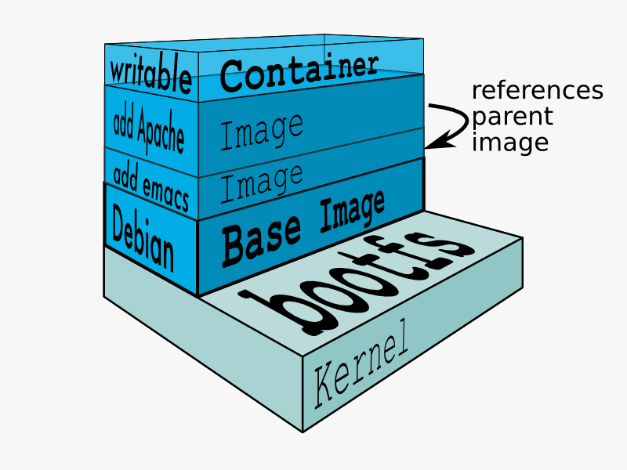
Docker Technology
libvirt: Platform Virtualization
LXC (LinuX Containers): Multiple isolated Linux systems (containers) on a single host
Layered File System
[Source: https://docs.docker.com/terms/layer/]

Slide 7
Docker History
2013-03: Releases as Open Source
2013-09: Red Hat collaboration (Fedora, RHEL, OpenShift)
2014-03: 34th most starred GitHub project
2014-05: JAX Innovation Award (most innovative open technology)

Slide 8
Run Platforms
Various Linux distributions (Ubuntu, Fedora, RHEL, Centos, openSUSE, ...)
Cloud (Amazon EC2, Google Compute Engine, Rackspace)
2014-10: Microsoft announces plans to integrate Docker with next release of Windows Server
Notes:
Windows: http://www.zdnet.com/docker-cto-why-microsofts-docker-plans-for-windows-will-matter-to-you-7000035150/
"That's why the result of the Microsoft announcement will not allow a container that runs on Linux to run seamlessly on Windows or vice versa. But that's OK because in the context of distributed applications that's not what developers are asking for."

Slide 9
Hello World
Simple Command - Ad-Hoc Container
docker run ubuntu echo Hello World
docker images [-a]
docker ps –a
Notes:
Immediately exits
docker ps
docker ps –a
Re-attach: docker start –i stoic_wozniak
docker commit –m «message» containerId imageName(e.g. mytest/test1:1.0)
New Image
docker images

Slide 10
Terminology - Image
Persisted snapshot that can be run
images: List all local images
run: Create a container from an image and execute a command in it
tag: Tag an image
pull: Download image from repository
rmi: Delete a local image
This will also remove intermediate images if no longer used

Slide 11
Terminology - Container
Runnable instance of an image
ps: List all running containers
ps –a: List all containers (incl. stopped)
top: Display processes of a container
start: Start a stopped container
stop: Stop a running container
pause: Pause all processes within a container
rm: Delete a container
commit: Create an image from a container
Notes:
docker run --rm to remove container after termination

Slide 12
Image vs. Container
Base Image
ubuntu:latest
run
Container
cid1
base image
cmd → new state
New Image
iid1
commit
Container
cid1
run
Container
cid2
Container
cid3
Container
cid4

Slide 13
Dockerfile
Create images automatically using a build script: «Dockerfile»
Can be versioned in a version control system like Git or SVN, along with all dependencies
Docker Hub can automatically build images based on dockerfiles on Github

Slide 14
Dockerfile Example
Dockerfile:
FROM ubuntu ENV DOCK_MESSAGE Hello My World ADD dir /files CMD ["bash", "someScript"]
docker build [DockerFileDir]
docker inspect [imageId]
Notes:
docker run -ti d97 /bin/bash
testFile.txt -> present
set -> env Variable PROVIDER set
docker run –P -d d97

Slide 15
Mount Volumes
docker run –ti –v /hostLog:/log ubuntu
Run second container: Volume can be shared
docker run –ti --volumes-from firstContainerName ubuntu
Notes:
Use docker start, docker attach to reuse container
Change script to echo ... >> /log/hello3.log

Slide 16
Publish Port
docker run –t –p 8080:80 ubuntu nc –l 80
Map container port 80 to host port 8080
Check on host: nc localhost 8080
Link with other docker container
docker run -ti --link containerName:alias ubuntu
See link info with set
Notes:
Use ifconfig -> eht1 to access from host

Slide 17
Documentation
Docker homepage: https://www.docker.com/
Introduction: https://www.docker.com/whatisdocker/
Online tutorial: https://www.docker.com/tryit/
Installation and user guide: https://docs.docker.com/
InfTec TecBoard: https://inftec.atlassian.net/wiki/display/TEC/Docker
Includes this presentation

Slide 18
Implementations

Slide 19
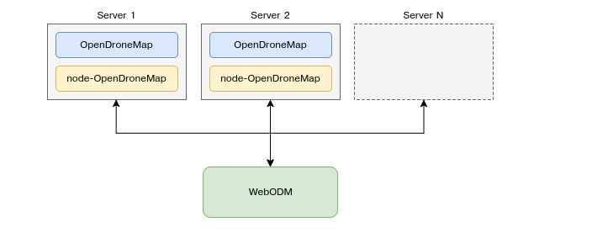

Slide 20

Requirements
Notes:
Git is a distributed version-control system for tracking changes in source code during software development. It is designed for coordinating work among programmers, but it can be used to track changes in any set of files. Its goals include speed, data integrity, and support for distributed, non-linear workflows python installation package

Slide 21
git clone https://github.com/OpenDroneMap/WebODM --config core.autocrlf=input --depth 1 cd WebODM ./webodm.sh start
Notes:
git clone https://github.com/OpenDroneMap/WebODM --config core.autocrlf=input --depth 1 cd WebODM ./webodm.sh start

Slide 22
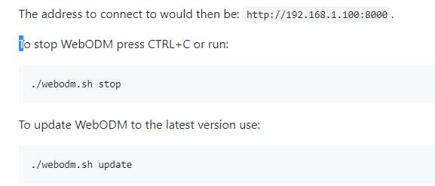
Get the web ODM started
http://localhost:8000
Notes:
The address to connect to would then be: http://192.168.1.100:8000.
To stop WebODM press CTRL+C or run:
./webodm.sh stop To update WebODM to the latest version use:
./webodm.sh update

Slide 23
Drone images
9 drone images are used in this case they were of Jpeg format

Slide 24
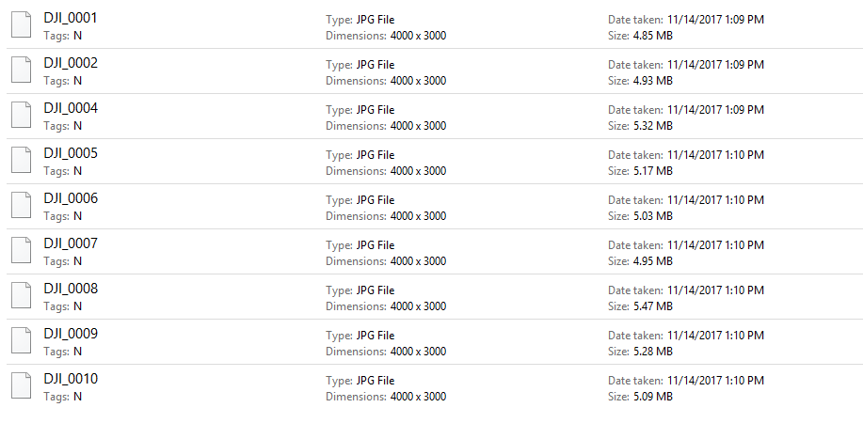

Slide 25
Output 3D Surface

Slide 26
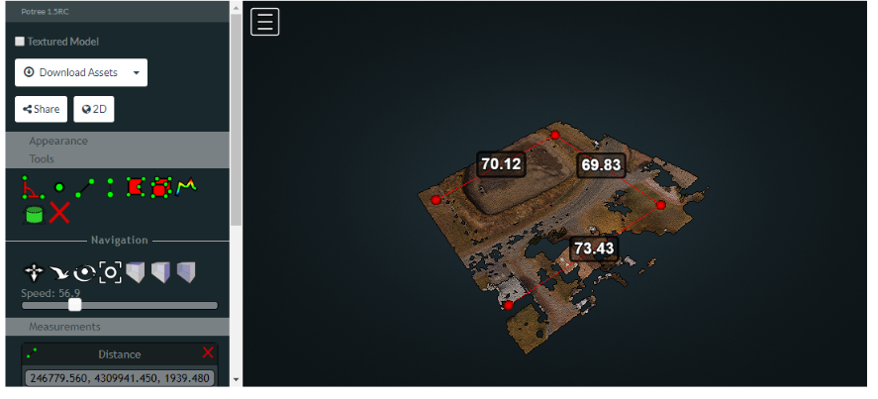

Slide 27
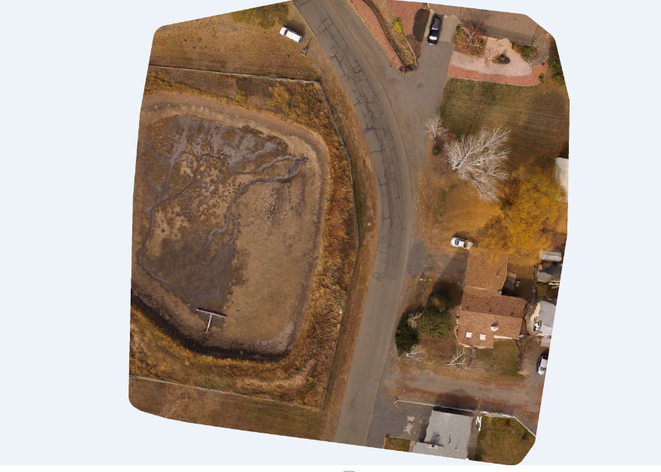

Slide 28
Now plotting it against the Google maps

Slide 29
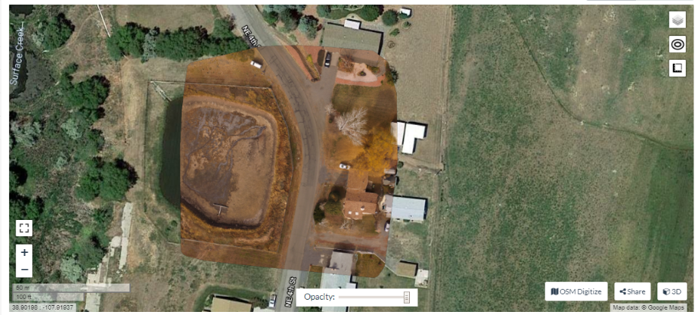

Slide 30
DEM from surface

Slide 31
