Slide 1
Diamond Detectors for Radiation and Luminosity Measurements in CMS
Matt Hollingsworth – U. Tennessee Knoxville
for the CMS-PLT Collaboration
University of Tennessee - Knoxville

Slide 2
CMS-Pixel Luminosity Telescope (PLT) Collaboration
Canterbury University
Anthony Butler, Phil Butler, Nuno Rodrigues
CERN
  Richard Hall-Wilton, Vladimir Ryjov
Fermilab
Lee Lueking
HEPHY Vienna
  Manfred Pernicka, Siegfried Schmid, Helmut Steininger
Rutgers University
  Ed Bartz, John Doroshenko, Yuri Gershtein, Eva Halkiadakis,
  Dmitry Hits, Amit Lath, Steve Schnetzer, Bob Stone
Princeton University
Valerie Halyo, Bert Harrop, Dan Marlow, Bill Sands, David Stickland
Vanderbilt University
  Bill Gabela, Will Johns
University of California, Davis
  Richard Lander
University of Tennessee
  William Bugg, Stefan Spanier, Matt Hollingsworth, Zong Chang Yang
Contributors
  Gary Grim (LANL), Alick Macpherson (CERN), Lalith Perera (Iowa)
University of Tennessee - Knoxville

Slide 3
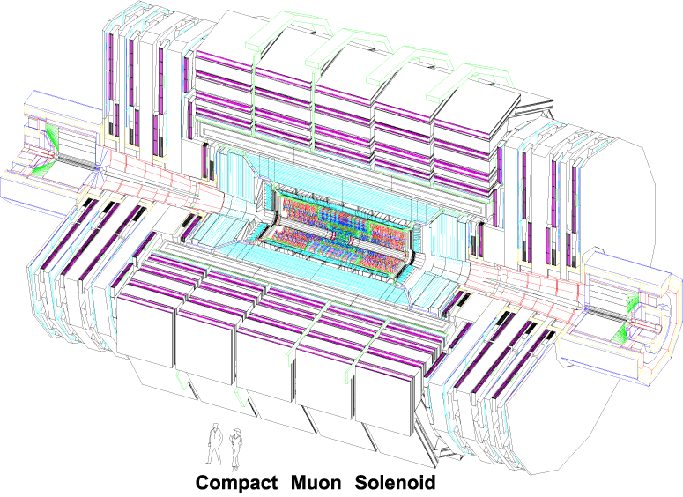
Beam Radiation Monitoring in CMS
The LHC’s high luminosity -> high radiation levels in CMS
  As high as ~2x10¹⁴ cm⁻² at r = 4 cm (pixel detector)
  Adverse beam conditions
    Reduced Lifetime
    Radiation Damage
Pixel Detector
Measure the radiation in CMS for
  Instrument protection (interlocks)
  Beam aborts (issue within 1 turn)
  Establish safe conditions (over time)
Multiple instruments along beam pipe
  Live displays (CMS/LHC/FNAL)
  Longer term analysis (comprehensive)
Diamond diodes closest to pixel (BCM1L)
  4+4 detectors measure flux (current)
  pCVD Diamonds (10x10x0.4mm)
  Warning/abort (based on thresholds)
BCM1L part of a suite of condition monitors
  A. Bell ; W. Lange, IEEE’08
BCM1
Z=± 1.9m, r=4.3cm
Add PLT for luminosity & radiation measurement
University of Tennessee - Knoxville
Notes:
Adverse Beam conditions reduce detector lifetime
Mention that it’s used where no BLMS are present
Interlocks
Mention that we can also project instrument lifetimes
Establish safe conditions->send the data to someone that can react to them
Communicate to CMS/LHC online monitoring
Interlocks: Pull Pixel HV, Injection Inhibit,
BCM1L is but one of 3 different instruments, BCM1L, BCM1F, BCM2.
Currently, the BCM system is the biggest installation of diamonds in HEP. It will be superceded by the PLT

Slide 4
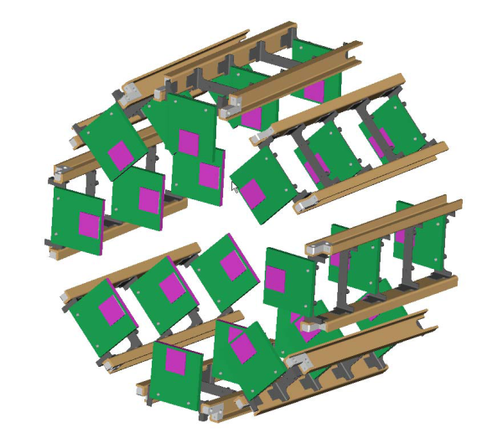
The Pixel Luminosity Telescope (PLT)
Independent of CMS (self-triggered)
Relative bunch-by-bunch measurements
Precision at 1% level (stat, syst)
Self monitoring/calibrating
⇒ 3 layer particle tracking
7.5cm
4mm
4mm
Beam Halo
4.45 cm
IP
P
P
175 cm
sCVD diamond pixel
  Fast pixel OR readout (3-layer coincidence)
  Full readout (1-10 kHz)
University of Tennessee - Knoxville
Notes:
We have infrastructure for measuring the flux… but we don’t normalize the flux to luminosity.

Slide 5
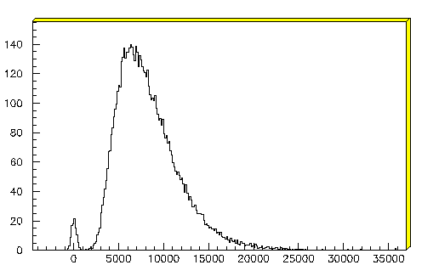
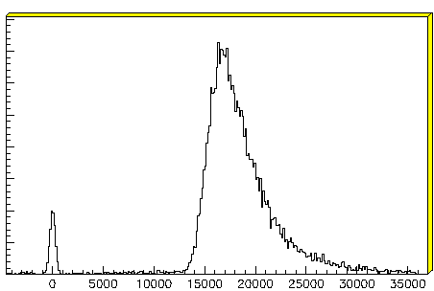
Single-Crystal Diamond Detector (sCVD)
Radiation hard (survives > 2 x 10¹⁵ p/cm²)
No need for cooling
Full charge collection at E-field < 0.2V/um
Fast signal collection (~1ns from 500 um)
Pulse height well separated from pedestal
⁹⁰Sr
Poly crystal
Single crystal
entries
# e-
# e-
University of Tennessee - Knoxville

Slide 6
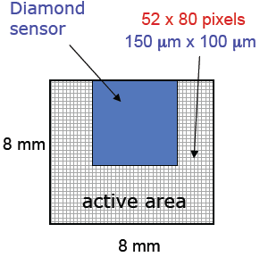
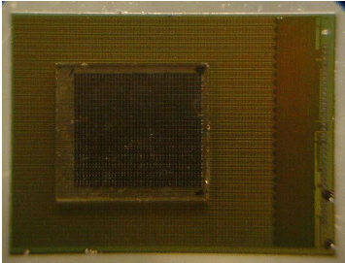
Readout
CMS Pixel chip (PSI46) bump-bonded to sCVD
Has fast cluster counting in double-columns built in
Individual pixel thresholds adjustable
Individual pixels can be masked
Self-triggered by fast pixel OR
Full analog readout of
  Hit address
  Charge deposit
Standard pixel readout (FEC, FED [ADC])
Bump bonded at Princeton micro-fab lab
University of Tennessee - Knoxville

Slide 7
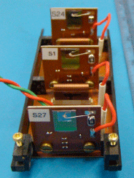
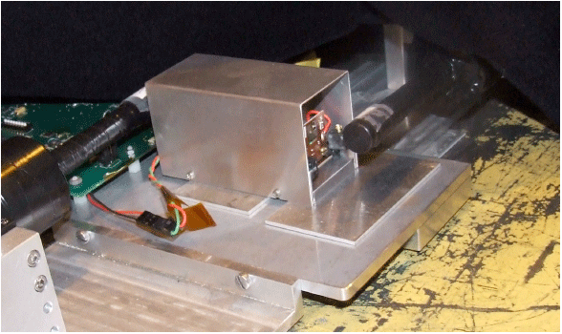
Beam Test
1 full PLT telescope was successfully tested at CERN SPS
150 GeV/c π+
2 days of beam time
Small (6x6 mm) Scintillators
(used as triggers)
3
2
1
Diamond
University of Tennessee - Knoxville

Slide 8
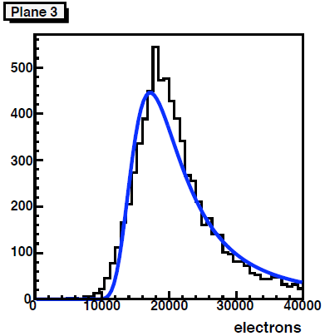
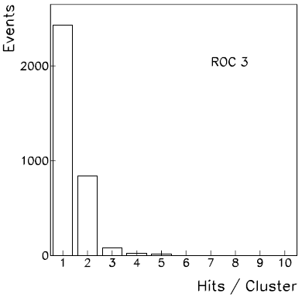
Charge Deposit
Calibrated using charge injection feature of PSI42
Require single cluster in all three planes
Sum over cluster
Most probable charge deposit: ~18,000 electrons (Si: ~28,000)
Threshold
University of Tennessee - Knoxville
Notes:
Good agreement with lab measurements shown earlier (90Sr)

Slide 9
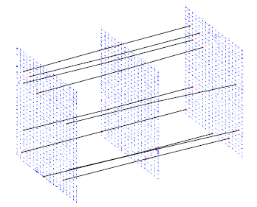
Occupancy
Fiducial area
  Masked border rows/columns
  Removed columns in the shadow of the entrance counter
Dead pixels
  Plane 1: 1.8%
  Plane 2: 2.2%
  Plane 3: 0.1%
Bump bonding efficient
University of Tennessee - Knoxville

Slide 10
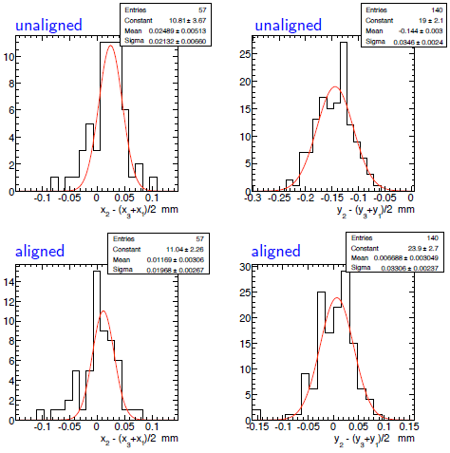
Alignment
ΔX
ΔY
Successfully reconstructed tracks
  Hit position defined as the “center of charge” (charge sharing)
Define residual: x₂ – (x₃-x₁)/2
Alignment
  X offset: 25 ± 5 um
  Y offset: 144 ± 3 um
Even with only a few tracks, a successful alignment was achieved
  X alignment: 57 tracks
  Y alignment: 140 tracks
ΔX
ΔY
University of Tennessee - Knoxville

Slide 11
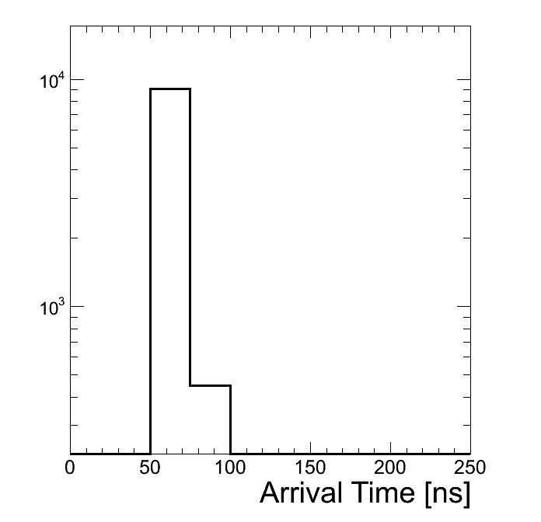
Fast-OR
Test beam particles arrive at random times with respect to our clock
⇒ count +- 1 time bin as the same event
In CMS, particles arrive at a definite phase of the 40 MHz clock.
⇒ fixed to 1 time bin
Efficiency
Plane1
AND
?
Plane2
AND
True
Plane3
Time bin size = 25ns (40 MHz)
Plane 1 Plane 2 Plane 3
Measured Efficiencies 99.3% 99.6% 99.9%
University of Tennessee - Knoxville

Slide 12
Outlook
Beam test shows PLT within requirements
First demonstration of tracks in diamond detectors
Further tests planned
  Demonstrate full readout chain
  Compare radiated/irradiated detectors
  Determine spatial resolution
Begin production of 16 telescopes (+4) telescopes next year
PLT ready for installation in CMS fall 2010
University of Tennessee - Knoxville
Notes:
Will become the biggest utilization of diamonds in HEP!

