Slide 1
PLT Web Control Interface Prototype
Matt Hollingsworth

Slide 2
Overview
The web framework is based upon the python distribution that comes with CMSSW
Added one python package called Django to handle web request/response
Can interface easily with the BRM online framework later (although does not yet)
Core of BRM online monitoring is DipCache (written by me), which serves cached data as xml, decoupled from any other software system
Will make a plot using this interface + BRM framework and present on Monday
Living in cmsplt/frontend

Slide 3
Current Features
Monitor overall status
Uptime
“Lumi” (fake number at the moment)
Currently running calibrations
Currently running data run
Job queue
Submit calibrations/data runs to run back-to-back
Cancel/delay/pause queue
Start/stop calibration runs
Assign calibration runs to data sets
Manage multiple configurations
Authentication (can’t do anything unless you sign in)

Slide 4
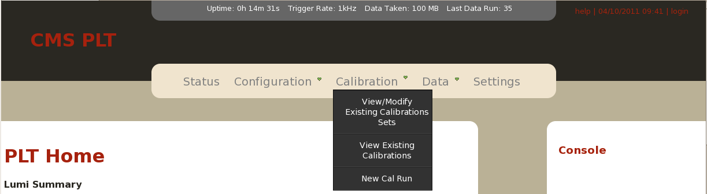
Header/Console
Shows uptime, trigger rate, data taken and last data run
(trigger rate is fake at the moment, since we don’t have any underlying DAQ software to provide it)
Includes navigation
Login info/current time
Appears on all pages ( so I won’t include it in future screenshots to save space)
There is also a “console” (right-hand side) which includes any error or info messages which are generated during use of the interface

Slide 5
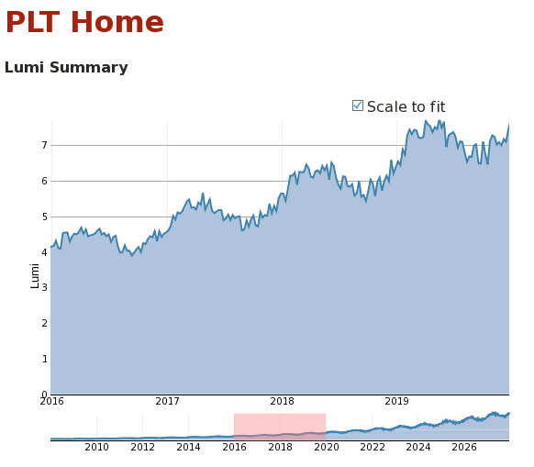
Overall Status
Includes Lumi Plot vs. time (fake data now, will later be filled by DipCache through BRM framework)
Also includes things like most recent cal run, most recent data run, etc (not pictured)

Slide 6
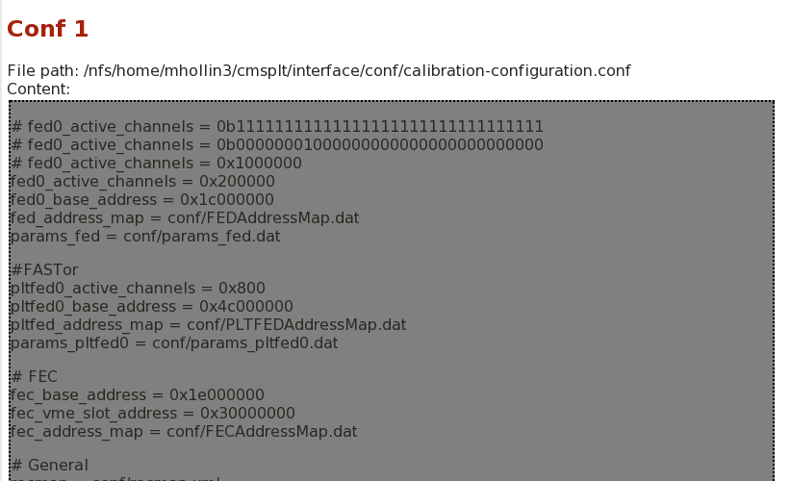
Configuration Managment
Manage Configurations (through “Configuration” objects stored in DB)
At the moment, manages different configurations by pointing to different directories which include config files
Can be interfaced with Anthony’s versioning code that way
Can be easily extended to keep the entire configuration in DB
Configurations are associated with calibration runs and data runs in the DB

Slide 7
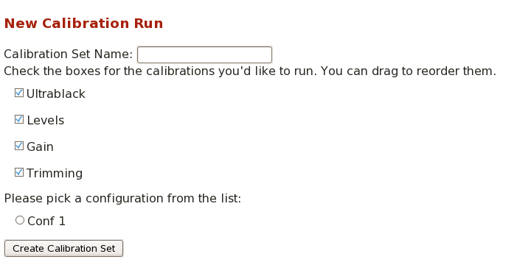
Create New Calibration Run
Creates a “CalibrationSet”, which is stored in a database, which is a collection of “Calibrations” (also stored in a database)
Later associated with “DataRun” objects (again stored in database) so that one can associate appropriate calibration runs with data runs

Slide 8
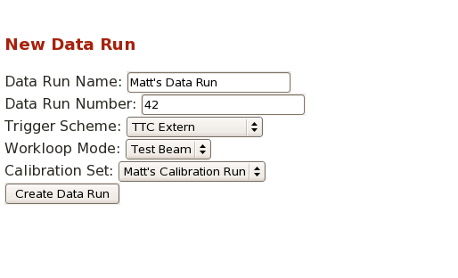
New Data Run
Creates a new Data Run with the specified trigger scheme, daq mode and associated calibration results

Slide 9
To-Do
This was developed at UT (no real system to test it on) so we will have to test it on a test stand
Full configuration in DB (?)
Maybe don’t want to do this since config files can be diffed etc
Easy to add in later

