Slide 1
Course Information
Course Code: CS106A
Course Name: Computer Programming I
Instructor: 林基成 (Ji-Cherng Lin)
Textbook:
C++ How to Program, Late Objects Version, 7/e, H. M. Deitel and P. J. Deitel

Slide 2
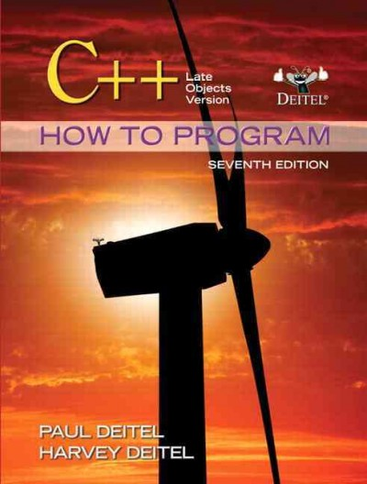

Slide 3
Contact Information
Office Location: Room 1304
Telephone:
Office: (03)463-8800 ext. 2354
Home: (03)462-8212
Mobile: 0970-722-135
E-mail: csjclin@saturn.yzu.edu.tw

Slide 4
Objectives
This course will teach students the basic elements of procedural-based C++ programming.
It is expected that students will be able to design basic C++ programs at the end of this course.

Slide 5
Topic Outline
Ch. 2. Introduction to C++ Programming
Ch. 3. Control Statements: Part 1
Ch. 4. Control Statements: Part 2
Ch. 5. Functions and an Intro to Recursion
Ch. 6. Arrays and Vectors
Ch. 7. Pointers
Ch. 8. Sequential-Access Files
Ch. 17. Random-Access Files
Sparse Matrices

Slide 6
Evaluation
Homework 20%
Midterm Exam 1 20% 10/31
Midterm Exam 2 20% 12/12
Final Exam 40% 1/9

