Slide 1
Brain MRI Multi-Task Classification
Tumor Type Classification · MRI Weighting · Lesion Heatmap
Prof. Yaghoubzadeh & Razavi
Mentored by Mina Shirazi
Mahyar Abbasi
Nima Adib
1/24

Slide 2
Dataset Overview
11,300 brain MRI scans from multiple tumor types
10 tumor classes: Normal, Astrocytoma, Ependymoma, Glioma, Hemangiopericytoma,
Meningioma, Neurocytoma, Oligodendroglioma, Schwannoma, Other
3 MRI weighting sequences: T1, T2, T1C+
Image resolution: up to ~512×512 pixels
Multi-modal metadata: tumor location (x,y), description text, scan dimensions
Data stored in SQLite database with relational schema
Dataset used: Brain MRI Images for Brain Tumor Detection (kaggle)
2/24

Slide 3
Exploratory Data Analysis
Tumor distribution analysis — slight class imbalance
Weighting distribution: T1, T2, T1C+ roughly balanced
Image size distribution — 512×512
Tumor location heatmap — spatial distribution of lesion centroids
Correlation analysis between tumor type and location patterns
Description text length and content analysis for NLP features
EDA included distribution plots, boxplots, and statistical summaries
3/24

Slide 4
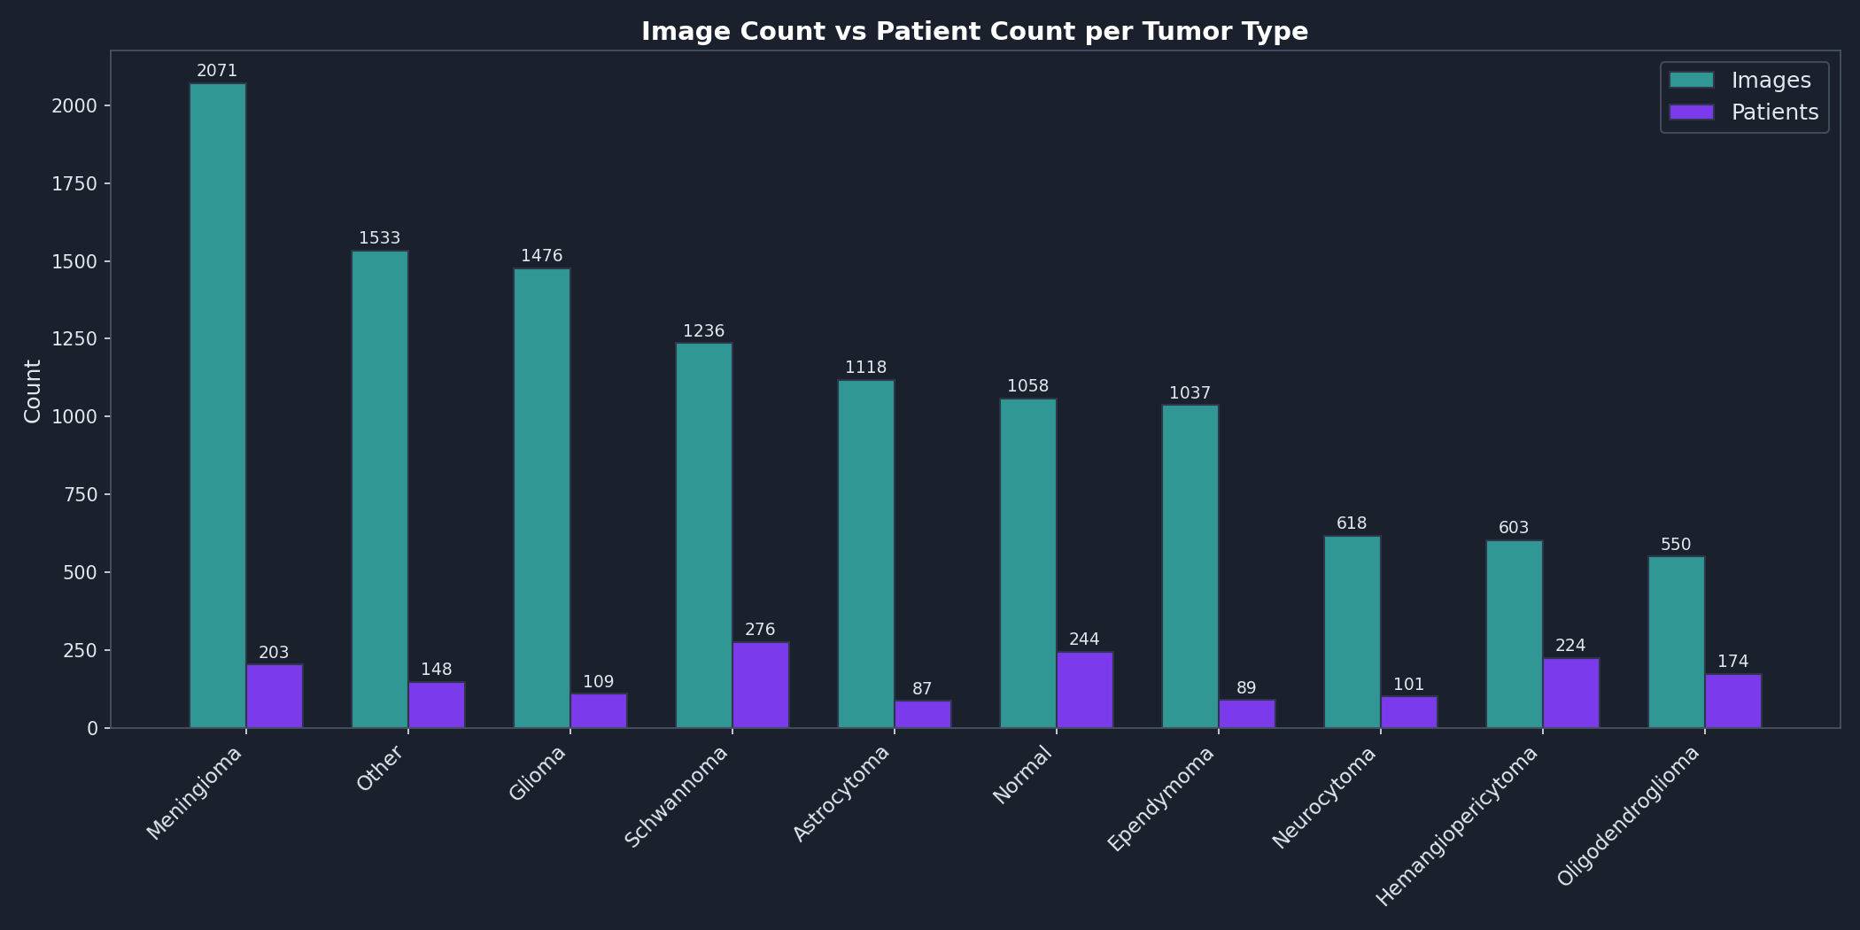
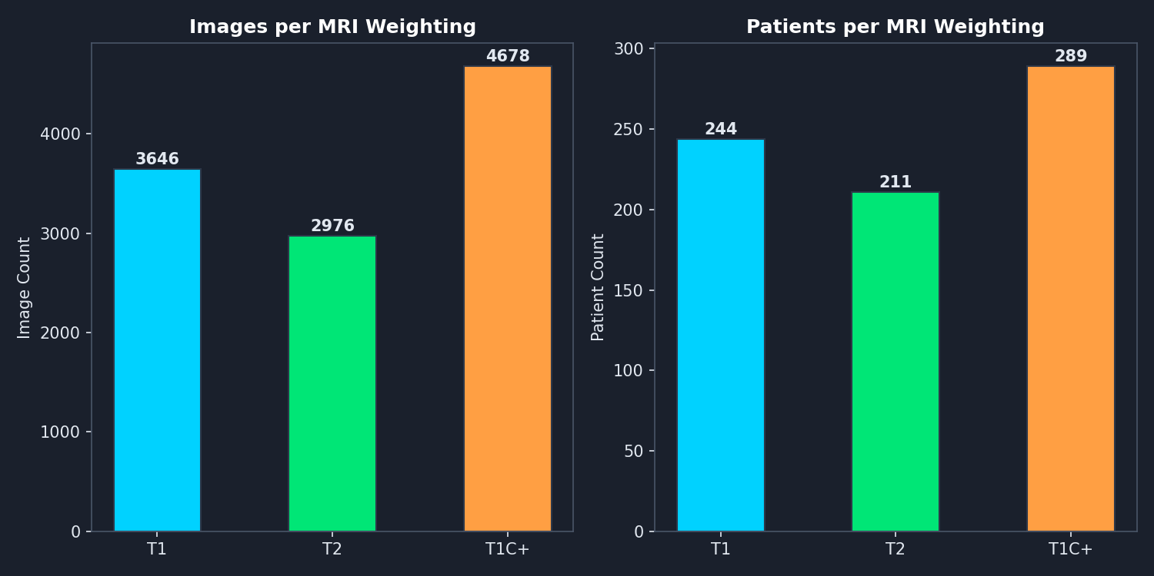
4/24

Slide 5
Data Preprocessing
Normalization: pixel values scaled to [0,1] range
Image resize to 224×224 for model input
Coordinate normalization: point_x, point_y normalized to [0,1]
Lesion offset normalization: distance from image center
Missing value handling: zero-fill for missing descriptions
Categorical encoding: tumor_type and weighting mapped to indices
Data quality checks: missing images logged and skipped
Preprocessing pipeline automated via preprocess.py
5/24

Slide 6
Database Architecture
SQLite relational database (brain_tumor_db.sqlite)
Database connection module: database_connection.py
Efficient querying for training data loading
Predictions saved back to database for persistence
Schema designed for reproducibility and traceability
Supports both training and inference pipelines
6/24

Slide 7
Feature Engineering
Spatial features: lesion_offset, lesion_offset_norm, is_central
Location one-hot encoding: loc_* brain region flags
TF-IDF vectorization of clinical descriptions (top 20 terms)
Text length feature: desc_length from description strings
Output: 50+ engineered features fed alongside image data
Feature engineering script: feature_engineering.py
7/24

Slide 8
Multi-Task Problem Definition
Task 1: Tumor Type Classification (10 classes, CrossEntropyLoss)
→ Primary task, weight 1.0 in composite loss
Task 2: MRI Weighting Classification (3 classes, CrossEntropyLoss)
→ Secondary task, weight 0.5
Task 3: Lesion Heatmap Regression (MSELoss)
→ Gaussian heatmap at lesion location, weight 5.0
Joint training: all heads learn simultaneously from shared backbone
Structured features fused via MLP branch for richer representation
Multi-task learning improves generalization via shared representations
8/24

Slide 9
CustomBrainNet Architecture
Input (3, 224, 224)
Image + Structured Features
5-Stage CNN Backbone
32 → 64 → 128 → 256 → 512 channels, BatchNorm
Spatial Features (512, 14, 14)
Feature MLP (64-dim)
Global Pool
Fusion: Concat(512, 64) → 576
Tumor Head (10 classes)
Weight Head (3 classes)
Heatmap Head (1-channel)
Sigmoid → 224×224 lesion map
Trainable params: ~2.4M
9/24

Slide 10
Training Configuration
Optimizer: AdamW (lr=1e-4, weight_decay=1e-4)
Scheduler: CosineAnnealingLR (T_max=10, restarts)
Maximum epochs: 60 (early stopping patience=7)
Batch size: 32
Input size: 224×224 pixels
Hardware: NVIDIA RTX 4070 (CUDA)
Data split: 80/20 stratified hold-out (seed=42)
Warm-start: resume training from previous checkpoint
Hyperparameters logged via MLflow
10/24

Slide 11
Regularization Techniques
Dropout: 0.3 in feature MLP, 0.4/0.3 in tumor head layers
Batch Normalization after every convolutional layer
Early stopping: monitor validation loss, patience=7 epochs
Best weights saved automatically to best_model_v4.pth
Weight decay (L2 regularization): 1e-4 in AdamW optimizer
Multi-task loss balancing prevents overfitting to any single task
Regularization needed due to 2.4M parameters on limited data
11/24

Slide 12
Data Augmentation (Albumentations)
Horizontal Flip (p=0.5) — mirror images for invariance
ShiftScaleRotate (shift=0.1, scale=0.1, rotate=15°, p=0.5)
RandomBrightnessContrast (p=0.3) — lighting variation
Keypoint-aware: tumor coordinates transformed with image
Validation: only resize + normalization (no augmentation)
Normalization: ImageNet mean/std (0.485, 0.456, 0.406)
12/24

Slide 13
Composite Loss Function
Loss = (1.0 × CE_{tumor}) + (0.5 × CE_{weight}) + (5.0 × MSE_{heatmap})
CE_{tumor}: 10-class CrossEntropy for tumor type
CE_{weight}: 3-class CrossEntropy for MRI weighting
MSE_{heatmap}: pixel-wise Gaussian heatmap regression
Heatmap target: σ=5 Gaussian centered at (point_x, point_y)
Normal scans: zero heatmap (no lesion to localize)
13/24

Slide 14
Evaluation Metrics
Accuracy: overall and per-class tumor accuracy
Precision, Recall, F1-Score via sklearn classification_report
Confusion Matrix: 10×10 heatmap of predictions vs true labels
Per-class accuracy breakdown with visual bars
Batch evaluation on held-out validation set (2260 samples)
All metrics printed to console and figures saved
Evaluation automated in evaluate.py
14/24

Slide 15
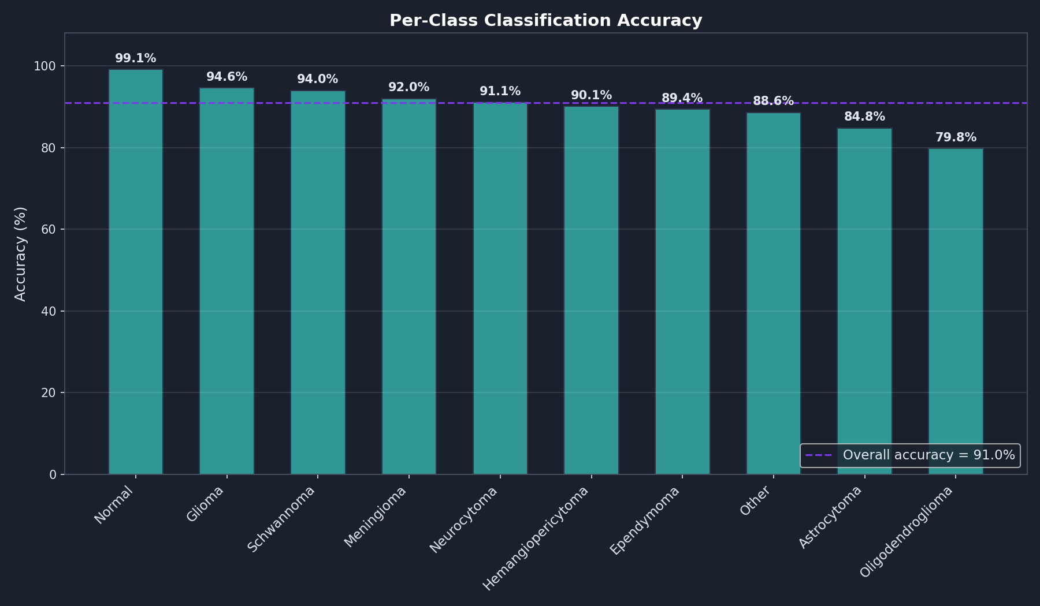
15/24

Slide 16
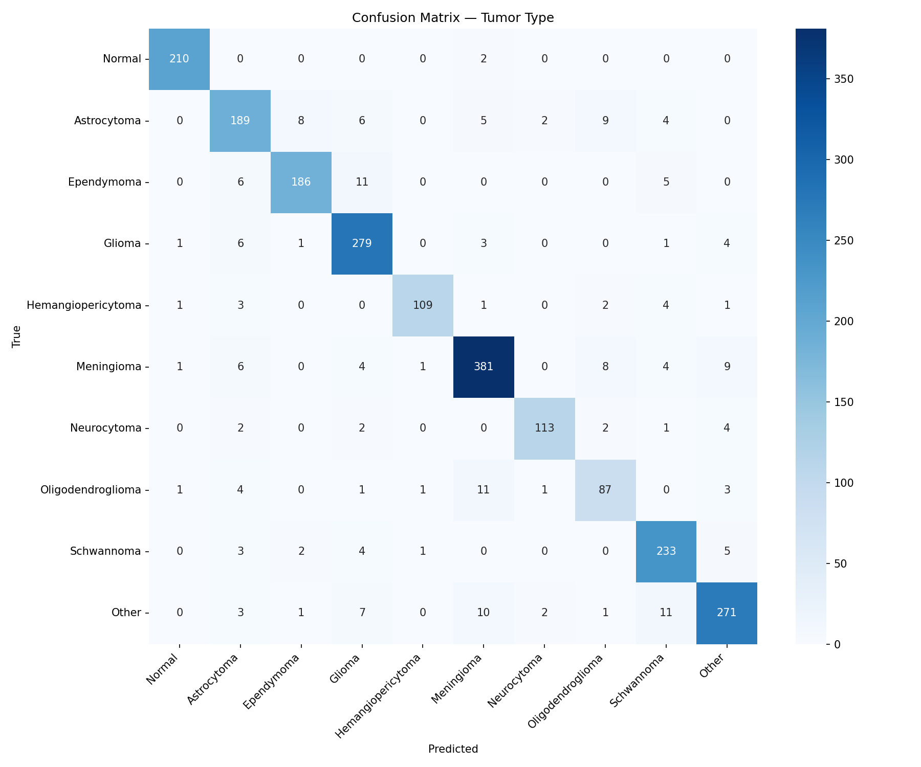
Confusion Matrix Analysis
Heatmap visualization saved to confusion_matrix_final.png
Confusion patterns consistent with clinical
similarity between tumor types
Confusion matrix enables targeted model improvement
16/24

Slide 17
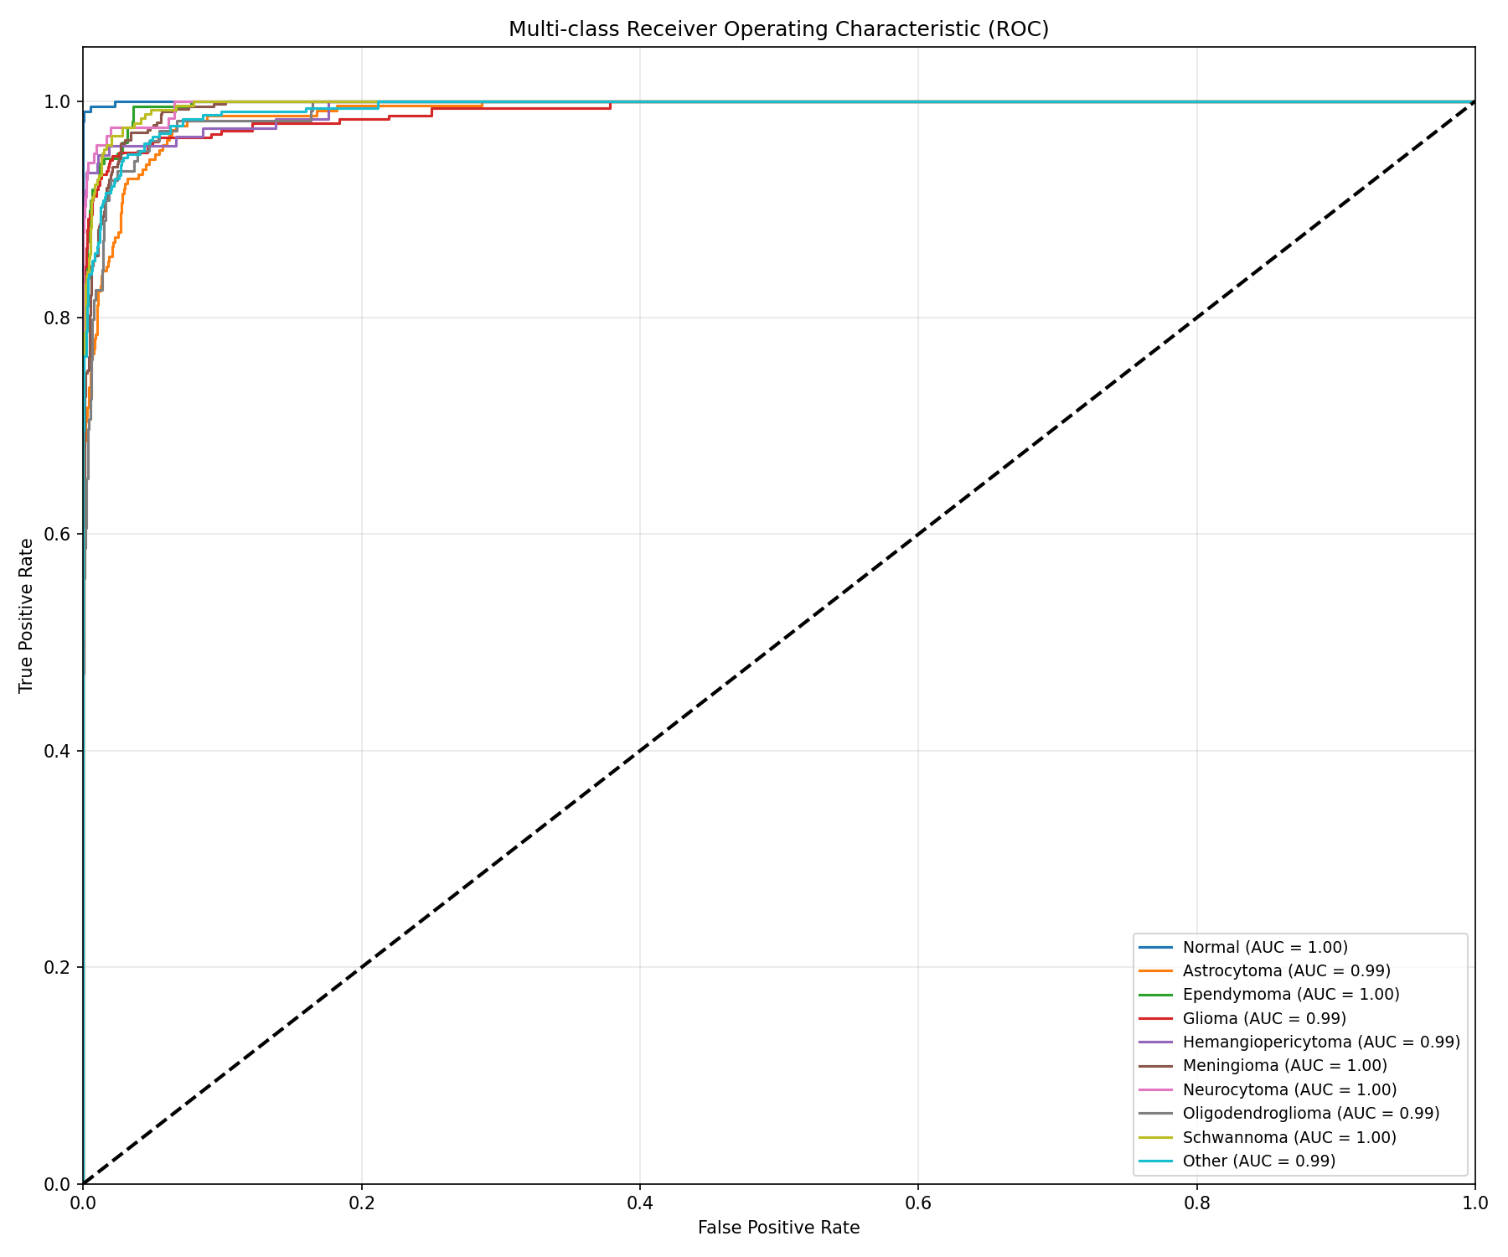
Receiver Operating Characteristic Curves
Multi-class ROC with one-vs-rest strategy per tumor type
AUC scores almost perfect, showing model’s performance
ROC curve saved to roc_curve.png
ROC analysis shows model ability to separate tumor types at various thresholds
17/24

Slide 18
Lesion Heatmap Localization
Gaussian heatmap target at lesion centroid (point_x, point_y)
σ=5 spreads heat over ~11×11 pixel region
Normal scans: zero heatmap (no lesion)
Model outputs 1-channel 224×224 heatmap via decoder
Predicted heatmap overlays on input image for visualization
MSE loss optimized with weight 5.0
Enables interpretable lesion localization alongside classification
18/24

Slide 19
End-to-End Pipeline Automation
Training Pipeline
load_data → preprocess → feature_engineering → train_model → save
Prediction Pipeline
load_data → preprocess → feature_engineering → load_model → predict → save_to_DB
Orchestrator: run_pipeline.py
--mode all | train | eval | predict
Reuses Phase 2 scripts
load_data.py, preprocess.py, feature_engineering.py, database_connection.py
19/24

Slide 20
MLflow Integration
Experiment tracking: all hyperparameters logged
Learning rate, batch size, epochs, loss weights, optimizer, scheduler
Per-epoch metrics: train/val loss and accuracy
Best metrics: best_val_loss, best_val_acc recorded
Model artifact: PyTorch model saved to MLflow registry
Model versioning: automatic version tracking across runs
Full reproducibility: every run can be recreated from logged params
20/24

Slide 21
Baseline Comparison
Single-task vs Multi-Task: multi-task improves generalization
Shared backbone learns richer representations across tasks
Pretrained vs Scratch: transfer learning significant boost (transfer)
ImageNet weights backbone vs custom 5-stage CNN scratch
Loss: composite weighted vs uniform — weighted better for heatmap
Feature fusion: MLP branch alone vs image-only
21/24

Slide 22
Reproducibility
Random seed: 42 (PyTorch, NumPy, Python random)
Full requirements: requirements_p3.txt with pinned versions
Environment: Python 3.14, PyTorch 2.x, CUDA 12.x
Data split: stratified 80/20, same split across all runs
Pipeline: single command python run_pipeline.py --mode all
Checkpoints: best weights saved to models/best_model_v4.pth
Logging: structured logs + MLflow tracking for every run
Every run fully reproducible from code + params
22/24

Slide 23
Clinical Impact & Integration
Triage assist: rank scans by tumor probability for radiologist review
Heatmap localization: draws attention to suspicious regions
Second opinion: automated classification supports diagnostic workflow
Weighting detection: auto-identify MRI sequence type from image
Integration: pipeline → model → report annotations
Latency: <1s per scan enables real-time clinical decision support
Limitation: not a diagnostic replacement — assistive tool only
Clinical impact: triage, localization, workflow integration
23/24

Slide 24
Failure Cases & Lessons Learned
Glioma vs Astrocytoma: histologically similar, imaging overlap
Rare classes → model underfits
Heatmap misses lesion: small tumors <10px poorly localized
Weighting confusion: T1 vs T1C+ visually similar without contrast
Additional labels (genomic/molecular) could disambiguate similar types
Lessons: need more rare class data, better backbone
Data preprocessing pitfall: dash/em-dash characters in image names broke regex extraction →
early pipeline bugs caused terrible accuracy
Lesson: preprocessing/data cleaning as critical as model architecture
Failure analysis guides future improvements
24/24

Slide 25
Thanks for your attention

