Slide 1
Marketing | Leads Conversion
DEPI –Microsoft Power BI Final Project-

Slide 2
Group: ALX2_DAT2_G2
Team members:
Eman Ibrahim Ghabour
Safaa khalaf
Maryem Hamdy Yassien Mariam Yehia Zakaria

Slide 3
Our Roles:
Eman Ibrahim Ghabour:
- Dax modeling and Dashboard building
Safaa khalaf:
-Data Cleaning &Transformation - Data Modeling.
Maryem Hamdy Yassien:
- Data Cleaning &Transformation and Dax modeling.
Mariam Yehia Zakaria:
- Determine Data Analysis Questions and Dashboard building

Slide 4
Objective of this Project:
identify the Leads having a higher conversion ratio (Customers with most probability of getting loans) so that they can specifically target these potential customers through additional channels and re-marketing.

Slide 5
Domain Specific Knowledge: .
A marketing lead: is a person who shows interest in a brand's products or services, which makes the person a potential customer. The primary goal of any company is to generate as many leads as possible. A company must guide prospects down the sales funnel with relevant content and offers towards their purchase

Slide 6
Dataset scope:
A digital team of a bank have challenges with lead conversions (Turning the Potential or interested customers into buying /actual customers). They have provided a partial data set for customers loan history from the last 3 months. They also collect basic details about customers.

Slide 7

Steps:
1-Data Cleaning and preprocessing
Tasks:
o Data Cleaning: Clean and preprocess the data using Power BI.
Tools: Power BI.
o Data preprocessing: search about similar data and give explanation in details.
Tools: internet browser and Microsoft word.

Slide 8
2-Model & Analysis Questions Phase
Tasks:
o Data Modeling: Build the relationships between tables in the data using Power BI.
Tools: Power BI.
o Determine Data Analysis Questions:
Determine all possible analysis questions that can be deducted from the given dataset and would be of interest to the organization’s decision makers, e.g., what is the impact on products category and regions on sales performance?
Tools: Power BI.

Slide 9
3-DAX Modeling & Dashboard Phase Tasks: o Build Dashboard: Build a Power BI dashboard that visualize the answers to the asked questions. Tools: Power BI.

Slide 10
The dataset explanation: It Contains More than 30,000 Records The dataset contains the following columns:

Slide 11
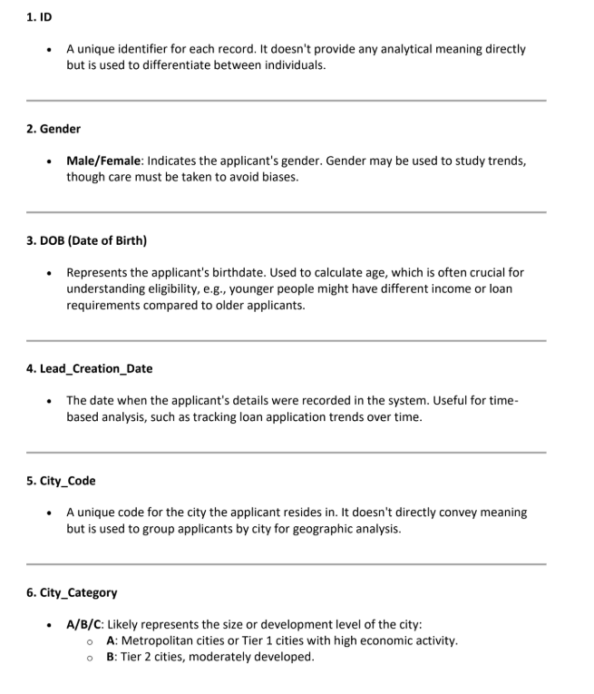

Slide 12
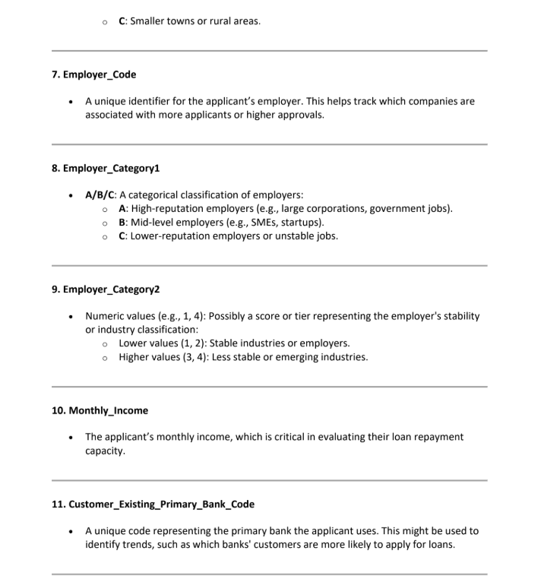

Slide 13
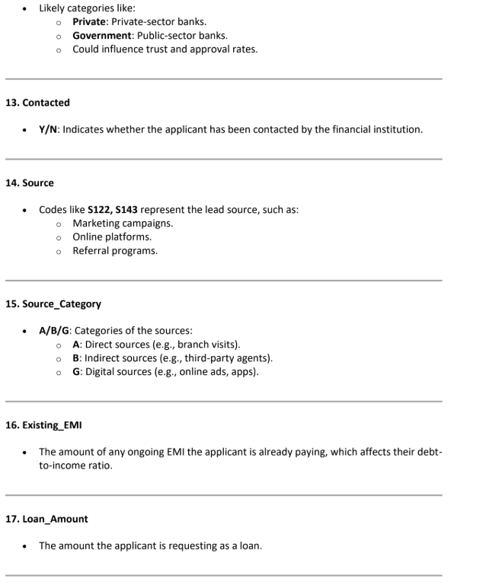

Slide 14
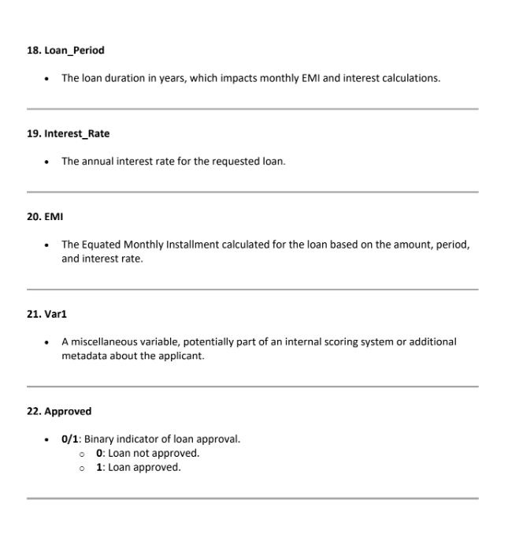

Slide 15

Data cleaning :
-Removed missing or duplicated values
Converted data types (Loan Amount, Date, etc.)
Created calculated columns for DTI, interest rate, loan period
Segmented categorical variables for better visuals

Slide 16
Our Key Performance Indicators (KPIs):
Total Loans Amount: 2B
Total Leads: 70K
Average Interest Rate: 6.14%
DTI Ratio: 0.06
Total Approved Loans: 1020

Slide 17
Important Calculated Measures:
Approval percentage measure
Approval percentage measure =
DIVIDE(
COUNTX(
FILTER(
train,train[Approved]=1
),
train[ID]
),
Count(train[ID])
)*100
Visual card
Non Approval percentage measure
Non Approval percentage measure =
DIVIDE(
COUNTX(
FILTER(
train,train[Approved]=0
),
train[ID]
),
Count(train[ID])
)*100

Slide 18
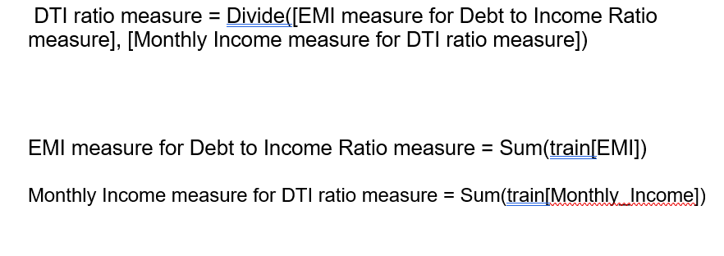
3- Debt to income ratio measure(DTI)

Slide 19
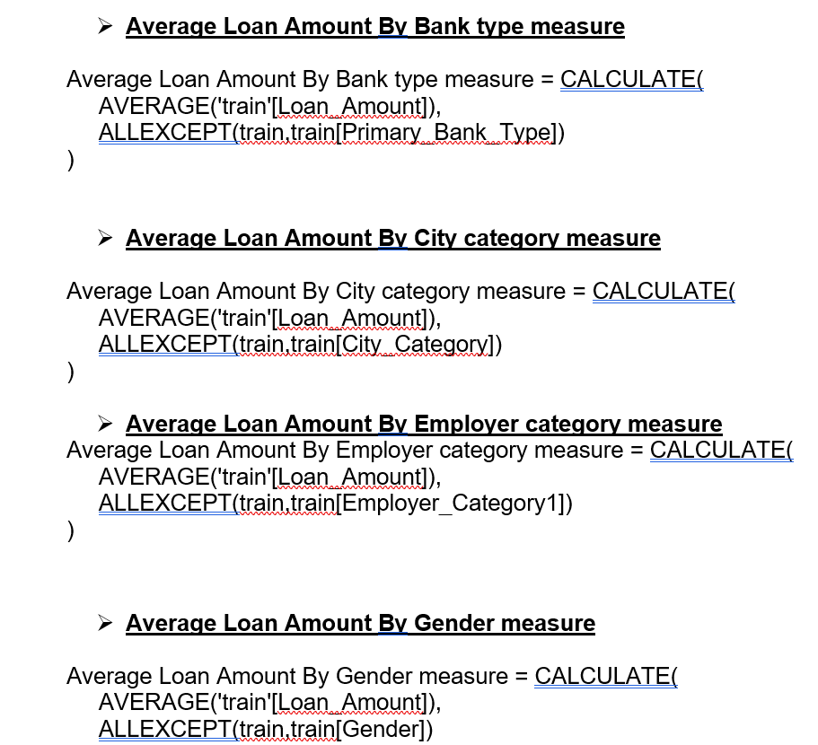

Slide 20
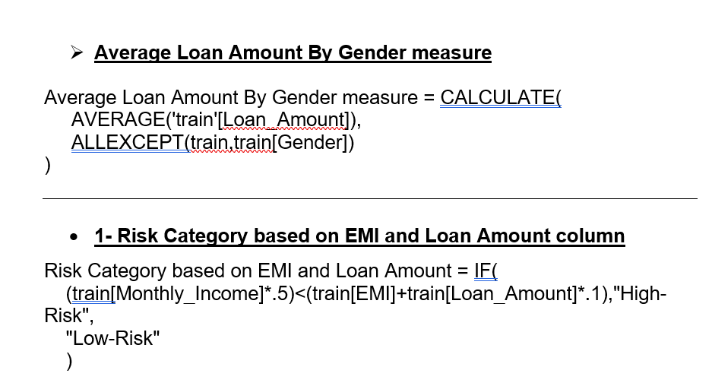

Slide 21
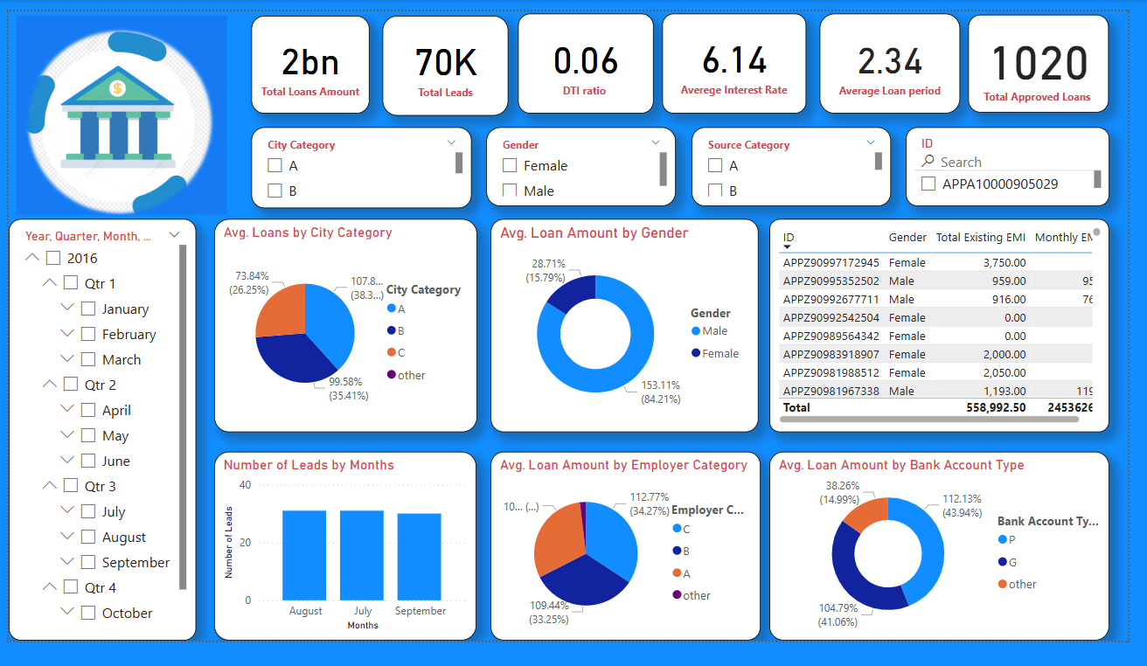

Slide 22
Questions for our Project:
1. Loan Approval Insights
Create a DAX measure to calculate the loan approval rate: What percentage of applicants were
approved for a loan?
Create a calculated column to categorize applicants as 'High-Risk' or 'Low-Risk' based on their
income, existing EMI, and loan amount.
- Analyze Loan Trends by Age Group: Categorize applicants into age groups (e.g., 18-25, 26-35, etc.).
2. Income & EMI Relationship
Write a DAX formula to calculate the Debt-to-Income Ratio (DTI) for each applicant: How does DTI
mpact loan approval rates?

Slide 23
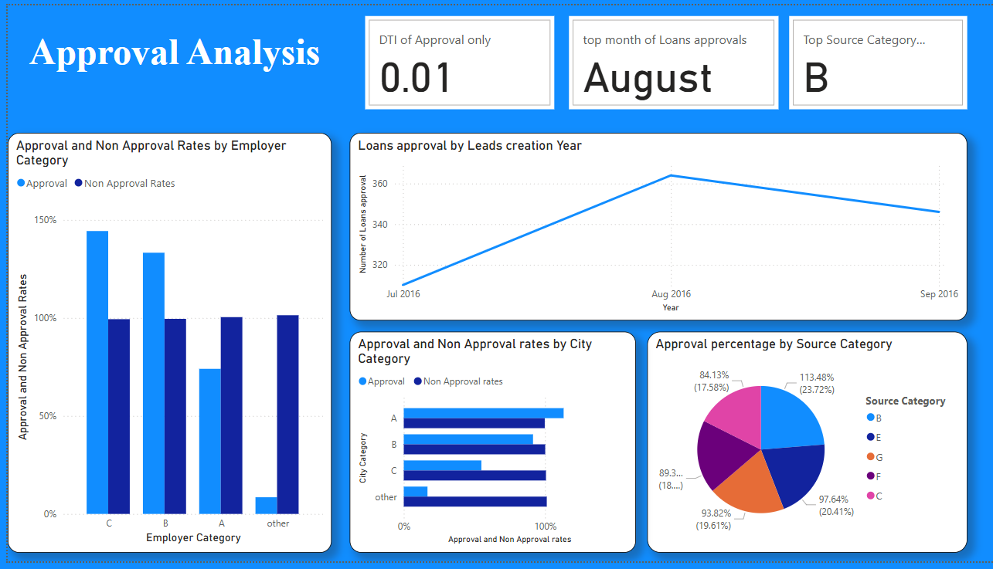

Slide 24
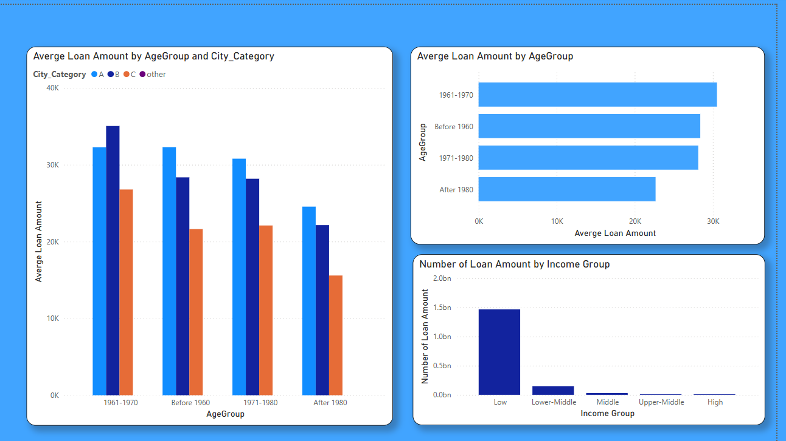

Slide 25
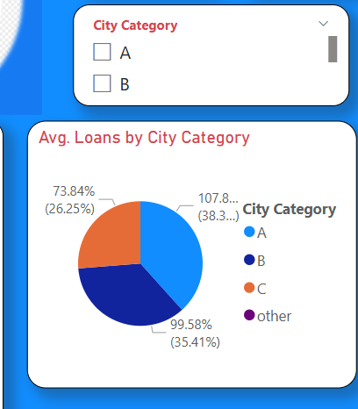
3. City Analysis - Create a measure to compare loan approval rates across different city categories (A, B, C). - Are applicants from metropolitan areas (Category A) more likely to get approved?

Slide 26
4. Loan Repayment & Risk Analysis
Calculate the Total EMI Burden: Create a measure that sums the applicant's existing EMI and new loan EMI.
Find the High-Risk Borrowers: Create a DAX column that flags applicants as 'High Risk' if their Debt-to-Income Ratio (DTI) is above a threshold.

Slide 27
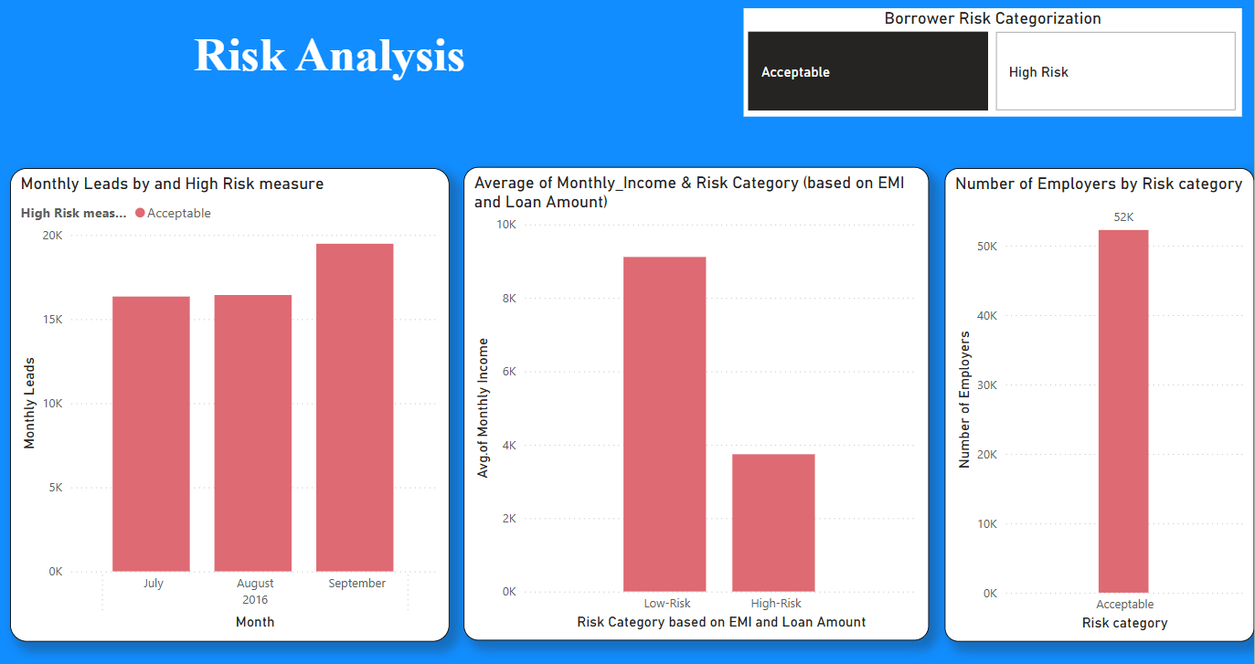

Slide 28
7. Customers Trends: - Segment Applicants by Income Group: Classify applicants into Low, Medium, and High-income groups. - Identify Frequent Loan Applicants: Find individuals who have applied multiple times.

Slide 29
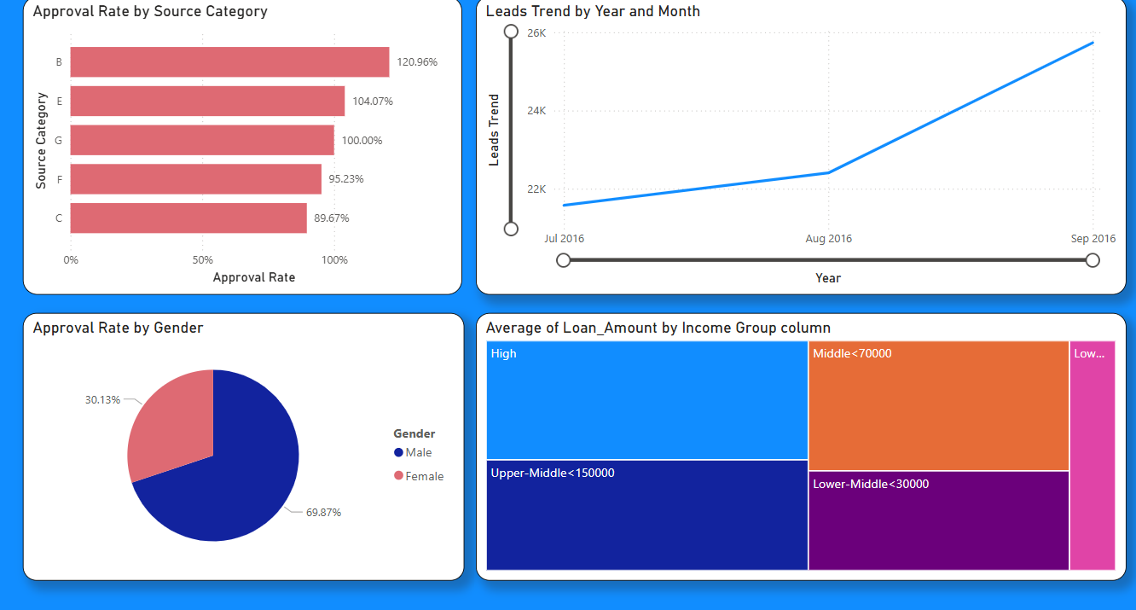

Slide 30

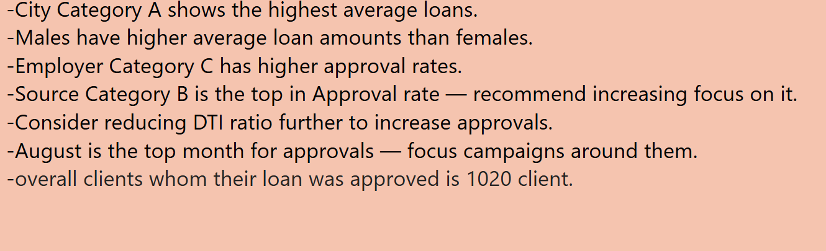
Insights & Recommendations:

Slide 31
Conclusion
The Market Leads Dashboard offers clear insight into loan trends.
Targeting high-performing categories can boost conversion
Like top categories in each Slicer.

Slide 32
Thank you

