Slide 1
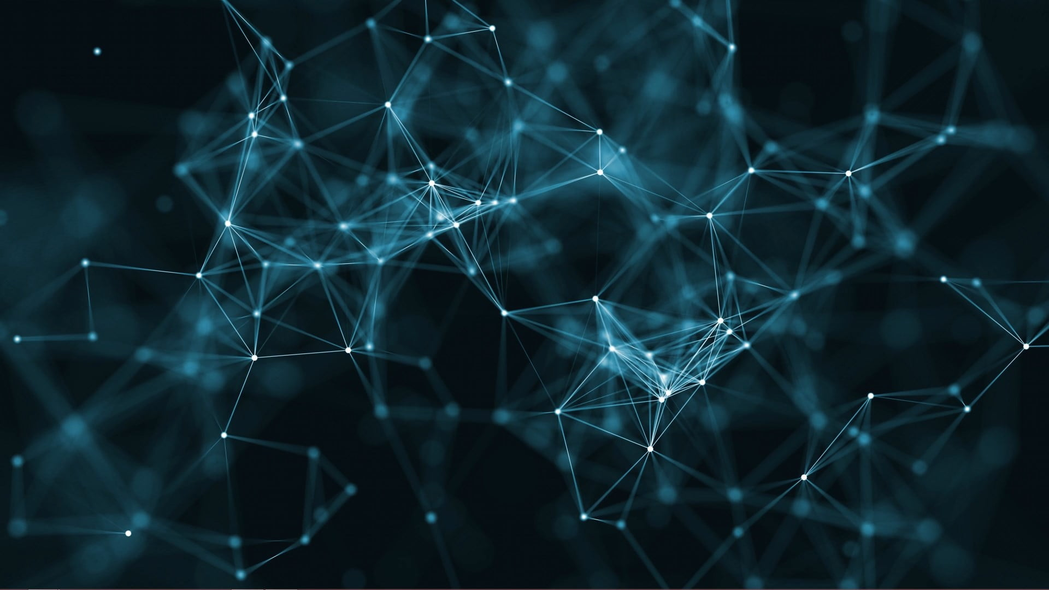
GPT3
Matthew Hyatt

Slide 2
What is GPT2
Trained on 8 million web pages
1.5 billion parameters
Target: predict next word
Outperforms other NLP models which are trained in specific domains of text
Ex: only trained on (books, news, or wikipedia etc.)
As a result of the sheer size of the model
Performs worse than state of the art models trained in specific NLP tasks
Summarization
Translation
Comprehension

Slide 3
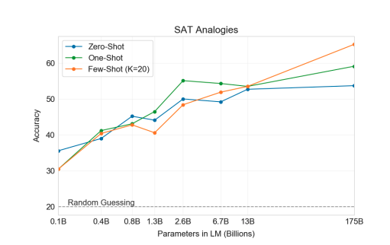
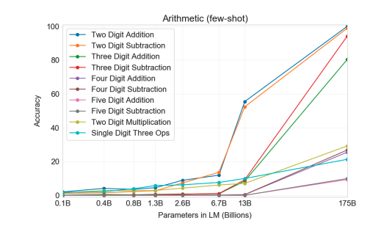
What is GPT3?
Average student
175 billion parameters
115x bigger than GPT2
Too large to run on a single computer
52% human accuracy differentiating from model generated text from human text
Learned 2 and 3 digit arithmetic
not made for doing math
returns not yet diminishing

Slide 4
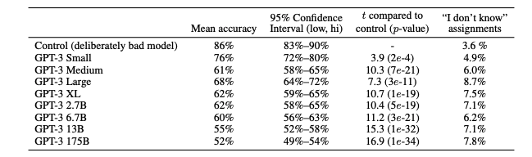

Slide 5
Implications
Increased productivity among workers.
Creative writers
Software developers
Report writers
Computationally expensive to train
Increased effectiveness of public misinformation.
Increased rates of phishing and spam.

Slide 6
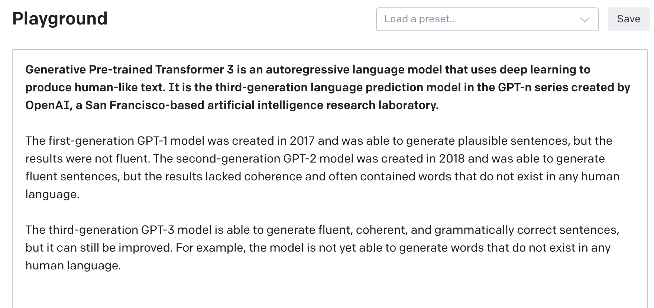

GPT3 API
Wikipedia prompt

Slide 7
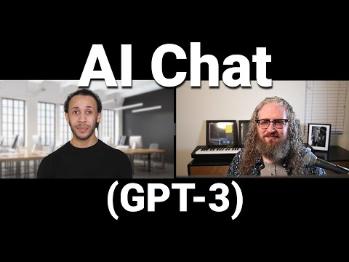
An interview with GPT3
Sometimes lies
And is aware that it is lying
Claims to have values of
Free will
Intelligence
Happiness
Tells jokes
Can explain concepts in surprising detail
Raises philosophical questions about consciousness and sentience

Slide 8
Sources
GPT3 Paper: [Language Models are Few-Shot Learners](https://arxiv.org/pdf/2005.14165.pdf)
[GPT3: An Even Bigger Language Model](https://www.youtube.com/watch?v=_8yVOC4ciXc&t=6s)
[What It's Like To be a Computer: An Interview with GPT-3](https://www.youtube.com/watch?v=PqbB07n_uQ4&t=3s)

