Slide 1
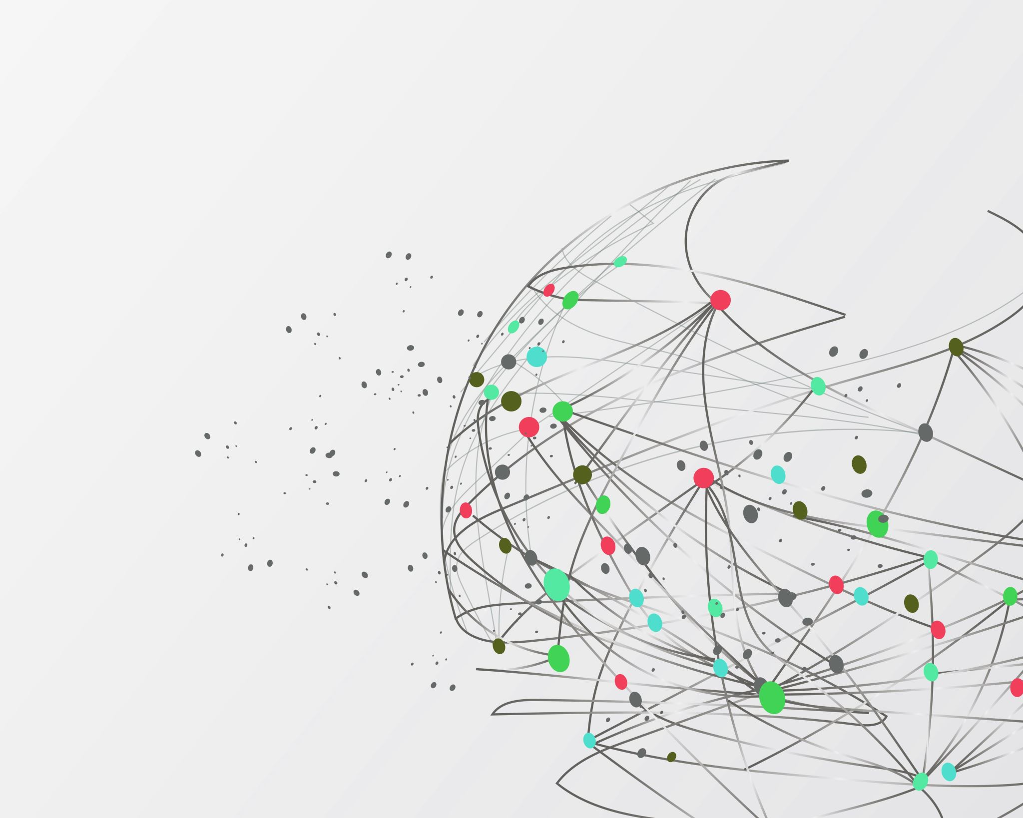
DRP 2025
Project by Charles-Étienne Lessard
mentored by Miguel Ayala

Slide 2
OUTLINE OF PROJECT
Our project : A Julia implementation of a system of ODE’s
Motivation
Example of specific equations
Results

Slide 3
Motivation: How are softwares useful in applied math?
Avoid tedious computations by hand
Approximate solutions to non-analytical problem
See how solutions vary as different parameters are varied
Visualization tools

Slide 4
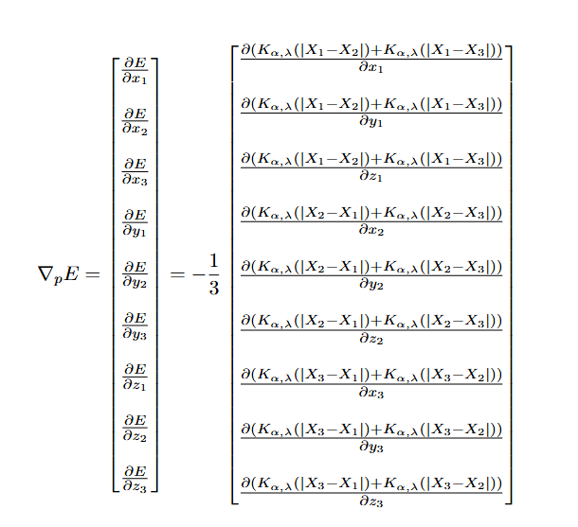
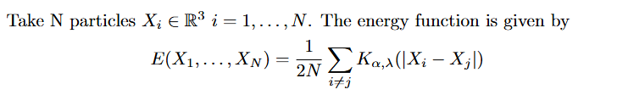
Example of specific equation
For only 3 particles, we have to solve a system of 9 equations

Slide 5
How does a solver work? (Newton’s ROOT finding Method)

Slide 6
Exploration

