Slide 1
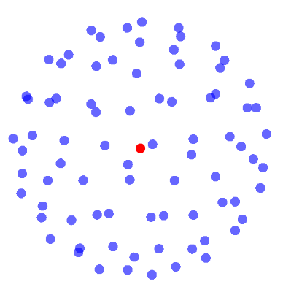
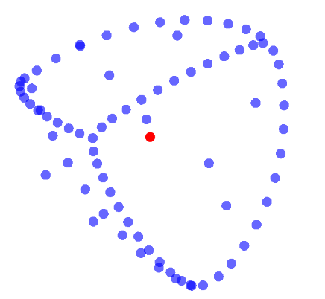
Symmetry Breaking in Particle Simulations: A Computational Exploration
Project by Charles-Étienne Lessard
mentored by Miguel Ayala

Slide 2
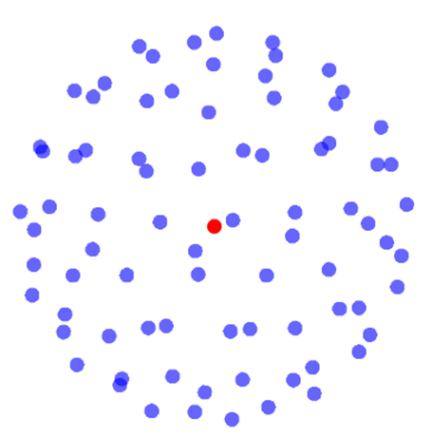
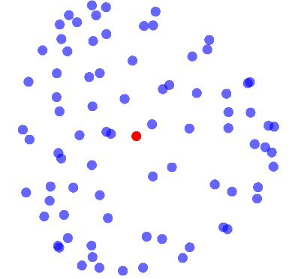

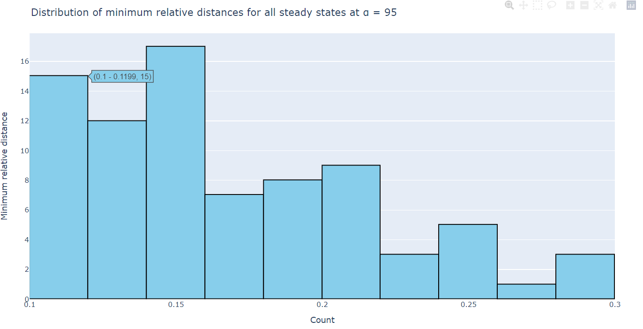
Computational Mathematics:
Approximate solutions to complicated differential equations
Efficient visualization tools
Modelling and prediction (when equations become impossible to solve by hand)
Exploration and intuition

Slide 3
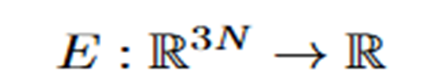
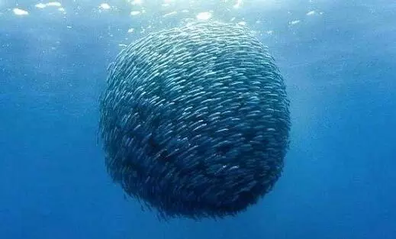
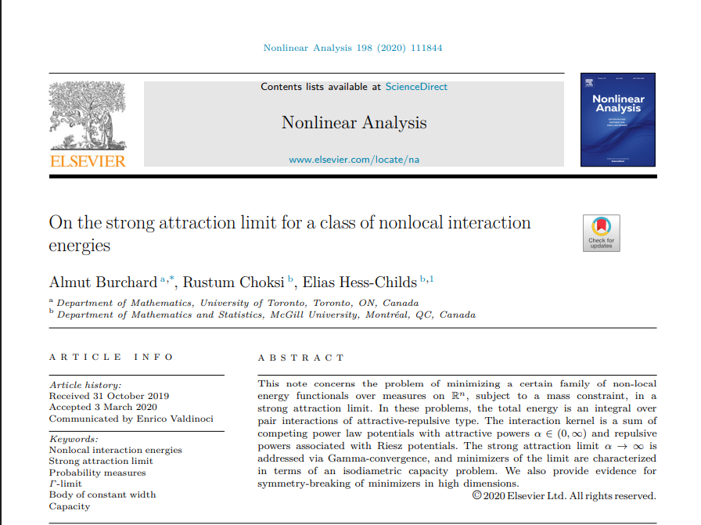
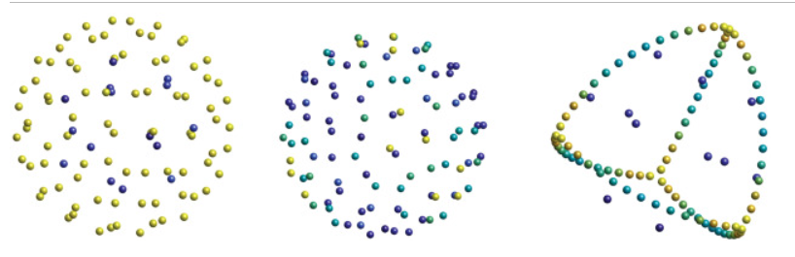
https://www.sciencedirect.com/science/article/pii/S0362546X20301036
Our project : Study the break of symmetry of a particle system
Energy Function:

Slide 4

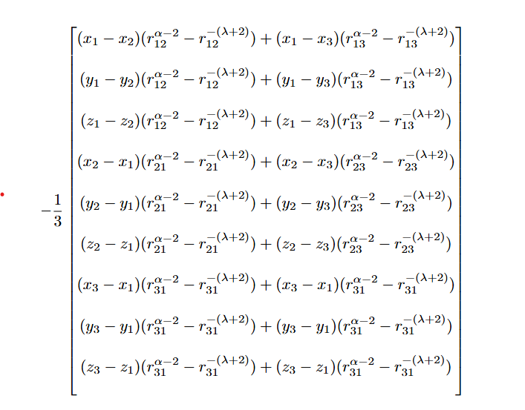




Finding the Minimizers
Energy Function:
Example: N = 3
Gradient of Energy Function:
Interaction Kernel
λ > 0 and α > 0

Slide 5
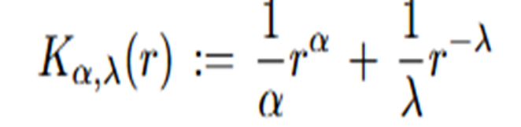

What can we explore?
Interaction Kernel
How does the variation of the parameters affect the shape of the minimizers?
Which quantitative measurements can we take on the shape of the local minimizers?
Does the number of particles have an influence on the shape of the minimizers?

Slide 6
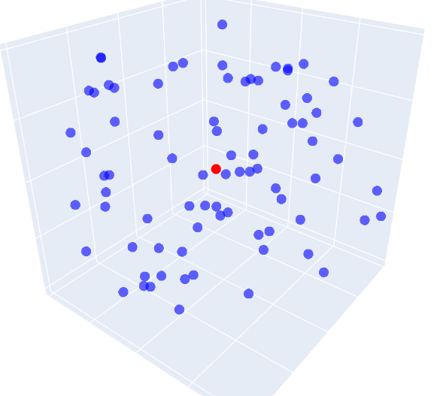
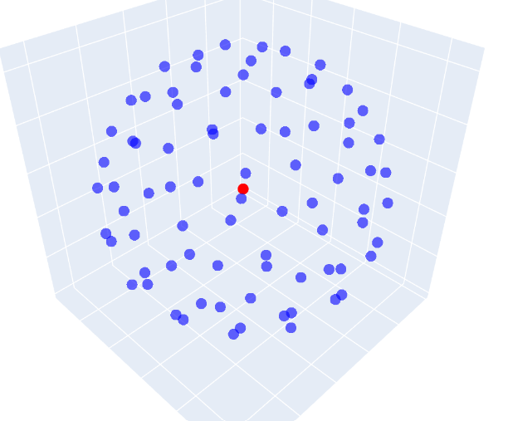
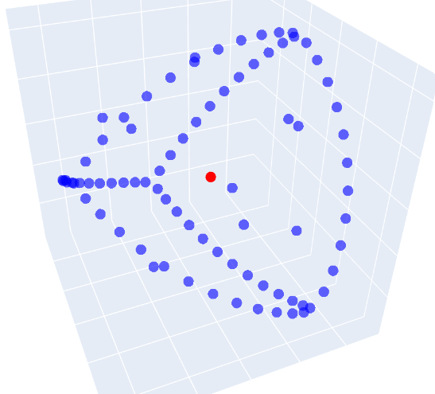

How does a solver work?
Random Initial Condition
Small value of α
Large value of α
Solve the ODE system
Continuation

Slide 7
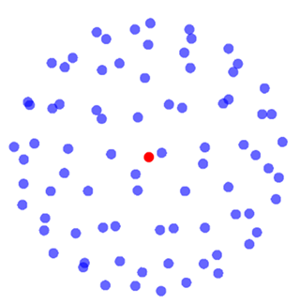
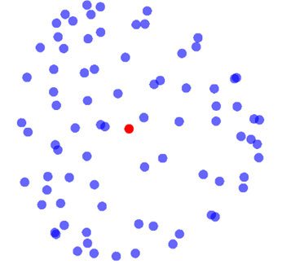

1.How does the variation of the parameters affect the behaviour of the minimizers?
Julia Notebook

Slide 8
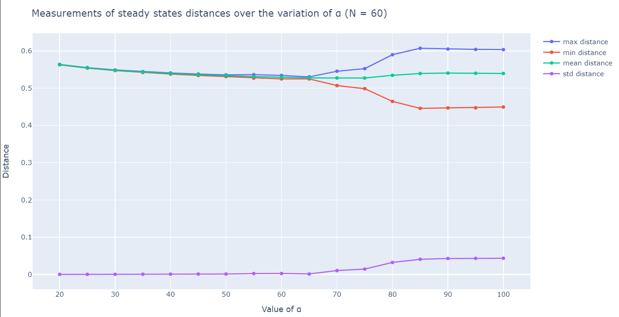
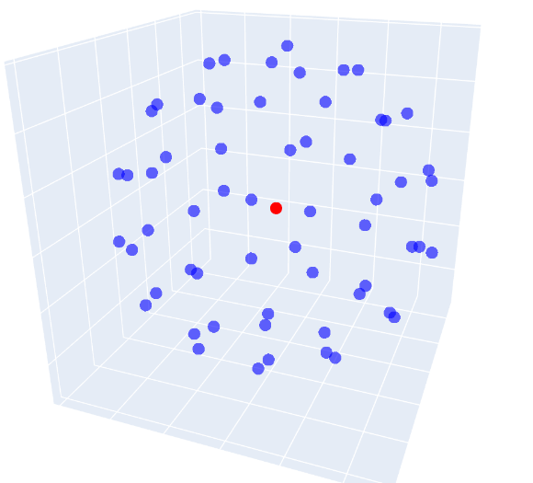
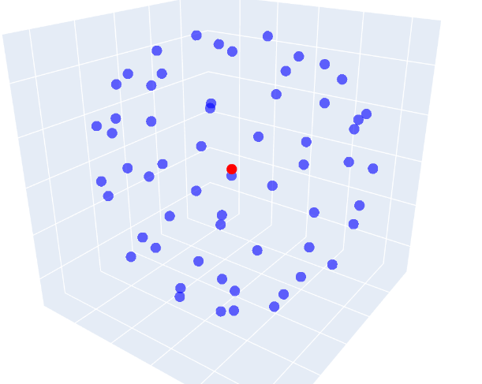
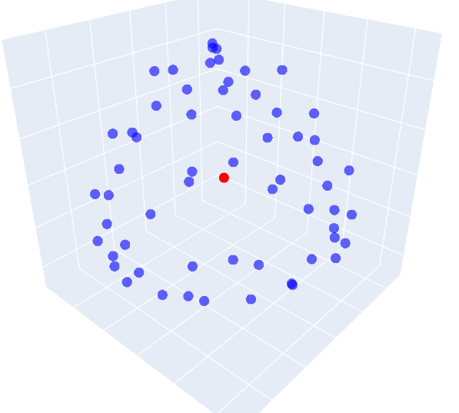
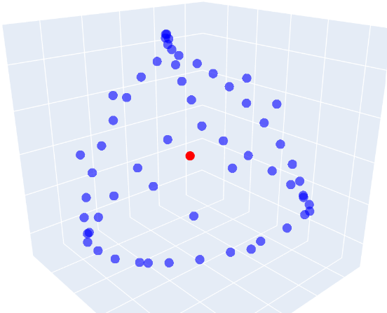
2. Which quantitative measurements can we take on the shape of the local minimizers?
α = 20
α = 75
α = 80
α = 100

Slide 9
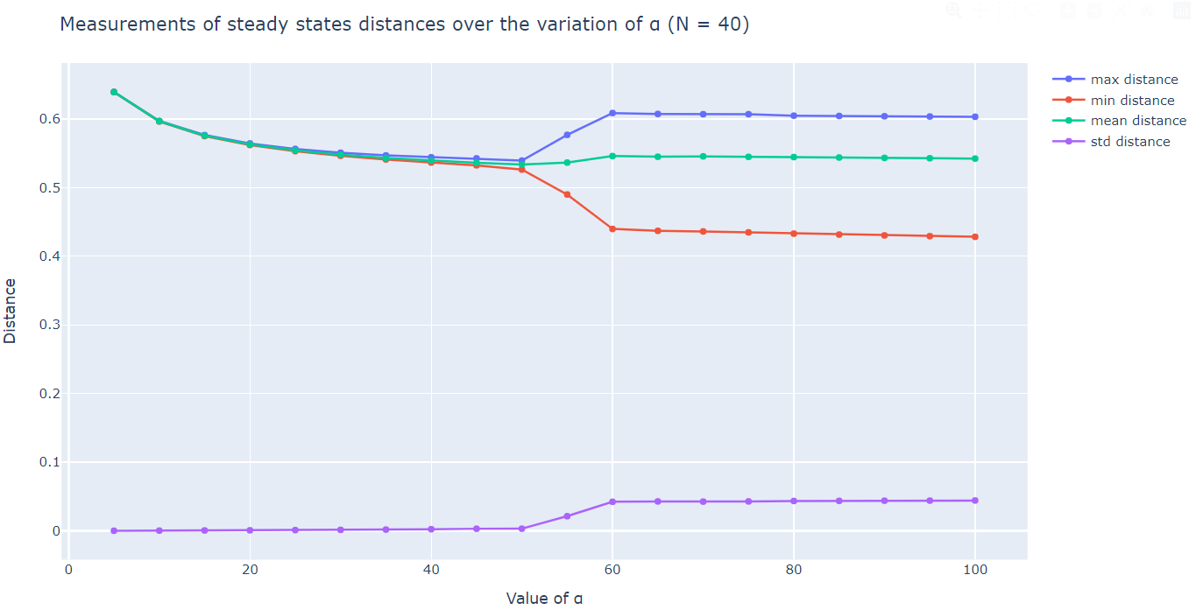
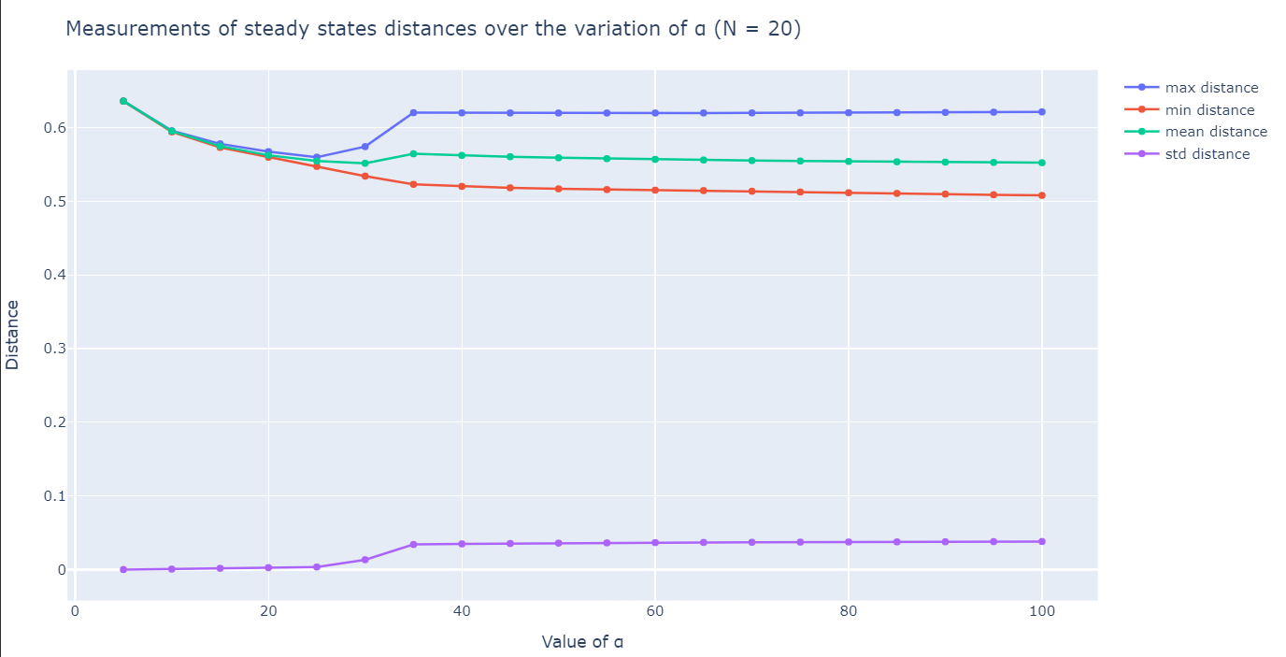
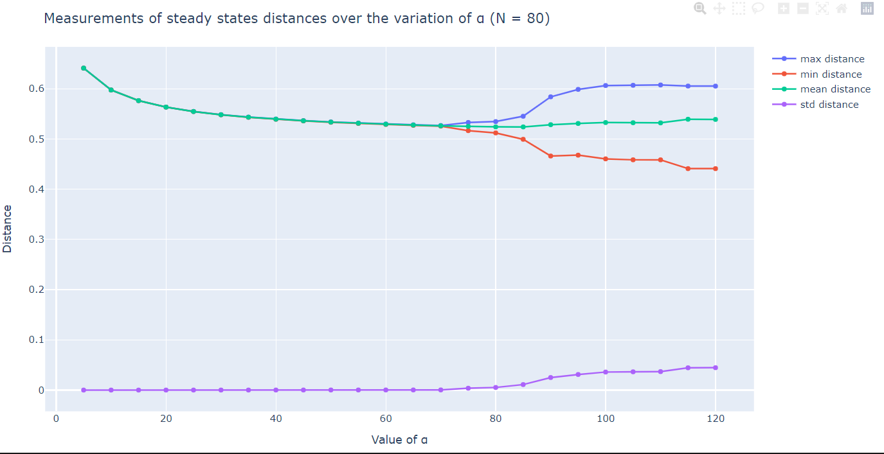
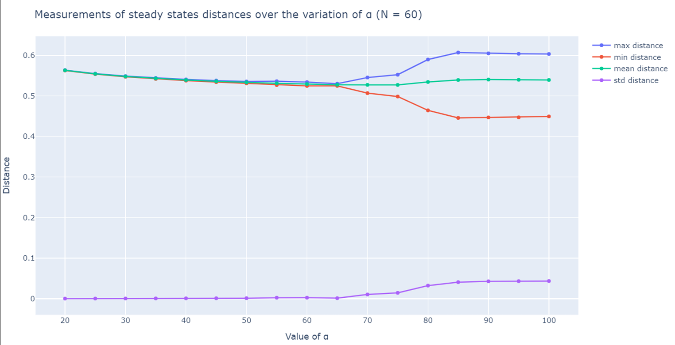
3. Does the number of particles have an influence on the behaviour of the Minimizers?

Slide 10

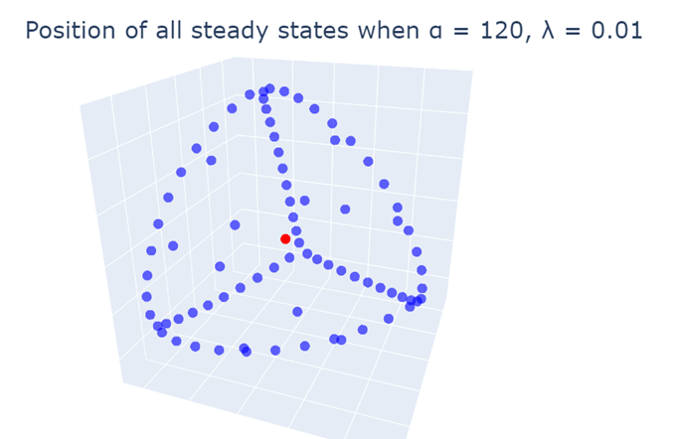

Further exploration: Other questions
When exactly and why do we observe a break of symmetry?
How does the parameter λ affect the shape of the minimizers?
Do different initial conditions affect the results?
Does using a different solver affect the results?
What can we say about the true location of the minimizers?
How about the global minimizers?
6.34 x 10⁻⁷

Slide 11
Thank you!

Slide 12
