Slide 1


A Tutorial

Slide 2





Version Control
Tracks changes in computer files
Efficient collaboration with colleagues
Project
Project_backup
Project_v3
Project_old
Amy
Bob
Charlie
Project
Time and Version

Slide 3
Version Control Systems
Computer C
Server
Version Database
Server
Change 3
Change 2
Version Database
Change 1
Change 3
Computer A
Computer B
Change 2
Change 1
Files
Files
Computer A
Computer B
Version Database
Version Database
Change 3
Change 3
Files
Files
Change 2
Change 2
Change 1
Change 1
Centralized SVN, CVS, Perforce
+ manage access rights
Distributed Git, Mercurial
+ local version database
+ backup on collaborator machines
3/25

Slide 4
About Git
Git is a distributed version control system for local and remote repositories
Git is advertised with the following features
Offers review functionality
Work offline anywhere
Fast and lightweight
Journal of changes rather than a backup
Serves the needs of beginners and advanced users equally well
4/25

Slide 5
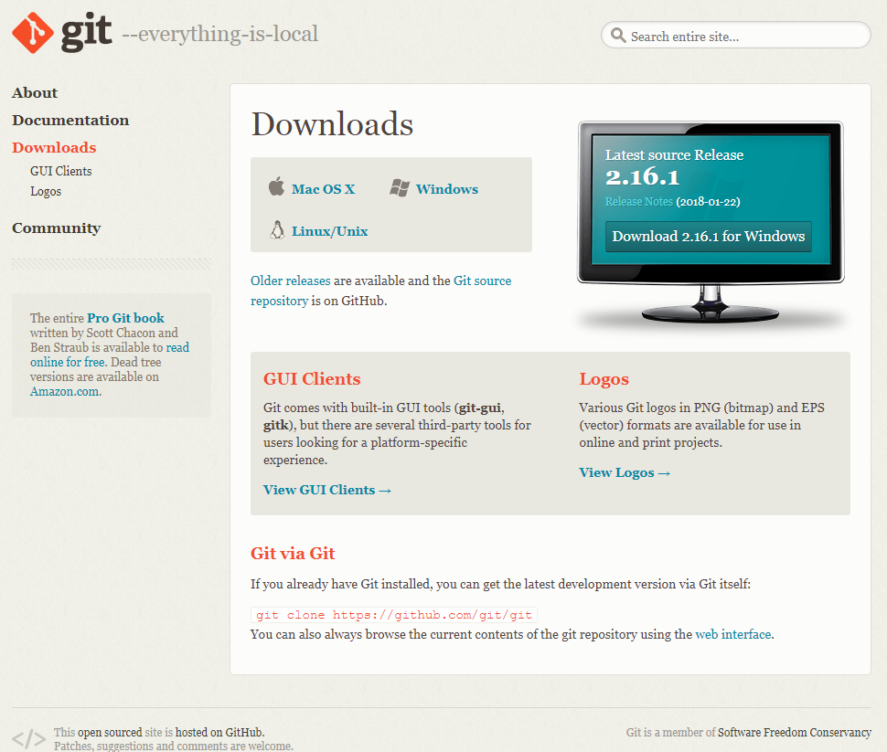
Installation
Download at https://git-scm.com/downloads
5/25

Slide 6
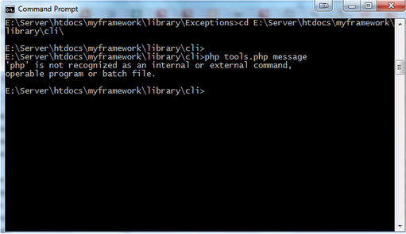
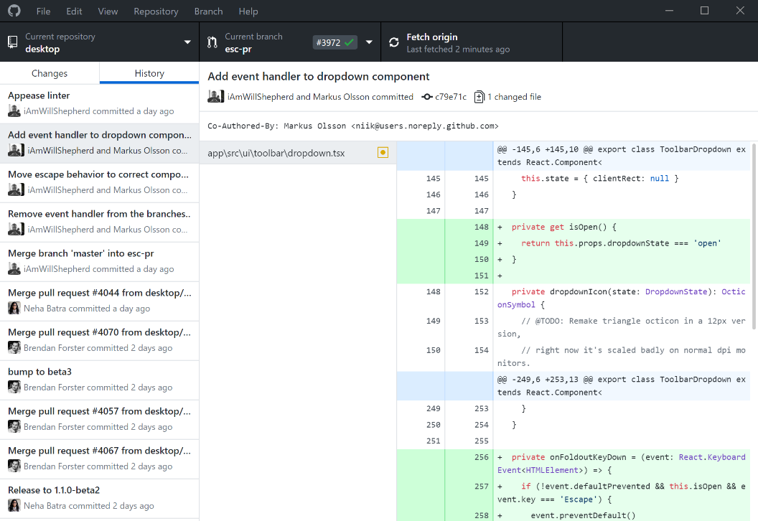
Interfaces
Command Line Interface (CLI)
Syntax: git [verb] [options]
Allows for customized commands
Commands are platform-independent
Graphical User Interface (GUI)
Saves typing
Lower barrier-of-entry
Graphically represents collaboration
Integrated Development Environment (IDE)
Integrates version control with projects
6/25

Slide 7
Command Line Interface
Windows Command Prompt
List all files
dir
Leave folder
cd ..
Enter folder
cd [folder]
MacOS, Linux Terminal
List all files
ls
7/25

Slide 8
Configure Git
Verify installed git version
git --version
Configure git
git config --global user.name “your name”
git config --global user.email “my@mail.nl”
git config --list
Open documentation of verb
git help [verb]
git [verb] --help

Slide 9


Local Repositories
The local repository is the project folder under version control. It contains the .git subfolder and all project related files and subfolders.
Initialize local repository
git init [project-name]
[project-name]
Check status of local repository
git status
.git
Create empty file on Windows
readme.txt
copy NUL [file-name]
Create empty file on MacOs, Linux
my_code.R
touch [file-name]

Slide 10

File Status Lifecycle
HEAD
b3bd9b
b06ecf
master
committed
Stage untracked/modified file
git add [file-name]
Commit staged files
staged
git commit -m “[message]”
Show modification
modified
git diff HEAD
git diff [commit] [commit]
Stage all files
untracked
git add -A
readme.txt
my_code.R
10/25

Slide 11
Log
HEAD
b3bd9b
b06ecf
master
Show logged commits
git log
Show command options
git help log
Show formatted log message and graph
git log --graph --oneline
Restore previous version
git checkout [commit-hash]

Slide 12
Commit message
Use imperative mode for summary line. Start with "Fix", "Add", instead of "Fixed", "Added".
Leave the second line blank
Line break the commit message (at about 72 characters)
Don't end the summary line with a period, as it is a title
Short (50 chars or less) summary of changes
More detailed explanatory text, if necessary. Wrap it to about 72 characters or so. In some contexts, the first line is treated as the subject of an email and the rest of the text as the body. The blank line separating the summary from the body is critical (unless you omit the body entirely); tools like rebase can get confused if you run the two together.
Further paragraphs come after blank lines.
Bullet points are okay, too
Typically a hyphen or asterisk is used for the bullet, preceded by a single space, with blank lines in between, but conventions vary here

Slide 13
Remote Repositories
Bare repository only contains version database
Working repository generates working directory from version database
GitHub
Version Database
Change 3
Change 2
Change 1
Computer A
Computer B
Files
Files
Version Database
Version Database
Change 3
Change 3
Change 2
Change 2
Change 1
Change 1
Distributed Version Control System
13/25

Slide 14
Remote Repositories
A project copy, which is hosted on a remote server: github.com/mi-erasmusmc/GitTutorial
remote
HEAD
Clone a remote repository
b3bd9b
b06ecf
afe8b8
git clone [url]
master
local
Lists remote repository Information
HEAD
b3bd9b
b06ecf
afe8b8
git remote –v
git branch -a
master
Push changes to remote repository
git pull
git push

Slide 15
Branches
Diverge from the main line of development to work independently.
remote
HEAD
afe8b8
b06ecf
List local branches
master
git branch
feature
Create a branch
11e501
0021a9
HEAD
git branch [branch-name]
local
HEAD
afe8b8
Enter a branch
master
git checkout [branch-name]
feature
Push branch to remote repository
11e501
0021a9
HEAD
git push –u origin [branch-name]
15/25

Slide 16
Merging
Combine two lines of development after independent work is completed.
remote
HEAD
afe8b8
b06ecf
adf4d3
Pull Master branch changes
master
git checkout master
git pull
feature
11e501
0021a9
Show Merged branches
HEAD
local
git branch --merged
HEAD
afe8b8
b06ecf
adf4d3
Merge feature branch into master
master
git merge [branch-name]
feature
11e501
0021a9
Push merge to remote repository
HEAD
git push
16/25

Slide 17

Merge Conflicts
HEAD
# Take sum of vector
sum <- function(x){
sum <- 0
if (any(is.na(x)) {
<<<<<<< HEAD
stop (“x has NA values")
=======
stop (“x contains NA")
>>>>>>> sumFun
}
for (val in x) {
sum <- sum + val
}
sum
}
afe8b8
b06ecf
adf4d3
# Take sum of vector
sum <- function(x){
sum <- 0
if (any(is.na(x)) {
stop (“x has NA values")
}
for (val in x) {
sum <- sum + val
}
sum
}
master
# Take sum of vector
sum <- function(x){
sum <- 0
if (any(is.na(x)) {
stop (“x has NA values")
}
for (val in x) {
sum <- sum + val
}
sum
}
sumFun
# Take sum of vector
sum <- function(x){
sum <- 0
if (any(is.na(x)) {
stop (“x contains NA")
}
for (val in x) {
sum <- sum + val
}
sum
}
11e501
0021a9
HEAD
git merge sumFun
Auto-merging sum.R
CONFLICT (content): merge conflict in sum.R
Automatic merge failed; fix conflicts and then commit the result.
Amy
Bob
git mergetool
sum.R
sum.R

Slide 18
Removing Branch
Show Merged branches
remote
HEAD
git branch --merged
afe8b8
b06ecf
adf4d3
master
Remove branch
feature
git branch –d [branch-name]
11e501
0021a9
HEAD
List remote branches
local
HEAD
afe8b8
b06ecf
adf4d3
git branch -a
master
Remove branch from remote repository
feature
git push origin –delete [branch-name]
11e501
0021a9
HEAD
18/25

Slide 19
Rebase
Changes base of a branch from one commit to another. Moved branch is composed of entirely new commits.
Rebase branch
HEAD
afe8b8
b06ecf
git checkout [branch-name]
git rebase master
master
feature
11e501
23ef02
0021a9
0ffe15
Fast-Forward merge
HEAD
git checkout master
git merge [branch-name]

Slide 20
Useful
Stage and commit all files
git commit –am “[message]”
Tag a commit
git tag
Set editor for commit messages - default vim
git config --global core.editor [editor]
.gitignore

Slide 21
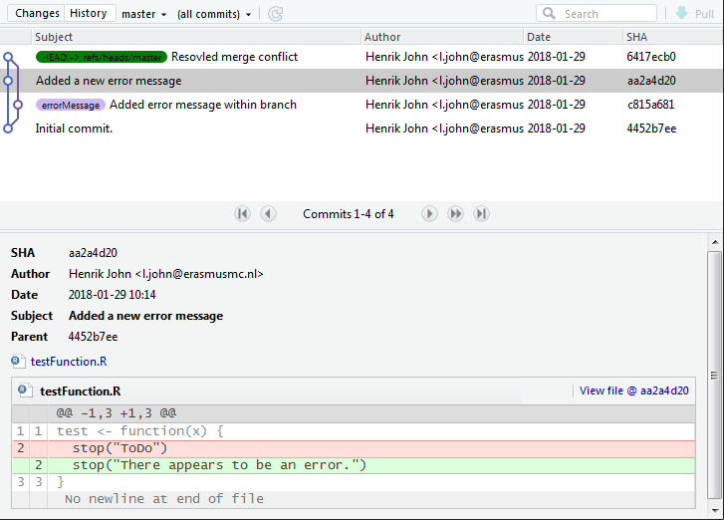
RStudio GUI
Visualize branches and changes
Merging functionality not available

Slide 22
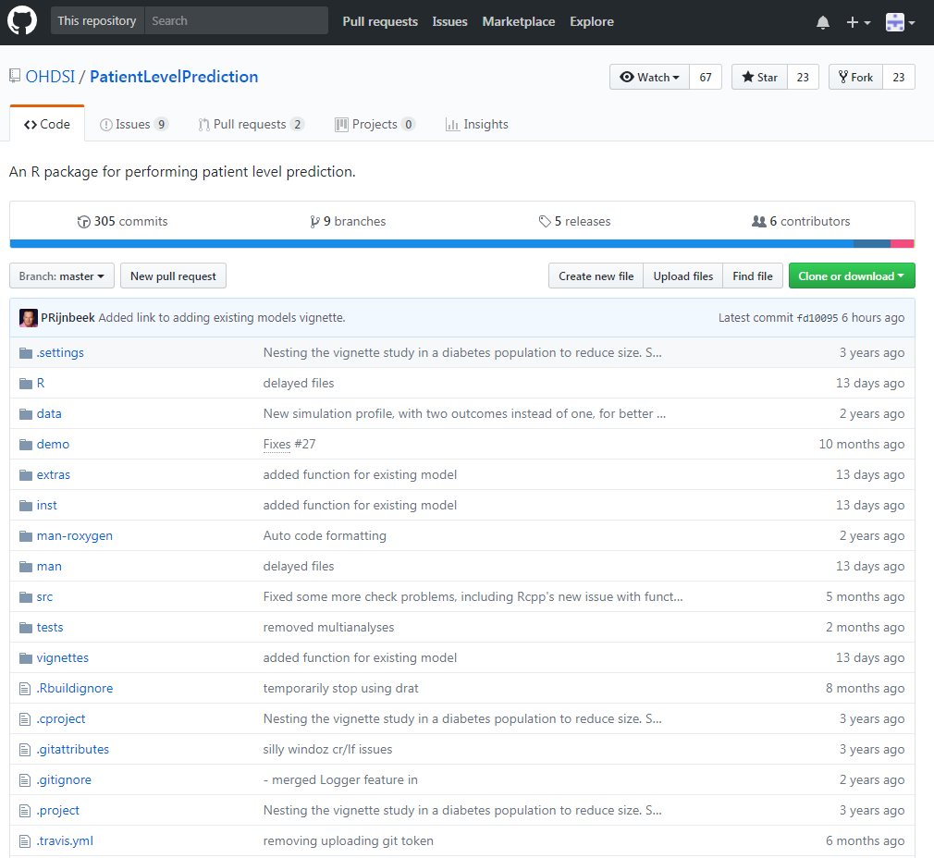
GitHub
Repositories store all files of a particular project
Visualize changelogs
Social network infrastructure
22/25

Slide 23


Medical Informatics Workflow
OHDSI GitHub
Erasmuc MC GitHub
IPCI Server
github.com/OHDSI
github.com/mi-erasmusmc
/data/git/
master branch
master branch
feature branches
feature branches
Sync.sh
Internet computer
IPCI computer
Internet
No Internet
Upstream
23/25

Slide 24
Assignment
Clone the project from https://github.com/mi-erasmusmc/GitTutorial
Create a new branch
Within the new branch modify participants.txt by adding your first name to the list
Commit the change to your branch
Merge your branch into the master
Push the master to the remote

Slide 25
Documentation
Installation files https://git-scm.com/downloads
Official documentation https://git-scm.com/documentation
DataCamp course https://www.datacamp.com/courses/introduction-to-git-for-data-science
Crash course https://www.youtube.com/watch?v=SWYqp7iY_Tc
RStudio course
Part 1: https://www.datacamp.com/courses/working-with-the-rstudio-ide-part-1
Part 2: https://www.datacamp.com/courses/working-with-the-rstudio-ide-part-2

