Slide 1


20 April 2022

Slide 2





Version Control
Tracks changes in computer files
Efficient collaboration with colleagues
Project
Project_backup
Project_v3
Project_old
Amy
Bob
Charlie
Project
Time and Version

Slide 3
Version Control Systems
Computer C
Server
Files
Version Database
Server
Change 3
Change 2
Version Database
Change 1
Change 3
Change 2
Computer A
Computer B
Change 1
Files
Files
Computer A
Computer B
Version Database
Version Database
Change 3
Change 3
Files
Files
Change 2
Change 2
Change 1
Change 1
Centralized SVN, CVS, Perforce
+ manage access rights
Distributed Git, Mercurial
+ local version database
+ backup on collaborator machines
4

Slide 4
About Git
Git is a distributed version control system for local and remote repositories
Git is advertised with the following features
Offers review functionality
Work offline anywhere
Fast and lightweight
Journal of changes rather than a backup
Serves the needs of beginners and advanced users equally well
5

Slide 5
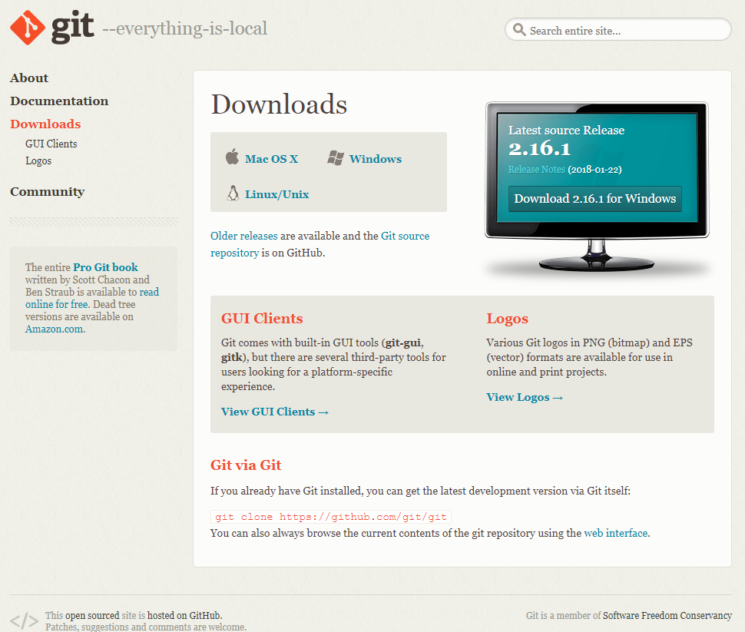
Installation
Download at https://git-scm.com/downloads
Accept default settings during installation
6

Slide 6
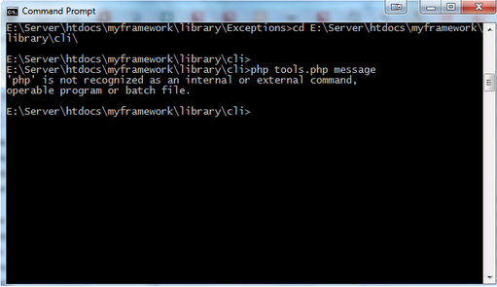
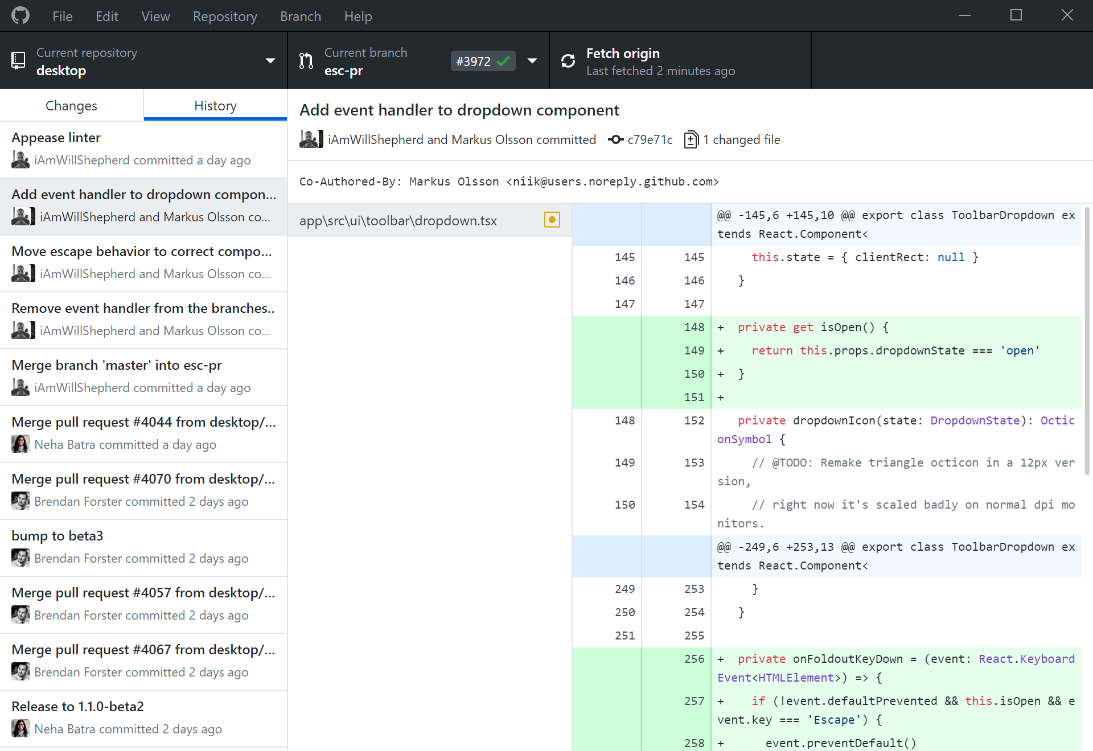
Interfaces
Command Line Interface (CLI)
Syntax: git [verb] [options]
Allows for customized commands
Commands are platform-independent
Fast
Graphical User Interface (GUI)
Saves typing
Lower barrier-of-entry
(we recommend GitHub Desktop or Sourcetree)
Integrated Development Environment (IDE)
Integrates version control with programming projects e.g., generates .gitignore.
7

Slide 7
Command Line Interface
Windows Command Prompt
List all files
dir
Leave folder
cd ..
Enter folder
cd [folder]
MacOS, Linux Terminal
List all files
ls
8

Slide 8
Configure Git – CLI
Verify installed git version
git --version
Configure git on a --system, --global or --local level
git config --global user.name “your name”
git config --global user.email “my@mail.nl”
git config --global --list
Open documentation of verb (e.g. config)
git help [verb]
git [verb] –help
git config --global --unset user.name

Slide 9
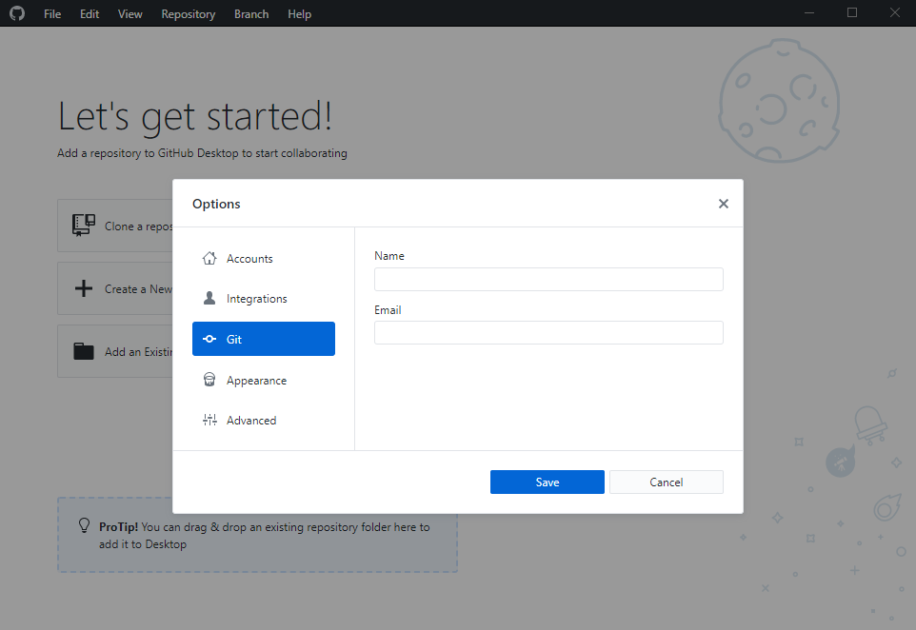
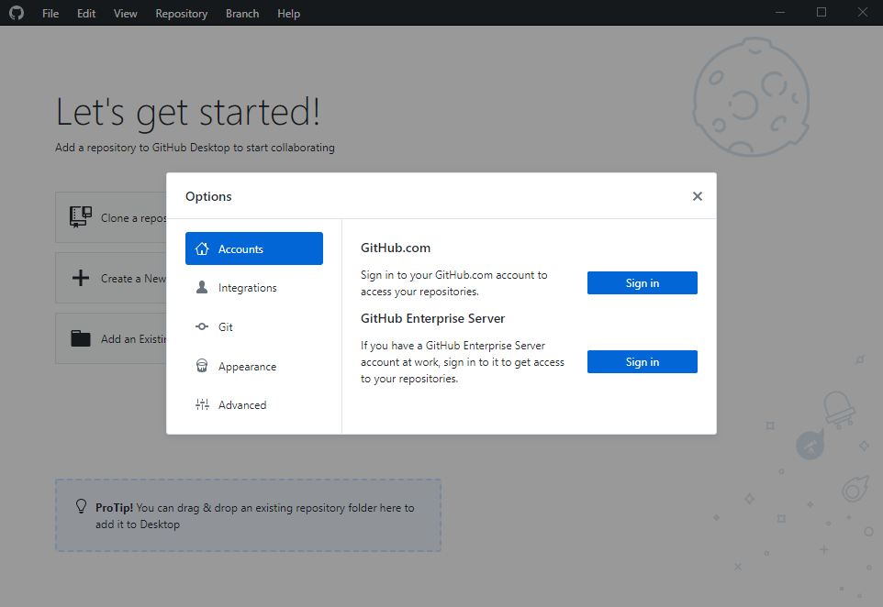
Configure Git – GUI (GitHub Desktop)
File → Options → Git
File → Options → Accounts

Slide 10


Local Repositories – CLI
The local repository is the project folder under version control. It contains the .git subfolder (hidden by default) and all project related files and subfolders.
Initialize local repository
git init [project-name]
[project-name]
Check status of local repository
git status
.git
Create empty file on Windows
readme.txt
copy NUL [file-name]
Create empty file on macOS, Linux
my_code.R
touch [file-name]

Slide 11
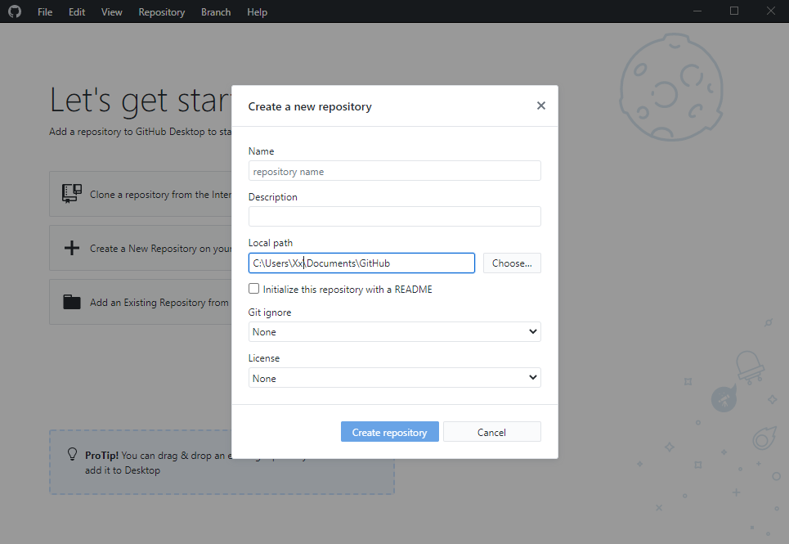
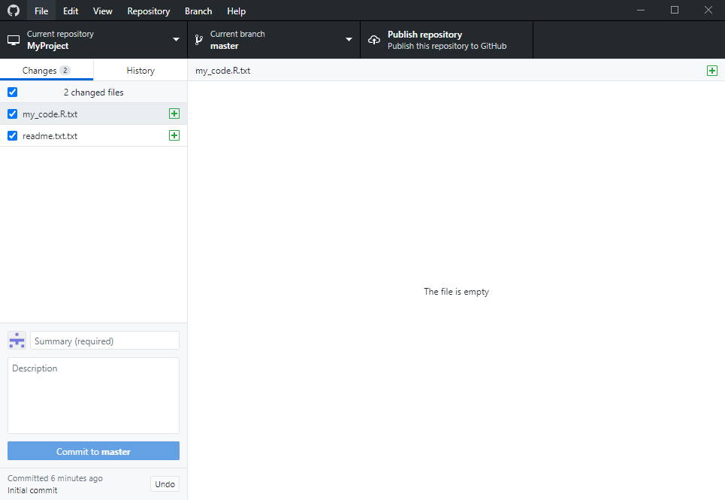
Local Repositories – GUI (GitHub Desktop)
Changes are detected with a background call to git status
File → New repository

Slide 12

File Status Lifecycle
HEAD
b3bd9b
b06ecf
master
committed
Stage untracked/modified file
git add [file-name]
Commit staged files
staged
git commit -m “[message]”
Show modification
modified
git diff HEAD
git diff [commit] [commit]
Stage all files
untracked
git add –A
readme.txt
my_code.R
13
Notes:
HEAD can point to any commit, it does not need to be the last commit in any branch. (When HEAD points to a commit that is not the last commit in a branch, that is a "detached HEAD"

Slide 13
Log – CLI
HEAD
b3bd9b
b06ecf
master
Show logged commits
git log
Show command options
git help log
Show formatted log message and graph. Also, check out https://tinyurl.com/pretty-log.
git log --graph --oneline

Slide 14
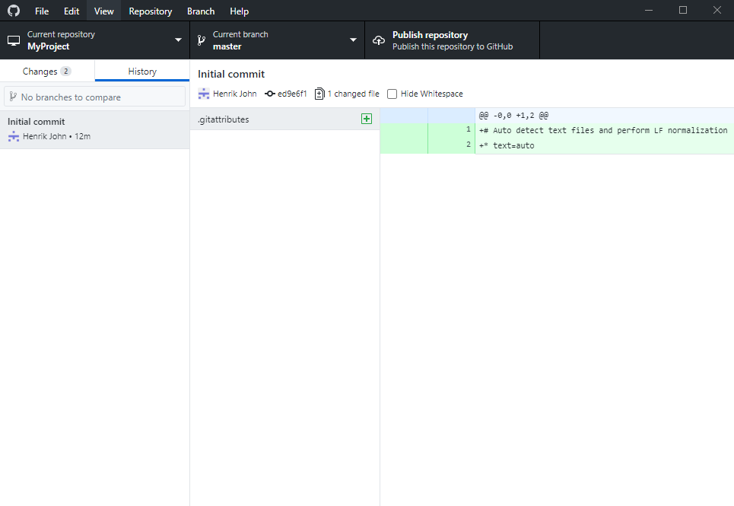
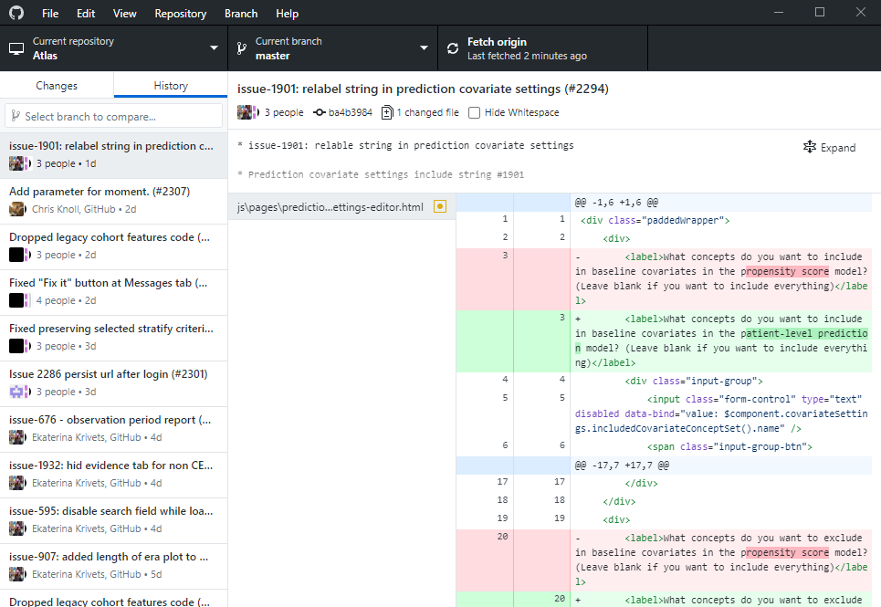
Log – GUI (GitHub Desktop)
History of the OHDSI Atlas repository
View → History

Slide 15
Commit message
Use imperative mode for summary line. Start with "Fix", "Add", instead of "Fixed", "Added".
Leave the second line blank
Line break the commit message (at about 72 characters)
Don't end the summary line with a period, as it is a title
Short (50 chars or less) summary of changes
More detailed explanatory text, if necessary. Wrap it to about 72 characters or so. In some contexts, the first line is treated as the subject of an email and the rest of the text as the body. The blank line separating the summary from the body is critical (unless you omit the body entirely); tools like rebase can get confused if you run the two together.
Further paragraphs come after blank lines.
Bullet points are okay, too
Typically a hyphen or asterisk is used for the bullet, preceded by a single space, with blank lines in between, but conventions vary here

Slide 16
Custom editor and tools
Git ships with editors and tools that are mostly command line based. While these tools are fast, they may not offer functionality or usability that suits all users and can, therefore, be changed.
Default core editor is vim , but can be changed, e.g., to Atom.
git config --global core.editor "atom -w"
Default difftool can be set, e.g., to Meld or Beyond Compare.
git config --global diff.tool "meld”
git difftool
Default mergetool can be set, e.g., to Meld or Beyond Compare.
git config --global merge.tool "meld”

Slide 17
Remote Repositories
Bare repository only contains version database (e.g., GitHub)
Working repository generates working directory from version database
GitHub
Version Database
Change 3
Change 2
Change 1
Computer A
Computer B
Files
Files
Version Database
Version Database
Change 3
Change 3
Change 2
Change 2
Change 1
Change 1
Distributed Version Control System
18

Slide 18
Remote Repositories – CLI
A project copy, which is hosted on a remote server, e.g., https://github.com/mi-erasmusmc/GitTutorial
remote
Clone a remote repository
b3bd9b
b06ecf
afe8b8
master
git clone [url]
local
HEAD
Lists remote repository Information
b3bd9b
b06ecf
afe8b8
git remote –v
git branch -a
master
Push changes to remote repository
git pull
git push

Slide 19
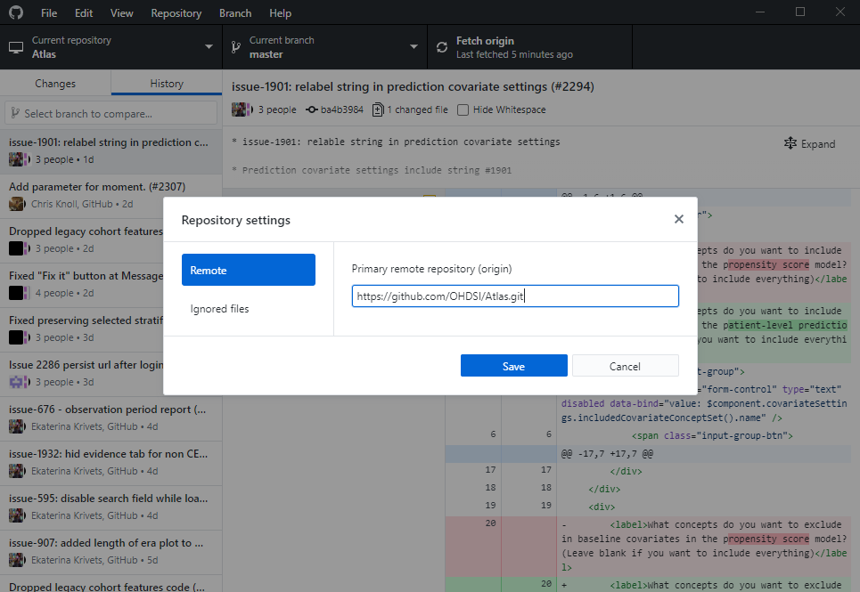
Remote Repositories – GUI (GitHub Desktop)
Repository → Repository settings → Remote

Slide 20
Branches – CLI
Diverge from the main line of development to work independently.
remote
afe8b8
b06ecf
List local branches
master
git branch
feature
Create a branch
11e501
0021a9
git branch [branch-name]
local
HEAD
afe8b8
Enter a branch
master
git checkout [branch-name]
feature
Push branch to remote repository
11e501
0021a9
HEAD
git push –u origin [branch-name]
21

Slide 21
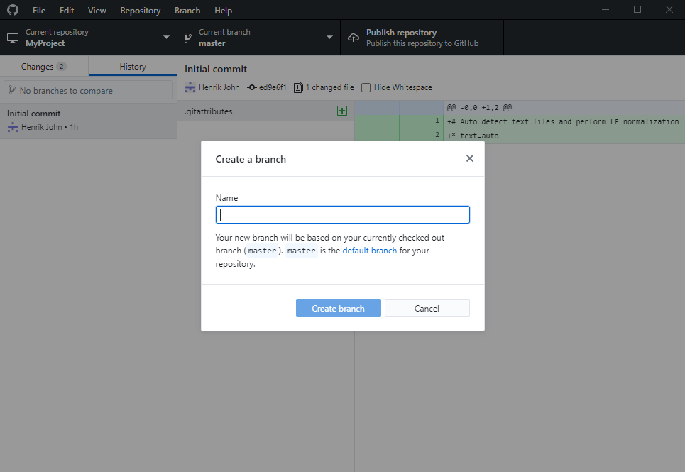
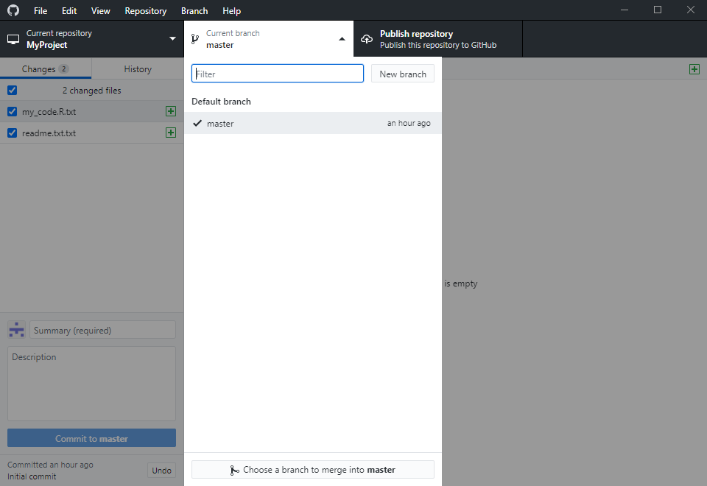
Branches – GUI (GitHub Desktop)
Checkout branches from the main window
Branch → New branch
22

Slide 22
Merging – CLI
Combine two lines of development after independent work is completed.
remote
afe8b8
b06ecf
adf4d3
Pull Master branch changes
master
git checkout master
git pull
feature
11e501
0021a9
Show Merged branches
local
git branch --merged
HEAD
afe8b8
b06ecf
adf4d3
Merge feature branch into master
master
git merge [branch-name]
feature
11e501
0021a9
Push merge to remote repository
git push
23

Slide 23
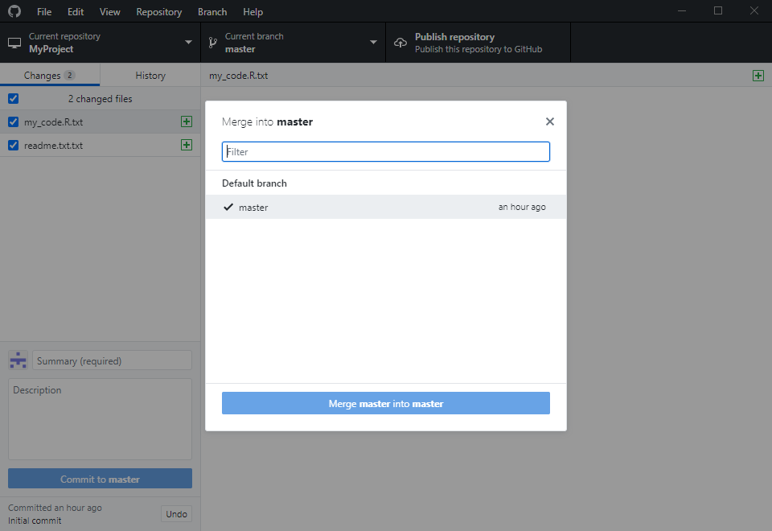
Merging – GUI (GitHub Desktop)
Branch → Merge into current branch
24

Slide 24

Merge Conflicts
HEAD
# Take sum of vector
sum <- function(x){
sum <- 0
if (any(is.na(x)) {
<<<<<<< HEAD
stop (“x has NA values")
=======
stop (“x contains NA")
>>>>>>> sumFun
}
for (val in x) {
sum <- sum + val
}
sum
}
afe8b8
b06ecf
adf4d3
# Take sum of vector
sum <- function(x){
sum <- 0
if (any(is.na(x)) {
stop (“x has NA values")
}
for (val in x) {
sum <- sum + val
}
sum
}
master
# Take sum of vector
sum <- function(x){
sum <- 0
if (any(is.na(x)) {
stop (“x has NA values")
}
for (val in x) {
sum <- sum + val
}
sum
}
sumFun
# Take sum of vector
sum <- function(x){
sum <- 0
if (any(is.na(x)) {
stop (“x contains NA")
}
for (val in x) {
sum <- sum + val
}
sum
}
11e501
0021a9
git merge sumFun
Auto-merging sum.R
CONFLICT (content): merge conflict in sum.R
Automatic merge failed; fix conflicts and then commit the result.
Amy
Bob
git mergetool
sum.R
sum.R

Slide 25
Removing Branch
Show Merged branches
remote
git branch --merged
afe8b8
b06ecf
adf4d3
master
Remove branch
feature
git branch –d [branch-name]
11e501
0021a9
HEAD
List remote branches
local
HEAD
afe8b8
b06ecf
adf4d3
git branch -a
master
Remove branch from remote repository
feature
git push origin –delete [branch-name]
11e501
0021a9
HEAD
26

Slide 26
Rebase – CLI
Changes base of a branch from one commit to another. Moved branch is composed of entirely new commits.
remote
afe8b8
b06ecf
23ef02
0ffe15
master
Rebase branch
feature
git checkout [branch-name]
git rebase master
11e501
0021a9
local
HEAD
afe8b8
b06ecf
Fast-Forward merge
master
git checkout master
git merge [branch-name]
feature
11e501
23ef02
0021a9
0ffe15
HEAD

Slide 27
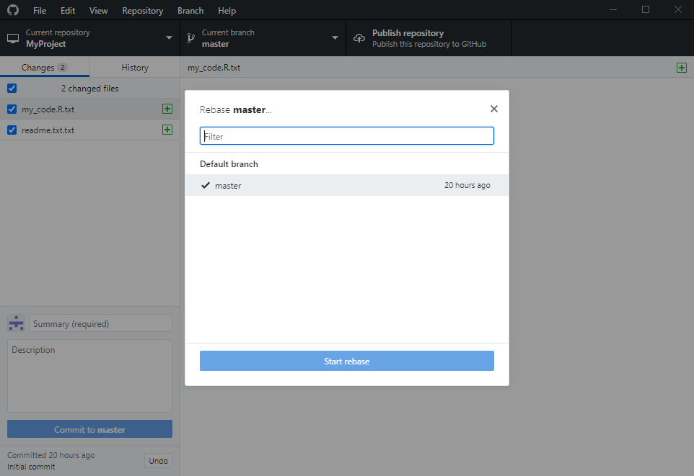
Rebase – GUI
Branch → Rebase current branch

Slide 28
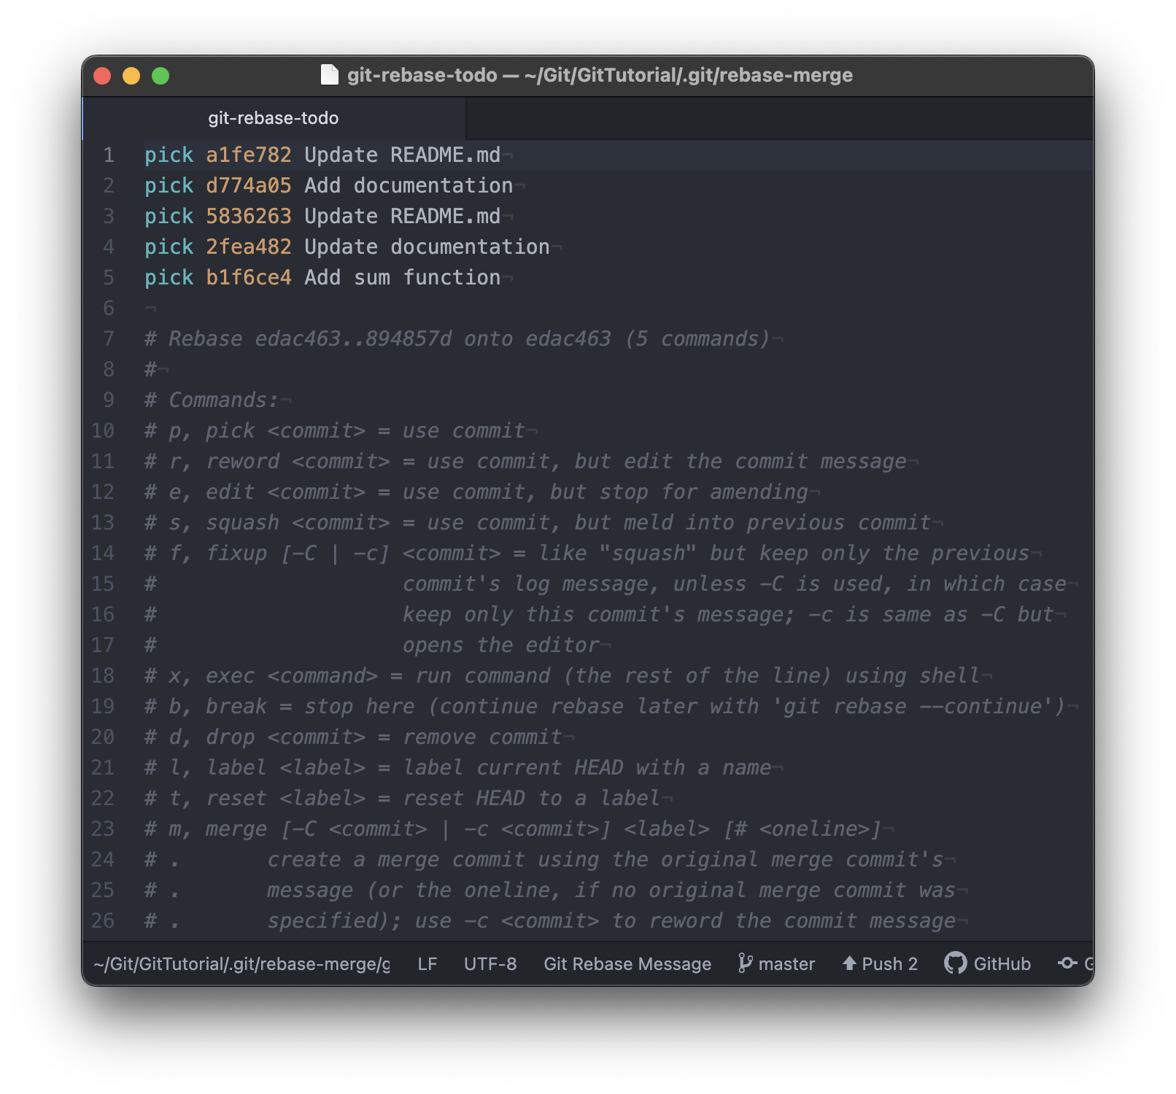
Interactive Rebase – CLI
Rewrite history using the powerful interactive rebase functionality. Combine multiple existing commits into one.
Rewrite last three commits
git rebase -i HEAD~3

Slide 29
Useful
Stage and commit all files
git commit –am “[message]”
Tag a commit
git tag
Stash changes in branch and apply them elsewhere
git stash
git stash apply
.gitignore

Slide 30



Health Data Science Workflow
OHDSI GitHub
Erasmuc MC GitHub
IPCI GitHub
https://github.com/OHDSI
https://github.com/mi-erasmusmc
http://shr-srv-github/mi-erasmusmc
master branch
master branch
feature branches
feature branches
Internet computer
IPCI computer
El Granito
Internet
No Internet
Upstream
31

