Slide 1
OpenCV – ROS bridge / Upcoming Software Team tasks
Yee Shian, Imran
12 June 2020

Slide 2
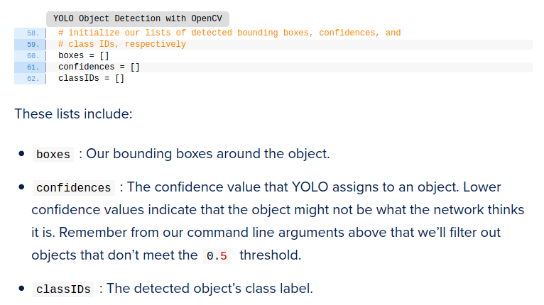
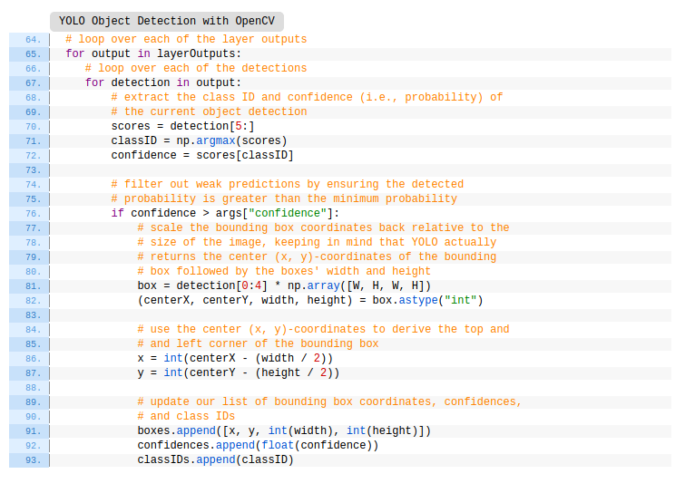
OpenCV – ROS bridge
Link: https://www.pyimagesearch.com/2018/11/12/yolo-object-detection-with-opencv/

Slide 3
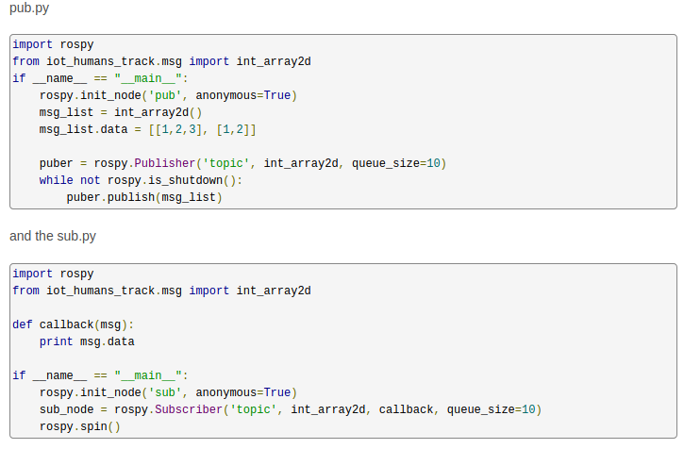

OpenCV – ROS bridge
Link: https://answers.ros.org/question/316061/publish-list-of-lists-with-python/

Slide 4
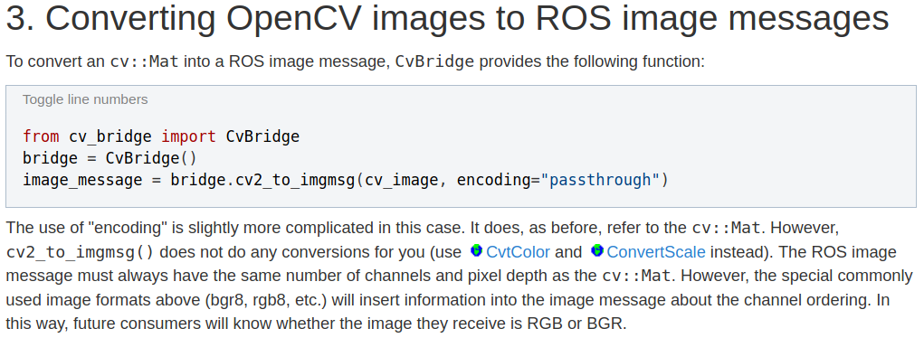
OpenCV – ROS bridge
Link: http://wiki.ros.org/cv_bridge/Tutorials/ConvertingBetweenROSImagesAndOpenCVImagesPython

Slide 5
Tasks
Timeline:
  Summer holidays (current till early August)
  Start of semester (early August)
  Mid terms ( end September / early October)
  Finals (mid November)
Intended outcomes:
  Specialised roles VS all members all-rounded (need to understand team’s expertise)
  Able to communicate needs to other teams effectively (eg. Hardware specs to hardware team, format of ROS pub / sub messages to control team)
  Technologies vs concepts

Slide 6
Tasks
Technologies used:
  OpenCV (Python / C++)
  ROS (Melodic)
  Tensorflow / Keras (1.14.0)
  PyTorch
Concepts:
  CNNs in general
  YOLO
  SSDs / Faster R-CNN
Tooling interface:
  Linux CLI
  Raspberry Pi / Jetson dev.
  Git / Github
  Docker
Hardware:
  Specifications (Physical dimensions)
  Computational limitations

Slide 7
Tasks
Understanding through explanations / presentations
Weekly / biweekly
Weekly check-ins on progress of the team
Concepts -> technology + hardware -> tools

Slide 8
Tasks
Timeline:
  Summer holidays (current till early August) = concepts, tech., hardware
  Start of semester (early August) = hardware, tools
  Mid terms ( end September / early October) = implementation on hardware (?)
  Finals (mid November) = collaboration with other teams

Slide 9
Tasks
Summer tasks:
  CNNs
    Layers:
      Pooling, conv. layers
    Padding, kernel, filter
  Diff. between R-CNNs, YOLO & SSD
  Implementing frameworks in TensorFlow, PyTorch
  Basic collaboration on Github

