Slide 1
RowanGo App
Rowan Retail

Slide 2
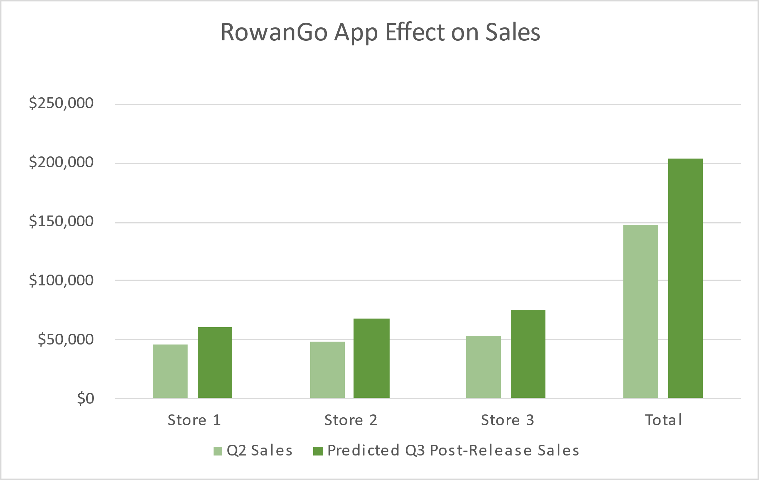

Slide 3
Rowen Retail Customer Contact
ID1 | ID | First | Last | Address | City | State | Zip Code
1 | 1 | Walker | Adkins | 6649 N Blue Gum St | New Orleans | LA | 70116
2 | 2 | Dave | Alston | 4 B Blue Ridge Blvd | Brighton | MI | 48116
3 | 3 | Naomi | Patel | 8 W Cerritos Ave #54 | Bridgeport | NJ | 8014
4 | 4 | Judy | Ng | 639 Main St | Anchorage | AK | 99501
5 | 5 | Luis | Sanchez | 34 Center St | Hamilton | OH | 45011
6 | 6 | Teo | Tadeo | 3 Mcauley Dr | Ashland | OH | 44805
7 | 7 | Britney | Spears | 7 Eads St | Chicago | IL | 60632
8 | 8 | Foster | Jenkins | 7 W Jackson Blvd | San Jose | CA | 95111
9 | 9 | Richard | Castle | 5 Boston Ave #88 | Sioux Falls | SD | 57105
10 | 10 | Meaghan | Garufi | 228 Runamuck Pl #2808 | Baltimore | MD | 21224

Slide 4

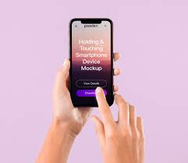
RowanGo App Lets Customers Shop Anywhere
Want great savings on the go? The new RowanGo app is free and available on iOS and Android. First-time users who download the app get a coupon for 20% off their first purchase. In addition, customers using the RowanGo app to shop get a 2% discount on all future Rowan purchases. Log in using your RowanGo credentials and watch the savings pile up.

Slide 5
