Slide 1
Presentation 1
Vihas Gowreddy
9/11/2020

Slide 2
Objectives
Install Python and Bokeh
Research Respiration Rate
Research Signal Processing and LSL

Slide 3
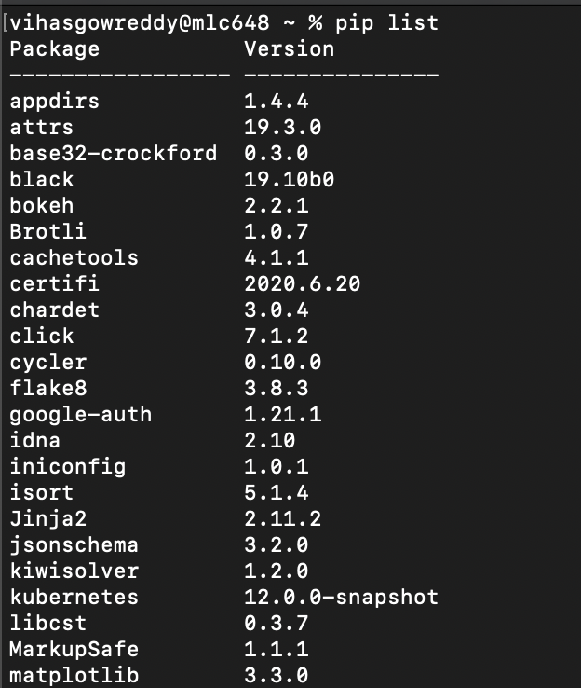
Outcomes Python and Bokeh

Slide 4
Outcomes Respiration Rate
Respiration Rate: a vital sign measuring number of breaths taken in a given time period
12 – 20 breaths per minute considered normal but can vary heavily due to age, illness, gender, intense activity, anxiety
Data can be extracted from ECG, PPG, and even a breath analyzer
ECG can be used because of connection between right side of heart and the lungs
Respiratory Signal Algorithms: Can determine by measuring either the size of the QRS complex spike in the ECG or the distance between multiple spikes
PPG uses a pulse oximeter which sends out low intensity IR light
Main measurement of value is blood oxygen saturation (usually >89%)
Respiratory Signal Algorithms: Uses a synchrosqueezing transformation to extract intensity, amplitude, frequency variations from PPG
Generalized algorithm steps:
Extract respiratory signal
Estimate a respiratory rate using the signal based on time or frequency
If multiple methods are used to calculate respiratory rate, can fuse

Slide 5
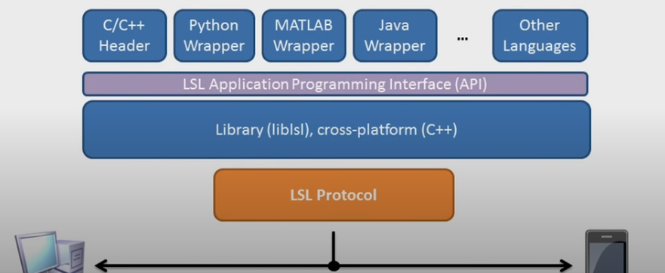
Outcomes Signal Processing and LSL
Signal Processing: modeling and analyzing data representations of physical events
ex. Telephones (speech), Autonomous Driving (sensor visuals and ultrasound)
Lab Streaming Layer(LSL) allows exchanging time series between device and app
Open source and cross platform
Real time access
ex. Sending OpenBCI streams to app that manipulates the data
LSL Architecture:

