Slide 1
Presentation 2
Vihas Gowreddy
9/18/2020

Slide 2
Objectives
Find working algorithm for respiration rate
Work on sample respiration rate data

Slide 3
Outcomes Find Working Algorithm for Respiration Rate
Currently only detecting peaks from respiration rate data corresponding to chest rising and lowering when breathing
Looking into other algorithms using ECG and PPG data but hit roadblock for now
Doesn’t show algorithm to extract respiratory signal
Will look into synchrosqueezing when looking into this

Slide 4
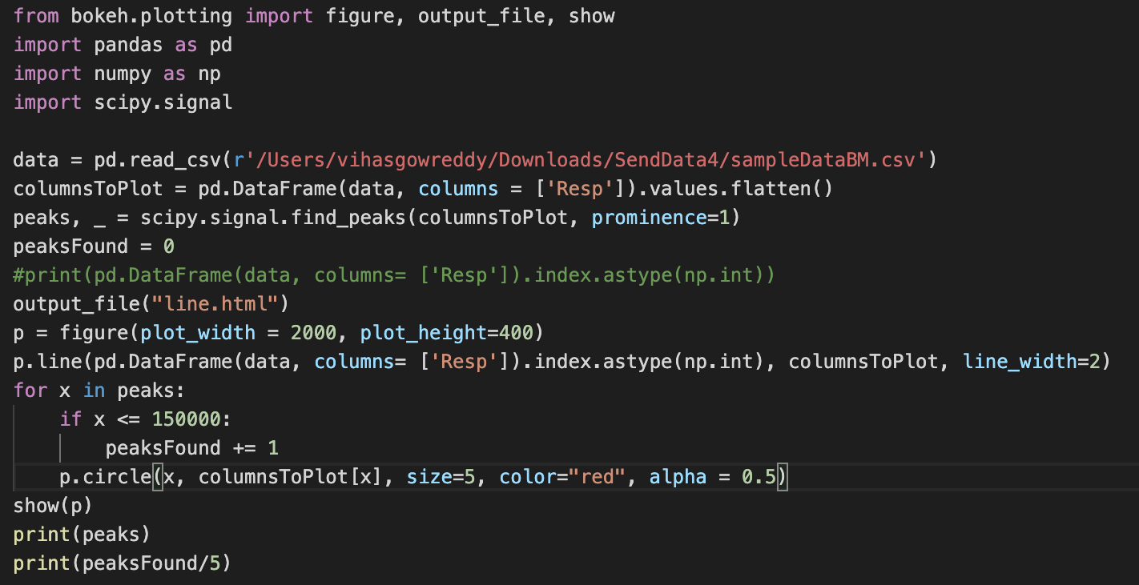
Outcomes Work on Sample Respiration Data (Demo)
Code:
Problems
Peak detection method is not accurate although respiration rate may indicate it is
Need to tweak find_peaks to be accurate or find new algorithm

Slide 5
Questions and Next Steps
Questions
What is the name of the technology being used to extract the electrical voltage to calculate the “resp” variable?
How does this technology work?
What does the drop in voltage to about 9 mean?
Next Steps
Fix peak detection or find better algorithm
Find respiratory signal extraction algorithms for at least ECG

