Slide 1
Environmental-Social-Health Observatory

Slide 2
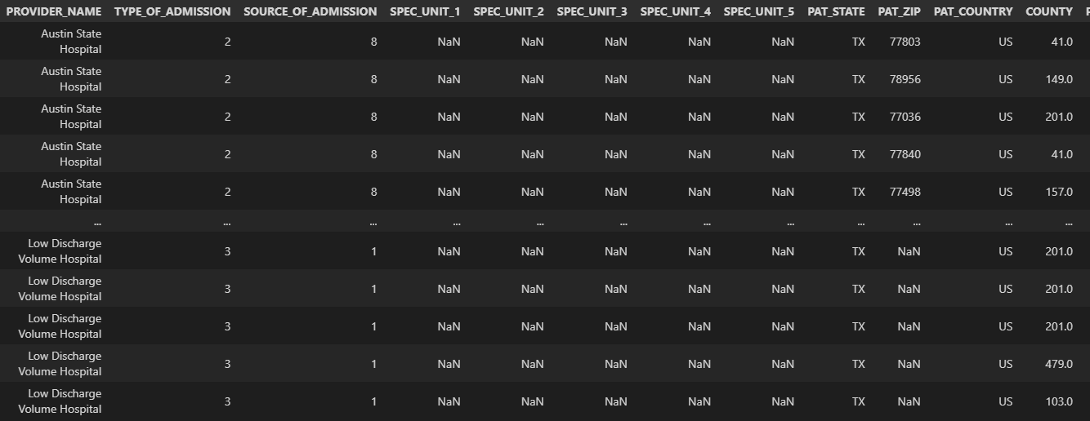
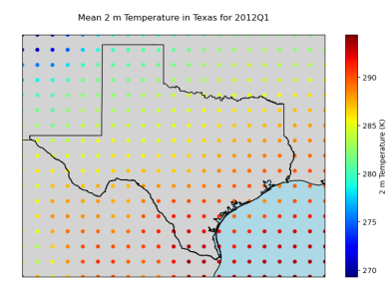
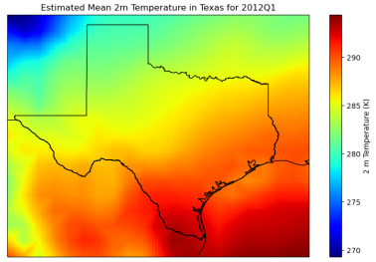
Data Sources
Hospitalization data
THCIC
Stored on the NAS
2000-2021, for each quarter (time resolution)
Environmental data
ECMWF (EAC4)
Month-averaged data -> quarterly means
Interpolate to fine grid point (0.75 x 0.75 -> 0.01 x 0.01)

Slide 3
Data Sources
Census data
Socioeconomic context
Collect data from
2000 – Decennial survey
2011 – American Community Survey (ACS)
2016 – ACS
2021 – ACS
And interpolate for the years in-between
As a start, variables such as age, sex, race, income, poverty,

Slide 4
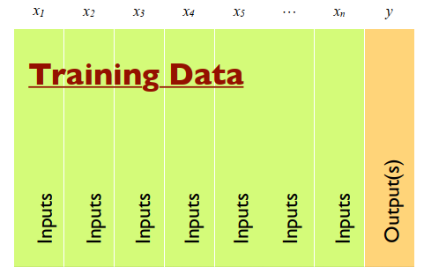
Goal
Environmental data
Hospitalizations per zip code
Socioeconomic data

