Slide 1
Meeting #5
10/7/21
Omar Luna

Slide 2
Deliverables
Write Script to read tobii data from file

Slide 3
Methodology and Learnings
Chose the Json participant file
Read in data from file
Converted it to dataframe
Parsed the data
Created a dataframe
Questions
Data kept together ?
Sorted?
More efficient?
Multiple files?
Learning
Dataframes
Dictionaries
Json library

Slide 4
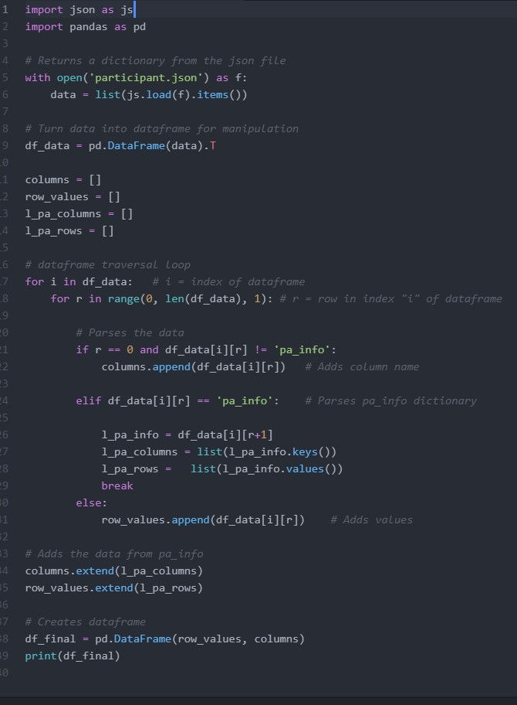
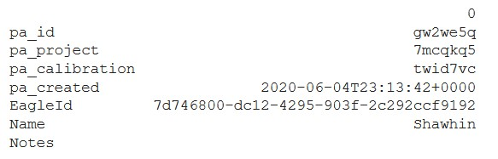
Results

