Slide 1
Meeting 2
9/16/21
Rolando Martinez

Slide 2
Deliverables
Install Python, dash, and set up IDE
Run an open-source app locally
Show results and what was learned

Slide 3
Methodology and Learnings
How did I do it?
Verified Python and pip3 installations
Set up PyCharm
Used pip to download dash library
Terminal commands to run open-source app
What did I learn on the way?
Create virtual environment
Python libraries
Create simple webapp using dash

Slide 4
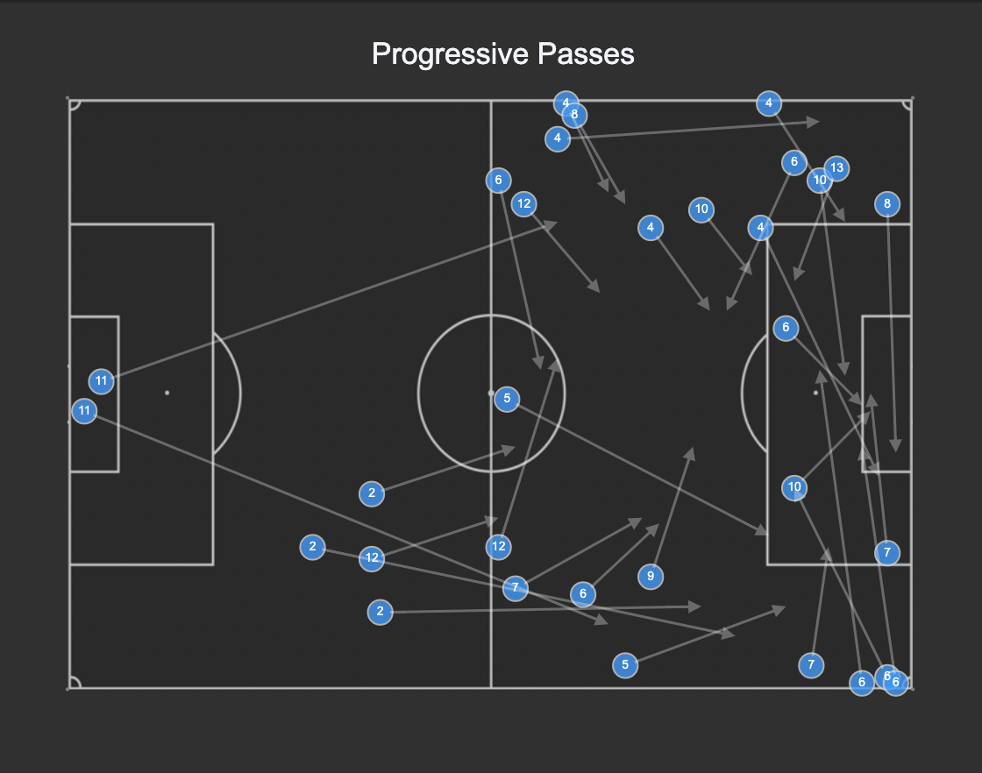
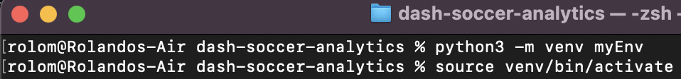
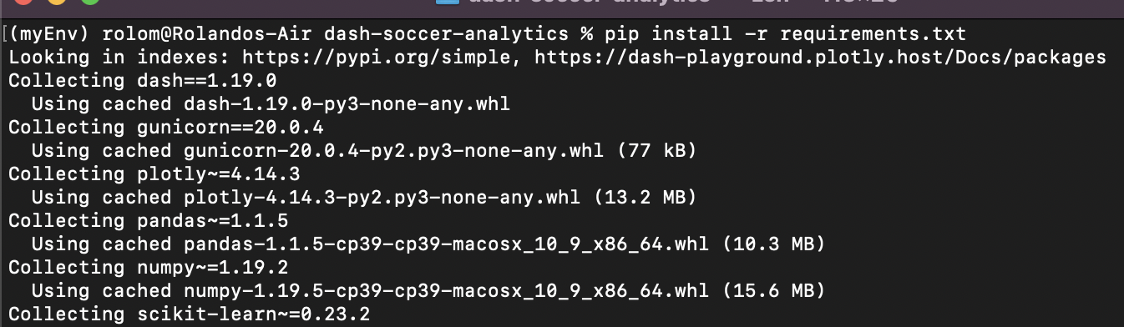
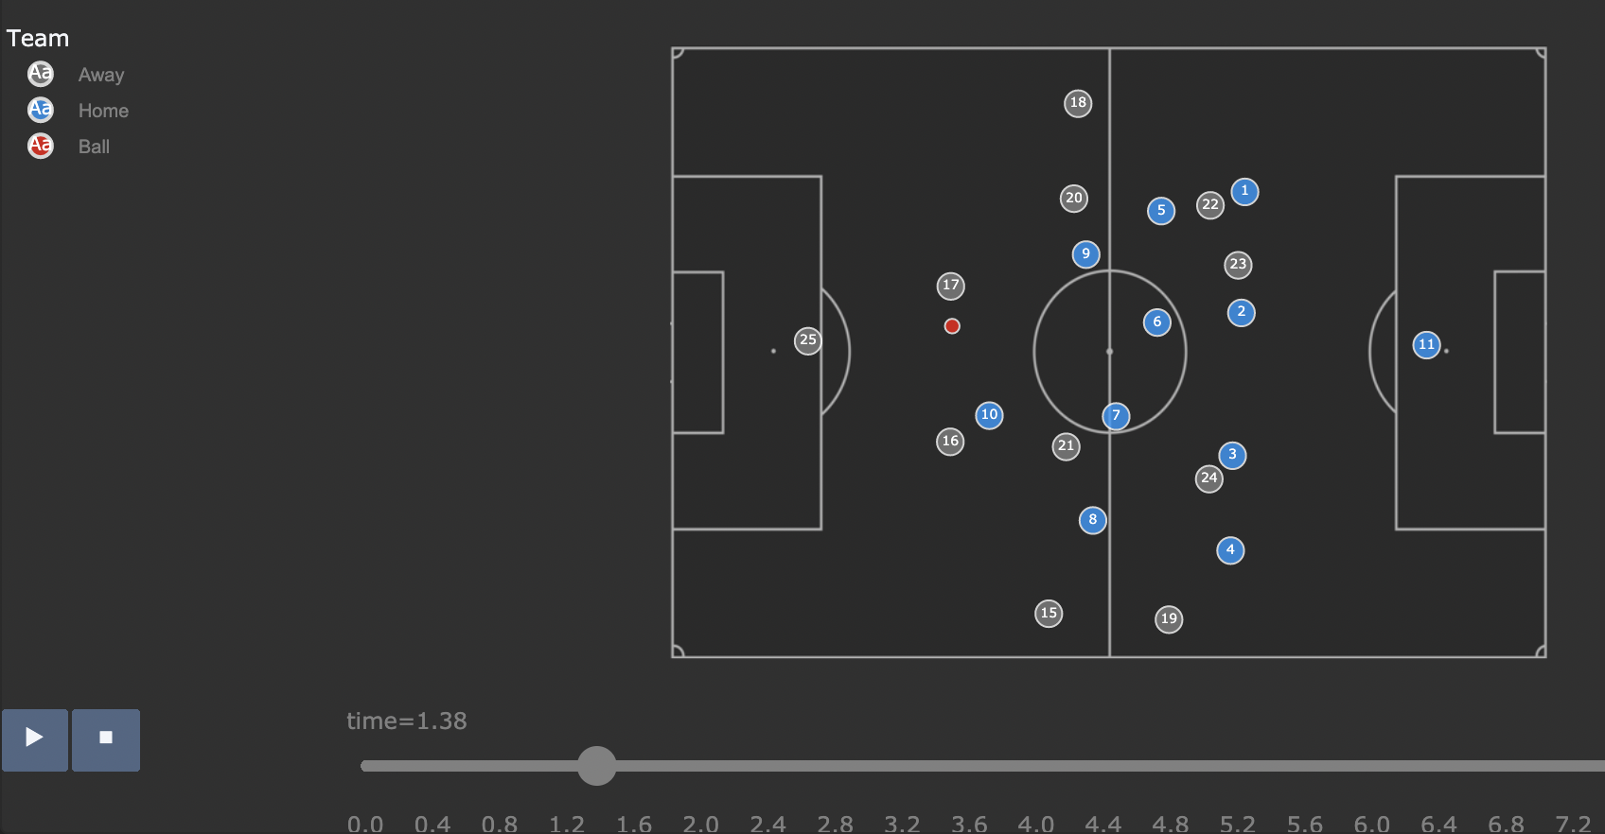
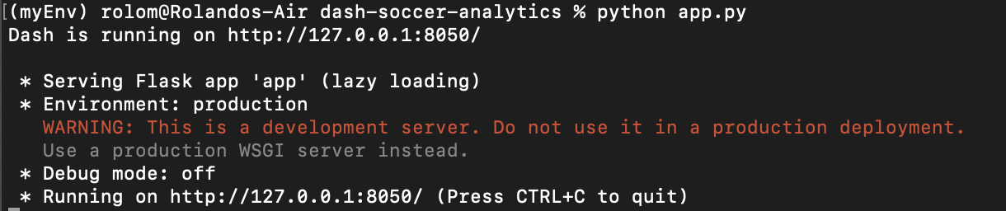
Results

