Slide 1
Meeting 2
9/16/21
Omar Luna

Slide 2
Deliverables
Install
Python
Dash
Run
Dash app locally
Present
Results from running the application

Slide 3
Methodology and Learnings
Process
Python
Previously installed
Dash
Simple command
Dash application
Install virtual environment
Download files using git
Activate environment
Install application
Update installation tools
Fix version errors
Learning
pip commands
Virtual environments
Command line refresher

Slide 4

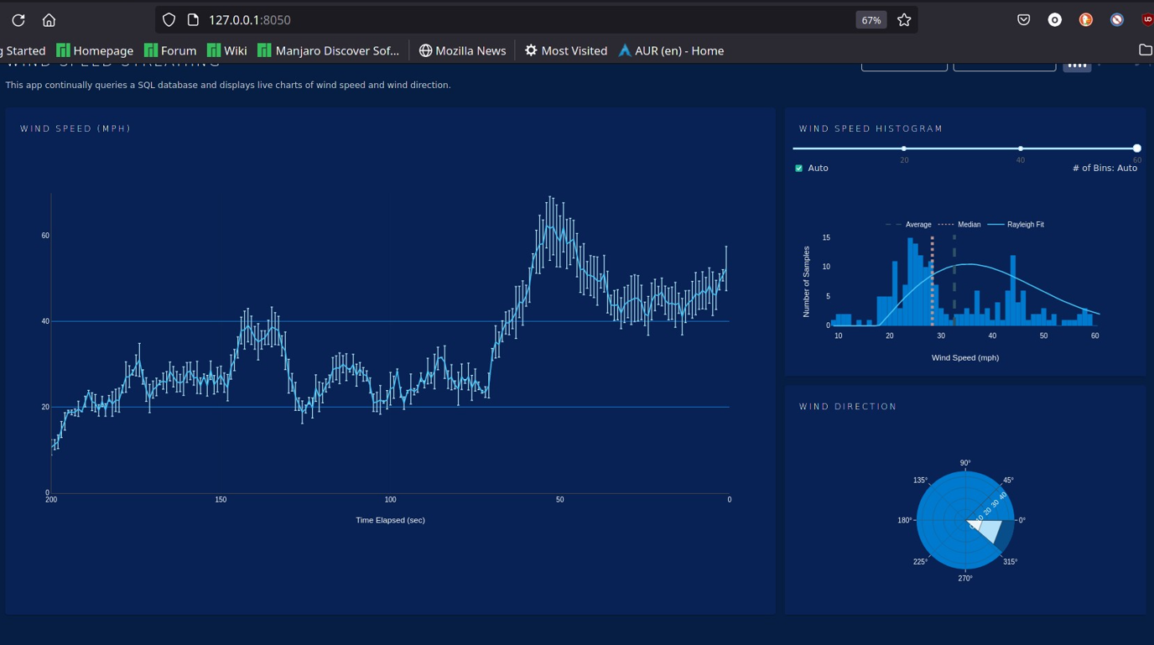
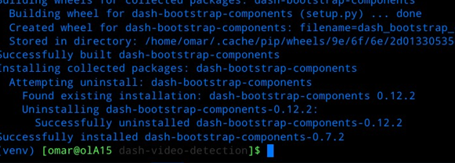
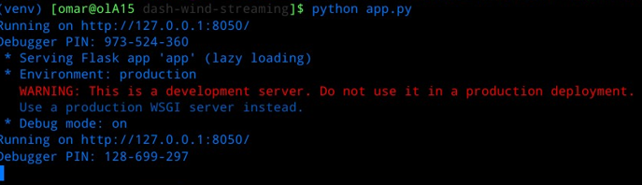
Results

