Slide 1
Meeting 2
9/16/2021
Chisom Sopuruchi

Slide 2
Deliverables
Install python, dash
Run open-source app locally from plotly gallery
Display the results

Slide 3
Methodology and Learnings
How did I do it?
Setup git on my virtual machine
Clone the repo.
Create a virtual environment and activate it
Install requirements and run the app
What did I learn on the way?
Git setup
Virtual environments setup

Slide 4
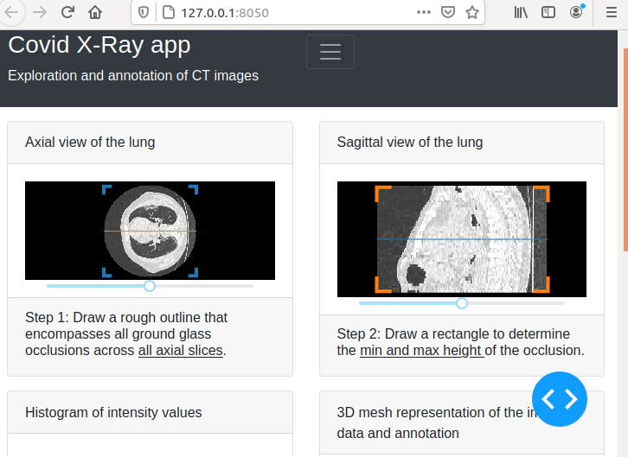
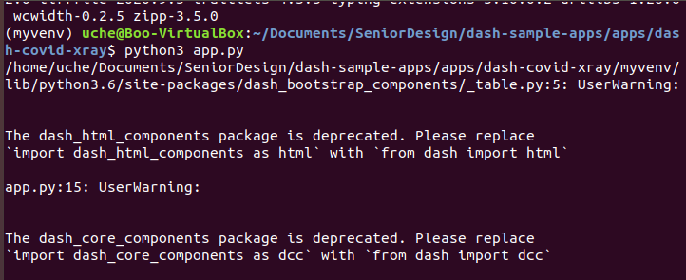
Results

