Slide 1
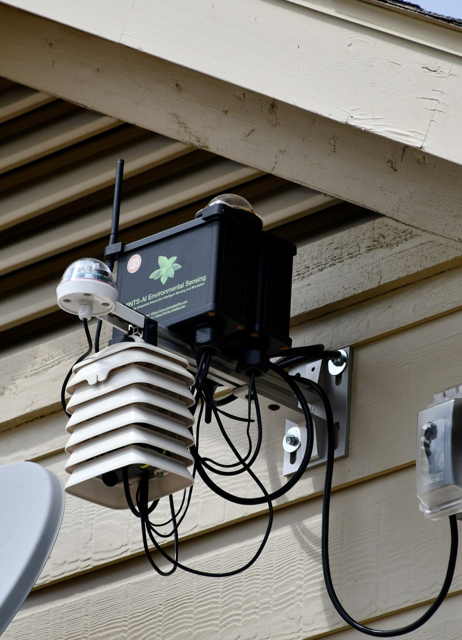
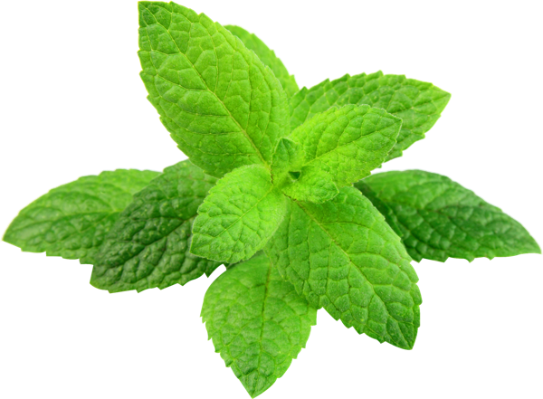

From Sensor to The Screen
MINTS IoT Data Pipeline
Rittik Patra
P.I: Prof. David J. Lary
MINTS Laboratory · UT Dallas
Notes:
[0:00–0:45] Welcome. Over the next 30 minutes we follow one measurement — a temperature, a PM2.5 value — from the chip that senses it to the dashboard where the public sees it. The photo is a real MINTS node in the field. (Edit the presenter line if someone else is presenting.)

Slide 2

Air pollution: Global Picture
8.9 M
deaths in 2015 attributed to long-term outdoor PM2.5 exposure (Burnett et al., PNAS 2018)
Monitors are sparse.
Low-cost sensors make dense, hyperlocal networks possible — if we calibrate them.
Fig. 1 — Deaths from outdoor air pollution, 2017. Our World in Data / IHME Global Burden of Disease (CC BY).
Notes:
[0:45–2:00] This is why the lab exists. The map (Our World in Data, from the Global Burden of Disease study) shows deaths attributed to outdoor air pollution by country. Burnett et al. (PNAS 2018) estimated about 8.9 million deaths in 2015 from long-term PM2.5 exposure. Regulatory monitors are excellent but sparse; low-cost sensors let us map pollution street by street — provided we calibrate them (Morawska et al. 2018; Karagulian et al. 2019).

Slide 3
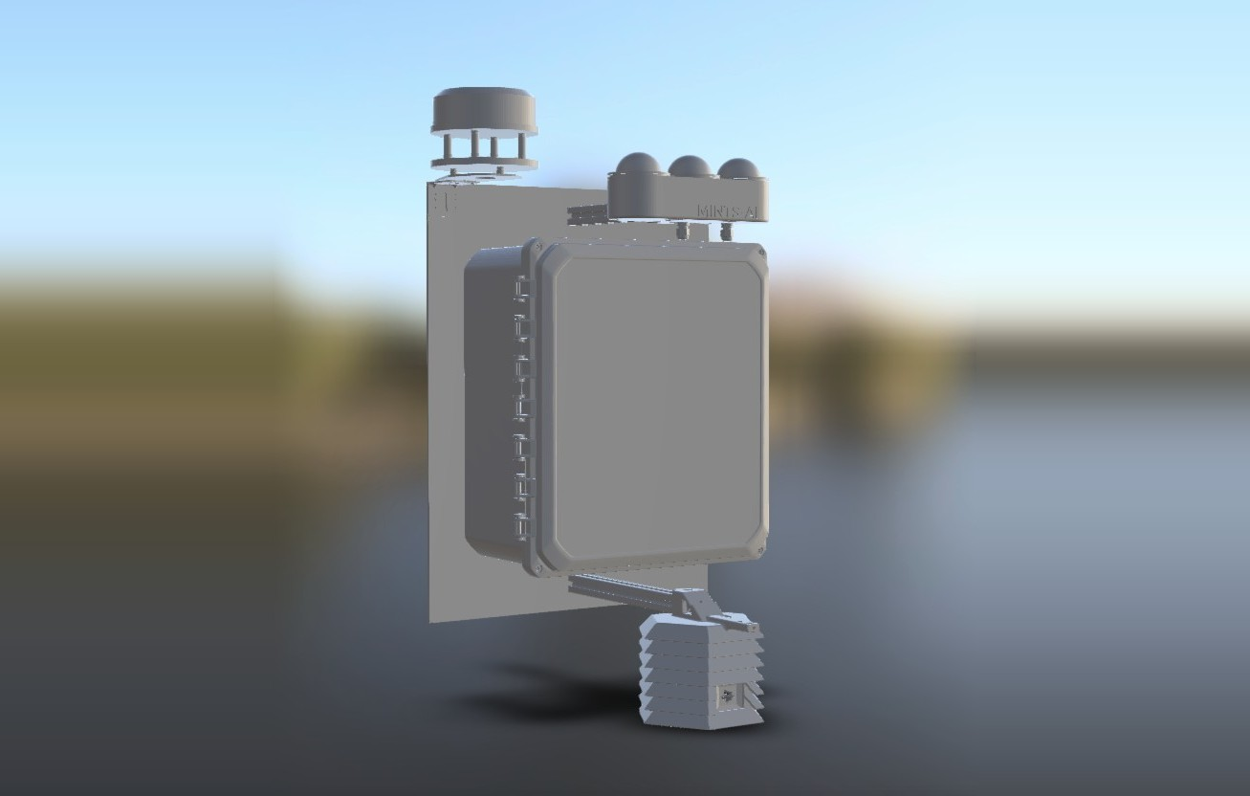
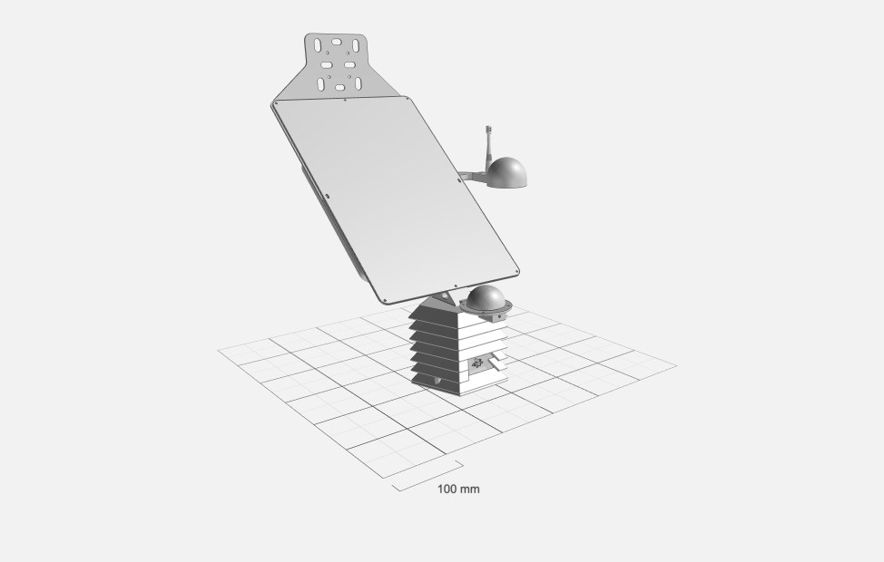
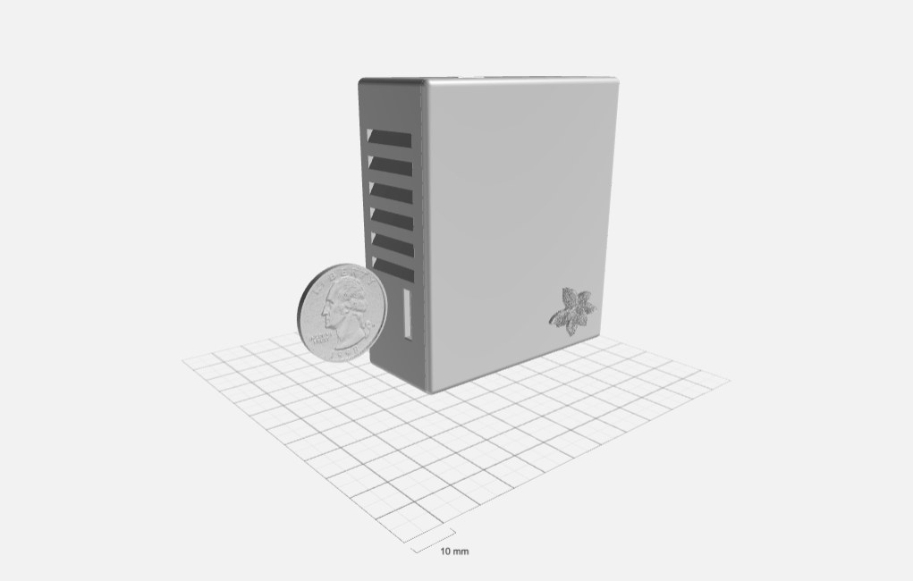
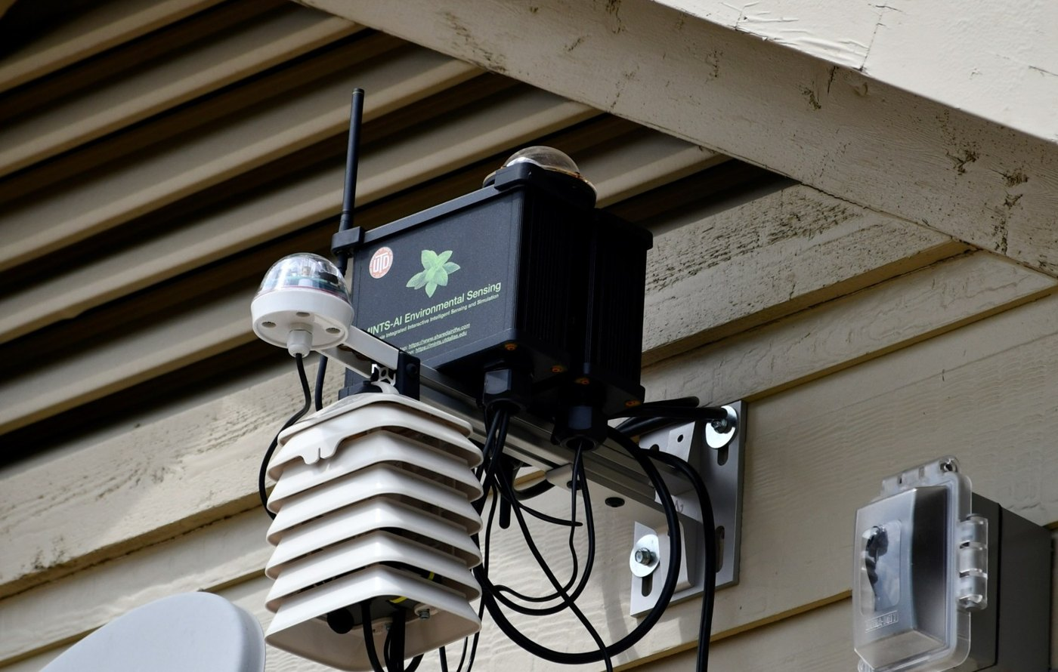
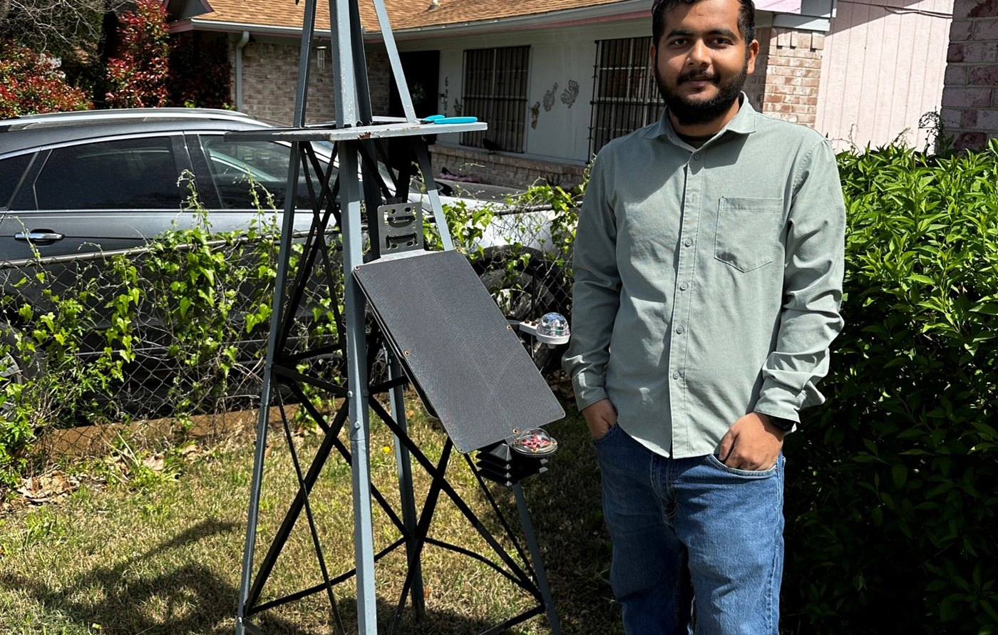
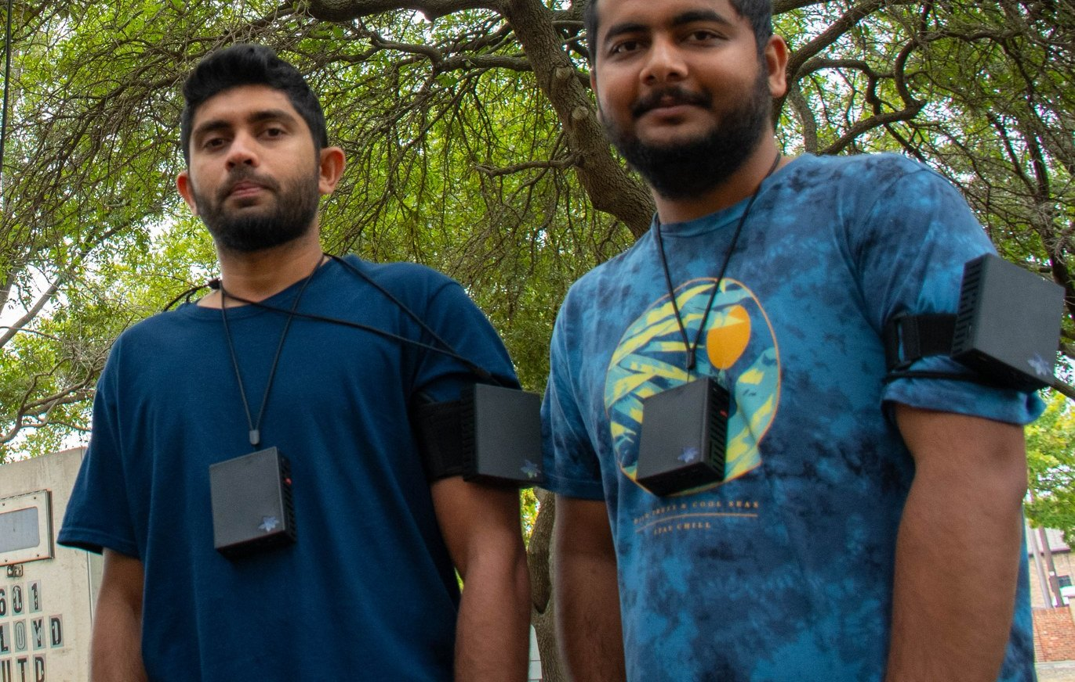
Three families of MINTS nodes
Mains-powered Direct-Connect (DC)
Solar-powered LoRaWAN (LR)
Wearable Personal exposure
Wi-Fi / Ethernet · rsync + MQTT
long-range radio · ChirpStack + MQTT
Wi-Fi / Bluetooth · rsync + MQTT
Notes:
[2:00–3:15] Top row: renders; bottom row: the same designs deployed. Mains-powered nodes such as the CANOPY design have internet (Wi-Fi or Ethernet) — we call them Direct-Connect, DC. Solar-powered nodes are usually off-grid and talk over LoRaWAN — LR nodes. Wearables are a separate project for personal exposure; today we focus on DC and LR, because they share the pipeline you'll be working on.

Slide 4
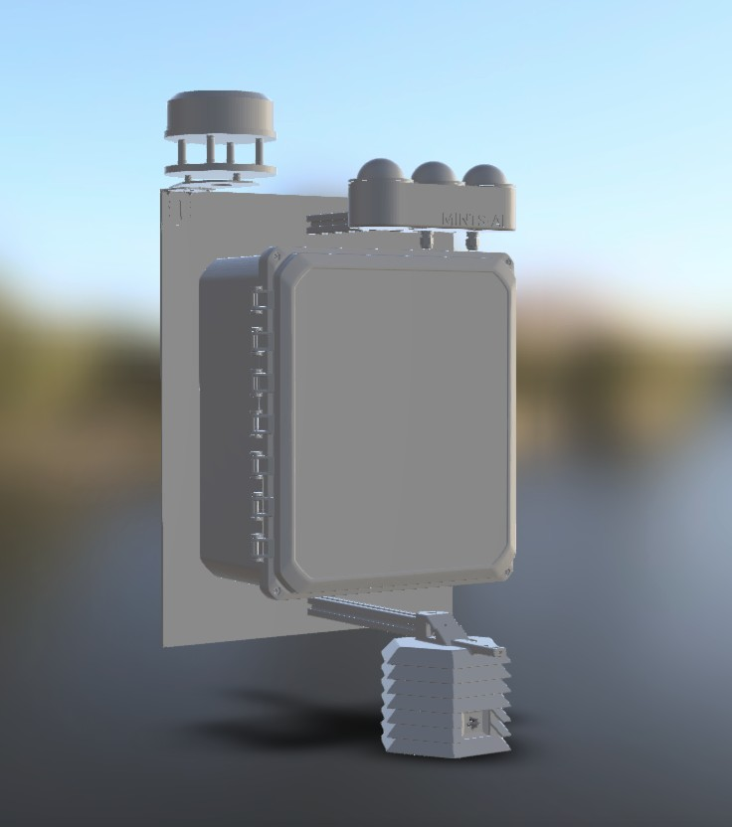

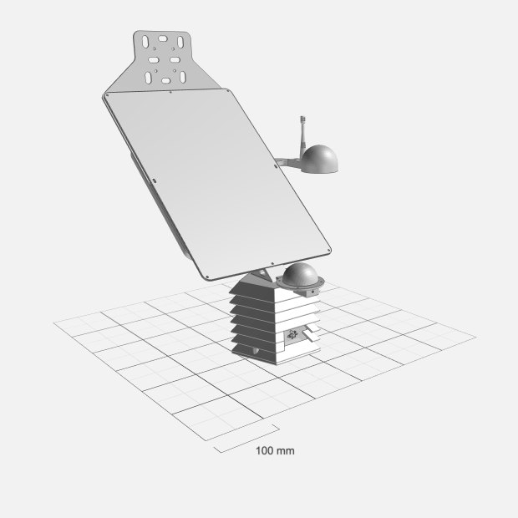



Simplified Pipeline
SSH Rsync
CSV File Storage
IMD data server
DC
NODES
LR MQTT
DC MQTT
DC MQTT
SharedAirDFW
Public portal
LR MQTT
LR
NODES
HTTPS
HTTPS
LR MQTT
Sensor data
Data flows
Sensor dashboards
SSH Rsync
DC MQTT
LR MQTT
HTTPS
MQTT : Message Queuing Telemetry Transport
Notes:
[3:15–4:45] The pipeline view from our Prezi, redrawn. Read it left to right. DC nodes push raw CSV files over SSH rsync (dark blue) to file storage on the IMD server, and stream live readings over MQTT (blue) to the public SharedAirDFW portal and to Node-RED. LR nodes reach the same places through LoRaWAN and then MQTT (teal) — including CSV storage via an MQTT subscriber. Node-RED writes to InfluxDB, and Grafana reads InfluxDB, both over HTTPS (red). Every later slide zooms into one arrow on this picture.

Slide 5
MQTT in three steps: publish → route → subscribe
1 Publish
2 Route
3 Subscribe
Broker
matches topics and forwards each message to every subscriber
e.g. Mosquitto, HiveMQ, EMQX
MINTS: mqtt.circ · TLS 8883
SharedAirDFW public map
topic
nodeID/sensorID
Publisher
sensor node sends a reading to a topic
Node-RED → InfluxDB → Grafana
JSON payload
CSV
MQTT subscriber → CSV storage
Why it suits IoT
Trade-offs
Lightweight — fixed header as small as 2 bytes
Decoupled — add subscribers without touching sensors
Reliable — QoS 0 / 1 / 2: at most, at least, exactly once
Low bandwidth — suits unstable, high-latency links
Broker is a single point of failure unless clustered
Security is opt-in — add TLS + auth (we use 8883)
Needs a live TCP link — too heavy for LoRa radios
No payload schema — both ends must agree on fields
Notes:
[4:45–6:00] MQTT — Message Queuing Telemetry Transport — is the standard messaging protocol for IoT: a lightweight publish/subscribe protocol (OASIS MQTT v5.0). Step 1: a publisher, here a sensor node, sends a reading to a topic such as nodeID/BME280. It doesn't know who will read it. Step 2: the broker (Mosquitto, HiveMQ, EMQX; ours is mqtt.circ, TLS on port 8883) matches topics and routes. Step 3: subscribers — SharedAirDFW, Node-RED, an MQTT-to-CSV subscriber — receive every message on the topics they subscribed to, instantly. Advantages: a fixed header as small as 2 bytes, decoupled producers and consumers, three Quality-of-Service levels (QoS 0 at most once, QoS 1 at least once, QoS 2 exactly once), and good behaviour on poor networks. Trade-offs: the broker is a single point of failure unless you cluster it; encryption and authentication are optional, so you must turn on TLS; MQTT needs a persistent TCP connection, which is why our battery-powered LoRa nodes use LoRaWAN instead and only reach MQTT after ChirpStack; and the payload is opaque bytes with no schema, so publisher and subscriber must agree on field order and units.

Slide 6
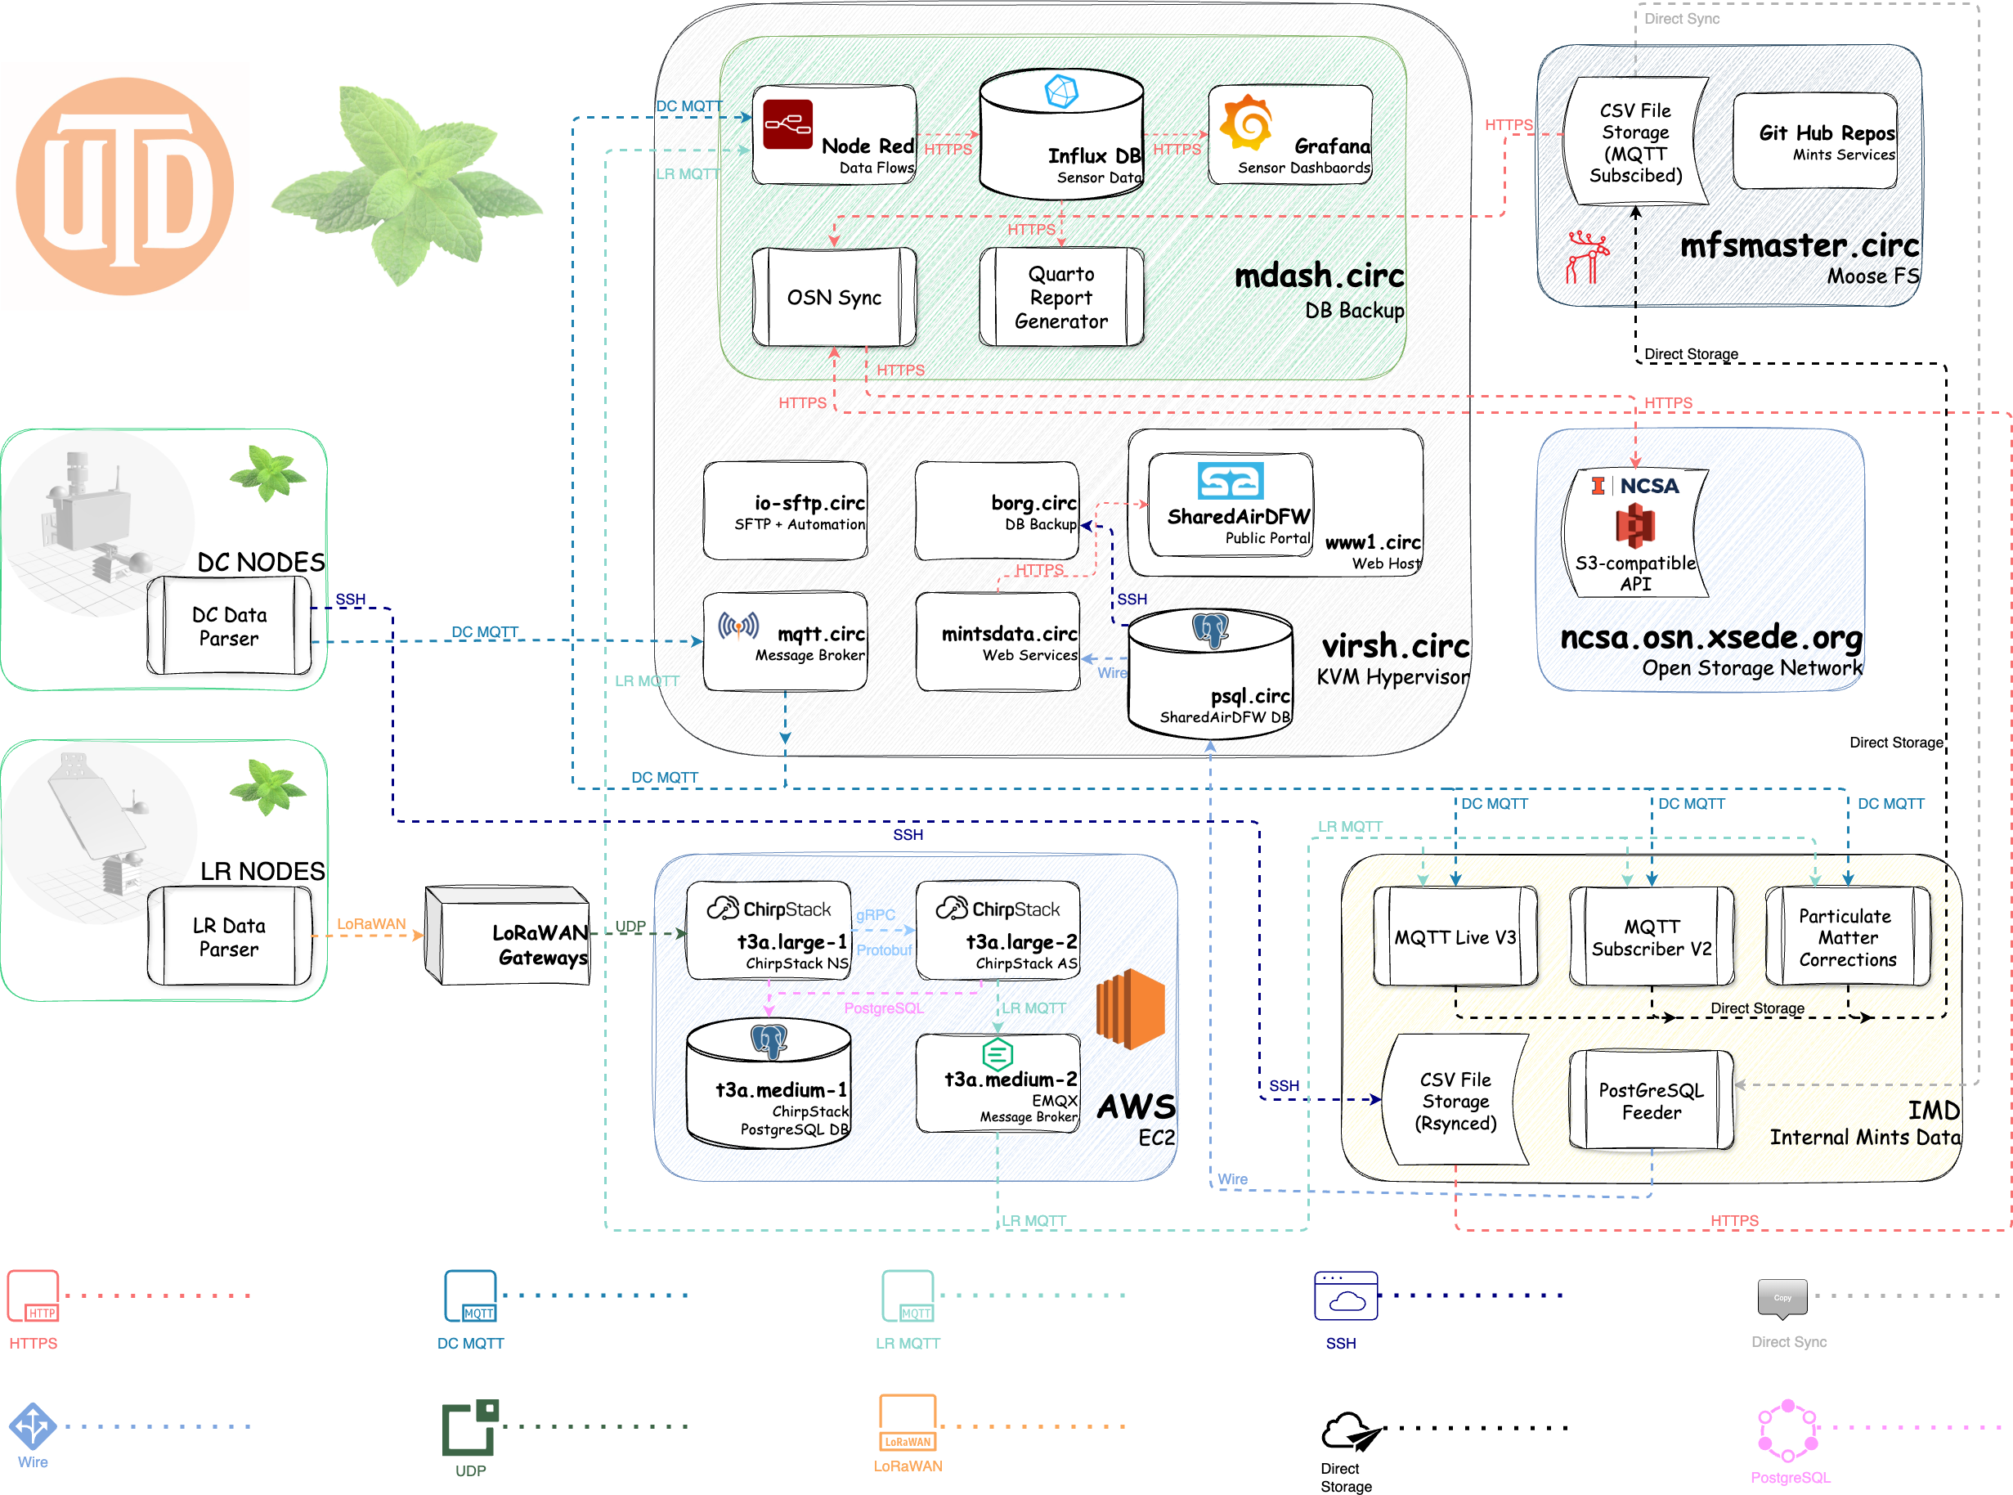
The Larger Image
mdash.circ
Node-RED · InfluxDB · Grafana · reports
virsh.circ
MQTT broker · SharedAirDFW web + database
AWS EC2
ChirpStack network & application servers, EMQX broker
IMD
rsynced CSVs · MQTT subscribers · PM corrections
mfsmaster / NCSA OSN
long-term file and object storage
Notes:
[4:45–5:45] You do NOT need to memorise this — it's the full map so you know where things live. Top: mdash.circ runs Node-RED, InfluxDB and Grafana. Middle: virsh.circ hosts the MQTT broker and the SharedAirDFW web portal and database. Bottom left: ChirpStack and an EMQX broker run on AWS EC2 for the LoRaWAN side. Bottom right: IMD, our internal data store, receives rsynced CSVs and runs MQTT subscribers and particulate-matter corrections. Long-term copies go to MooseFS and the NCSA Open Storage Network.

Slide 7
NODE Names and IDs underneath
Node name
CANOPY 01
CANOPY 01
└─ 001e0642c3d6
├─ BME280
│ dateTime · temperature
│ pressure · humidity · altitude
└─ COZIRAEH2000
dateTime · co2Recent · co2Filtered
temperature · humidity
node ID · sensor ID · fields
Notes:
[5:45–6:30] Hierarchy: node name → node ID → sensor ID → fields. CANOPY 01 is the human name for this box (the render shows the CANOPY design). Underneath, its computer has a hardware ID (teal), each attached sensor has a sensor ID (vermilion), and each sensor reports an ordered list of fields. In InfluxDB you filter by node and sensor ID — that's how you find your data.

Slide 8
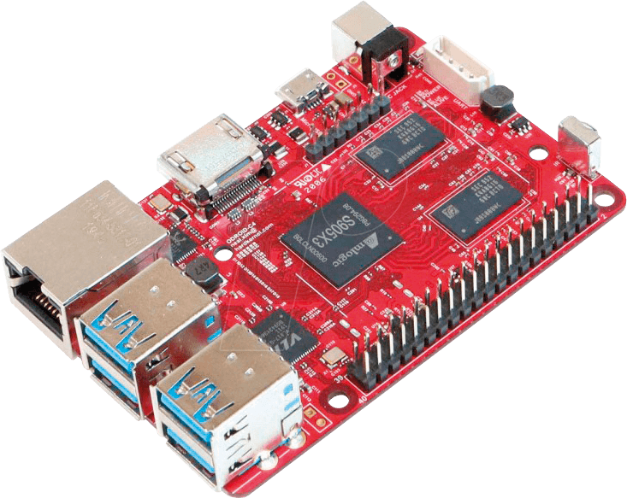
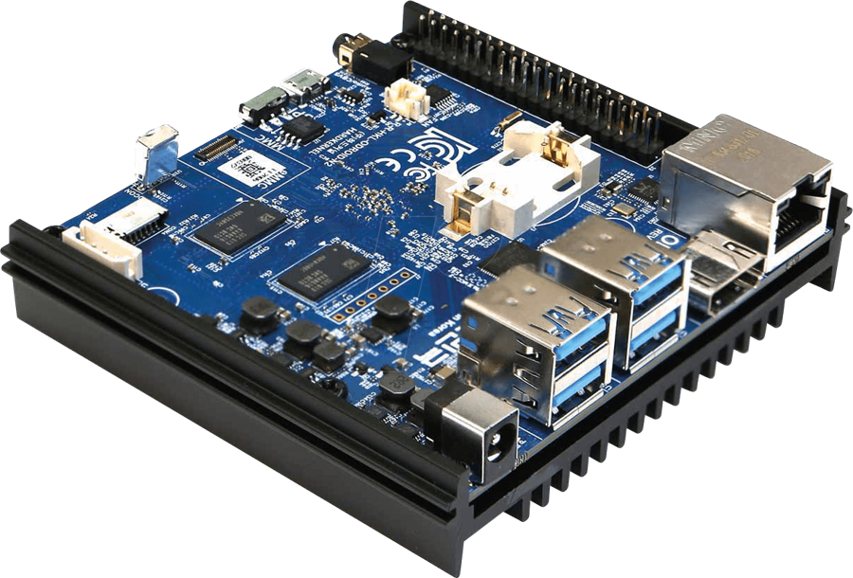
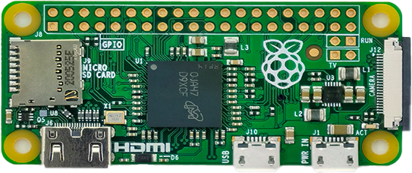
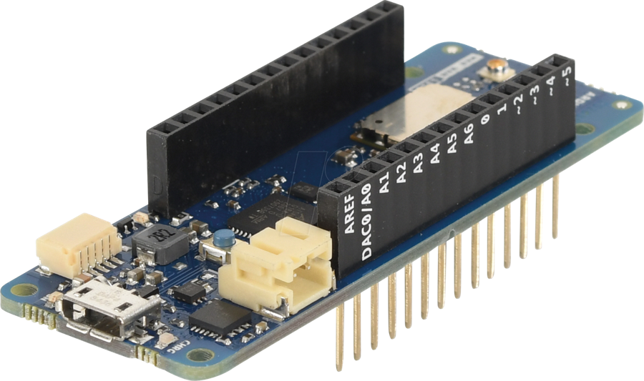
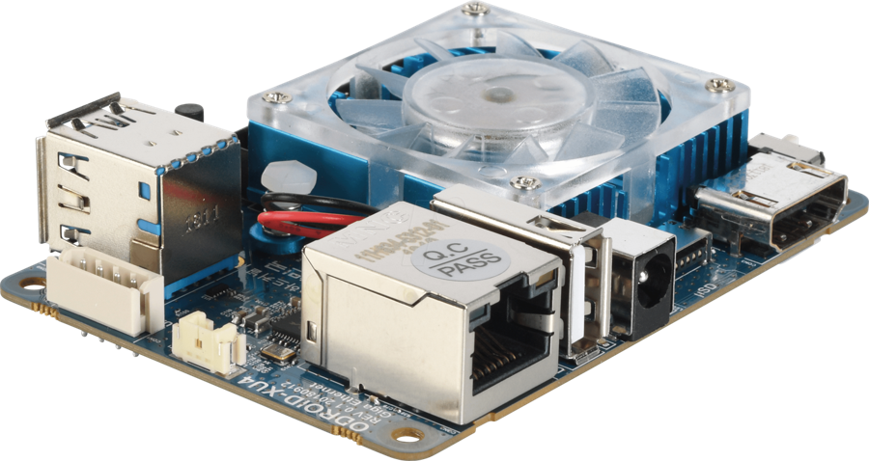
Node IDs : Hardware Defined
e45f0156553f
001e064a16dc
001e0642c3d6
The first 6 hex digits name the maker
e45f01 Raspberry Pi
001e06 Hardkernel (ODROID)
a8610a Arduino (LoRa DevEUI)
001e0637371e
a8610a343238750e
Notes:
[6:30–7:30] Each board has unique hardware addresses — MAC addresses for Wi-Fi, Ethernet and Bluetooth, or a DevEUI for a LoRaWAN radio. The firmware reads one automatically (findMacAddress tries eth0 first) and uses it as the node ID, so you never type it by hand. The first six hex digits are the manufacturer's organisationally unique identifier — e45f01 is Raspberry Pi, 001e06 is Hardkernel's ODROID boards, a8610a is Arduino.

Slide 9
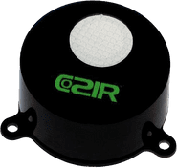
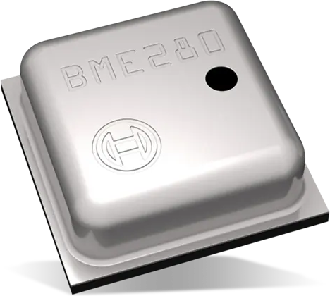
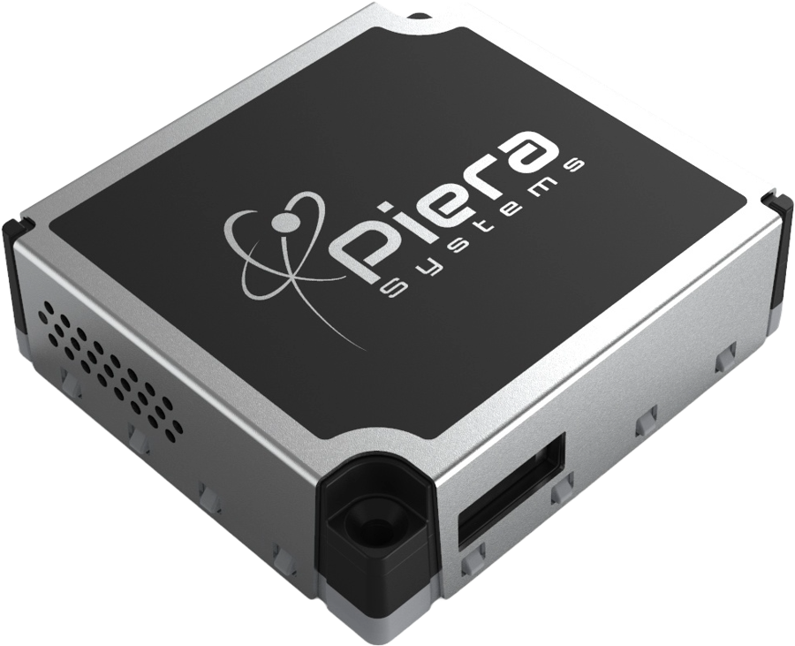
Sensor IDs and Fields
IPS7100
COZIRAEH2000
BME280
particle counts + mass
CO2 (infrared)
climate
pc0_1 … pc10_0
pm0_1 … pm10_0
co2Recent · co2Filtered
temperature · humidity
temperature · pressure
humidity · altitude
Every reading starts with a dateTime field. In InfluxDB, sensor IDs are called “measurements”.
Notes:
[7:30–8:30] Three sensors you'll meet on almost every node. The sensor ID is the model name in capitals; the fields are the ordered list of values it reports, always starting with dateTime. In InfluxDB the sensor ID is called a 'measurement'. All supported sensors and their field lists are in dcSensorIDs.py.

Slide 10
The sensors
01
Notes:
[8:30] About six minutes on sensors: what's on a node, the two key sensing principles, and why we calibrate.

Slide 11
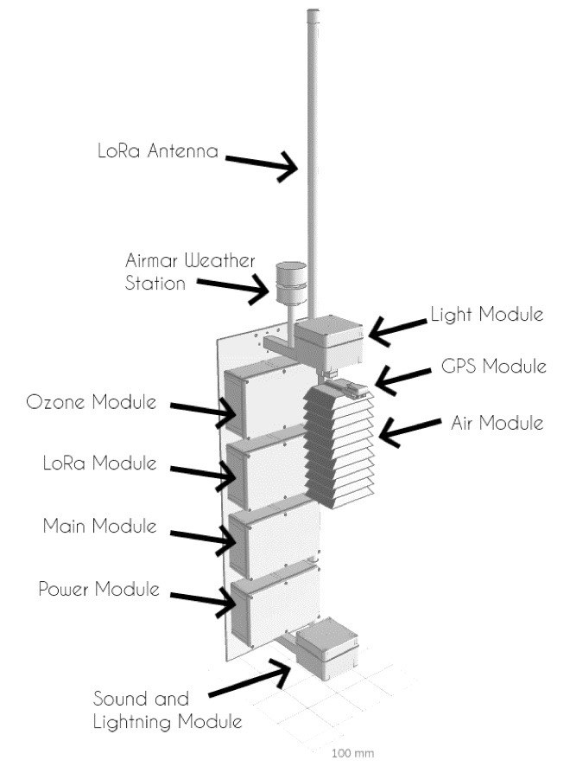
Nodes: Sensor Module Stack
SENSOR ID | MEASURES | PRINCIPLE
IPS7100 | Particle counts 0.1–10 µm; PM0.1–PM10 | Optical scattering
BME280 | Temperature, pressure, humidity | MEMS
COZIRAEH2000 | CO2 | Non-dispersive infrared
SCD30 | CO2, temperature, humidity | Non-dispersive infrared
L70 | Position | GNSS
INA219 | Battery & solar power | Current shunt
RG15 | Rainfall | Optical rain gauge
AS7265X | 18-band light spectrum | Spectral photodiodes
40+ sensor definitions live in dcSensorIDs.py
Fig. 2 — Exploded view of a MINTS node.
Notes:
[8:30–9:45] The exploded view shows how a node is built: antenna and weather station on top, then air, light, GPS, ozone, LoRa, main computer and power modules, with a sound-and-lightning module at the bottom. The table lists the sensors you'll see most. Don't memorise it — know that each sensor has an ID and a fixed field list in dcSensorIDs.py.

Slide 12
Particulate Matter (PM) Sensor
Photodiode
Laser
pulse height ∝ particle size → size bin
01
Counts, not weighs
02
Humidity inflates PM
03
Size response varies
Mass is inferred assuming density, shape and refractive index.
Particles absorb water and grow (Jayaratne et al., AMT 2018).
Selectivity differs between sensors (Kuula et al., AMT 2020; Hagan & Kroll, AMT 2020).
Notes:
[9:45–11:15] The IPS7100 (Piera Systems) pulls air past a light beam. Each particle scatters a flash; the photodiode turns it into a pulse whose height grows with particle size, so pulses are binned by size and counted. Mass in µg/m³ is then inferred with assumptions about density, shape and refractive index. At high humidity particles absorb water and swell, so the sensor over-reads (Jayaratne et al. 2018); size selectivity also varies between low-cost sensors (Kuula et al. 2020; Hagan & Kroll 2020). That's why every PM sensor sits next to a humidity sensor.

Slide 13
Context: Meterological Data and CO₂
BME280
COZIR / SCD30 · NDIR
Temperature, pressure and humidity in one MEMS package — data in their own right, and inputs to the PM correction.
CO2 absorbs infrared near 4.26 µm: less light at the detector means more CO2.
T
P
RH
IR source
gas cell · path L
filter + detector
I = I₀ e^{−αcL}
°C
Pa
%
Beer–Lambert law. Low-cost NDIR needs temperature, pressure and humidity correction (Martin et al., AMT 2017).
Notes:
[11:15–12:30] The BME280 (Bosch) measures temperature, pressure and humidity with MEMS structures — humidity changes a capacitance, pressure changes a resistance. The CO2 sensors on our nodes (the GSS COZIR in the Prezi, and the Sensirion SCD30) are non-dispersive infrared: CO2 absorbs near 4.26 µm, and the Beer–Lambert law relates transmitted intensity to concentration. Because the exponent depends on path length and gas density, NDIR readings need temperature, pressure and humidity correction (Martin et al. 2017).

Slide 14
Calibration: Humidity Correction and ML Based
Humidity correction
remove water-growth bias
Random forest
learned against a reference
Calibrated PM2.5
what SharedAirDFW shows
Reference: co-located EPA-designated BAM 1022 (FEM) monitor near Fort Worth, ~8 months of paired data.
0.97
0.82
Report the validation score. The gap between training and independent validation is the honest measure of generalisation.
R² · training
R² · independent validation
Wijeratne et al., Air 2025 (doi:10.3390/air3010009); Wijeratne et al., Sensors 2020 (doi:10.3390/s20010099).
Notes:
[12:30–14:00] We co-locate nodes with a regulatory-grade instrument (an EPA federal-equivalent-method BAM 1022 near Fort Worth) and learn the mapping from raw particle bins plus climate to the reference PM2.5. In Wijeratne et al. (Air, 2025) the random-forest model reached R² = 0.97 on training data and 0.82 on independent validation. Always report validation, not training.

Slide 15
Direct-Connect pipelines
02
Notes:
[14:00] Section 02: what happens on a DC node, and the two ways its data leave it — rsync for the archive, MQTT for live data.

Slide 16
Data Structure: Ordered Dictionary
sensorDictionary = OrderedDict([
("dateTime", str(dateTime)),
("temperature", 28.40),
("pressure", 98651.00),
("humidity", 38.00),
("altitude", 225.01)])
sensorFinisher(dateTime, "BME280", d)
Always → CSV on disk
then SSH rsync
If mqttOn → JSON
DC MQTT, live
runs on the node's single-board computer
mintsData/raw/
└─ 001e06122a5a/2021/07/20/
├─ MINTS_001e06122a5a_BME280_2021_07_20.csv
├─ MINTS_001e06122a5a_IPS7100_2021_07_20.csv
└─ MINTS_001e06122a5a_SCD30_2021_07_20.csv
Node ID
Sensor ID
one file per sensor per day
Notes:
[14:00–15:15] Every reader script builds an OrderedDict and hands it to sensorFinisher(). That function always writes a CSV row — one file per sensor per day, under the node ID and date — and, if mqttOn is True in mintsDefinitions.py, also publishes the same dictionary over MQTT. Keep the same field order and units as the existing definition in dcSensorIDs.py.

Slide 17
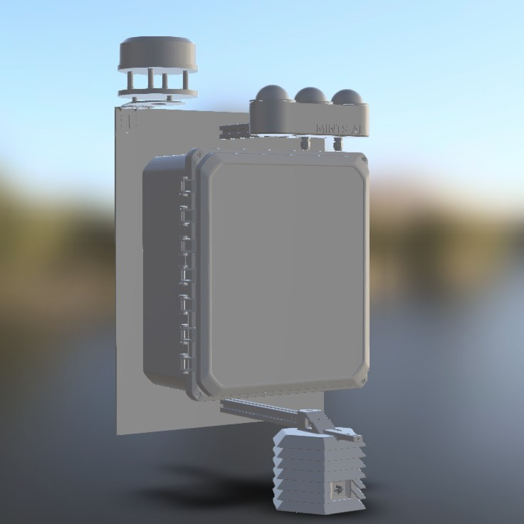
Lane A: rsync mirroring
Retention
CSV File Storage
IMD data server
Node
SSH Rsync · port 2222
14 days
IMD server
full history
1
2
3
4
ssh-keygen
authorized_keys
ssh -p 2222 …
cron * * * * *
on the node
add the public key on the server
test the login
rsync every minute
If rsync breaks for two weeks, the node deletes data before it reaches the server — check it.
Notes:
[15:15–16:15] Lane A, the dark-blue dashed line. The node uses SSH key authentication (no stored passwords) to rsync its raw CSV folder to the IMD data server every minute from cron; rsync only sends what changed. Meanwhile deleter.py keeps just the last 14 days on the node — so a silent rsync failure becomes data loss after two weeks. Command: rsync -avzrtu -e "ssh -p 2222" /home/teamlary/mintsData/raw/ mints@mintsdata.utdallas.edu:raw

Slide 18
Lane B: MQTT publish
MQTT Subscriber
→ CSV storage
MQTT broker
mqtt.circ
TLS · 8883
DC MQTT
SharedAirDFW
public portal
topic 001e0642c3d6/BME280
{
"dateTime": "2025-10-08 16:23:41",
"temperature": 28.4,
"pressure": 98651.0,
"humidity": 38.0, "altitude": 225.01
}
HTTPS
HTTPS
:1880
:8086 · sharedAirDFW
:3000
Fig. 3 — An illustrative DC MQTT message: topic = <nodeID>/<sensorID>.
Notes:
[16:15–17:45] Lane B. The node publishes each reading once, as JSON, to topic nodeID/sensorID on the MINTS broker (mqtt.circ) over TLS on port 8883. Publish/subscribe means the node doesn't know who's listening (Light, JOSS 2017). Three consumers subscribe: an MQTT subscriber that writes CSVs to storage, the public SharedAirDFW portal, and Node-RED, which parses the message and writes it over HTTPS to InfluxDB (bucket sharedAirDFW); Grafana reads InfluxDB for dashboards. Ports: Node-RED 1880, InfluxDB 8086, Grafana 3000.

Slide 19
Nodered Summary
New node
New sensor
1
Add a row to id_lookup.csv: node ID, name, type, device, active
1
Check the sensor ID is unused in dcSensorIDs.py
2
On the server: git pull AirQualityAnalysisWorkflows
2
In Node-RED add MQTT-in + JSON nodes; link to “parse for Mints Data”; deploy
3
Rebuild only Node-RED:
podman-compose up --build -d
3
Export all flows to the repo, then pull and rebuild
Never remove the InfluxDB container. Stop and remove only the Node-RED container before rebuilding.
Notes:
[17:45–19:00] The most common first-week confusion: “my script runs but nothing shows in Influx.” Nine times out of ten the node or sensor isn't registered — the workflow drops unknown IDs silently. Nodes are registered in id_lookup.csv; sensors in the Node-RED flows. Commit to AirQualityAnalysisWorkflows, git pull on MDASH, and rebuild only the Node-RED container. Never remove the InfluxDB container — that's where the data live.

Slide 20
LoRaWAN pipeline
03
Notes:
[19:00] Section 03: long range, low power, very few bytes — the radio, the network architecture, the security handshake, and packing data into bytes.

Slide 21
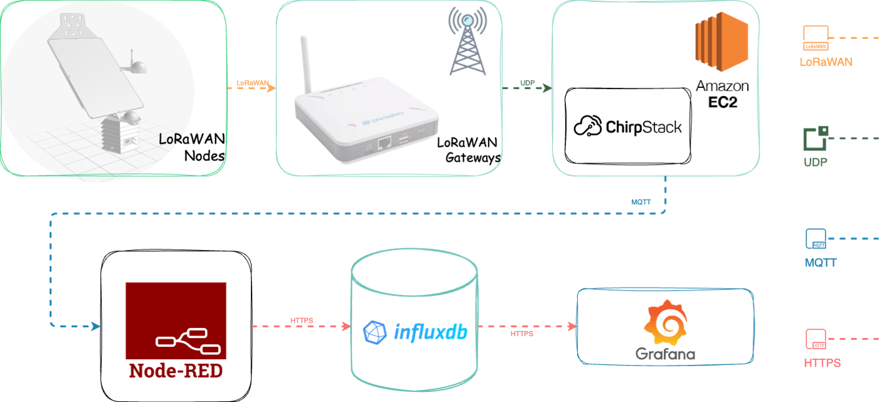
Node → gateway → ChirpStack → MQTT → Node-RED
Notes:
[19:00–20:15] The LoRaWAN lane from the Prezi. The solar node transmits over LoRaWAN radio (orange) to a Dragino gateway. The gateway forwards packets over UDP (green) to the ChirpStack network server running on Amazon EC2. ChirpStack decrypts and publishes them over MQTT (blue), and from there it's the same Node-RED → InfluxDB → Grafana stack as the DC lane, over HTTPS (red). Protocol key on the right.

Slide 22
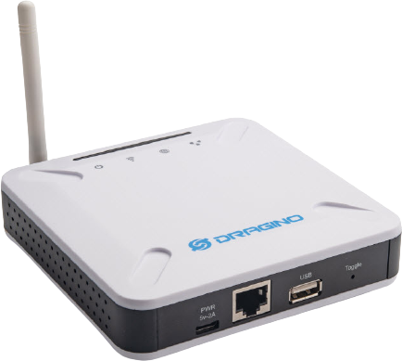
Range & Power vs Bandwidth
Chirp spread spectrum
trades data rate for sensitivity and range (Augustin et al., Sensors 2016).
Shared spectrum
duty cycle and collisions limit scale (Adelantado et al., IEEE Commun. Mag. 2017).
LoRaWAN gateway
MINTS settings
US915 · sub-band 8 · OTAA · DR2 (SF8, 125 kHz, ≈3.1 kbit/s).
Field range
~7 km rural; <1 mile in obstructed urban sites (Wijeratne et al., Air 2025).
Fig. 4 — IPS7100's 56-byte packet does not fit DR1 (53 B) — one reason MINTS uses DR2. LoRa Alliance RP002 Regional Parameters.
Notes:
[20:15–21:30] LoRa uses chirp spread spectrum: slower chirps (higher spreading factor) reach farther but carry fewer bits. Quiz: the IPS7100 particle packet is 56 bytes — would it fit at DR1? No, the US915 limit is 53 bytes. That's one reason the firmware uses DR2 (SF8, 125 kHz, ~3.1 kbit/s), allowing up to 125 bytes. Range in the field: up to ~7 km rural, under a mile at obstructed urban sites.

Slide 23

OTAA: Node Communication
Join Request
DevEUI · AppEUI · DevNonce · MIC(AppKey)
Join Accept
AppNonce · NetID · DevAddr · settings
Both sides derive
NwkSKey → MIC integrity
AppSKey → AES-128 payload
Join Request
Forward request
Join Accept
Join Accept
LoRaWAN packet
Forward to server
Notes:
[21:30–23:15] The Over-The-Air Activation handshake (LoRaWAN 1.0.x), drawn like the Prezi. The AppKey is a shared secret that never travels over the air. The node sends a Join Request (DevEUI, AppEUI, a fresh DevNonce) signed with a MIC computed from the AppKey; the gateway forwards it to ChirpStack, which looks up the DevEUI, checks the MIC and replies with a Join Accept (AppNonce, NetID, DevAddr, settings) encrypted with the AppKey. Both sides then derive two session keys: NwkSKey protects integrity to the network; AppSKey encrypts the payload end-to-end to the application. That's why every node needs its own AppKey — never reuse the default.

Slide 24
Field Order
33 33 e3 41
4 bytes · float32
80 ad c0 47
4 bytes · float32
00 00 18 42
4 bytes · float32
28.40
98651.0
38.00
temperature
pressure
humidity
payload = 3333e34180adc04700001842 12 bytes · little-endian · FPort 21
SENSOR | FPORT | PAYLOAD
BME280 | 21 | 12 B
IPS7100 | 15 | 56 B
L70 GPS | 5 | 55 B
SCD30 | 33 | 12 B
No labels travel in the packet — position is meaning.
The FPort tells Node-RED which “Unpack” function to use; swap two fields on the node and pressure is silently stored as humidity.
Notes:
[23:15–25:00] LoRa can't afford text, so each value becomes 4 raw bytes: np.float32(value).tobytes().hex(). On the ARM single-board computer these bytes are little-endian — so 28.40 becomes 33 33 e3 41. Concatenate in a fixed order and you have the payload; the FPort identifies the sensor (portIDs.yml on the node, LoRaSummaryWrite in Node-RED — they must agree). Packet sizes match the Prezi's table; SCD30 = 12 bytes (3 floats). Exercise: decode 00001842 back to 38.0.

Slide 25
Six Steps from Bench to Dashboard
01
02
03
Read the DevEUI
Generate an AppKey
Create the device
Run bme280Transmitter.py; record the radio's DevEUI.
python3 keyGenerator.py — unique per node.
ChirpStack → UTD organisation → MINTS application; set keys.
04
05
06
Configure the node
Watch the frames
Register in the workflow
Put the AppKey in the node's credentials file; rerun.
“LoRaWAN frames” in ChirpStack: BME280 on FPort 21.
id_lookup.csv; new sensors also need a port ID, a sensorIDCheck entry and an Unpack function.
Notes:
[25:00–26:15] Steps 1–5 put the device on the LoRaWAN network; step 6 makes the analytics workflow accept its data. Diagnostic rule: if frames arrive in ChirpStack but not in InfluxDB, the problem is in Node-RED or id_lookup.csv — not the radio. The guide repository walks through all of this as exercises (lrMqttPipelineEX01–04).

Slide 26
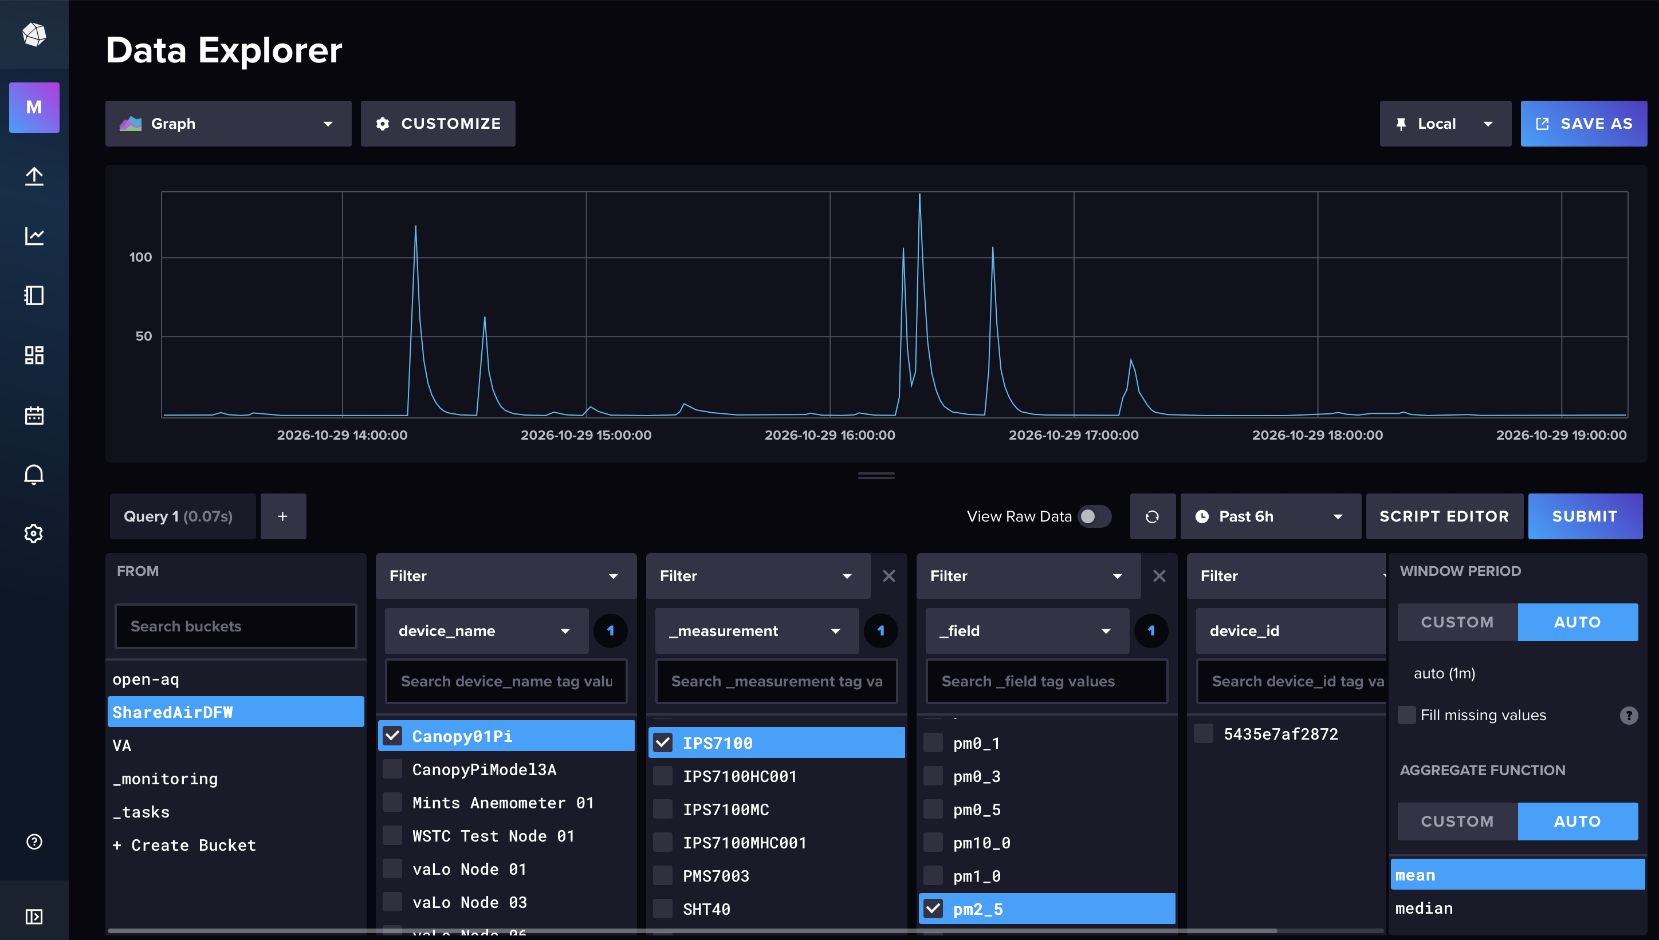
InfluxDB

Slide 27
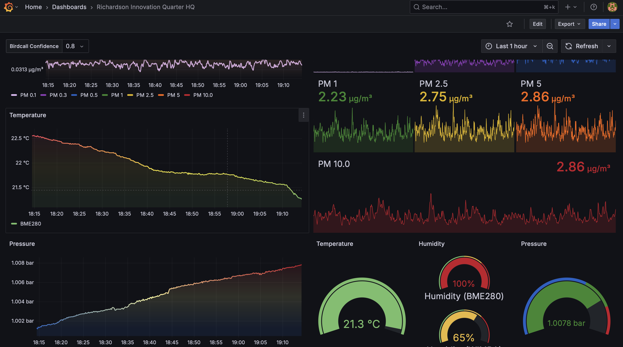
Grafana

Slide 28


References
# | REFERENCE | DOI
1 | Wijeratne et al. (2025) Air 3(1):9 | 10.3390/air3010009
2 | Wijeratne et al. (2020) Sensors 20(1):99 | 10.3390/s20010099
3 | Burnett et al. (2018) PNAS 115:9592 | 10.1073/pnas.1803222115
4 | Morawska et al. (2018) Environ. Int. 116:286 | 10.1016/j.envint.2018.04.018
5 | Karagulian et al. (2019) Atmosphere 10:506 | 10.3390/atmos10090506
6 | Jayaratne et al. (2018) Atmos. Meas. Tech. 11:4883 | 10.5194/amt-11-4883-2018
7 | Hagan & Kroll (2020) Atmos. Meas. Tech. 13:6343 | 10.5194/amt-13-6343-2020
8 | Kuula et al. (2020) Atmos. Meas. Tech. 13:2413 | 10.5194/amt-13-2413-2020
9 | Martin et al. (2017) Atmos. Meas. Tech. 10:2383 | 10.5194/amt-10-2383-2017
10 | Augustin et al. (2016) Sensors 16:1466 | 10.3390/s16091466
11 | Adelantado et al. (2017) IEEE Commun. Mag. 55(9):34 | 10.1109/MCOM.2017.1600613
12 | Light (2017) J. Open Source Softw. 2(13):265 | 10.21105/joss.00265
Guide repository
github.com/mi3nts/
iotSystemsGuide
Original Prezi
prezi.com/p/7z-to2jklim-
Notes:
[26:15–30:00] Questions. Point people to the repository QR code first — it walks through every pipeline as hands-on exercises — then the two MINTS papers (refs 1–2). Refs 3–5 cover motivation and low-cost sensing, 6–9 sensor physics, 10–12 networking. Images in this deck come from the MINTS IoT Systems Prezi and the lab's own renders and photos.

Slide 29
Thank You

