Slide 1


Edge-Based Cross Sensitivity Correction
Dheeraj Somashekar
3/26/26
MINTS Lab Meeting
1

Slide 2

Contents
Background
Outline
Approach
Possible Failures
References
2

Slide 3
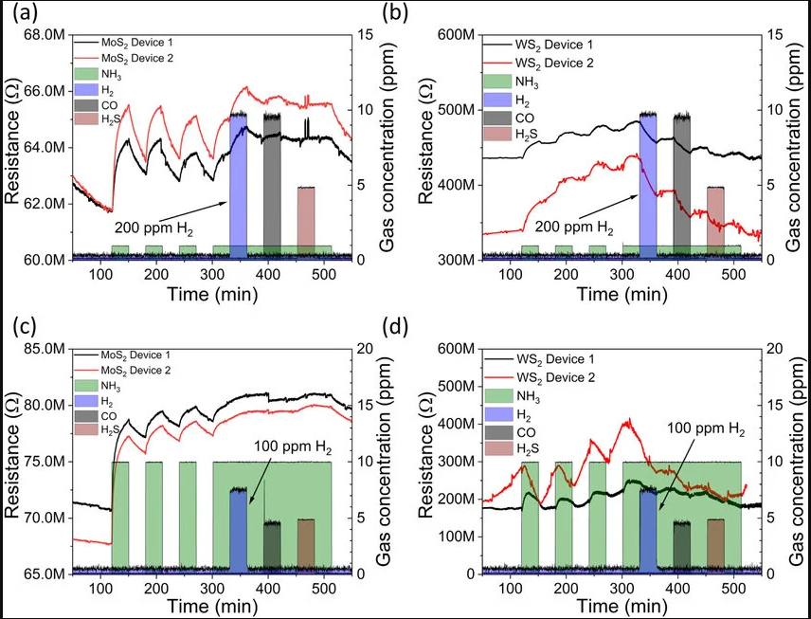

Background
Low-cost electrochemical gas sensors (SO₂, O₃, NO₂, CO) are widely used in urban air-quality networks but suffer from significant cross-sensitivity to co-pollutants and humidity.
Environmental factors like temperature and relative humidity modify sensor baseline, cause drift, and amplify interference effects.
Limited research on performing real-time, embedded cross-sensitivity correction directly on microcontrollers.
(1) Cross-sensitivity analysis of the sensors using (a), (b) low concentration NH3, and high concentration H2, CO and H2S pulses as well as (c), (d) similar analyte concentrations during the measurements.
(1) https://www.researchgate.net/figure/Cross-sensitivity-analysis-of-the-sensors-using-a-b-low-concentration-NH3-and-high_fig5_334078522
3

Slide 4
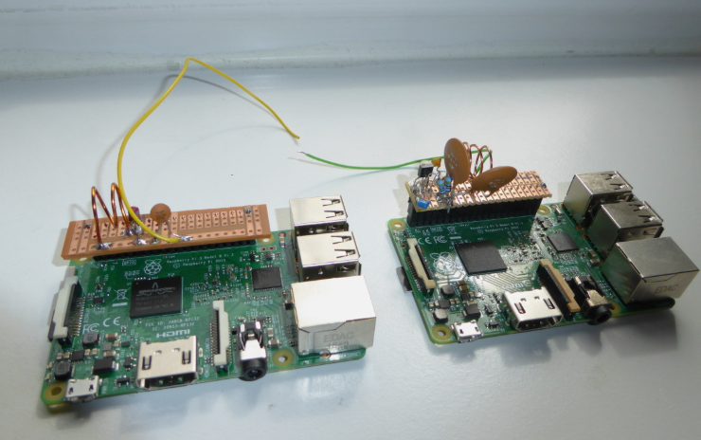
Outline
Goal ➔ Enhance the accuracy of low-cost sensors using real-time edge computing.
Problem ➔ Prone to cross-sensitivity, often misreporting O3, NO2, or humidity as SO2.
Use a Raspberry Pi to act as a "digital filter" that can differentiate between target gas signals and environmental interference.
Transition from unreliable data to "refined" research-grade data without expensive equipment.
(2) Low pass Filter using Raspberry Pi
4
(2) https://dk0tu.de/posts/Raspberry_Pi_Lowpass_Filters/

Slide 5
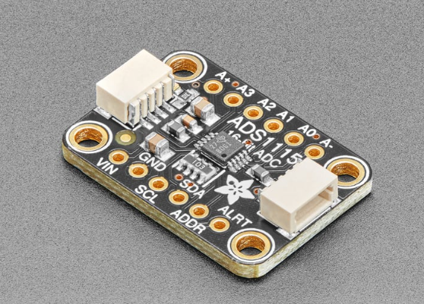
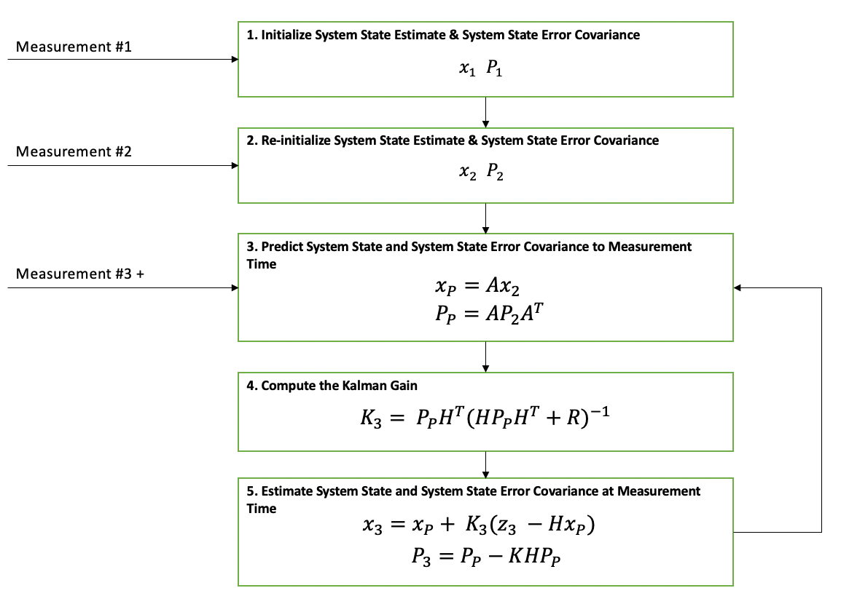
Approach
Interface sensors with a Raspberry Pi via a 16-bit ADS1115 ADC for high-resolution signal capture.
Expose sensors to controlled "interference events" to quantify false-positive readings.
Map the mathematical relationship between Gas X & Gas Y.
Utilize Linear Regression or a Kalman Filter in Python to subtract known interferences in real-time.
Expected Outcome: A "clean" output stream with a significantly reduced Root Mean Square Error (RMSE).
(3) Kalman Filter
5
(3) https://thekalmanfilter.com/kalman-filter-explained-simply/

Slide 6
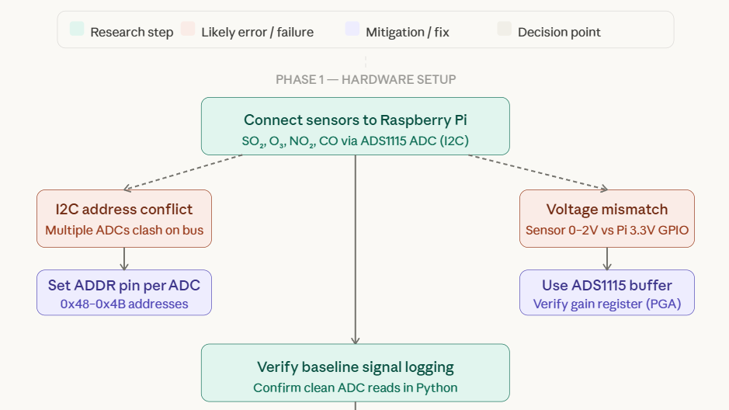
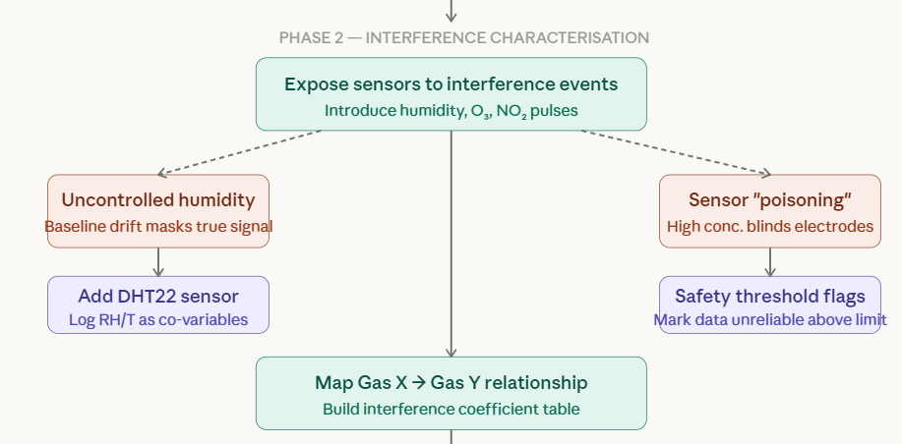
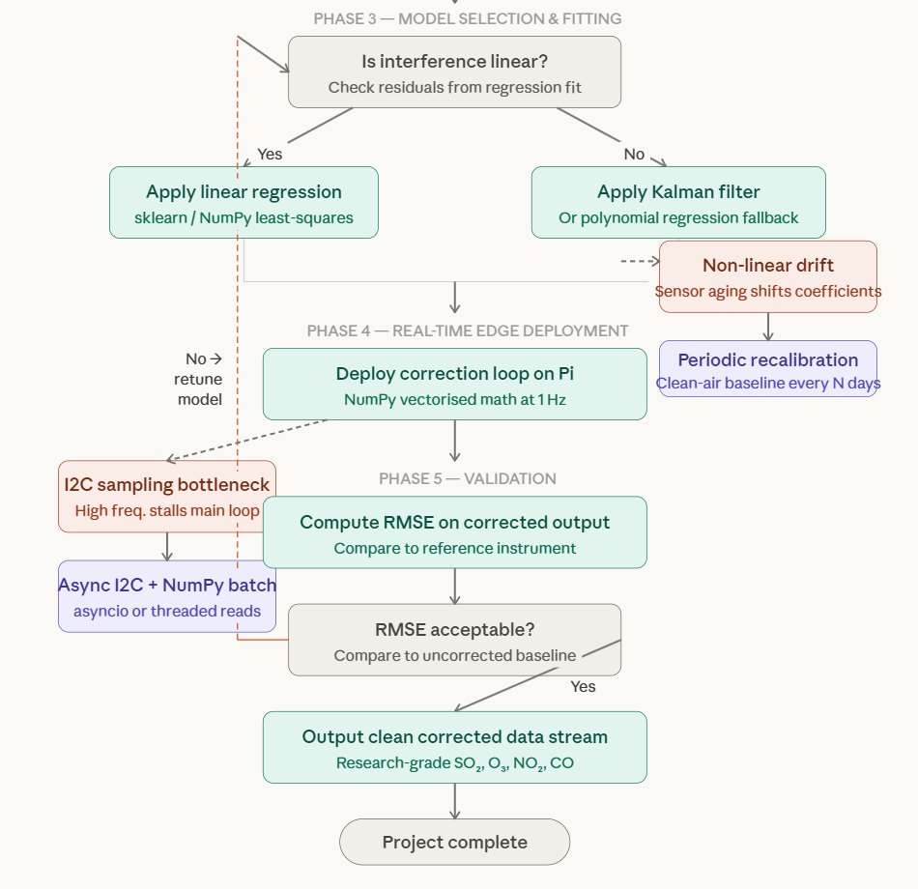
Project Workflow

Slide 7
Possible Failures
Non-Linear Interference
Risk: Cross-sensitivity may be non-linear or vary with sensor age.
Potential Approach: Use polynomial regression or periodically re-calibrate the baseline in clean air.
Environmental “Poisoning”
Risk: Extreme humidity or high gas concentrations could temporarily "blind" the sensor.
Potential Approach: Program "Safety Thresholds" in the firmware to flag data as unreliable during extreme environmental spikes.
Processing Latency
Risk: High-frequency sampling might bottleneck the Pi's I2C bus.
Potential Approach: Optimize Python code using NumPy for vectorized math and adjust sampling rates to 1Hz.
7

Slide 8
References
Hayward, I., Martin, N. A., Ferracci, V., Kazemimanesh, M., & Kumar, P. (2024). Low-Cost Air Quality Sensors: Biases, Corrections and Challenges in Their Comparability. Atmosphere, 15(12), 1523. https://doi.org/10.3390/atmos15121523
Xiaobing Pang, Marvin D. Shaw, Stefan Gillot, Alastair C. Lewis, The impacts of water vapour and co-pollutants on the performance of electrochemical gas sensors used for air quality monitoring, Sensors and Actuators B: Chemical, Volume 266, 2018, Pages 674-684, ISSN 0925-4005, https://doi.org/10.1016/j.snb.2018.03.144.
Jarvinen, Topias & Lorite, Gabriela & Peräntie, Jani & Toth, Geza & Saarakkala, Simo & Virtanen, Vesa & Kordás, Krisztián. (2019). WS2 and MoS2 thin film gas sensors with high response to NH3 in air at low temperature. Nanotechnology. 30. 10.1088/1361-6528/ab2d48.
8

Slide 9

Thank you
9

