Slide 1

Comparative Materials Exposure Study
Prakriti Ashwin
April 2nd, 2026
MINTS Lab Meeting
1
Notes:
Save this document with a new name before you begin work.
When adding a new slide, click on the small arrow next to “New Slide” on the toolbar. Select the layout that will best fit the content you want to add.
Change the layout of an existing slide: click the “Layout” button on the top toolbar to reformat your existing content to another master slide.
Refer to utdallas.edu/brand for specific rules on using the University logos and wordmarks.

Slide 2

Table of Contents
1. Background
2. Outline
3. Methodology
4. Possible Failure Modes
5. References
2
Notes:
Copy and paste these onto various slides to highlight main points

Slide 3
Table of Contents
BACKGROUND
OUTLINE
METHODOLOGY
POSSIBLE FAILURE MODES
REFERENCES
2
Notes:
Copy and paste these onto various slides to highlight main points

Slide 4
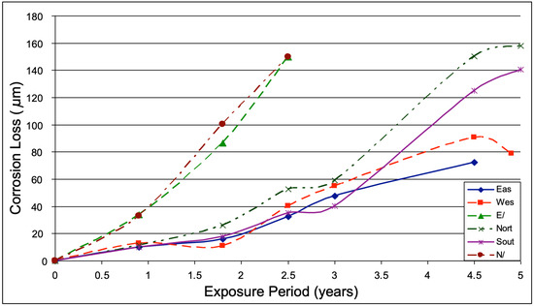
Background
Guiding Question: How is infrastructure impacted by air pollution?
Traditional corrosion models are outdated: “newer” pollutants (NOx, ozone, and PM)
Power distribution and transportation lose $2.5 trillion per year.
Micro-Climates (specific conditions near buildings) unaccounted for
Atmospheric Corrosion of Steel on the Australian Central Pacific Coast: microclimate example
C. Tzanis, et al. “On the Corrosion and Soiling Effects on Materials by Air Pollution in Athens, Greece.”
Veleva, Lucien, et al. “Atmospheric Corrosion.” ResearchGate, 1 Jan. 2003, www.researchgate.net/publication/261176470_Atmospheric_Corrosion.
“ISO 9225:2012 Corrosion of Metals and Alloys.” Iso.org, International Organization for Standardization, 2012, www.iso.org/obp/ui/#iso:std:iso:9225:ed-2:v1:en.
3

Slide 5
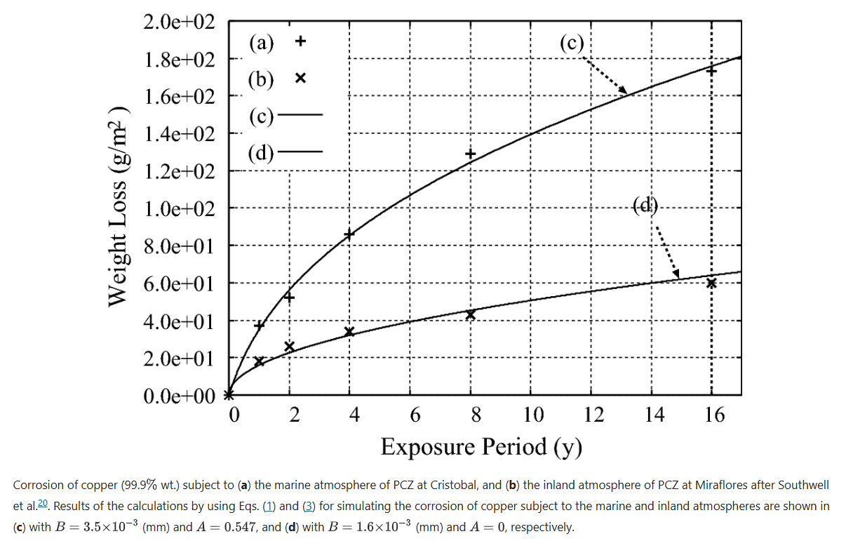

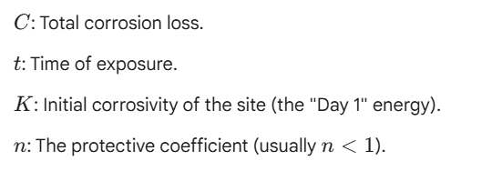
Outline
Objective: to quantify the Surface Degradation Rate of infrastructure materials exposed to local urban pollutants.
Method: Correlating environmental data with daily visual surface analysis over 2 years.
Atmospheric corrosion is most active during initial exposure: Power Law of Corrosion
https://www.nature.com/articles/s41598-022-10748-1/figures/1
Veleva, Lucien, et al. “Atmospheric Corrosion.” ResearchGate, 1 Jan. 2003, www.researchgate.net/publication/261176470_Atmospheric_Corrosion.
4

Slide 6
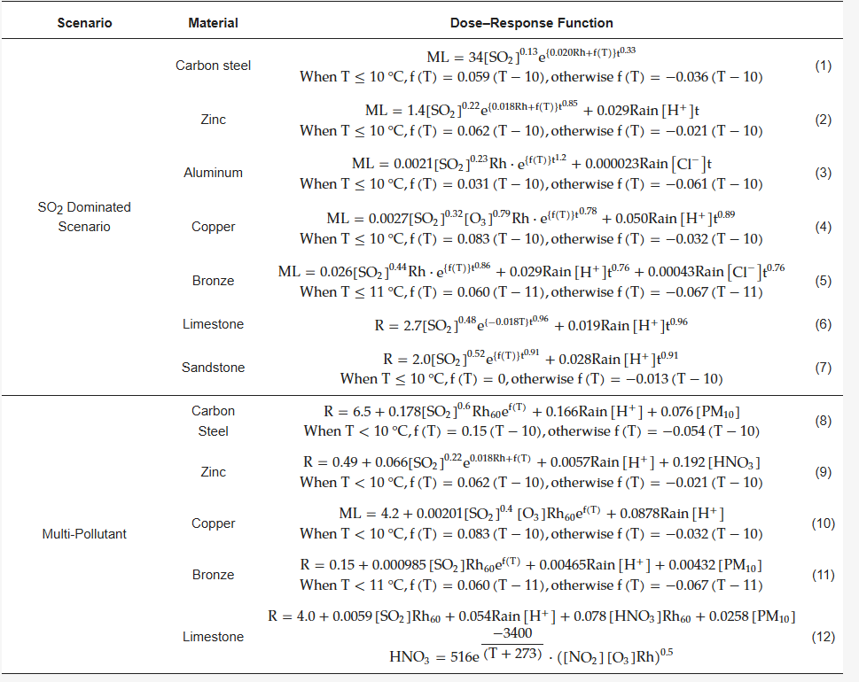
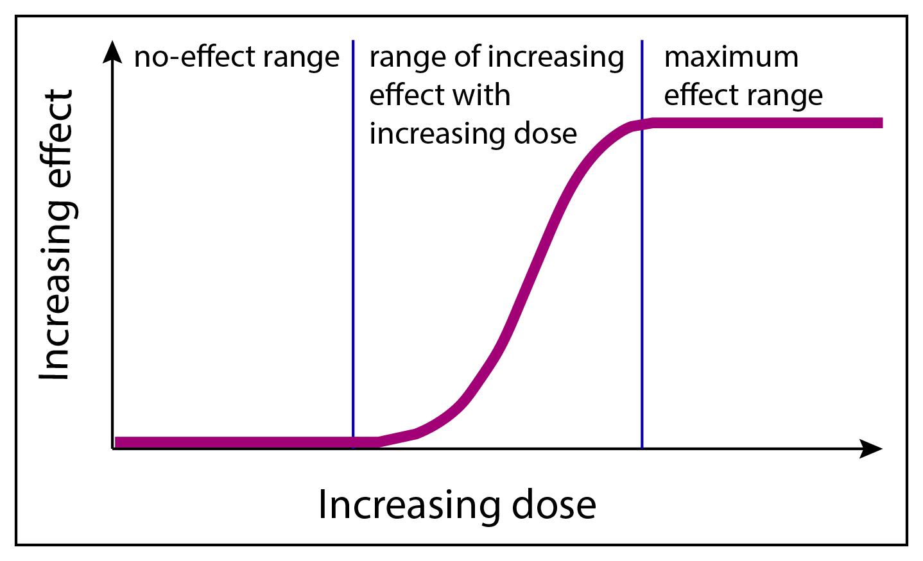
Outline
Dose-Response Theory
Dose of a drug correlates to a biological response: toxicology concept
Dose-Response functions of pollutants on materials can be mathematically derived.
Dose-Response Functions.
Toxicology Dose-Response Curve
Bai, Zhe, and Yu Yan. “Dose–Response Functions for Assessing Corrosion Risks to Urban Heritage Materials from Air Pollution under Climate Change: Insights from Europe and China.” Buildings, vol. 15, no. 13, 27 June 2025, p. 2271, https://doi.org/10.3390/buildings15132271.
C. Tzanis, et al. “On the Corrosion and Soiling Effects on Materials by Air Pollution in Athens, Greece.”
5

Slide 7
Methodology
Material | Preparation for Preconditioned Sample | Preparation for Treated Sample | Goal for both samples
Mild Steel | Soak in vinegar, then scratch in the center | Zinc spray, then scratch in the center | Track rusting of surface
Aluminum | Rub with high-pH cleaner | Clear automotive lacquer | Track “Grey Value” or dullness
Galvanized Steel | Spray with a 5% salt-water mist and let dry. | Microcrystalline wax | Track how zinc layer deteriorates
Wood | Leave under a heat lamp for 48 hours | Oil sealer | Track fiber raising and silvering (UV damage)
Concrete | Freeze-thaw cycles: freezer and then in hot water 5 times | Siloxane penetrating sealer | Track darkening and cracking
Total 15 samples of the same size, 5 preconditioned, 5 treated, 5 left natural.
NOTE: both mild steel samples will be scratched in the center with a nail to localize rust occurrence.
2. Mount the samples on a 3D printed board at a 45-degree angle.
3. Place the board near traffic intersection under an overhang with access to power
“ISO 8565:2011 Metals and Alloys — Atmospheric Corrosion Testing.” Iso.org, International Organization for Standardization, 2011, www.iso.org/obp/ui/en/#iso:std:iso:8565:ed-2:v1:en.
6

Slide 8
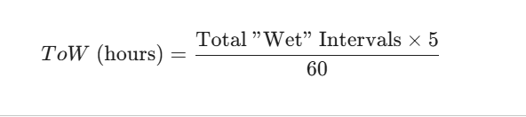
Methodology
4. Continuously collect data for 90 days
Time average of 5 minutes worth of data for analysis
4. After 90 days, depending on deterioration already achieved, collect data every 5 minutes
Time average of 2-3 days worth for analysis
5. High-res photo daily.
6. Compare images
Sensor | Quantity Measured
IPS-7100 | PM2.5 and PM10
SGP41 | Nox and VOC
SHT4x | Humidity and Temperature -> ToW: Humidity > 80%, Temp > 0 C
“ISO 9225:2012 Corrosion of Metals and Alloys.” Iso.org, International Organization for Standardization, 2012, www.iso.org/obp/ui/#iso:std:iso:9225:ed-2:v1:en.
Veleva, Lucien, et al. “Atmospheric Corrosion.” ResearchGate, 1 Jan. 2003, www.researchgate.net/publication/261176470_Atmospheric_Corrosion.
7

Slide 9
Methodology
Expected Outcomes:
Treated > Natural > Preconditioned
Particulate Shielding: moisture and chemicals trapped under PM10
Pulls moisture out of the air
So2 and Nox dissolved in water are trapped against the surface
Differential aeration cell: higher oxygen around the dust than under it
Material | Natural Sample | Preconditioned Sample | Treated Sample
Mild Steel | Uniform orange coating, clearer around the scratch | Deeper rust and deterioration around the scratch | Surface stays grey and clean, orange lines around the X
Aluminum | Slight dulling | Pitting (white spots) | Filiform Corrosion
Galvanized Steel | White chalky powder (zinc oxide) | Red rust | No major changes, preserved.
Wood | Silver-grey color | Fiber Raising | No major changes, preserved.
Concrete | Grimy due to particulate shielding | PM penetrated the concrete | No major changes, preserved.
Leygraf, Christofer, et al. Atmospheric Corrosion. Hoboken, NJ, USA, John Wiley & Sons, Inc., 22 June 2016, onlinelibrary.wiley.com/doi/book/10.1002/9781118762134.
Veleva, Lucien, et al. “Atmospheric Corrosion.” ResearchGate, 1 Jan. 2003, www.researchgate.net/publication/261176470_Atmospheric_Corrosion.
C. Tzanis, et al. “On the Corrosion and Soiling Effects on Materials by Air Pollution in Athens, Greece.”
8

Slide 10
Possible Failure Modes
Slow Progress
No visible change in 90 days.
More than likely for natural samples
Immediate deterioration on preconditioned samples is expected
ToW data as justification: “threshold” humidity not met
Environmental Interference
Condensation
Photos in late afternoon, no atmospheric moisture
9
Footer information

Slide 11
References
Bai, Zhe, and Yu Yan. “Dose–Response Functions for Assessing Corrosion Risks to Urban Heritage Materials from Air Pollution under Climate Change: Insights from Europe and China.” Buildings, vol. 15, no. 13, 27 June 2025, p. 2271, https://doi.org/10.3390/buildings15132271.
C. Tzanis, et al. “On the Corrosion and Soiling Effects on Materials by Air Pollution in Athens, Greece.” Atmospheric Chemistry and Physics, vol. 11, no. 23, 5 Dec. 2011, pp. 12039–12048, https://doi.org/10.5194/acp-11-12039-2011.
“ISO 8565:2011 Metals and Alloys — Atmospheric Corrosion Testing.” Iso.org, International Organization for Standardization, 2011, www.iso.org/obp/ui/en/#iso:std:iso:8565:ed-2:v1:en.
“ISO 9225:2012 Corrosion of Metals and Alloys.” Iso.org, International Organization for Standardization, 2012, www.iso.org/obp/ui/#iso:std:iso:9225:ed-2:v1:en.
Leygraf, Christofer, et al. Atmospheric Corrosion. Hoboken, NJ, USA, John Wiley & Sons, Inc., 22 June 2016, onlinelibrary.wiley.com/doi/book/10.1002/9781118762134.
Veleva, Lucien, et al. “Atmospheric Corrosion.” ResearchGate, 1 Jan. 2003, www.researchgate.net/publication/261176470_Atmospheric_Corrosion.
10

Slide 12

Thank you
10

