Slide 1
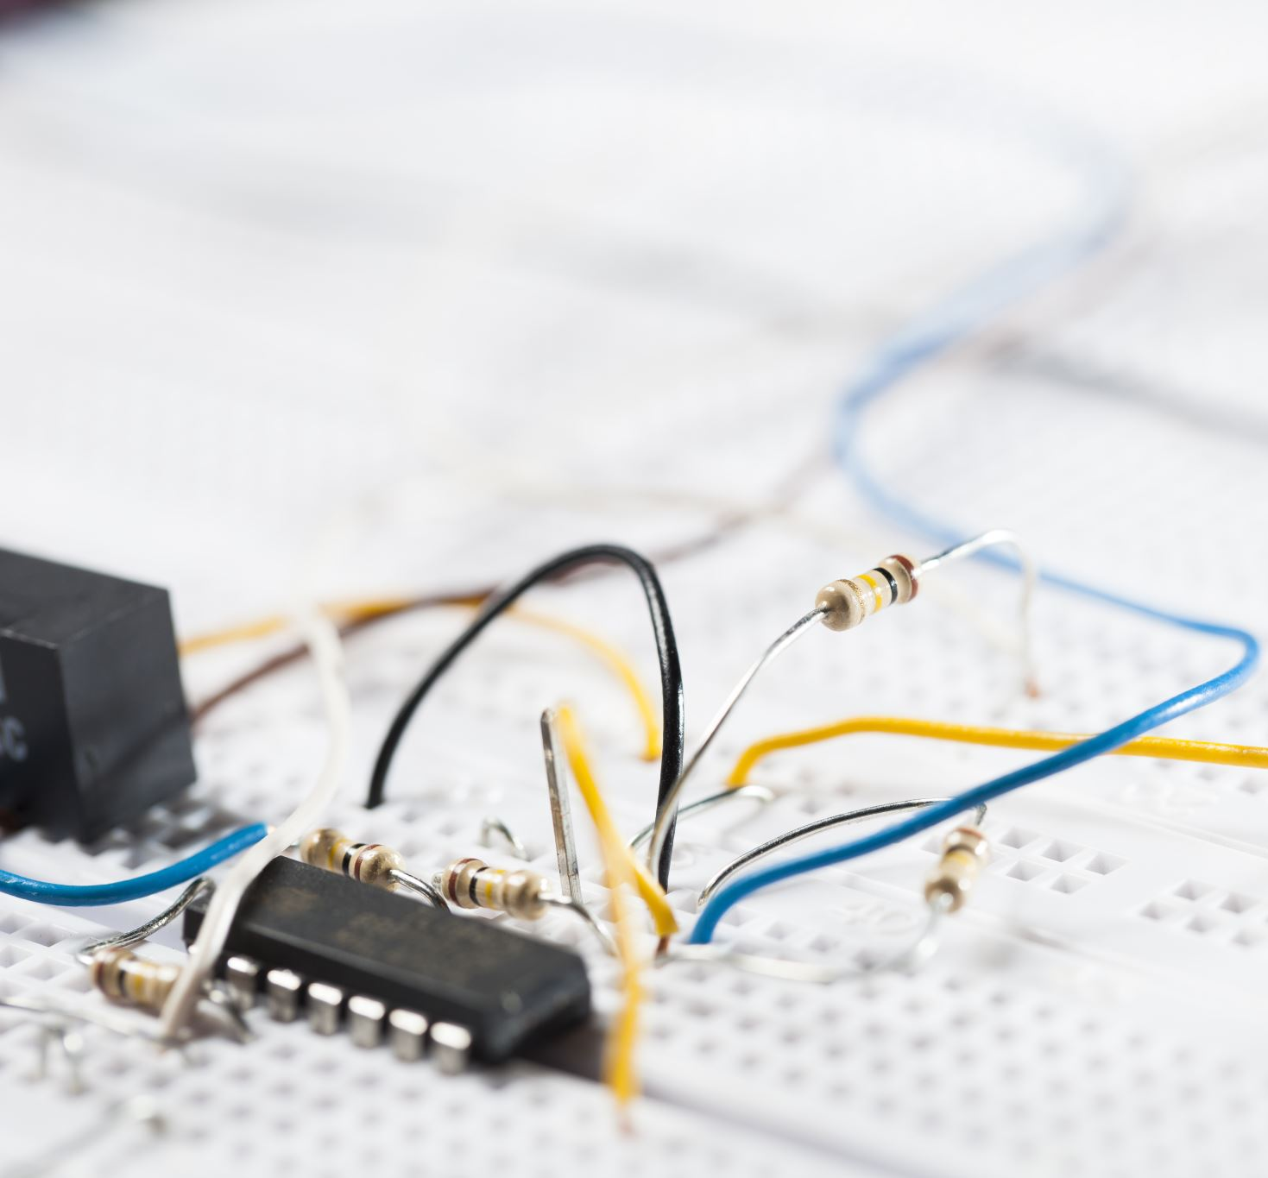


How to use Power Sensing/Monitoring for IOT System
Tunde Awoyinka & Diego Malagon

Slide 2
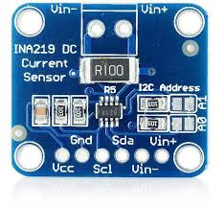
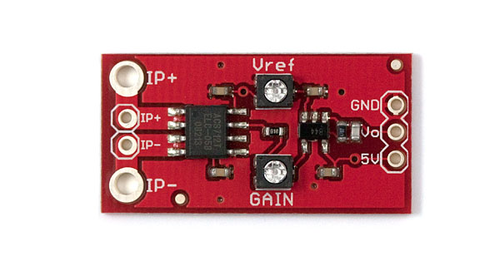
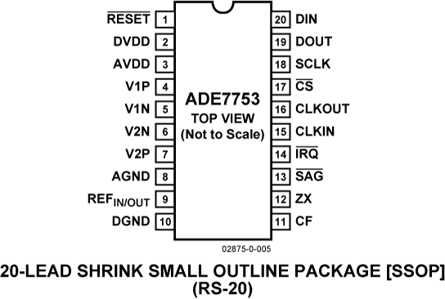
Selection and Integration of Power Sensors
Criteria for selecting appropriate power sensors
accuracy
power consumption
measurement range
INA219 DC Current Sensor
Examples of popular sensor options:
Shunt resistor-based sensors (e.g., INA219, INA226)
Others
Hall-effect sensors (e.g., ACS712)
Dedicated power metering ICs (e.g., ADE7753, MCP39F511
ACS712 AC/DC Current Sensor

Slide 3
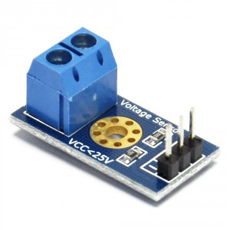
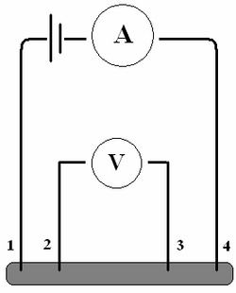
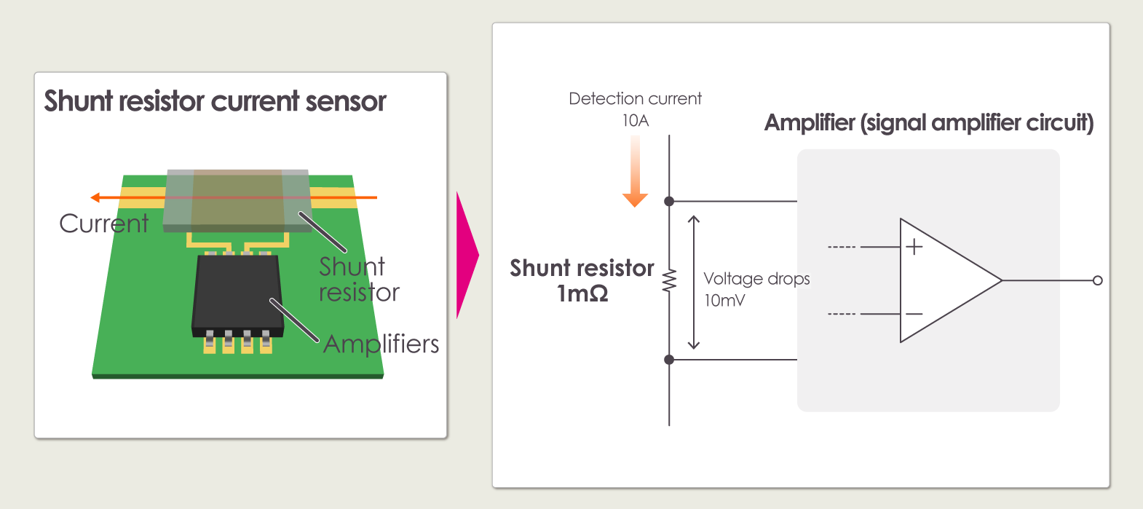
Power Monitoring Circuits and Design
INA219 DC Current Sensor with shunt resistor
Type of power monitoring circuits:
Voltage sensing circuits using voltage dividers
Current sensing methods (shunt placement, Kelvin connections)

Slide 4
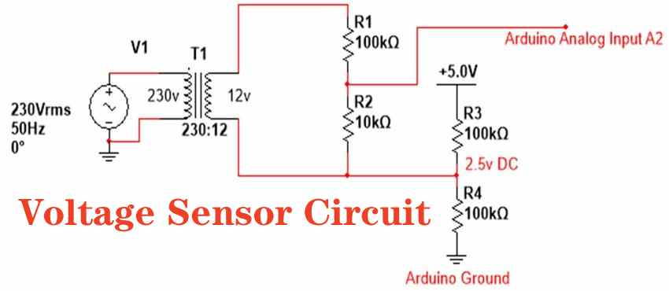
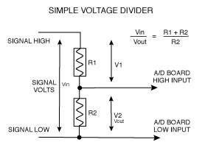
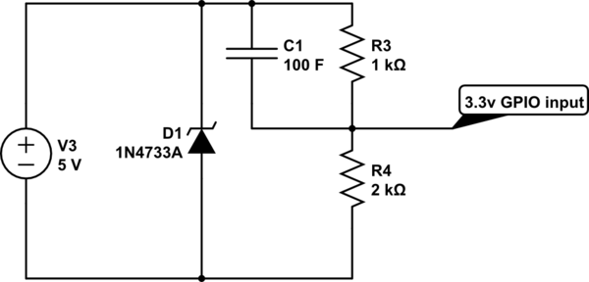
Voltage Sensing circuits using voltage dividers
The Setup:
A voltage divider consists of two resistors (R1 and R2) connected in series across a voltage source. The sensor resistance (Rs) is placed in series with a known reference resistor (R1), forming the voltage divider.

Slide 5
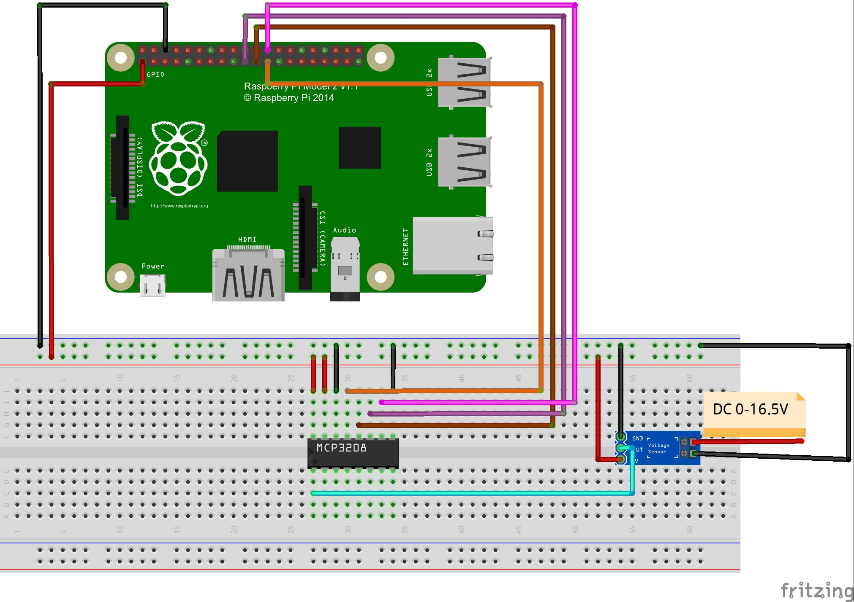
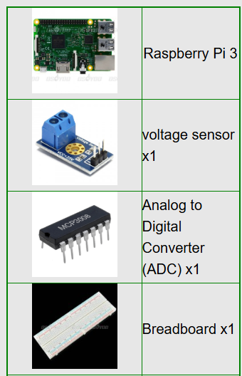
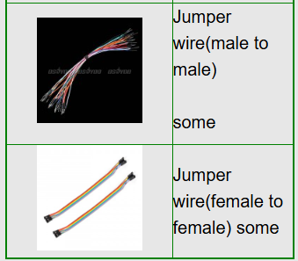
Voltage Measurement using ADC
Voltage Measurement:
The microcontroller's analog-to-digital converter (ADC) is connected to the center tap of the voltage divider (the junction between the sensor and the reference resistor(R1)).

Slide 6
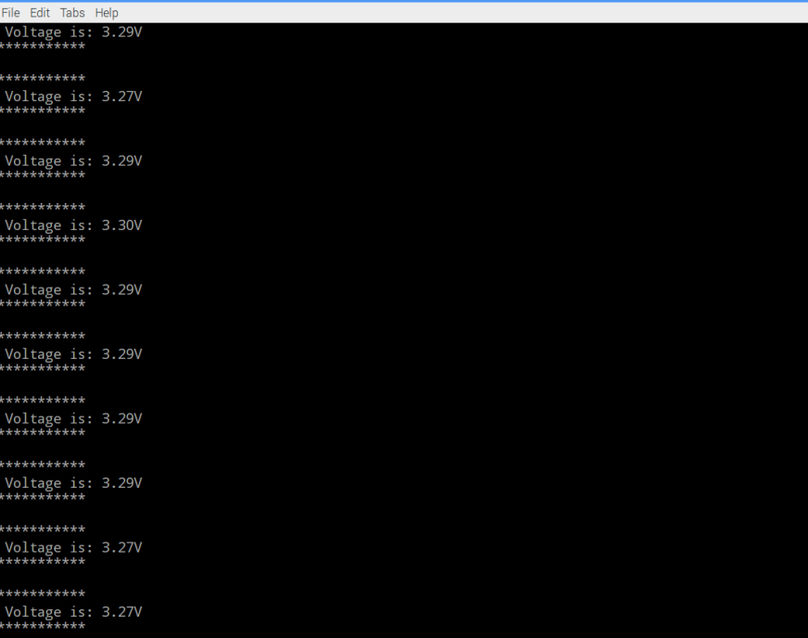
Voltage Monitoring
Software
connect the raspberry pi to monitor, or login in pi via SSH.
1)Write the code
1)enter the following command to create a new file named voltage.py and save this file at direction: /home/pi, and then press enter
sudo nano voltage.py
Enter the sample code in new file, the code can be got by executing shell commands.
2)Run python program
sudo python ./voltage.py
3) Test
Connect the DC port to power supply less 16.5V, the monitor would show the voltage value. For example,you will get the value of 3.29V with the a little allowable error when it connect to 3.3v power supply.

Slide 7
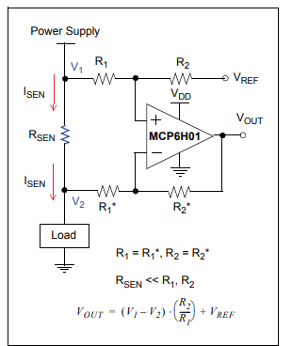
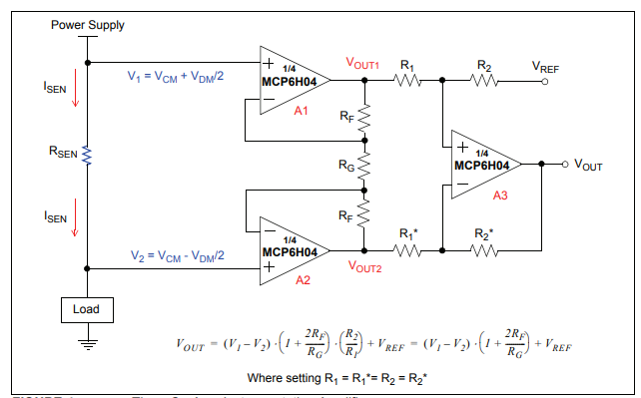
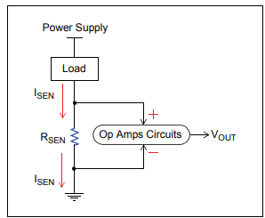
Current sensing methods (shunt placement)
High-side Current Sensing with Three Op Amp
The shunt resistor creates a small voltage drop proportional to the current, which is then measured to determine the current
High-side current sensing connects the sensing resistor(shunt resistor) between the power supply and load. Low side current sensing is between the load and ground.
Normally, the sensed voltage signal (VSEN = ISEN × RSEN) is so small that it needs to be amplified by subsequent op amp circuits (e.g., noninverting amplifier) to get the measurable output voltage (VOUT).
High-side Current Sensing with Single Op Amp
INA219 DC Current Sensor with shunt resistor
Low-side Current Sensing

Slide 8
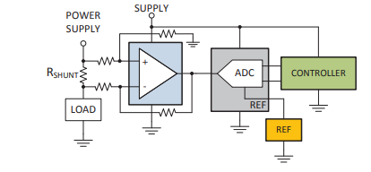
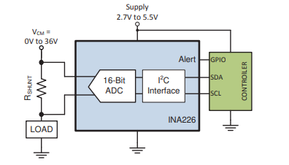
Current Sensing Monitoring
Monitoring of the differential voltage directly across the shunt resistor using a fully differential input ADC (Analog to Digital Converter) and Controller
Direct monitoring of the voltage drop across the current sensing resistor using INA226 and Controller

Slide 9
Microcontroller and Sensor Interfacing

Slide 10
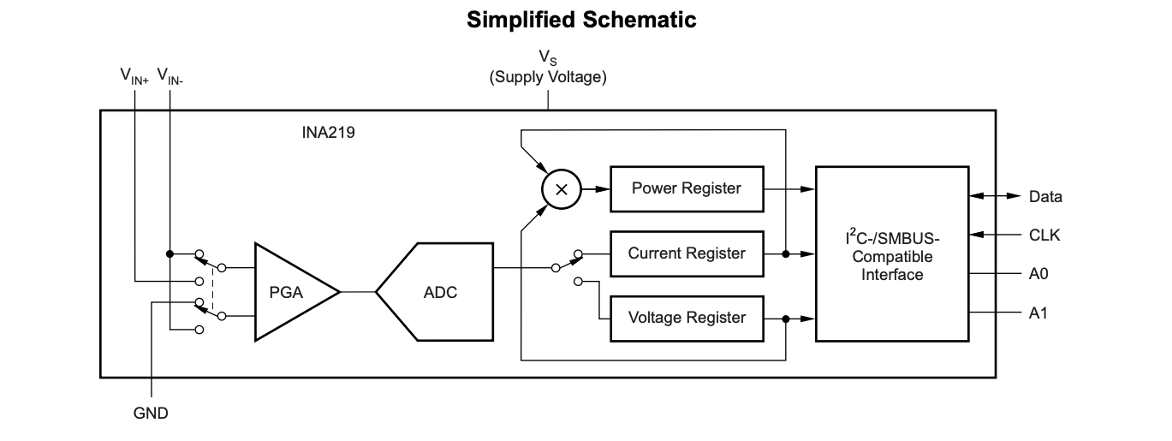
Using I2C interface with raspberry pi
16 programmable addresses
Senses Bus Voltages from 0 to 26 V
The device uses a single 3- to 5.5-V supply, drawing a maximum of 1 mA of supply current.

Slide 11
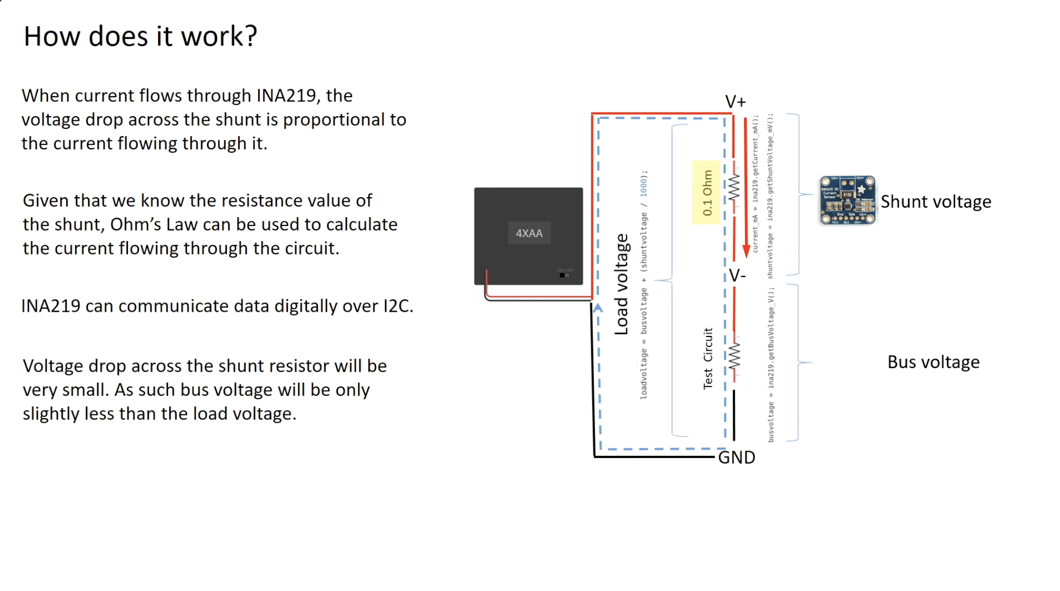
V50 USB battery pack

Slide 12
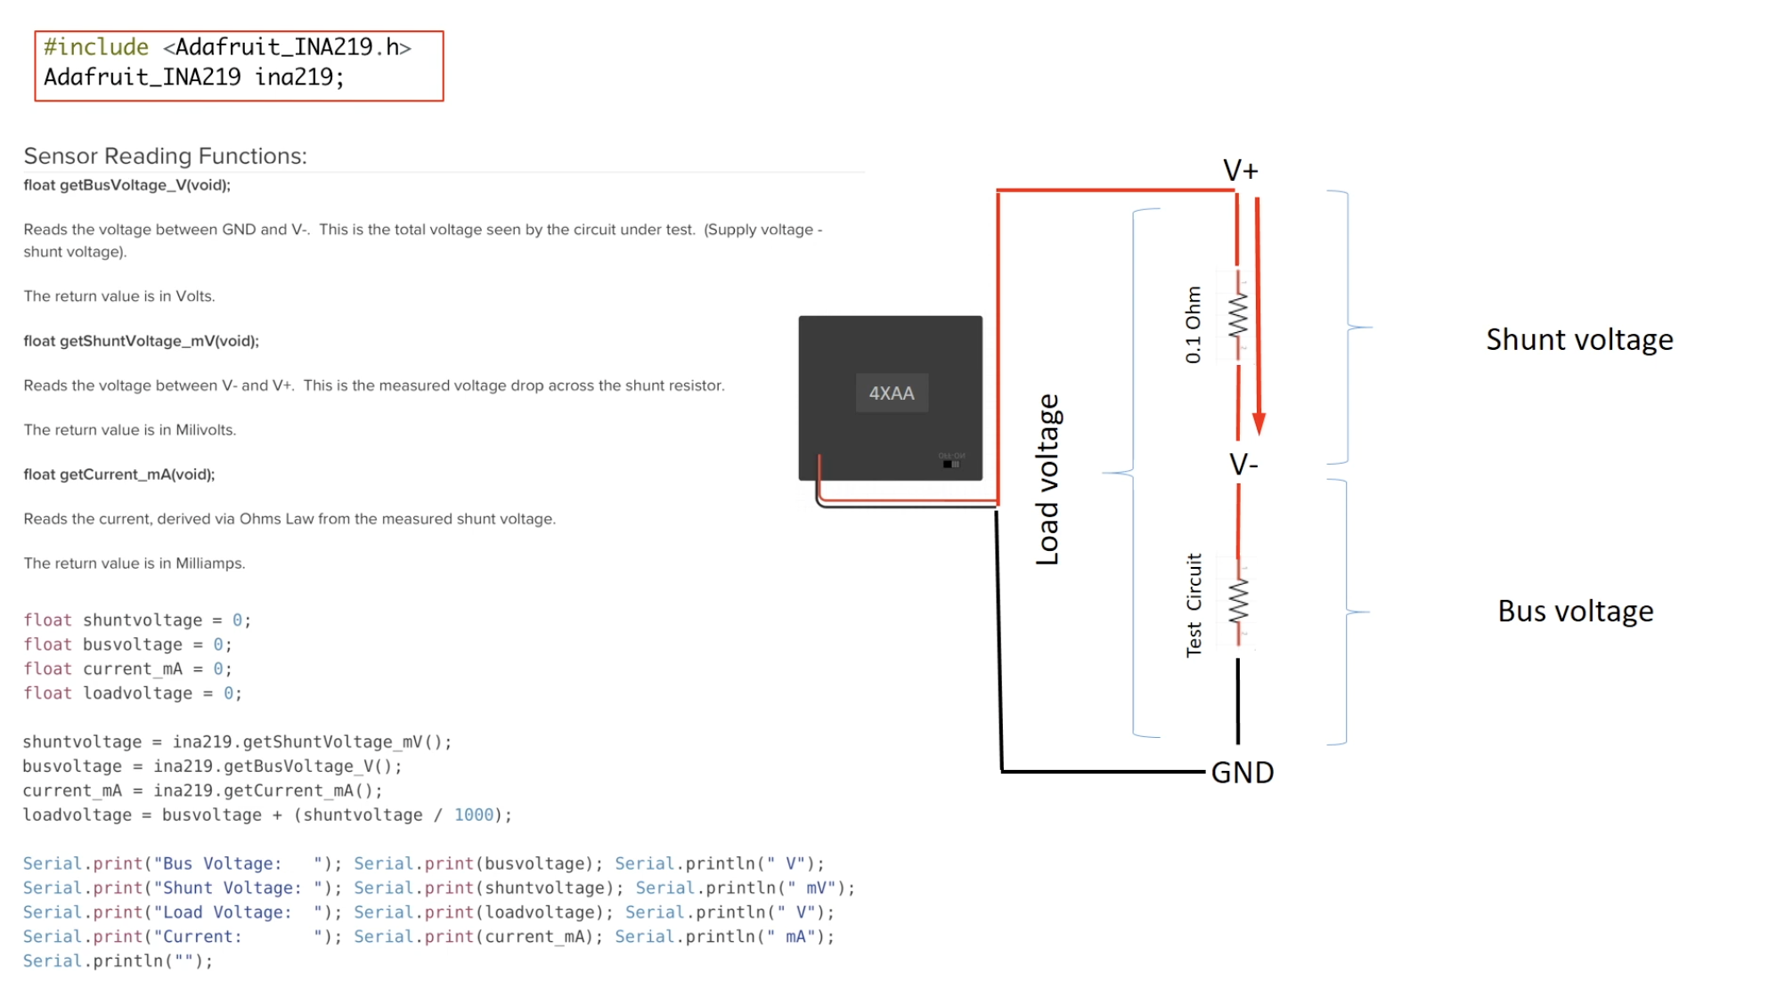
V50 USB battery pack

Slide 13
Data Sampling Techniques
Technique | Good For | Trade-offs
Fixed Interval | General logging | Simple, may miss fast spikes
Moving Average | Noisy signals | Adds small delay
Change Detection | Efficient logging | Might miss small variations

Slide 14
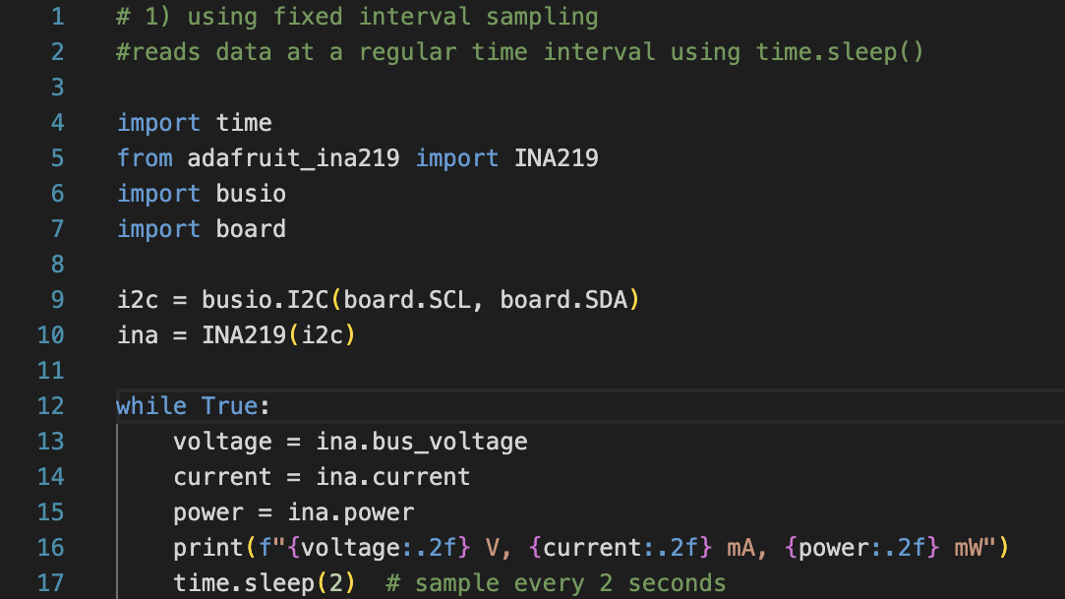

Slide 15
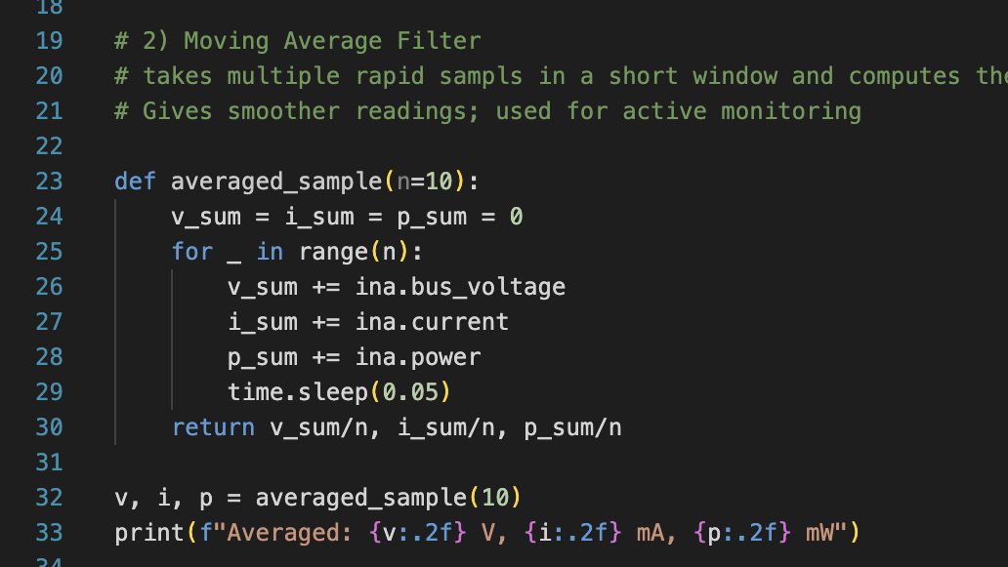

Slide 16
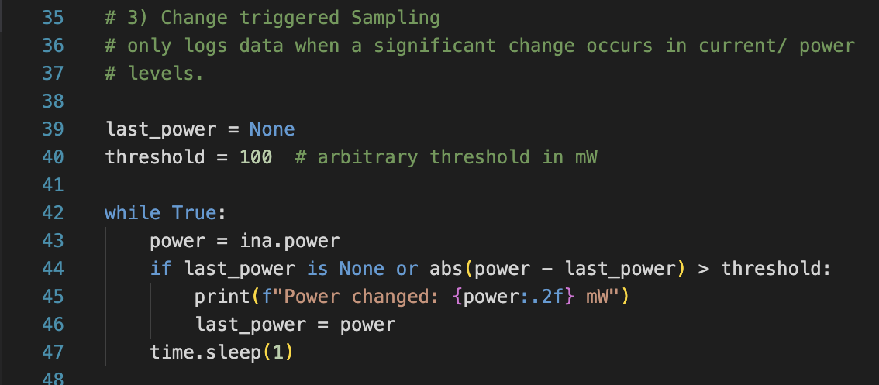

Slide 17
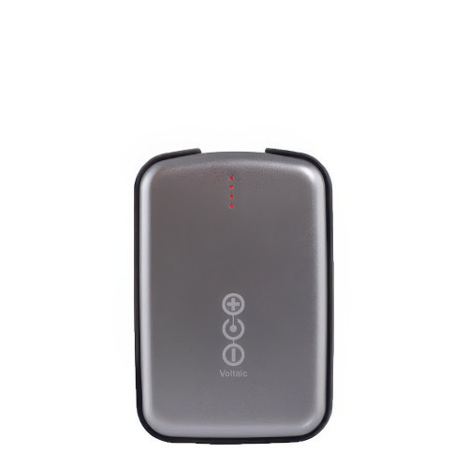
Voltaic V50 USB Battery Pack
Always On feature provides continuous powering of microcontrollers, sensors, or other devices with low or intermittent power consumption.
can charge a connected device while simultaneously being recharged itself.
offers two USB-A output ports, both with the Always On functionality, allowing for powering multiple devices or different components of an IoT system.

