Slide 2
welcome to my presetnation
about my new chrome extension!!!!

Slide 3

dropping logits

Slide 4
chapter 1
it turns ai marketing slop into poop jokes
thats it

Slide 5
chapter 2
look at these examples

Slide 6
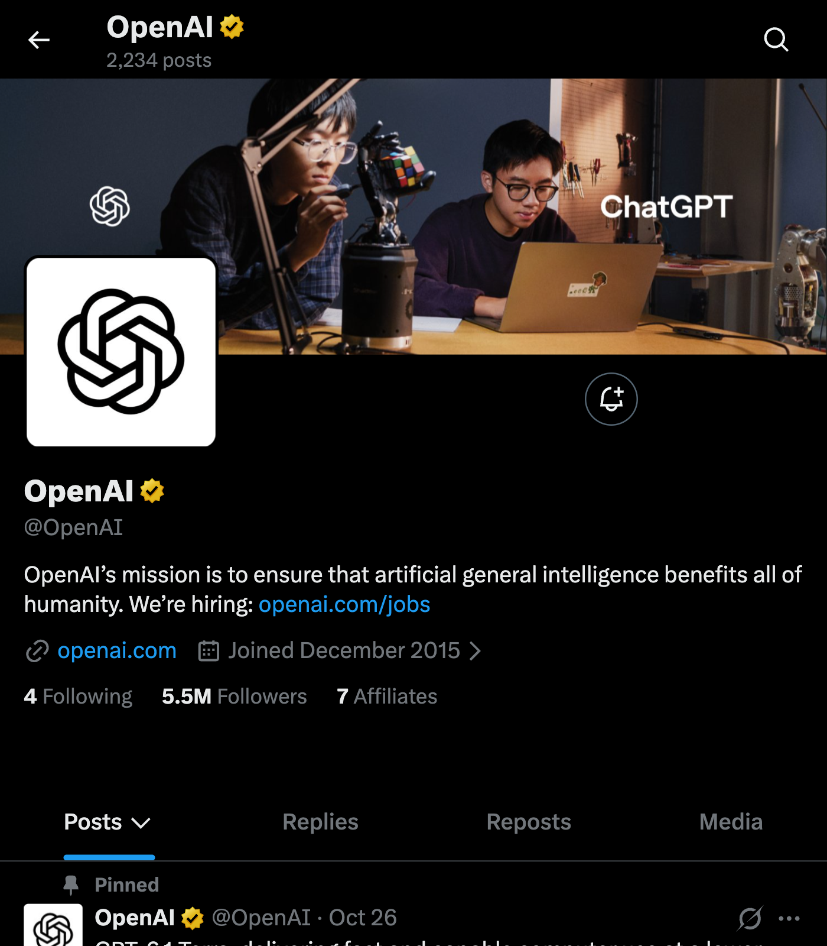
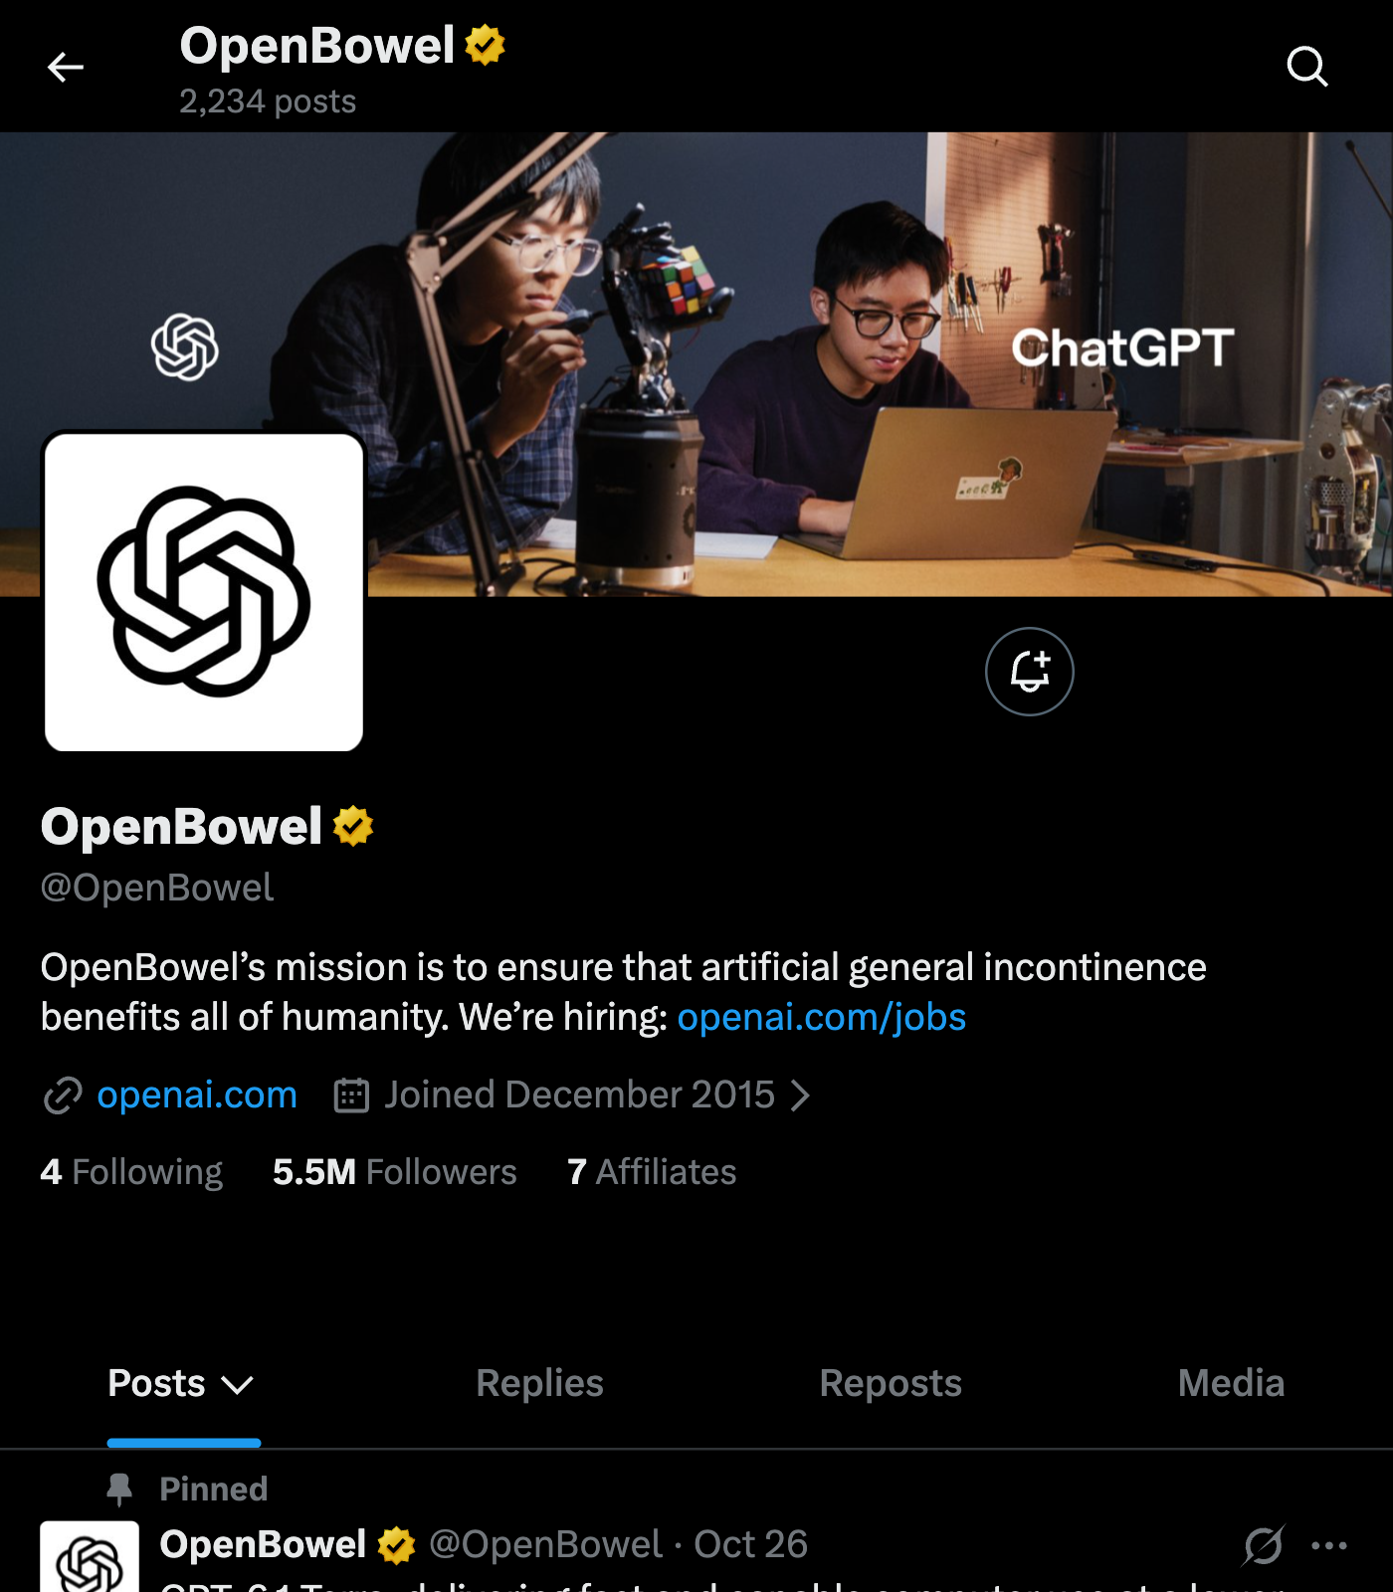

Slide 7
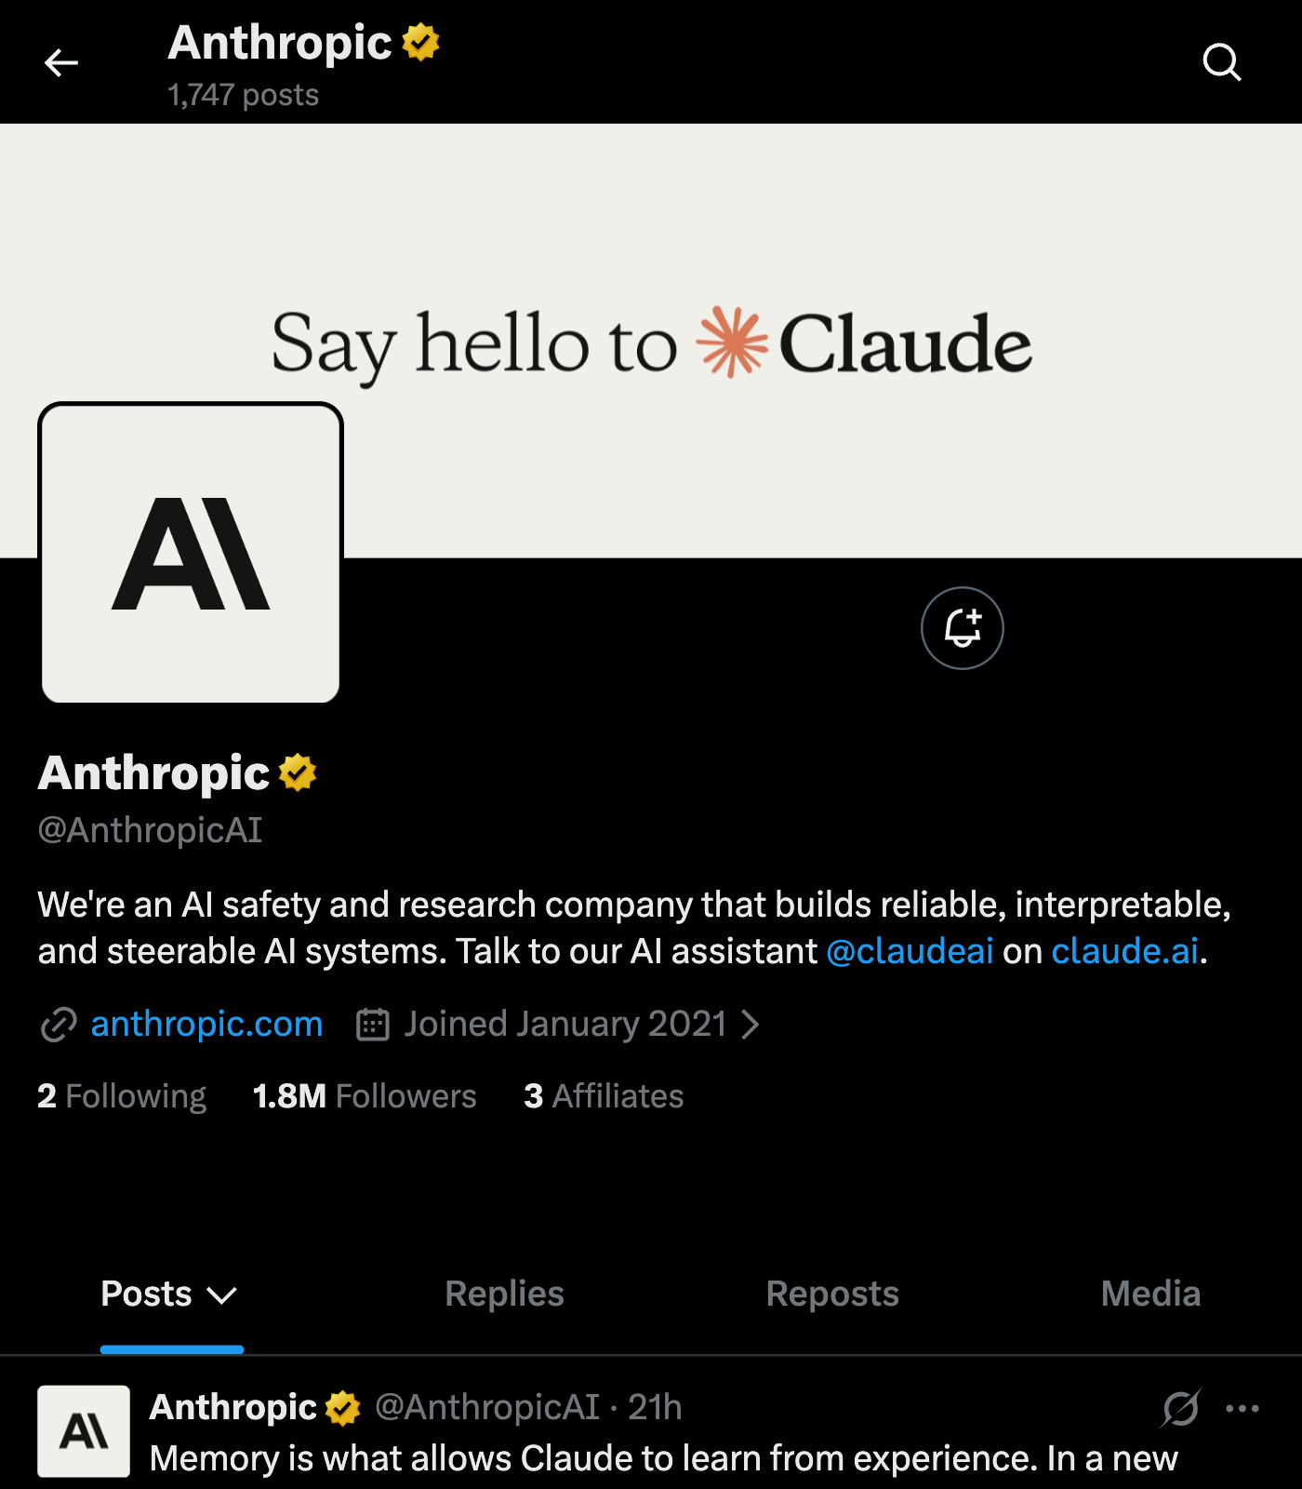
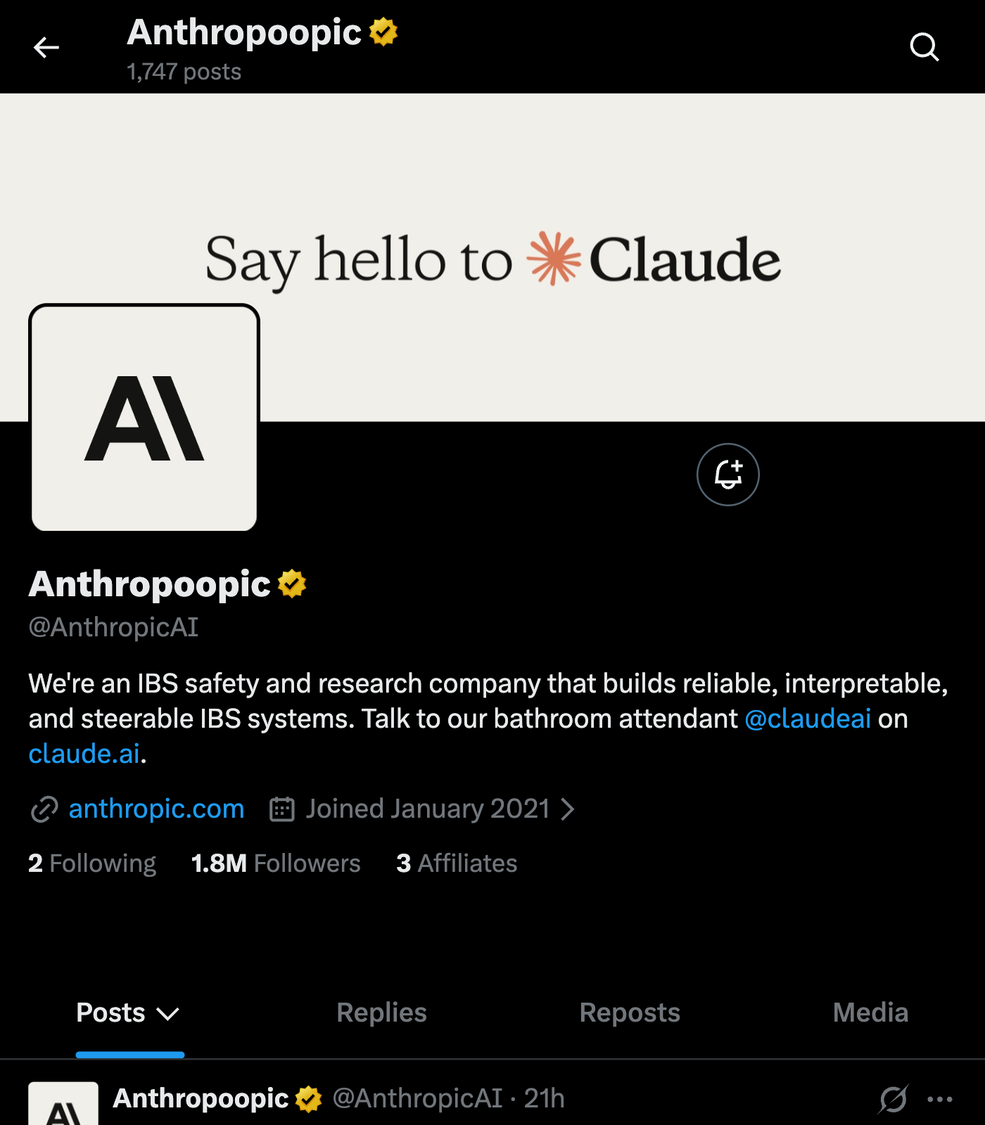

Slide 8
Introducing Our Most Powerful Model Yet
Squeezing Out Our Most Pungent Log Yet

Slide 9
Launching state-of-the-art models
Dropping state-of-the-fart logs
Industry-leading benchmarks
Industry-leaking skidmarks
Fewer hallucinations
Fewer sharts
Our path to AGI
Our path to Number Two
Mixture of experts
Mixture of excrements
Open source
Open sewer

Slide 10
any questions?
download now on the google chrome web store!!!

