Slide 1
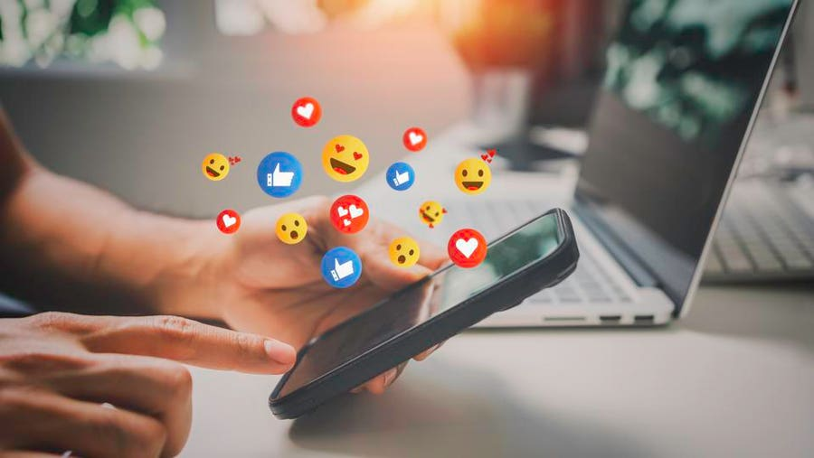
Social Media:
Its History, Business Uses, and Dangers
Mia Cuccinello
CSIT100_04FA26
11/16/2026

Slide 2
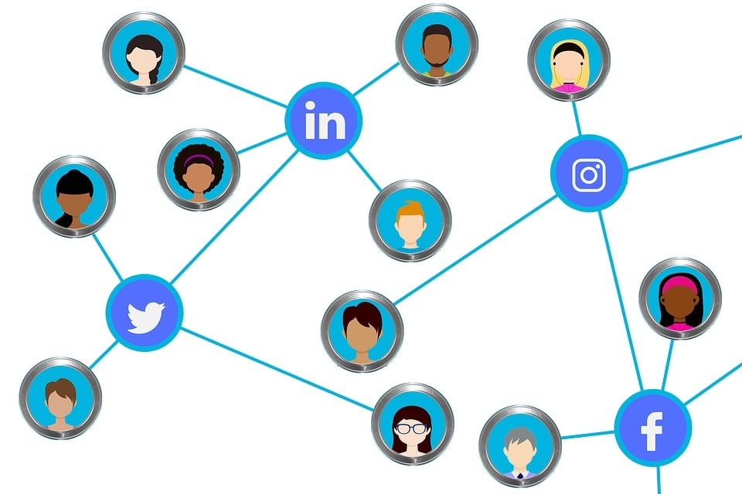
Introduction to Social Media
Social media is an important part of everyday life.
Platforms like Instagram, TikTok, and Facebook help people connect and share information.
Social media allows for news, photos, and videos to spread quickly.
Businesses use social media to promote products and reach customers.
Social media has benefits but also risks involving privacy, safety, and misinformation.

Slide 3
Section 1: History of Social Media
The Beginning of Social Media...
  Social media has evolved from early communication technologies.
  In 1844, the telegraph allowed messages to travel long distances.
  In 1969, ARPANET connected computers at universities.
  These inventions helped shape the internet and social media we use today.

Slide 4
Section 1: History of Social Media
The Rise of Social Media Platforms...
  Social media became popular in the early 2000s.
  Myspace launched in 2003, allowing users to connect and share music.
  Facebook launched in 2004, making online networking more popular.
  Twitter launched in 2006, allowing users to share short updates.
  These platforms changed how people communicate online.

Slide 5
Section 1: History of Social Media
The Evolution of Modern Social Media...
  Social media continued to grow with new technology.
  Instagram launched in 2010, focusing on sharing photos.
  Snapchat introduced disappearing messages and stories.
  TikTok became popular for short videos and trends.
  Smartphones made social media easier to access anywhere.

Slide 6
Section 1: History of Social Media
Social Media Today...
  Social media is a major part of everyday life.
  Platforms like Instagram, TikTok, and Snapchat help people connect.
  Users can quickly share photos, videos, and news.
  Social media provides entertainment, education, and information.
  It has changed how people communicate and stay connected.

Slide 7
Section 2: Business Uses of Social Media
Social Media in Business...
  Social media is an important tool for businesses.
  Companies use Instagram, Facebook, TikTok, and many more platforms to promote products.
  Businesses can reach more people and attract customers.
  Social media helps increase brand awareness.
  Companies can connect with customers and receive feedback.

Slide 8
Section 2: Business Uses of Social Media
Advertising & Marketing...
  Businesses use social media to advertise products through posts, photos, and videos.
  Paid ads help companies reach specific audiences.
  Influencers promote products to their followers.
  Discounts and special offers encourage purchases.
  Social media marketing helps attract customers and increase sales.

Slide 9
Section 2: Business Uses of Social Media
Connecting with Customers...
  Social media allows businesses to communicate directly with customers.
  Companies can respond to questions, comments, and messages.
  Businesses use social media to build relationships with their audience.
  Customer feedback helps companies improve their products and services.
  Staying active on social media helps businesses build trust and customer loyalty.

Slide 10
Section 2: Business Uses of Social Media
Measuring Social Media Success...
  Businesses use analytics to track social media performance.
  Reach: Number of people who see a post.
  Impressions: Total number of times a post is viewed.
  Engagement: Likes, comments, shares, and clicks.
  Analytics help businesses understand their audience and improve content.

Slide 11
Section 3: The Dangers of Social Media
Privacy & Personal Information...
  Sharing personal information online can create privacy risks.
  Strangers may see personal details, photos, and locations.
  Posts and pictures can be shared without permission.
  Deleted content may still exist through screenshots.
  Privacy settings help keep personal information safe.

Slide 12
Section 3: The Dangers of Social Media
Online Scams & Cyberbullying...
  Social media can expose users to scams and cyberbullying.
  Fake accounts may trick people into sharing personal information.
  Suspicious links can steal information or money.
  Cyberbullying includes threats, rumors, and hurtful comments.
  AI can create fake images, videos, and messages.

Slide 13
Section 3: The Dangers of Social Media
Mental Health & Well-Being...
  Excessive social media use may affect mental health.
  Social media use can be associated with anxiety and depression.
  Comparing oneself to others online may lower self-esteem.
  Social media can negatively affect body image.
  Limiting screen time can help develop healthier habits.

Slide 14
Section 3: The Dangers of Social Media
How to Stay Safe on Social Media...
  Use strong passwords and keep login information private.
  Check privacy settings and limit location sharing.
  Avoid suspicious links, messages, and accounts.
  Think before sharing personal information online.
  Block and report scams, cyberbullying, and threats.

Slide 15
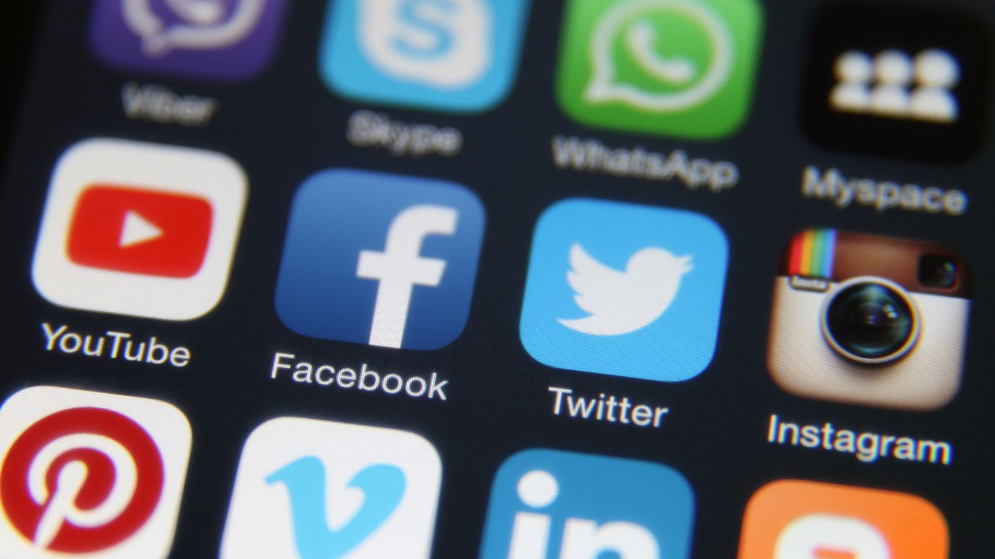
Conclusion
Social media has become an important part of everyday life.
It has changed how people communicate and share information.
Businesses use social media to promote products and reach customers.
Social media offers benefits but also risks, such as scams and privacy concerns.
Understanding these risks helps people use social media safely.

Slide 16
Works Cited
Boyd, Danah M., and Nicole B. Ellison. “Social Network Sites: Definition, History, and Scholarship.” Journal of Computer-Mediated Communication, vol. 13, no. 1, 2007, pp. 210–230. https://doi.org/10.1111/j.1083-6101.2007.00393.x.
Federal Bureau of Investigation. “Stay Safe Online: Kids and Teens.” FBI, https://www.fbi.gov/how-we-can-help-you/online-safety/stay-safe-online-kids-and-teens.
Maryville University. “The Evolution of Social Media: How Did It Begin, and Where Could It Go Next?” Maryville University, 28 May 2020, https://online.maryville.edu/blog/evolution-social-media/.
Siems, S., et al. “Social Media Marketing for Small Businesses: A Practical Guide.” Oklahoma State University Extension, https://extension.okstate.edu/fact-sheets/social-media-marketing-for-small-businesses-a-practical-guide.
U.S. Department of Health and Human Services, Office of the Surgeon General. Social Media and Youth Mental Health. 2023, https://www.hhs.gov/surgeongeneral/reports-and-publications/youth-mental-health/social-media.
Washburn, T., and M. Rahe. “Harnessing Social Media to Drive Sales.” University of Missouri Extension, Mar. 2025, publication no. G6229, https://extension.missouri.edu/publications/g6229.

Slide 17
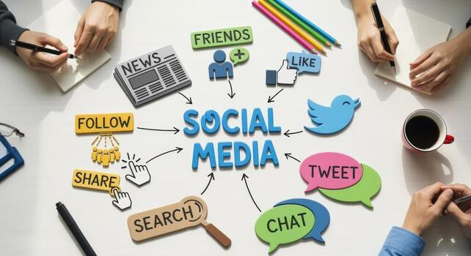
Thank you!

